Slide 1
WP4.8. Modelling Vegetation Moisture Stress
with LST to Air Temperature difference
Rob King (Met Office)

Slide 2
Introduction
Idea:
Plants transpire less when moisture stressed
Less evaporation from leaf surface
Leaves warmer than air when moisture stressed
Observed easily on the leaf-level scale
Scale this up to the satellite LST-level
Leaf Temp Increases
21
22
24
Air: 22
Moisture Stress Increases

Slide 3
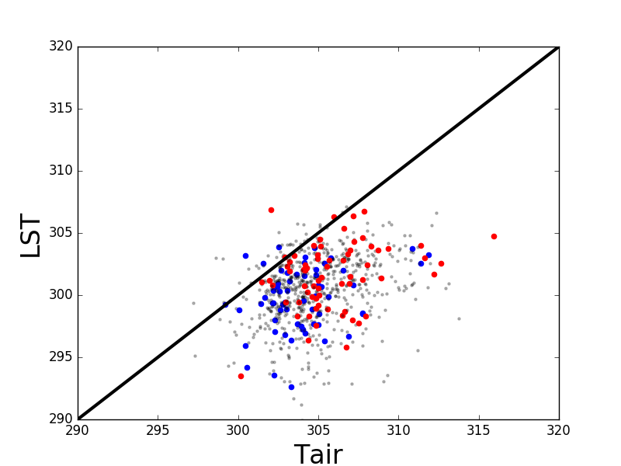
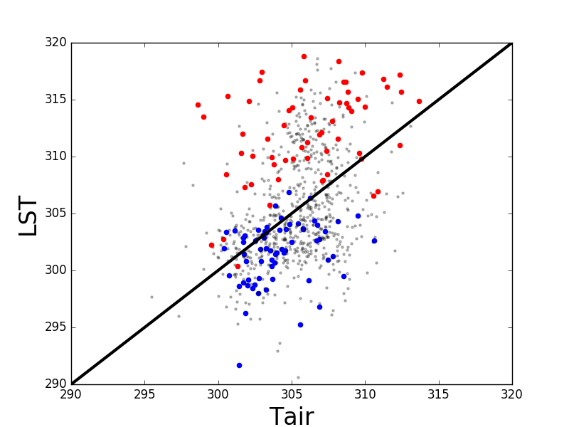
Example
North
West
North
East
North Brazil:
Seasonal rainfall gradient
March
October
Modis LST
WFDEI (ERA-I) Temp/Rain

Slide 4
This Work
Understand LST to Air Temperature differences:
Vegetation moisture stress
  Across different biomes
  Large spatial regions
  Time-series of point locations
ECVs
  LST, Soil Moisture, Land Cover, Above Ground Biomass

Slide 5
This Work
Understand LST to Air Temperature differences:
Vegetation moisture stress
JULES (Joint UK Land Environment Simulator)
  Modelling vegetation response to moisture stress
  ESA CCI products as forcing data
  Observations of water and carbon fluxes
Links to LS3MIP (land surface snow and soil moisture)

Slide 6
WP4.9. Evaluation of modelled LST vs air temperature
Debbie Hemming & Rob King (Met Office)

Slide 7
Introduction
…following on from WP4.8…
Aim:
Evaluate how well models (JULES, UKESM1, CMIP5, CMIP6…) capture the observed relationships between LST and Temperature across different vegetation types and moisture regimes.
Approach:
Derive relationships between LST and Temperature (near surface) for historic model runs of JULES, UKESM1 and other CMIP5 and 6 models (where available).
Evaluate model LST vs Temperature relationships across different vegetation types and moisture regimes.
Identify key regions and vegetation types where models differ significantly from observations.
Assess, using JULES runs and other simple models, the possible reasons for these differences.

Slide 8
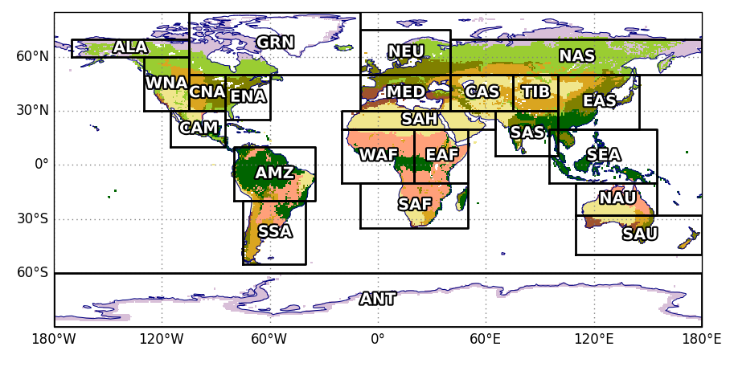
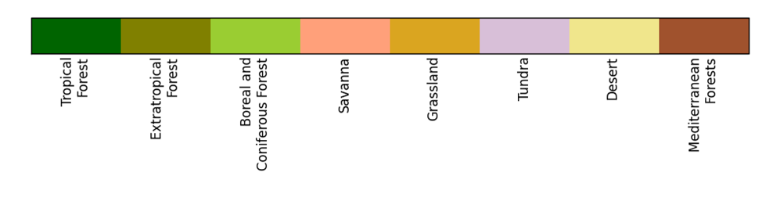
Approach
Giorgi regions studied
WAF: Western Africa
SAH: Sahara
EAF: Eastern Africa
SAF: Southern Africa
WWF biomes
1: Tropical trees
2: Extratropical trees
3: Boreal and Coniferous forest
4: Savanna
5: Grassland
6: Tundra
7: Desert
8: Mediterranean forests

Slide 9
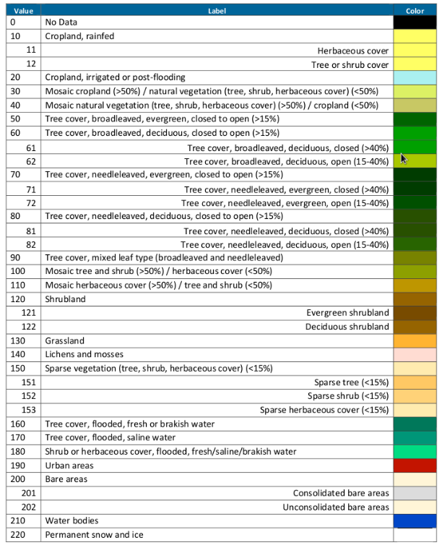
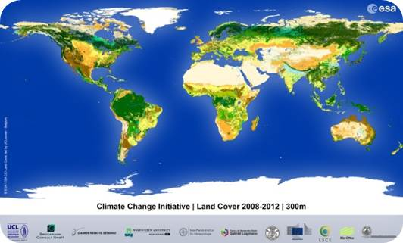
Approach
Use ESA CCI Landcover types to define vegetation types
ESA LC-CCI biomes

Slide 10
WP4.10. Comparison of vegetation variations –
satellite products and modelled
Debbie Hemming (Met Office)

Slide 11
Introduction
Aim:
Compare the seasonal timing and magnitude of vegetation-relevant CCI products with other satellite products (inc MODIS) and vegetation variables from existing historic model runs (of JULES, UKESM1, CMIP5/6).
Question:
Can the large-scale CCI ECV satellite products be used to improve the representation of vegetation phenology and therefore the modelling of carbon and water exchanges in land surface/Earth System Models?
Approach:
Identify significant differences in vegetation phenology between CCI products and other satellite and model data.
Suggest key areas for model development to improve vegetation phenology.
Contribute results to a multi-model evaluation of modelled phenology conducted in the CRESCENDO project.

Slide 12




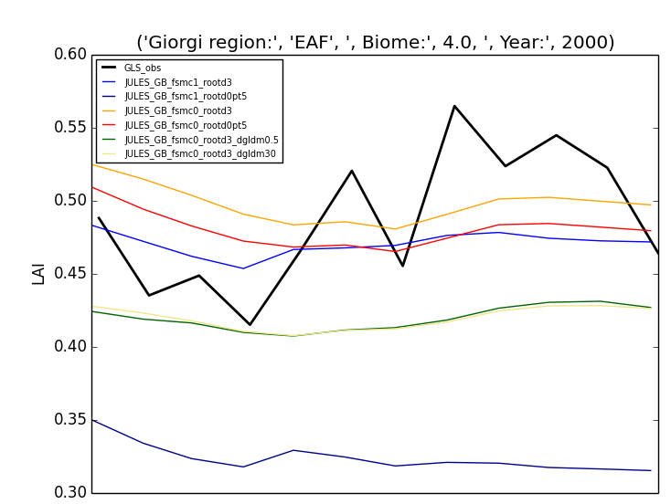
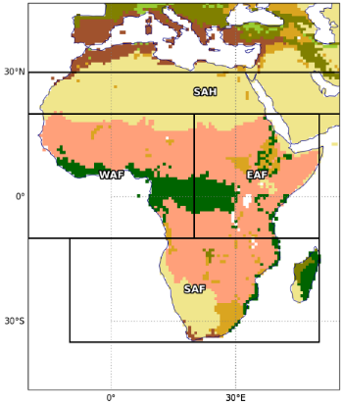
Example – previous work
DfID funded FCFA IMPALA project
Comparison of…
LAI satellite observation product
Copernicus Global Land Service
1km spatial resolution
Sensors – SPOT-VGT and PROBA-V
1999 – present
Product versions 1.4 and 1.5
LAI JULES global model runs (varying parameter settings)
JULES vn4.6 with 9 PFTs
CRU NCEP forcing 1860-2017
N96, 192x145 grid
Hyde land cover fractions
East Africa
% coverage:
Savanna ~63%
Seasonal cycle of LAI, JULES vs satellite

Slide 13

Relevant to WCRP Grand Challenges
Climate sensitivity:
Improving modelling of the role of vegetation on climate sensitivity.
World food / plant productivity:
Improving understanding and modelling of plant productivity and it’s sensitivity to climate.
Carbon feedbacks:
Improving modelling of terrestrial carbon cycle → climate feedbacks.

