Slide 1
Thomas Nagler and snow_cci team
CMUG Meeting 29-31 Oct 2018

Slide 2
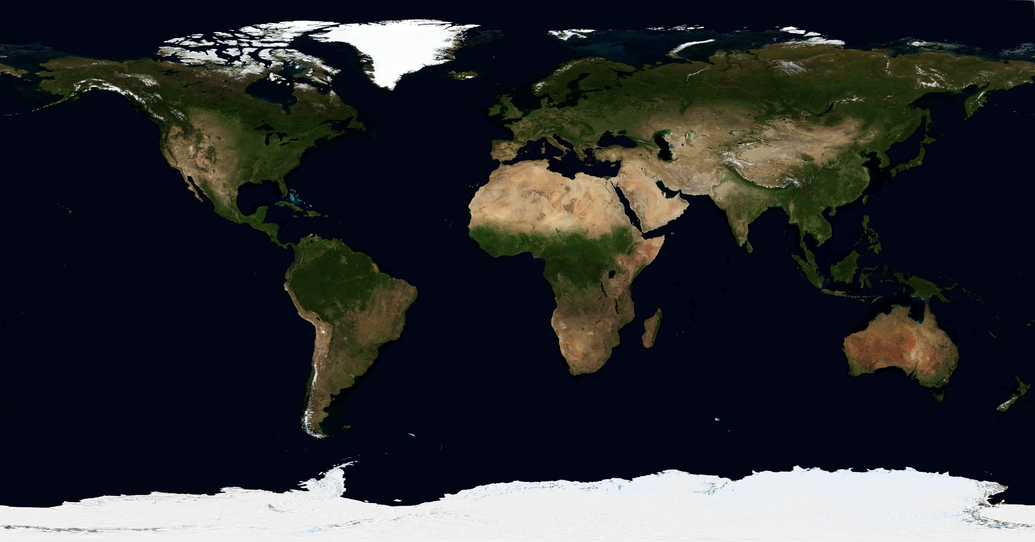
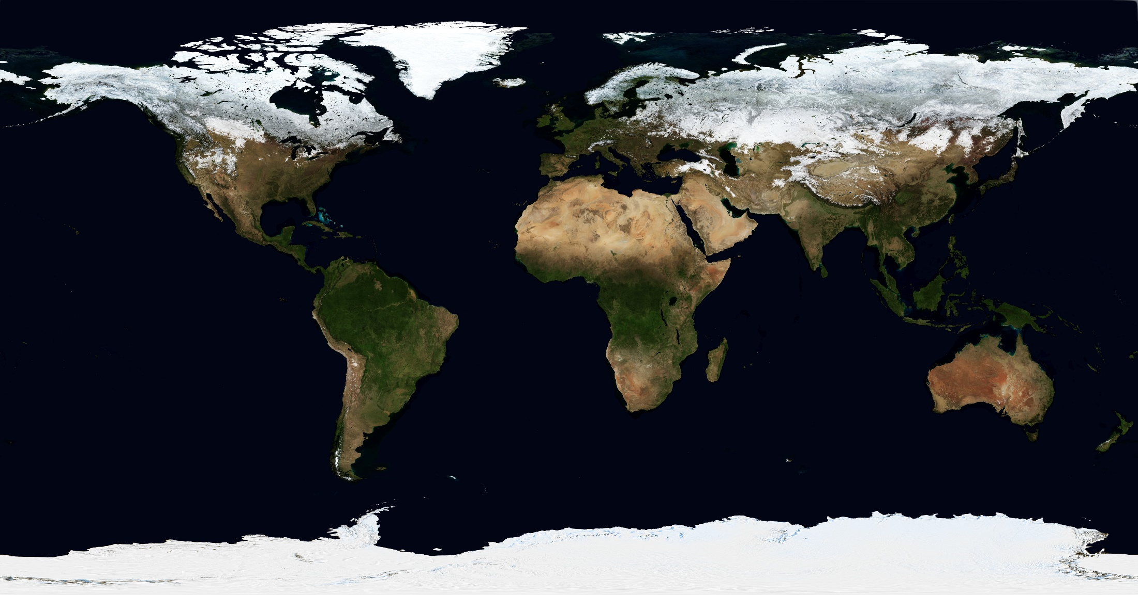
Seasonal Snow
covers up to ~47 Mio km² in extent and has a mass of ~3000 Gt
~98% of seasonal snow cover occurs in the Northern Hemisphere
highly variable in space and time
very sensitive to weather on short term and to climate change on long term

Slide 3
ECV SNOW
Primary OBJECTIVES
The overarching goal of Snow CCI is the generation of homogeneous, well calibrated, long-term time series of key snow cover parameters (snow area extent and snow mass) from multi-sensor satellite data for climate applications.
A main motivation for this initiative are significant discrepancies in the climatologies, anomalies, and trends in global snow cover time series from different products, detected in the ESA Snow Product Intercomparison project (SnowPEx).
In order to ensure the suitability of the snow products, representatives of the climate research community are directly involved in Snow CCI, advising on product requirements, contributing to product evaluation, and utilizing the data for specific research tasks (4 use cases defined).
snow_cci KICK OFF - 27 September 2018

Slide 4


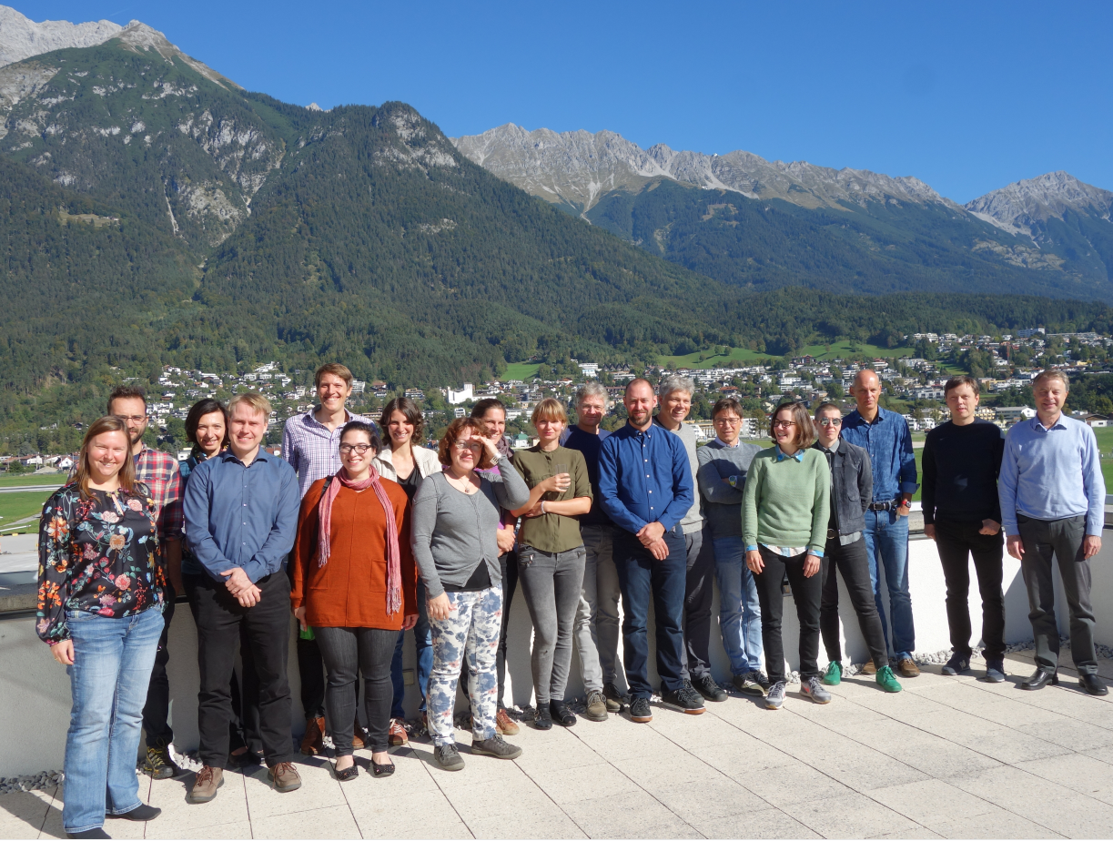











Snow CCI Team
ENVEO Environmental Earth Observation IT, Innsbruck, Austria (SL + PM)
Environmental and Climate Change Canada, Toronto, Canada
EURAC Earth Observation, Bolzano, Italy
Finnish Meteorological Institute, Helsinki, Finland
Finnish Environment Institute, Helsinki, Finland
GAMMA Remote Sensing, Gümligen, Switzerland
Norwegian Computing Centre, Oslo, Norway
University of Berne, Berne, Switzerland
Centre National de la Recherche Scientifique, IGE, Grenoble, France
Swedish Meteorological and Hydrological Institute, Norrköping, Sweden
University of Edinburgh, Edinburgh , United Kingdom
ECMWF, United Kingdom

Slide 5
2. Will your User Requirements be consistent with the needs of the Climate Research Groups (CRGs), CMUG needs, and GCOS requirements, including source traceability?
User WS will be held 29 November and will include input from the snow_cci CRG, CMUG Members and broad snow-climate user community
User requirements survey distributed in advance of the workshop: includes science users, CRG and CMUG members
Yes, we anticipate strong similarity to GCOS requirements
Product | Frequency | Resolution | Required Measurement uncertainty | Required Stability (per 10y)
Snow Covered Area | Daily | 1 km 100 m in complex terrain | 5% | 4% (max. error of omission and commission in snow area);
SWE | daily | 1 km | 10 mm | 10 mm

Slide 6
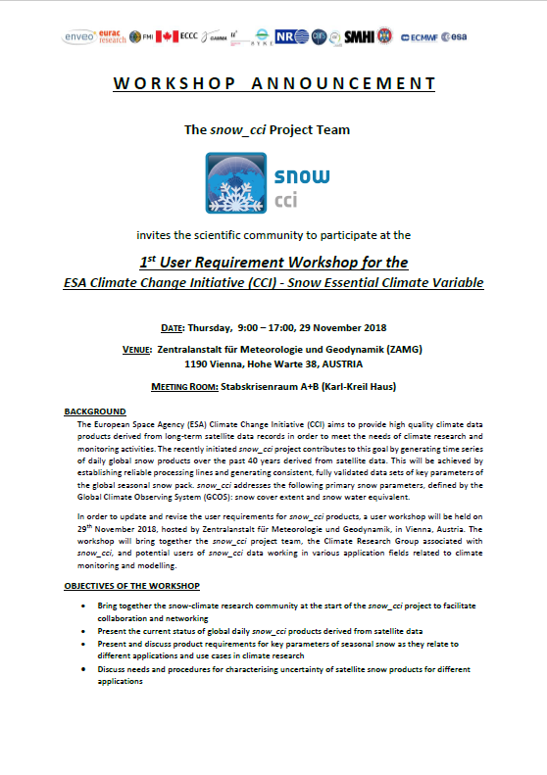

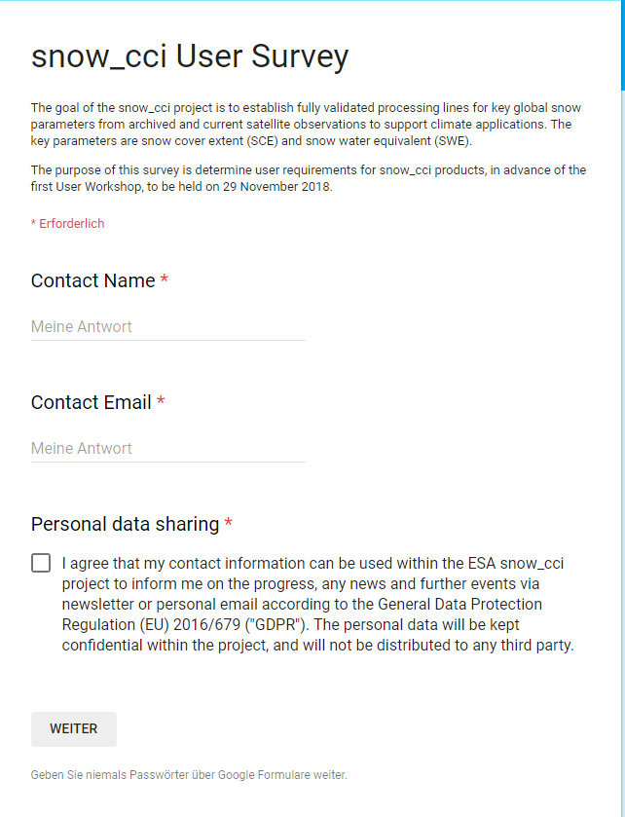
Snow cci User Requirements WS and Questionaire
Snow Products Requirements Questionaire
https://goo.gl/forms/Q9KU9QZNZhQ1nTDJ2

Slide 7
(3) How will your product specifications develop to meet the needs of your individual CRG, how will the CRGs use the proposed products in their applications?
Product specifications will be refined following input at the User Requirements Workshop and Questionaire
Baseline snow_cci product specifications
 | Snow Extent | Snow Water Equivalent
Parameter | Fractional SE [%] | Snow mass
Description | Viewable Snow Snow on Ground | Version with filled alpine areas to be developed
Spatial Coverage | Global (without Antarctica and Greenland ice sheet) | Global non-mountain areas (without Antarctica and all of Greenland)
Spatial Resolution | Ca. 4 km Ca. 1 km | Ca. 25 km
Period | 1981 – onwards (4 km) 1999 – onwards (1 km) | 1978 - onwards
Frequency | Daily | Daily
Map Projection | Geographic Grid (Lat/Lon) | Geographic Grid (Lat/Lon)

Slide 8
Case Studies to be performed by CRG
Case study 1 – Regional and global snow cover trend analysis for IPCC SROCC & AR6 – (C. Derksen / ECCC)
Analysis of CCI+ products will be used to estimate global and regional SE and SWE trends
Case study 2 – Assessment of snow and snow feedbacks in CMIP6 models (G. Krinner / CNRS)
Apply snow_cci products to evaluation of CMIP6 simulations from a large ensemble of models
IPCC 5th Assessment Report
Case study 3 – Evaluation of ESM-SnowMIP simulations (R. Essery, UED)
Apply snow_cci products to extend ESM-SnowMIP model evaluation to broader regions around reference sites
Case study 4 – Long-term simulations of large scale hydrological regimes in a changing climate (D. Gustafsson, SMHI)
Apply snow_cci products to evaluate long term simulations of hydrological runoff into the Arctic Ocean (HYPE model evaluation)
Use Case - Multi-decadal comparison between the ECMWF ERA5 climate reanalysis and snow_cci (P. de Rosnay, EMCWF)
Assess the potential contribution of snow_cci products to ERA5 ECMWF reanalysis

Slide 9
4. How will you address the integrated perspective for consistency between the ECVs, including identification of gaps?
Snow_cci aims to
use outputs from other cci projects (clouds, land cover, etc.)
will provide snow products to other cci projects (permafrost)
engage other cci projects in our user community, consistency should be checked at product level (land surface temperature, soil moisture)

Slide 10
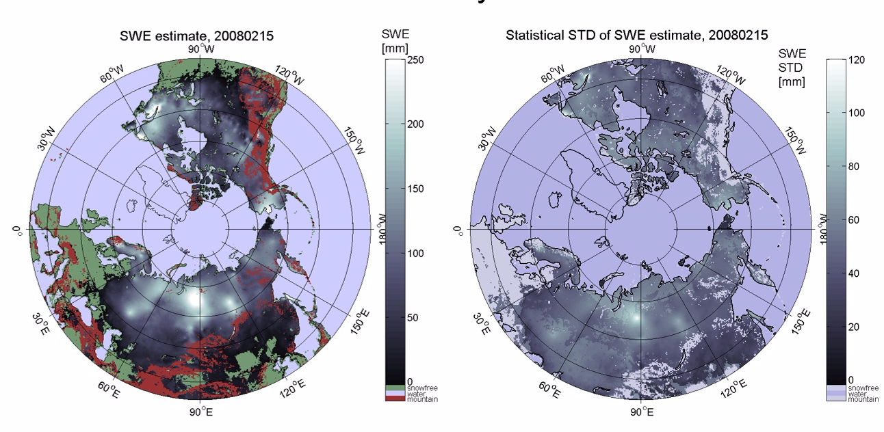
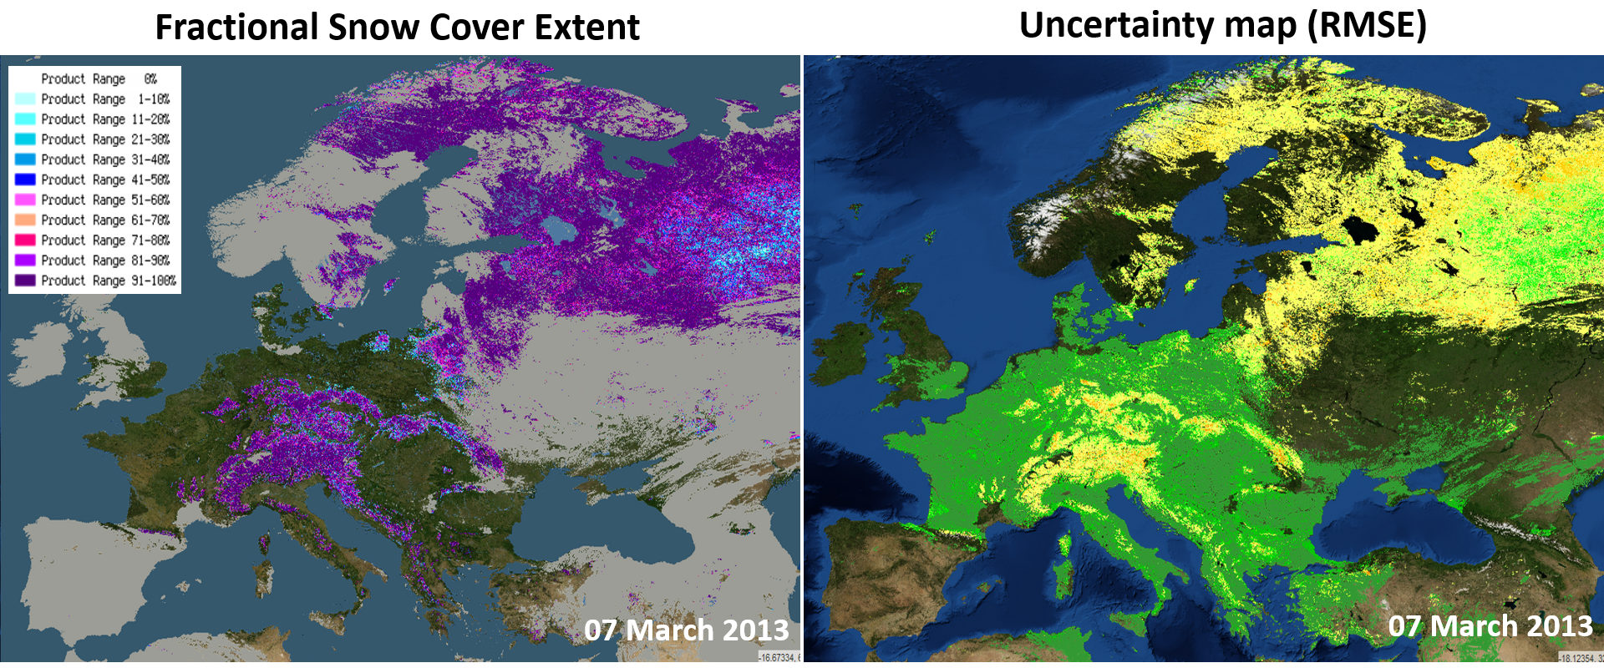
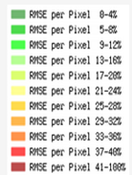
5. How will you deal with uncertainties in products?
Validation of products with independent reference data sets (in-situ data, snow products from other sources)
Uncertainty maps will accompany each daily product
Derivation of uncertainty within the processing chain, and communication of uncertainty to the user community is a priority topic for the URWS
Prototypes Products and Uncertainty Maps
Fractional Snow Extent and Uncertainty map
Snow Water Equivalent and Uncertainty map (Std)
15 Feb 2008

Slide 11
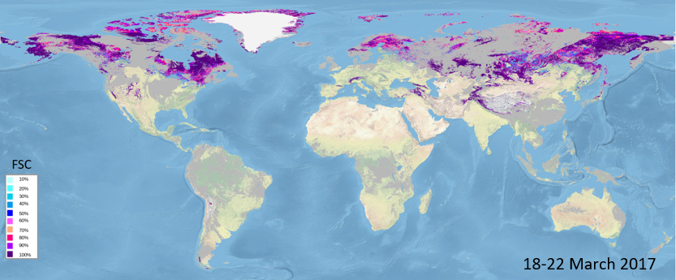
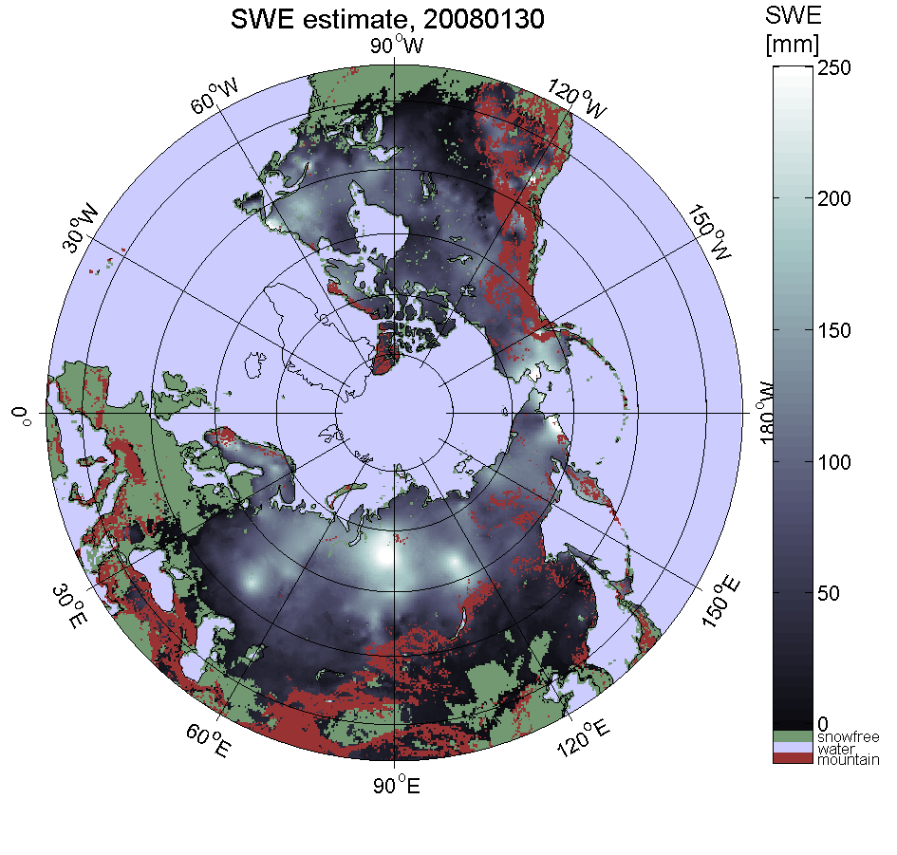
6. What data are you producing, and when?
Daily, Global Fractional Snow Extent Map
Year-2: Full time series of Snow Extent and SWE Products / V1
provided to users for evaluation and feedback, fully validated
Year-3: Reprocessed time series of Snow Extent and SWE Products / Version 2, with improved algorithms, fully validated
Product | YEAR-1 | YEAR-2 | YEAR-3
SE | AVHRR (1981-present) ATSR-2 (1995-2003) AATSR (2002-2013) | AVHRR/2 (1981-2016) AVHRR/3 (2006-present) ATSR-2 (1995-2003) AATSR (2002-2013) MODIS (1999-present) SLSTR (2016-present) Merged all missions (1981-2019) | AVHRR/2 (1981-2016) AVHRR/3 (2006-2020) ATSR-2 (1995-2003) AATSR (2002-2013) MODIS (1999-2020) SLSTR (2016-2020) Merged all missions (1981-2020)
SWE | SMMR (1978-1987) SSM/I (1987-2016) | SMMR (1978-1987) SSM/I (1987-2016) Merged all missions (1978-2019) | SMMR (1978-1987) SSM/I (1987-2016) Merged all missions (1978-2020)
Daily, Global Snow Water Equivalent Product

Slide 12
7. What are your data needs for ECMWF reanalysis data?
ECMWF reanalysis utilized to drive snow models which provide complementary SWE information for inter-comparison and potential gap-filling of alpine areas. Daily SWE products will be generated from 1978 onwards.

Slide 13
8. How will you know if your CRG work is complementary with CMUG research?
4 (+1) CRG Use Cases are defined, overview of use cases will be presented at CMUG Meeting
CMUG members working on snow products were invited to UWS: 29 Nov 2018, Vienna
Receive planned work on snow products evaluation by CMUG members and review and coordinate activities CRG team.
Participation and coordination of CRG at CMUG and co-location meetings

Slide 14
9.What meetings do you plan to attend over the next 12 months? Colocation, Living Planet,…..
December 2018: American Geophysical Union Fall Meeting
March 2019: CCI+ Co-location meeting
April 2019: EGU General Assembly
May 2019: ESA Living Planet
July 2019: IGARSS (TBC)

Slide 16
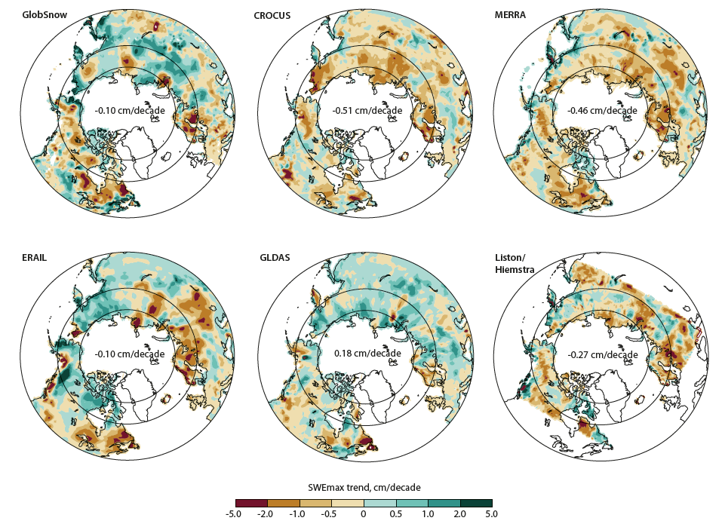

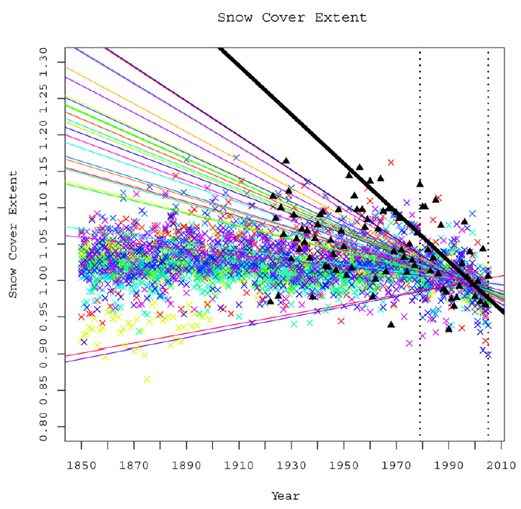

CRG Use Case Summaries
Case study 1 – Regional and global snow cover trend analysis
Case study 2 – Evaluation of CMIP6 simulations
CMIP6 will provide: land-only climate model simulations forced by observation-constrained global meteorological data for the 20th century; atmosphere-land simulations with prescribed observed oceanic boundary conditions since 1979; coupled atmosphere-land-ocean simulations since 1860
By exploiting these different simulation types, we aim to identify precise causes for the observed snow trends and drivers of projected trends
Analysis of CCI+ products will be used to estimate global and regional SE and SWE trends
Inter-comparison with observationally constrained land models will be used to quantify trend uncertainty and diagnose the roles of surface temperature and precipitation in driving SE and SWE trends

Slide 17

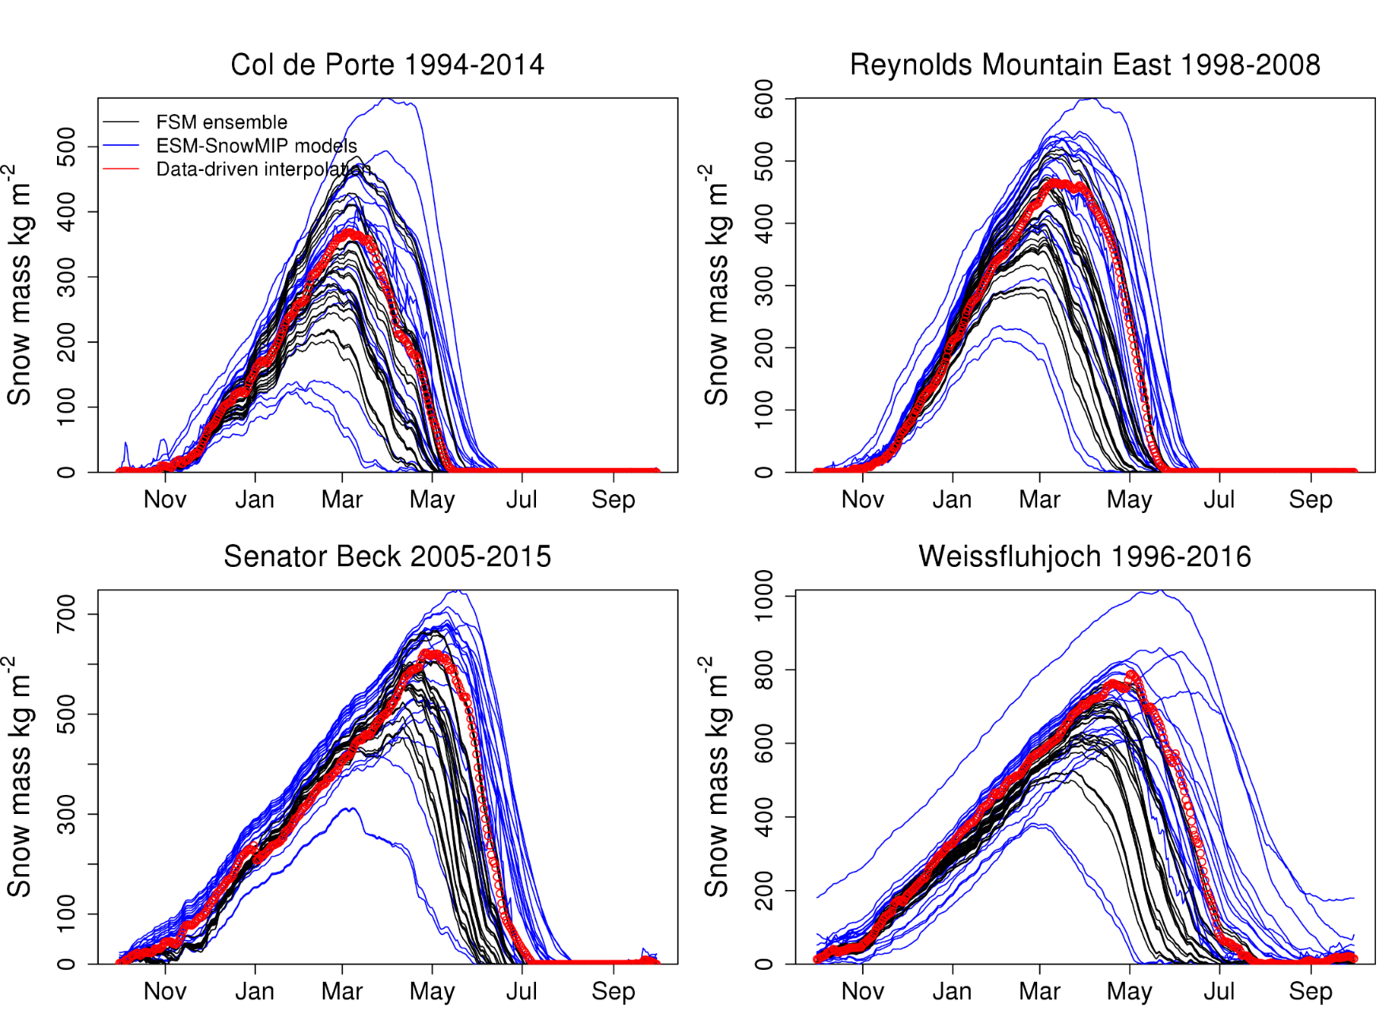

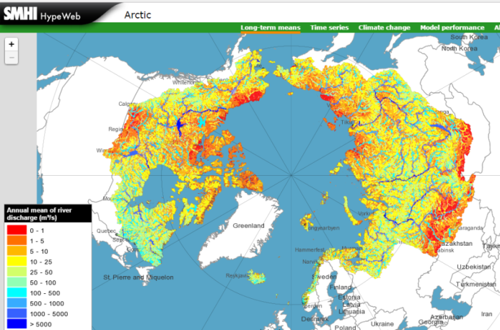
CRG Use Case Summaries
Case study 3: Evaluation of ESM-SnowMIP simulations
Case study 4 – Long-term simulations of large scale hydrological regimes in a variable climate
The Earth System Model Snow Model Inter-comparison Project (ESM-SnowMIP) includes simulations at highly-instrumented reference sites
The utility of constraining model snow mass balance directly with coarse-resolution SWE products or indirectly with high-resolution SCE products will be assessed
Extending from point to ~ 0.5° grid scales will enable connections to be made with the large-scale model performance evaluated in case study 2
Snow water equivalent and snow extent products will be assessed from a hydrological point of view using applications of the hydrological model HYPE for Sweden and the pan-Arctic drainage basin of the Arctic Ocean.
CCI+ data will be used for model evaluation as well as hydrological reanalysis together with observed river discharge data for the available data period.
Improved estimate of river discharge to the Arctic Ocean.

Slide 18

CRG Use Case Summaries
Partner-led Case study: Multi-decadal comparison between the ECMWF ERA5 climate reanalysis and snow_cci
Terrestrial snow plays an important role in operational Numerical Weather Prediction and in climate reanalyses, both for initialization of the land surface, and verification of forecast skill.
Snow_cci products will be assessed for their potential contribution to ERA5 ECMWF reanalysis, with potential engagement with other operational centres (ERA5 is part of the EU-funded Copernicus Climate Change Service climate reanalysis, delivered by ECMWF)
Both the snow CCI+ and the ERA5 snow cover data records will be re-gridded to a regular 0.25 degrees grid and compared at global scale for a multi decadal period spanning 1990 to 2016

