Slide 1
Summary of CSWG breakout group
Session I – Round-table discussions of topics below
Treatment of uncertainties (Rob)
Consistency between ECVs (Paul)
Visualisations, data portal, toolbox, CMF, ESMVal Tool (Emilie)
Data delivery times & AOB (Paul)
Session II – Communication across CMUG and ECV project CRGs
Overview of Slack (Paul)
Do you know who else is working with the same CCI datasets (Paul)
Session III – Engagement with external groups
Are you involved in any project/initiative relevant for CCI datasets? (Paul)
How can we reach out to potential CCI data users?
How can we maximise uptake of CCI datasets?
Publishing results for IPCC AR6

Slide 2
Treatment of Uncertainties
The Yellow Table

Slide 3
Uncertainties
Same language to describe uncertainties across all ECVs
What is needed depends on the applications – work with ECV teams to get this
Not all information is statistical
Radar info for AGB, view angle for LST
Good documentation
Measurement equations and their different components, even if not all parts can be understood. See how the uncertainty arises
Breakdown of the uncertainties as well as overall value
Eg LST errors split to cloud and emissivity components
What ground/site date used as validation
Can see if in a dense or sparse sampled region

Slide 4
Uncertainties
How to work with the uncertainties
Document how to propagate the information
Including spatial correlations
Eg Cloud fraction, land cover…
Communicate what we don’t know about the uncertainties
Eg aerosol clear sky vs cloud, LST = canopy or ground?
Users and ECV teams must work together to get the right information
Uncertainty information must add value to the product

Slide 5
Uncertainties
Feedback and lessons learnt from Phase 1
Remind existing ECVs
Share with new ECVs
Lots of material available

Slide 6
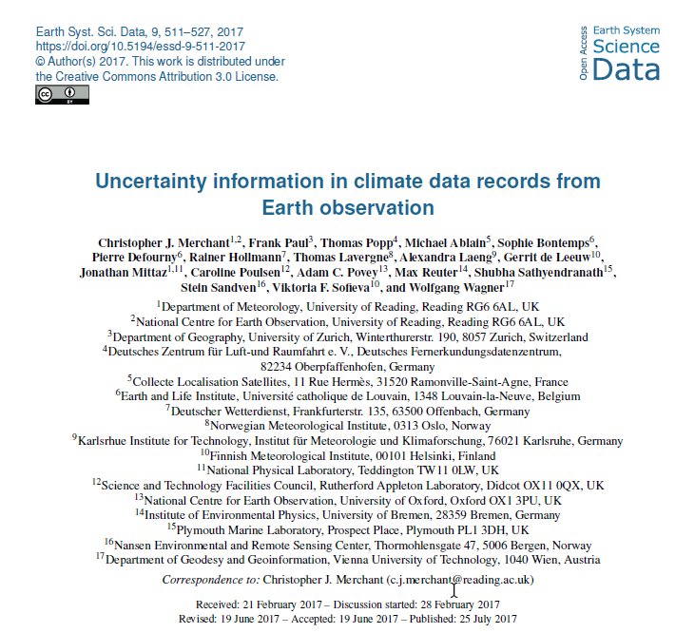

Slide 8
Ensuring “consistency” between ECVs (1 of 3)
 | New ECVs |  |  |  |  |  |  |  |  | Existing ECVs
 | Water Vapour | Sea Salinity | Sea State | Lakes | Snow | Perma-frost | LST | HRLC | AGB | SST | OC | SSH | SI | O3 | Aero | Clds | GHG | Fire | LC | SM | IS - Green | IS Ant | Glac
WV
S. Sal
S. Stat
Lakes
Snow
PF
LST
HRLC
AGB
SST
OC
SSH
SI
O3
Aero
Clds
GHG
Fire
LC
SM
IS – G
IS – Ant
Glac

Slide 9
Ensuring “consistency” between ECVs (2 of 3)
CCI Land Sea mask,
As provided by the Land Cover project,
Higher resolution version needed by some
Other masks needed
Standards for Data
DEWG have a document on agreed data standards
Ed can provide more info (maybe already has)
Common retrievals of satellite data
Possibility of sharing downloads and processing
CCI Data delivery times – plans have been shared and projects are aware, in case they have dependencies – summary in CMUG report

Slide 10
Ensuring “consistency” between ECVs (3 of 3)
Most (all?) of the new CCI+ ECV projects have a requirement for reanalysis data to support the development of their CCI data – and this will be ERA5
Projects have a clear understanding of what ERA5 data they need
Seek agreement with ESA about a which version/time-step/resolution for CCI use. Should ESA endorse or approve this?
Noted that (1) existing CCI projects used ERA-interim
(2) ERA-interim will be discontinued soon
Can the CMUG researchers at ECMWF help?

Slide 11
Visualisation and analysis tools (CSWG summary)
Integration meeting, Met Office, Exeter, UK, 31 October 2018

Slide 12
Tools
Aim: Sharing knowledge of these tools, ensuring everyone is aware of what already exists and what can be used for what.
Ran a quick informal count of how many (presents) have used or tried to use each tool (excluding tool developers)
Notes:
Task 6: Coordination and outreach
Responsible partners: Met Office, ECMWF, MPI-M, Météo France, IPSL, SMHI, BSC [All partners = 8.8 PM]
CMUG workshops and events
… It is proposed to continue the Integration meetings hosted by CMUG annually (as in Phase 2) …
… CMUG input to climate meetings to engage researchers across Europe will be organised … (European Conference on Applied Climatology (ECAC))
… A workshop in the third year of CMUG is also proposed to gather input for the CMUG deliverable of a Foresight report / community white paper on satellite Earth observations …
Publications
… publish the results of its climate science research on CCI dataset …
… CCI special issue, focusing on the exploitation of CCI data products …
… IPCC WG1 deadline which is (approximately) January 2020 …
Coordination with other activities
… CMUG will ensure it works alongside related activities from the EC, EUMETSAT, GCOS or other international initiatives and research projects …
… CMUG will work with the CCI Knowledge exchange team (and the experts it employs such as Planetary Visions) to ensure effective communications and synergies with special events (e.g. Living Planet, EGU) …
… CMUG will also continue to engage with European funded research projects ...
… Obs4MIPS is creating a one stop shop for satellite climate datasets and the continued inclusion of the CCI datasets relevant to climate modelling should be a high priority for the CMUG …
Climate data forum
… the climate data portal and forum website will be maintained (WP2.2) …
… The outreach part of CMUG will also be used to promote this to the wider user community which includes Copernicus related projects, other stakeholders (EEA, JRC) and commercial users of climate data …
… Web statistics, and surveys (if needed) …
Including CCI results in IPCC climate science assessments
… the CCI data sets have a key role (by providing observations of climate change trends and effects and also through supporting climate models) especially if CCI projects such as CMUG can provide input to the IPCC process ...

Slide 13
Brief summary of discussions
ESMValTool
Useful for comparison of climate model outputs with observations
New version coming soon, will handle more spatial projections thanks to Iris Python library (+ further capabilities)
CMF
Useful for looking a time series and slow variability and cross-ECV analysis
Easy to use

Slide 14
Brief summary of discussions
Data portal
Single point of access to CCI data – Has all “old” ECVs
Dataset final version (working versions exchanged differently between researchers)
Sometimes information mismatch between ECV project websites and data portal
CCI toolbox
Useful for analysing CCI ECVs, 30 to 40 operations currently available (e.g. regridding, blending)
Not cloud based right now – must be installed on platform where data are located (which can be an issue)

Slide 15
Brief summary of discussions
Obs4MIPs
Another way to get the CCI data
Regridded for model comparison (caution: units changed!)
Retrieval through web interface or your own scripts
Other comments
All CCI data in a big data cube (e.g. Digital Earth Australia)
Link to Google Earth Engine Tool?
earthsystemdatacube.net already has CCI data (some on the cloud, can use Python to carry out analysis directly there)
Could be useful if researchers shared some of their scripts (e.g. calculating ocean current)

Slide 16
Actions
Gather in one place a list of all ECVs (or point to existing list more clearly)
Gather in one place a list of all available tools with a quick explanation of what they can be used for and links to each
Try to get a sense of which ECV datasets are used with which tool and what they are used for

Slide 17
Session II – Communication across CMUG and ECV project CRGs
Overview of Slack
Do you know who else is working with the same CCI datasets
Session III – Engagement with external groups
Are you involved in any project/initiative relevant for CCI datasets?
How can we reach out to potential CCI data users?
How can we maximise uptake of CCI datasets?
Publishing results for IPCC AR6

Slide 18
Communication within the CSWG
CMUG proposal to use a social media comms tool, in addition to email and other existing tools (email, wiki, video-conf.).
Slack was chosen, needs to be approved by ESA (security and data sharing concerns)
http://bit.ly/cmug-cci-slack = how to join
Assuming it is approved, we will know within a year whether it is useful
http://cmug-cci.slack.com = website

Slide 19
Engagement with external groups
https://docs.google.com/document/d/1yokmbGSn0aQjwYJcsxKnEUg6eVqoewUd-H9NtcKuZas/edit

Slide 20
CMUG will produce a report of the meeting to capture the agreements, issues and actions
We would like to put the presentations online – please opt out if you so wish
Next CMUG meeting – Autumn 2019, place TBD

