Slide 1
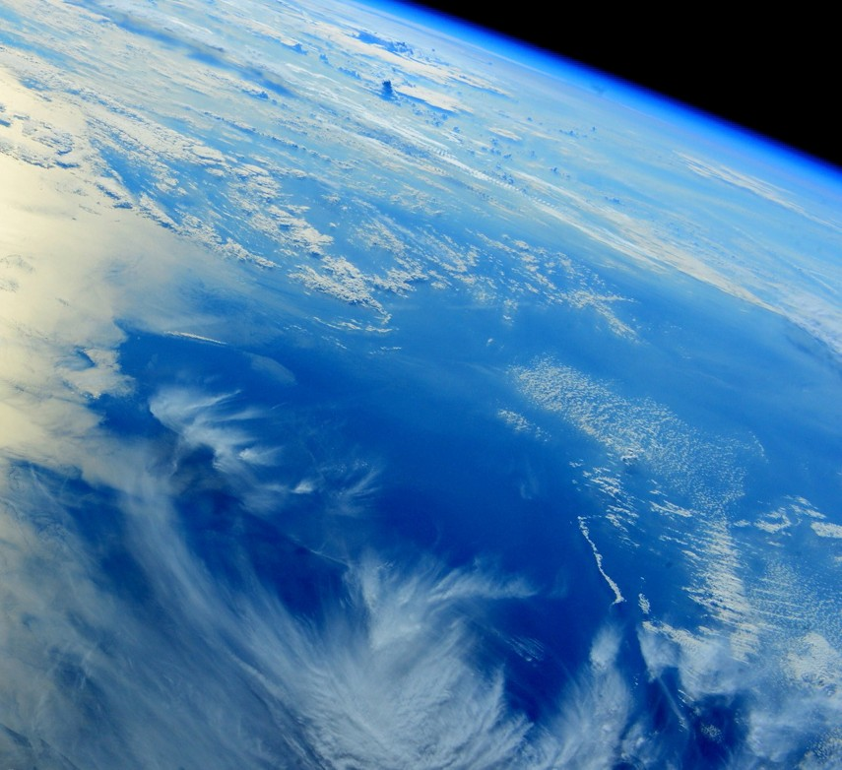
Feedback from Science Leads
CMUG Integration Meeting 2018
ESA UNCLASSIFIED - For Official Use

Slide 2
1. CCI sessions at international conferences
Living Planet Symposium
Tuesday will include a session “Observations for supporting the UNFCCC Paris Agreement” which comprises a high-level panel discussion (UNFCCC, GCOS etc) and an open session for talks etc
Single CCI overview talk in the latter with an overall storyline taking contributions from the science leads - Discuss specifics of the content at the next Colocation Meeting.
Projects are encouraged to submit to the symposium and their contributions will go into the relevant disciplinary sessions
Discussion on having a CCI session at a future GCOS Conference, with the aims being to feed back to GCOS and have visibility in the wider community
Suggestion to compile a “CCI slide pack” as a resource for all to use as appropriate when attending relevant meetings/conferences/workshops.
Notes:
CCI at GCOS Conference: This was seen as potentially useful/necessary but there was not overwhelming support amongst the science leads.

Slide 3
2. Interactions with GCOS / ECV Inventory
Discussion about how to feed in to GCOS requirements/discussions:
Through direct input into the panels: TOPC/AOPC/OOPC
Proposal to update the ESA response to GCOS with current status of existing ECVs and adding entries for new ECVs
Currently much interest/activities in GCOS to generate “Climate Indicators” relevant to adaptation and mitigation
Beyond the scope of current CCI to support this sort of activity
Suggestion to take note of what IPCC requires to provide policy relevant assessments that could include such indicators and use this as a way of making a contribution
ECV inventory needs to be updated and that this includes a linked gap analysis

Slide 4
3. CCI paper on consistency
Thomas/Rainer/Michaela leading a paper on consistency across ECVs
The status of the paper was presented:
Drafts of framing sections are evolving
To be circulated in the coming weeks for science leads to provide examples as input

Slide 5
4. Maximising input into IPCC
Grey literature is relevant and a good way to make a contribution is to identify relevant chapters and authors and provide them with papers, project reports along with a brief summary of their relevance
Deadlines for WG-I are December 2019 for paper submission, September 2020 for acceptance but, importantly, the WG-II and WG-III deadlines are later
Suggestion of two focus areas for possible CCI input into AR6:
Closing budgets
Multiple lines of evidence to underpin statements on observed changes
ESA mentioned that a specific proposal on cross-ECV work relevant to AR6 could be favourably received if attached to an existing contract
IPCC chapter outlines and author lists will be circulated
Notes:
This material could be used directly, possibly with the contributor being invited to be a Contributing Author on the relevant chapter
WG-I: Physical science basis
WG-II: Impacts, adaptation and vulnerability
WG-III: Mitigation

Slide 6
5. Cross ECV studies including consistency
There was a lack of clarity on how much cross-ECV consistency work had been undertaken previously with existing ECVs:
Some bilaterally between ECV projects rather than by CMUG
Feeling that such activities should continue for the new ECVs in addition to the work done by CMUG
To help generate more cross-ECV work, CMUG to circulate its CCI+ cross-ECV table and previous work on ECVs with physical links from a process perspective

Slide 7
6. Golden year
Particularly relevant for new ECVs when generating their very first datasets
Keep 2008 as a reference given the work done on this in CCI
Agreed to having an 18-month period (October 201x to March 201(x+2)) so set of full seasons were included in both hemispheres
There was support for 2018 given the hot summer in the northern hemisphere:
Would mean starting now to generate data for October 2017-September 2018
Extending to March 2019 over the coming months
To help generate consensus on which 18 months to choose, each ECV project to provide information on which recent years it would have a problem with

