Slide 1
Project Overview
Darren Ghent
and the land surface temperature cci Team

Slide 2
Objectives
Consistency in algorithms, cloud masking, uncertainties
Building the first 20+ year climate datasets for LST
Resolving the global diurnal cycle for LST by merging multiple polar orbiting and geostationary data
An objective to be the best source of LST data for the user community:
  LST is an essential parameter for diagnosing Earth System behaviour and evaluating Earth System Models
  Crucial constraint on surface energy budgets, particularly in moisture-limited states
  A metric of surface state when combined with vegetation parameters and soil moisture
  As an independent temperature data set for quantifying climate change complementary to the near-surface air temperature ECV based on in situ measurements and reanalyses

Slide 3
Key Advancements
An expected accuracy and precision of all the LST ECV Products will be < 1 K
A first assessment of the stability of LST ECV Products
A first global LST CDR with record length over 25 years
A first passive microwave time series with record length of over 20 years
Intercalibration and time difference corrections of level-1 data for CDRs
Retrieval algorithm consistency across LST ECV products and CDRs
Consistency of uncertainty approach
Optimisation of best cloud clearing detection across new sensors
Demonstration of seamless end-to-end LST ECV production for complete multi-mission archives
Fully independent and rigorous product validation and intercomparison extended to new sites and external datasets
Significantly increase maturity levels of all LST ECV Products
Demonstration of climate applications resulting in at least four journal papers led by users

Slide 4
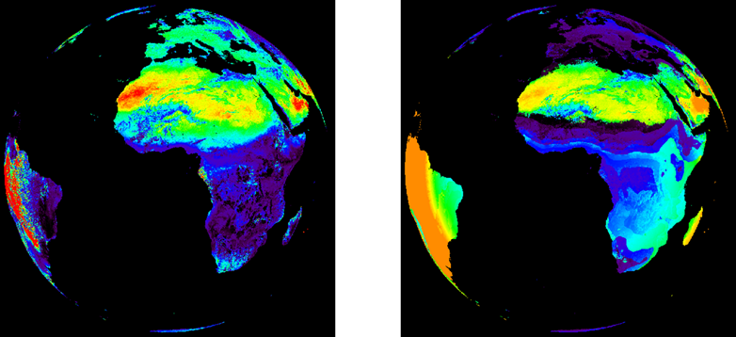
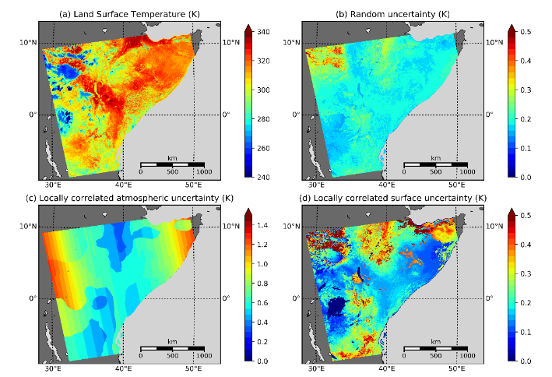
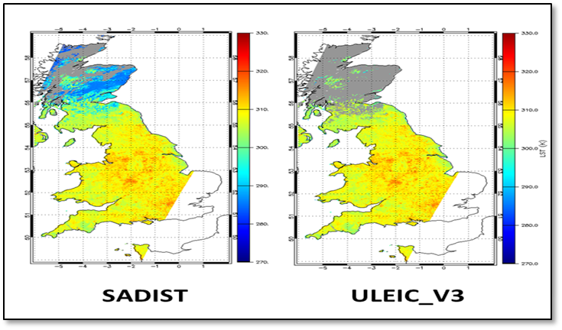
Key Developments
Algorithm development
  Bias and time difference corrections of level-1 data for CDRs
  Retrieval algorithm consistency across LST ECV products and CDRs
  Consistency in land surface emissivity (LSE)
Ensure consistency of uncertainty approach
  Components that are separated according to their differing correlation properties
  Validation of uncertainties
Optimisation of best cloud clearing detection across new sensors
  Best cloud clearing approaches for long-term CDR and for Merged CDR

Slide 5
User requirements
 | Threshold | Breakthrough | Objective
Dataset length | 10 years | 30 years | > 30 years
Spatial resolution | 1 km | < 1 km | < 1 km
Temporal resolution | 6 hours | 1 hour | < 1 hour
Accuracy | 1 K | 0.5 K | 0.3 K
Precision | 1 K | 0.5 K | 0.3 K
Stability | 0.3 K / decade | 0.2 K / decade | 0.1 K / decade
LST CCI User Requirements
High quality data more important than spatially complete fields
High temporal resolution more important for global studies
High spatial resolution more important for local studies
Dataset length is more important for global studies, whilst high data resolution is more important for local studies
GCOS LST Requirements
Item | Type | Value
Horizontal resolution | Threshold | 0.05°
Temporal resolution | Threshold | Day-night
 | Target | ≤ 3-hourly
Accuracy | Threshold | <1 K
Precision | Threshold | <1 K
Stability | Threshold | <0.3 K per decade
 | Target | <0.1 K per decade
Length of record | Threshold | 20 years
 | Target | >30 years

Slide 6
LST ECV products
Instrument | Satellite(s) | Year 1 | Year 3 | Products | Comments
ATSR-2 | ERS-2 | 1995-2003 | 1995-2003 | 1 km L2P 0.05° [0.01°] Daily L3C 0.05° [0.01°] Monthly L3C
AATSR | Envisat | 2002-2012 | 2002-2012
AVHRR/3 | NOAA-15-19 |  | 1998-2016 |  | GAC (4km)
 | Metop-A-C |  | 2007-2020 |  | FRAC (1km)
MODIS | Terra | 1999-2018 | 1999-2020
 | Aqua | 2002-2018 | 2002-2020
SLSTR | Sentinel-3A | 2016-2018 | 2016-2020
 | Sentinel-3B |  | 2018-2020
SEVIRI | MSG-1-4 | 2008-2010 | 2004-2020 | 0.05° Hourly L3U | MVIRI being done by CM SAF
Imager | GOES 12-16 |  | 2004-2020
JAMI | MTSAT-2 |  | 2009-2015
SSM/I | DMSP F-13,17 | 1998-2018 | 1995-2018 | 0.25° Daily L3C
ATSR-MODIS-SLSTR CDR | ATSR, MODIS, SLSTR | 1995-2012 | 1995-2020 | 0.05° [0.01°] Daily + Monthly L3S | ATSR-2 through to SLSTR
Merged IR CDR | LEO+GEO IR above |  | 2009-2020 | 0.05° 3-hourly L3S | 3-hourly Merged GEO+LEO
Experimental IR+MW | Select IR + MW |  | [1 year 2008] | 0.05° 3-hourly L3S | Global diurnal cycle (clear+cloudy)

Slide 7
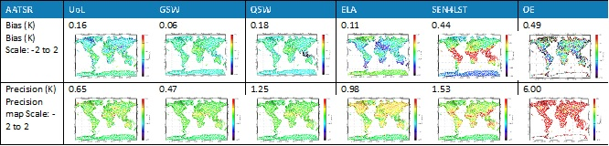
Algorithm consistency
For highest quality LST products for climate studies it is critical to implement the optimum retrieval algorithm
Achieved through an algorithm intercomparison (“round robin”):
6 infrared algorithms were tested for 3 infrared sensors
7 microwave algorithms were tested for 1 microwave sensor
Assessment through a set of metrics
Designed and developed a Benchmark Database (BDB) for training, testing and selection of algorithms
Paper in preparation
Dataset | First Choice Algorithm | Second Choice Algorithm
AATSR | UOL Overall Rank for AATSR: 4 | GSW Overall Rank for AATSR: 6
MODIS | GSW Overall Rank for MODIS: 3 | QSW Overall Rank for MODIS: 8
SEVIRI | GSW Overall Rank for SEVIRI: 3 | UOL Overall Rank for SEVIRI: 8
AATSR / SLSTR / MODIS CDR | UOL | GSW
Merged Dataset (AATSR / MODIS / SEVIRI) | GSW | UOL
SSM/I | NNE_A | NN_A

Slide 8
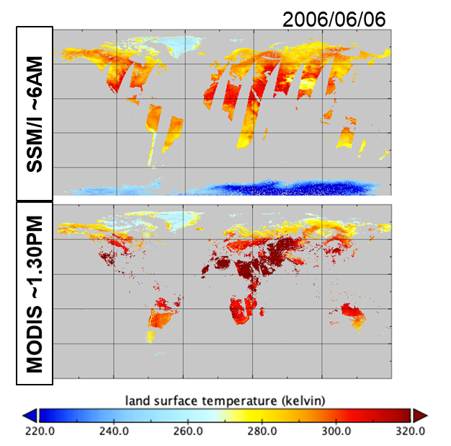
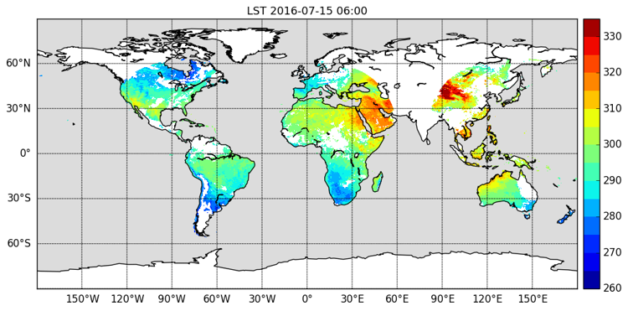
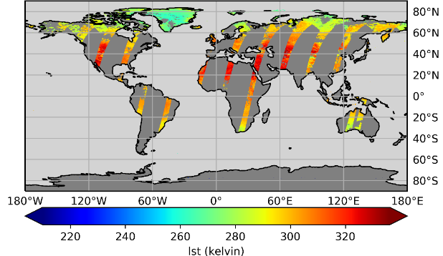
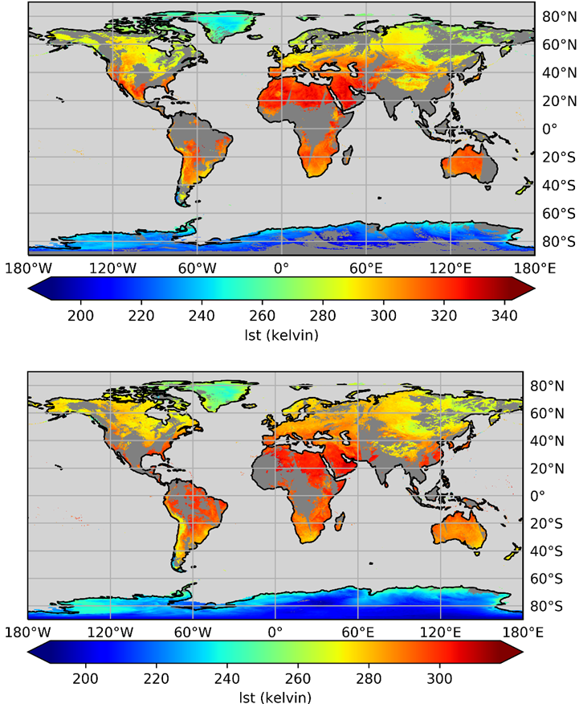
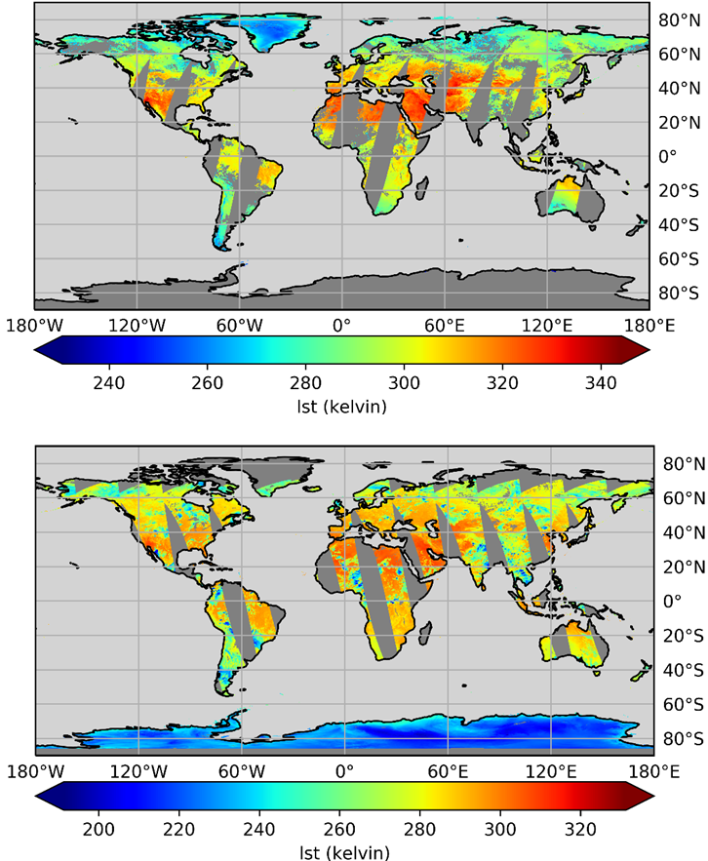
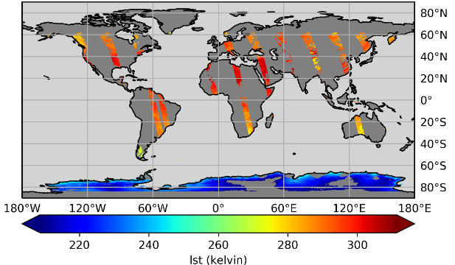
First ECV Products
Microwave
TIR (GEOs)
TIR (ATSRs)
TIR (MODIS)
TIR (Sentinel-3)

Slide 9
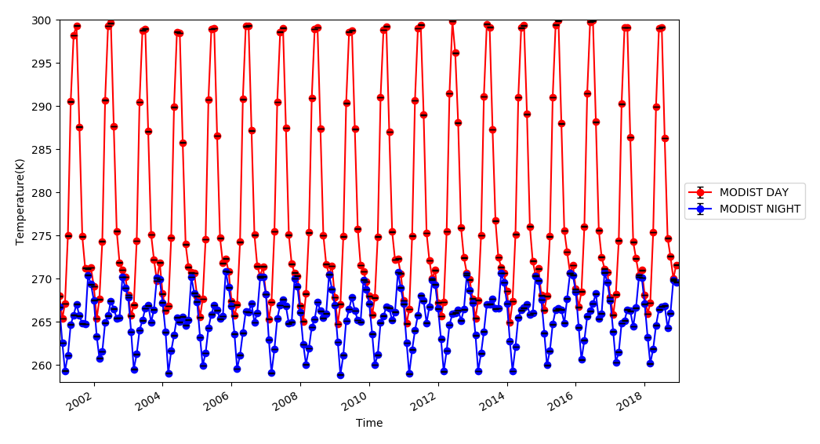
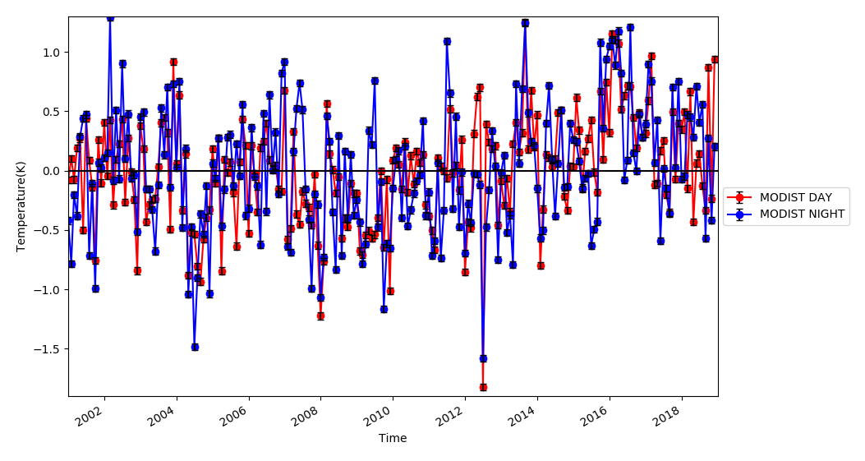
First Long Time Series
18-Year Terra MODIS LST
Terra MODIS Monthly LST Anomalies

Slide 10
Product Validation: Key Points
Implement community established protocols
  LST Validation Protocol (Schneider et al., 2012)
  CEOS LPV Best Practices (Guillevic et al., 2017)
Multi-sensor Matchup Database (MMDB)
  Powerful and flexible capability built on core matchup code and harmonised data format for ingesting and processing multiple data streams
Product Validation
  “Category-A” LST Validation against “Gold Standard” in situ measurements
  Validation of product uncertainties at the sites
Product Intercomparison
  “Category-C” LST Validation (satellite vs. satellite intercomparison)
  Polar matchups (LEO vs. LEO)
  Intercompare LEO products with respect to GEO Reference Products
Dedicated Validation Team (KIT) ensures independence from Data Providers

Slide 11
User Case Studies
Team | Title
Met Office Hadley Centre | Regional and Global Trends in LST
DMI | Assimilating Greenland ice sheet surface ice temperature into atmosphere and ice sheet models
Ruhr University Bochum | Characterisation of Surface Urban Heat Islands
MPI-BCG | Biosphere-atmosphere exchange of sensible and latent heat
MeteoRomania | Intercomparison and integrated use of LST in urban climate studies
LIST | Integration of LST into a physically-based surface energy balance model

Slide 12
Highlights
Strong interaction with the community:
Input into cross-ECV activities (Permafrost, Lakes, …)
Good visibility of LST CCI within the science community, government, and awareness by industry
Building into the ESA CCI portfolio
High quality products:
Driven by the User Requirements
Consistent algorithms applied to both IR and MW datasets
First datasets being made available on UK JASMIN project workspace to CRG and CMUG users
Improvements on pre-cursor datasets and current operational products
First papers in preparation

Slide 13
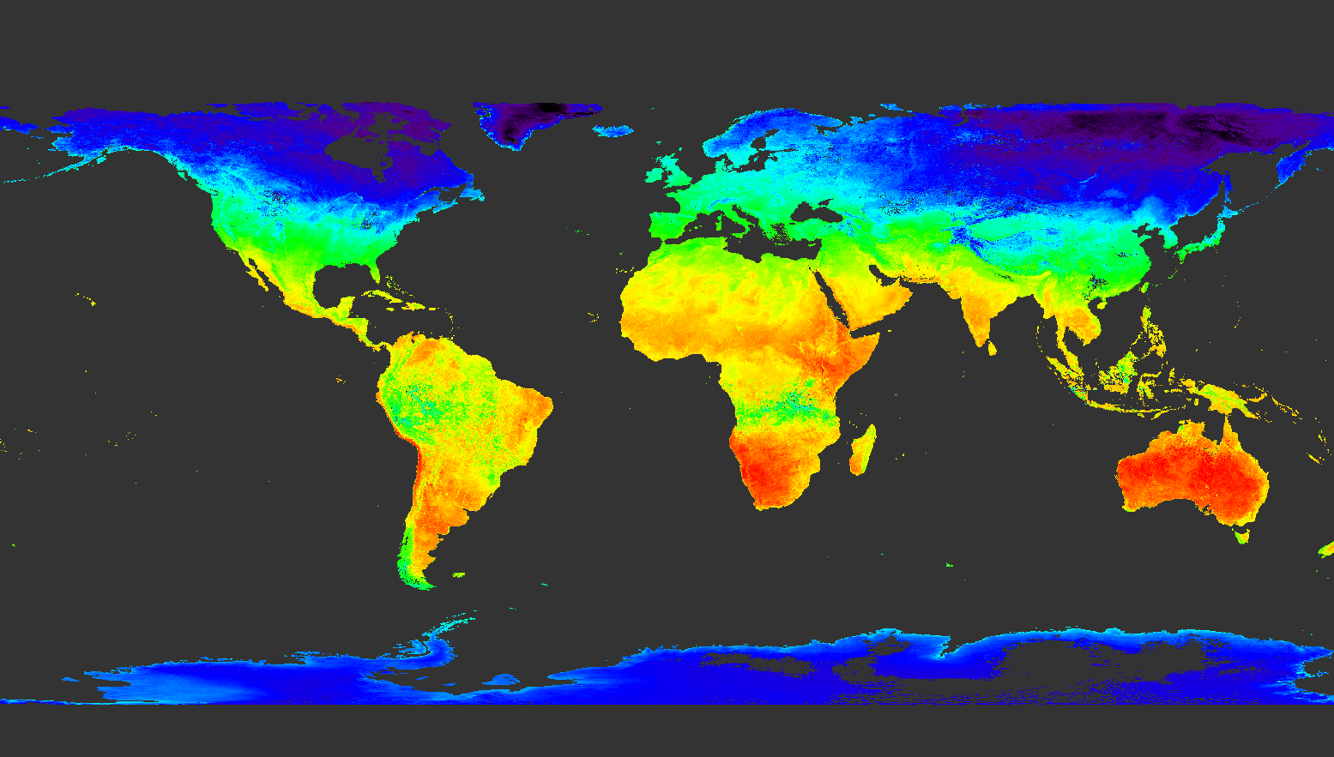
Questions
Website: cci.esa.int/lst

