Slide 1




Evaluation of LST in EC-EARTH3-Veg climate model (&ECMWF model):
Use of LSA-SAF and role of vegetation
Emanuel Dutra (emanuel.dutra@ipma.pt, IPMA, IDL)
Thanks:
Ricardo Tomé, Miguel Nogueira, Isabel Trigo, Sofia Ermira, João Martins, Frederico Johansen (IPMA, FCUL, IDL)
David Warlind, Paul Miller, Lars Nieradzik, Klaus Wyser, Wilhelm May (U.Lund, SMHI)
Clément Albergel (ESA), Gianpaolo Balsamo, Souhail Boussetta (ECMWF)
ESA LST CCI User Workshop 2020, 24-26 June.
Funded by FCT CONTROL PTDC/CTA-MET/28946/2017

Slide 2
Motivation
Recent study has found large errors land surface temperature(LST) in ERA-Interim/ERA5 over Iberia in summer. The errors are associated with the vegetation cover and seasonality;
EC-EARTH3-Veg climate model shares the “same” atmosphere/land as ECMWF, but it’s coupled to a dynamical vegetation model: Does this matter for LST ?
Can we enhance the use of Earth Observations (EO) in model development ?
Routine use of LST for model evaluation ? Can it guide model development ?

Slide 3
Data & Methods
Models:
  EC-EARTH3-Veg: IFS+HTESSEL(atmosphere/land)+NEMO(ocean)+LPJG(dyna veg.)
    CMIP6 : 4 ensemble members, historical and scenarios; (3 hourly LST not part of the MIP’s data requests, only from 1 simulation);
    AMIP simulations : with CMIP6 vegetation (AMIP_CMIP) and ERA vegetation (AMIP_ERA);
  IFS & CHTESSEL: ECMWF current model cycle, atmosphere and land-surface;
    Offline simulations driven by ERA5 & 1-year atmospheric nudged simulations;
  SURFEX : land-surface model developed by Metéo-France;
  ERAI/ERA5 reanalysis;
Data
  LST satellite data from LSA-SAF 1 or 3-hourly 2004-2015 : clear sky only.
  ESA-CCI land cover transformed to EC-EARTH/IFS land-cover types (static 2010);
  Copernicus Global Land Service (CGLS) Leaf Area Index ;
Main focus over Iberia with ongoing global results (mix of finalized and ongoing works).

Slide 4
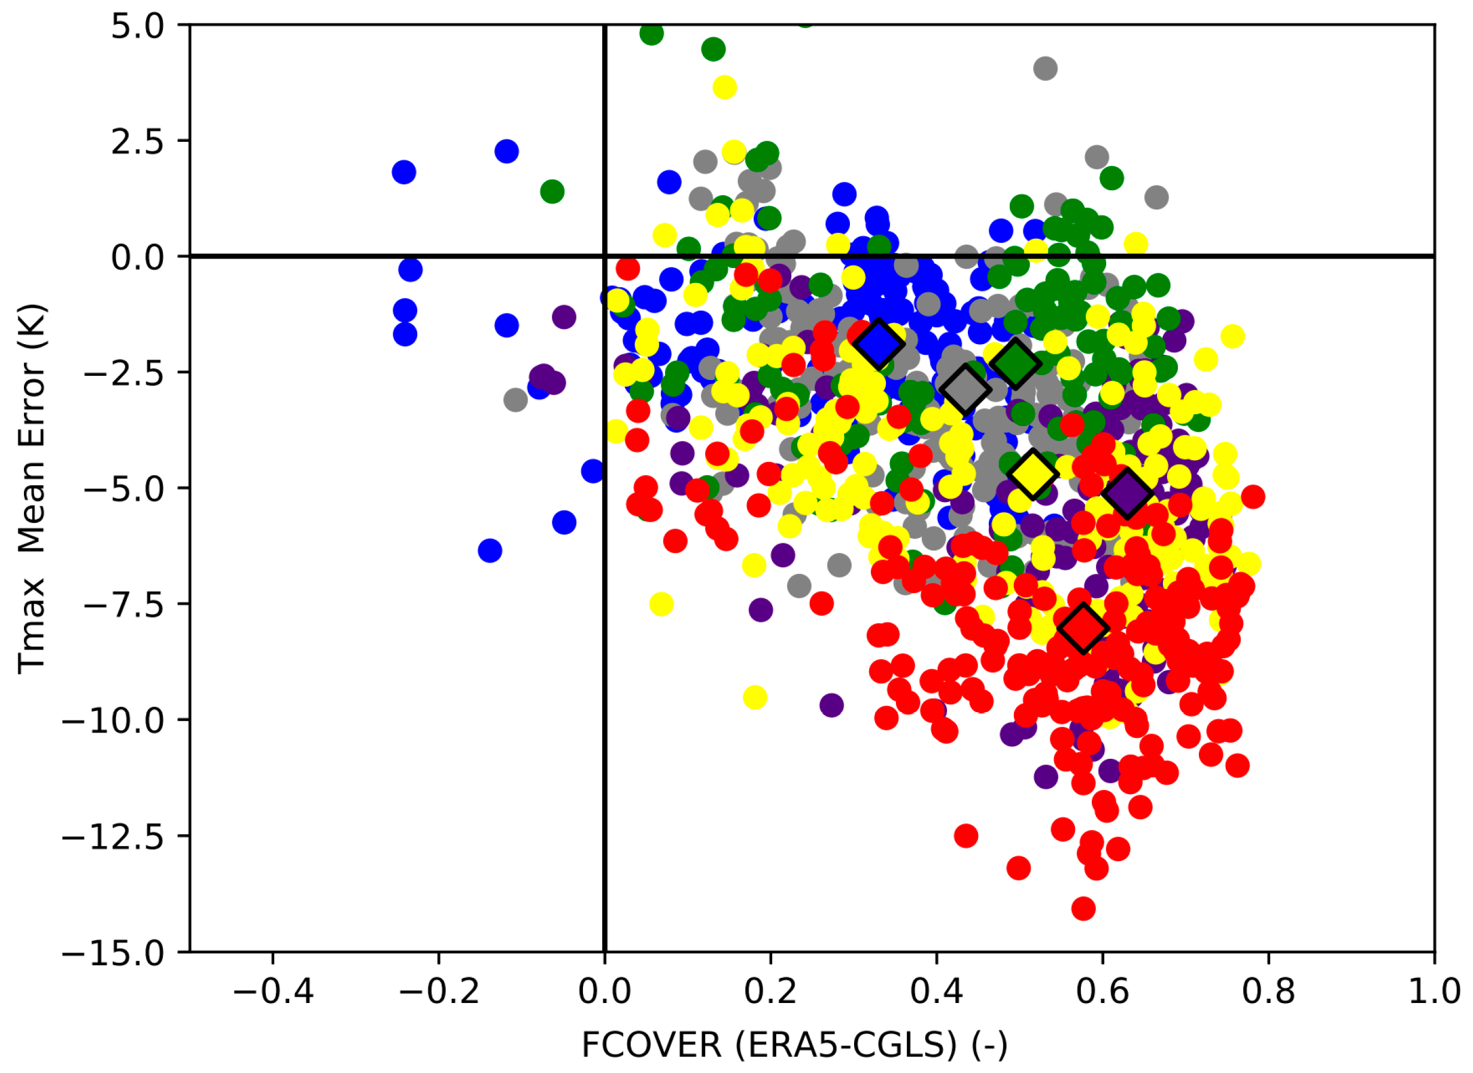
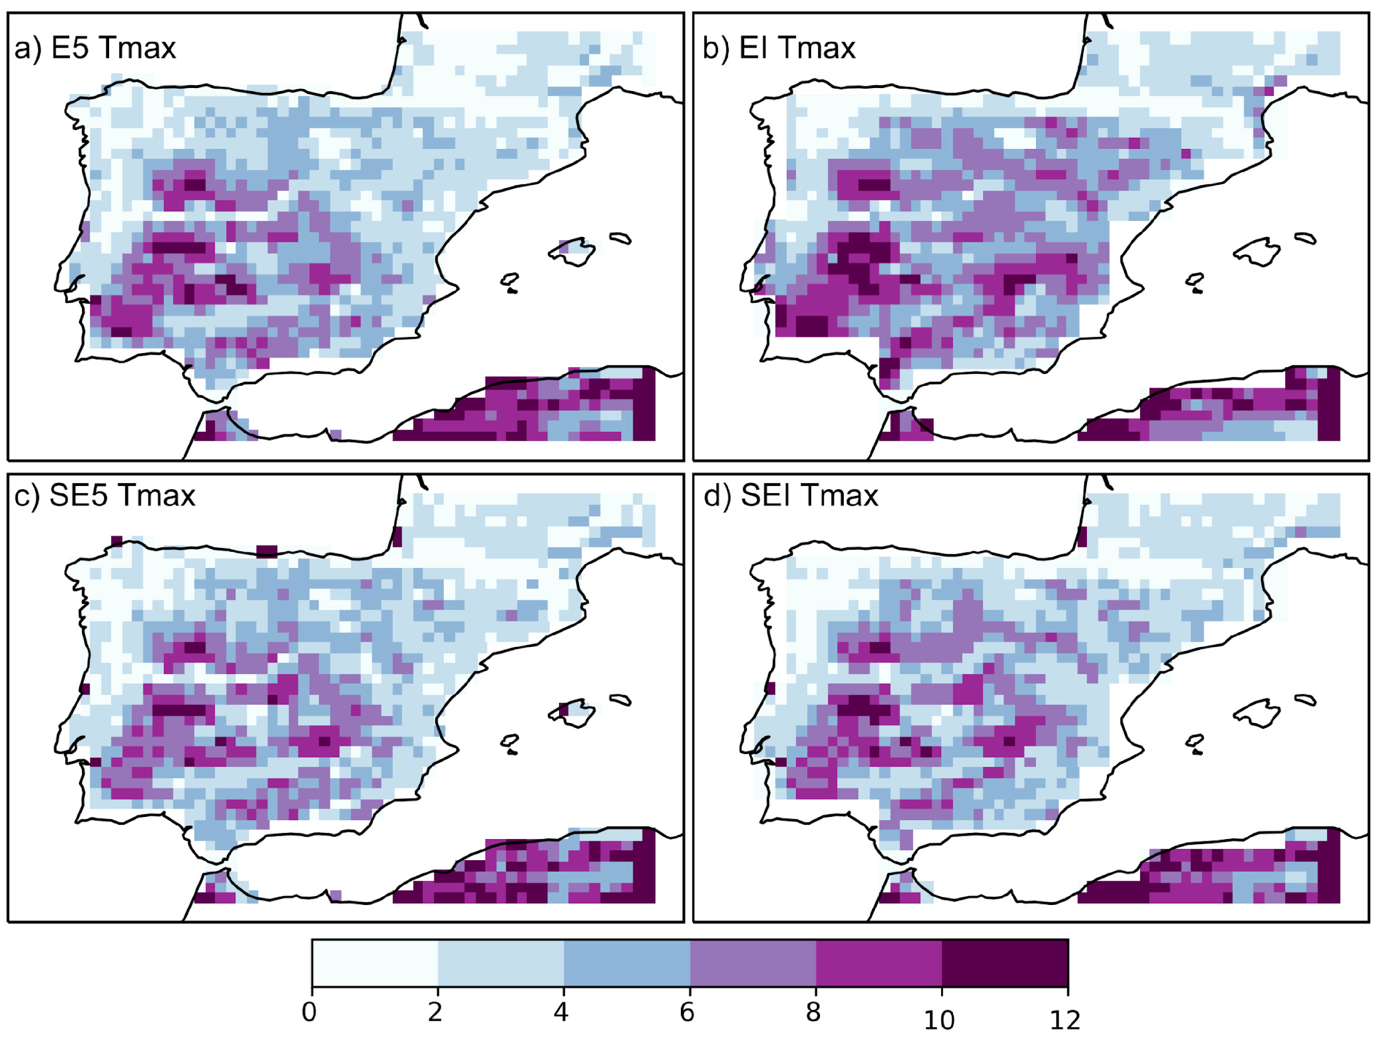
ERAI/ERA5 LST vs LSA-SAF
ERA5/ERAI LST maximum temperature RMSE JJA (K)
LST Tmax error (Yaxis) versus CGLS green vegetation cover difference between ERA5 & CGLS) (Xaxis)
Large daytime errors associated with vegetation cover and seasonality.
Johannsen, F.; et. al, Cold Bias of ERA5 Summertime Daily Maximum Land Surface Temperature over Iberian Peninsula. Remote Sensing 2019, 11, 2570, https://doi.org/10.3390/rs11212570

Slide 5
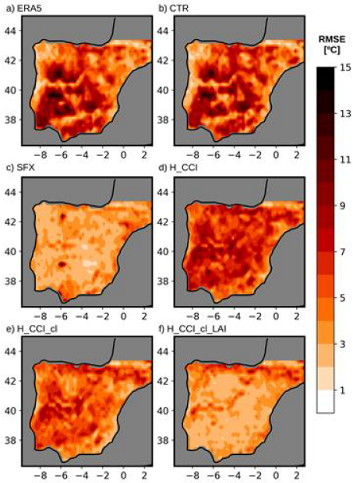
Role of land-cover in IFS CHTESSEL (&SURFEX)
RMSE of JJA daily maximum LST
ERA5
CTR
Offline simulations 2004-2015 driven by ERA5 meteorology
CTR : reproduces the bias of ERA5
SFX (SURFEX): Much smaller biases ;
H_CCI : replacing land cover by ESA-CCI
H_CCI_cl : H_CCI + Vegetation seasonality (clumping)
H_CCI_cl_LAI : H_CCI_cl + CGLS LAI
Clear-sky only: ERA5 TCC < 0.3 & LST > 0.7,
Synchronous in Time
Max LST between 11-15h
SFX
H_CCI
Combined effect of land-cover & vegetation seasonality (via clumping using LAI) reduces the daytime LST errors
H_CCI_cl
H_CCI_cl_LAI
Nogueira, M., et. al.: Role of vegetation in representing land surface temperature in the CHTESSEL (CY45R1) and SURFEX-ISBA (v8.1) land surface models: a case study over Iberia, Geosci. Model Dev. Discuss., https://doi.org/10.5194/gmd-2020-49, in review, 2020.

Slide 6
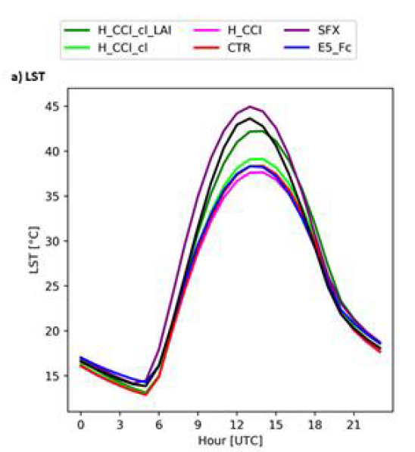
Role of land-cover in IFS CHTESSEL (&SURFEX)
Mean diurnal cycle LST (clear-sky) in JJA over Iberia
Clear improvement with updated land-cover and LAI (dark green) compared with observations (black) and Surfex (purple);
Small impact in minimum (nighttime) temperatures;
Some temporal shift.
LSA-SAF OBS
Nogueira, M., et. al.: Role of vegetation in representing land surface temperature in the CHTESSEL (CY45R1) and SURFEX-ISBA (v8.1) land surface models: a case study over Iberia, Geosci. Model Dev. Discuss., https://doi.org/10.5194/gmd-2020-49, in review, 2020.

Slide 7
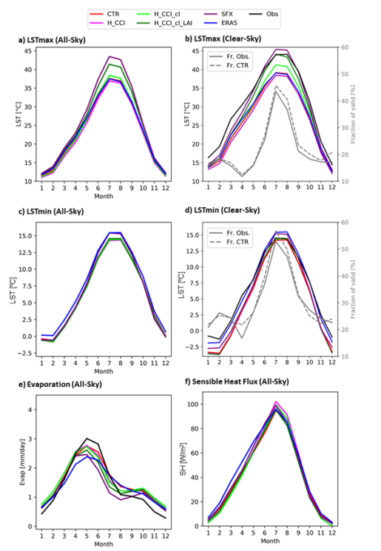
Role of land-cover in IFS CHTESSEL (&SURFEX)
Mean annual cycle of LSTmax, LSTmin, Evaporation & Sensible heat flux
Main impact during late Spring to Autumn in LSTmax. Smaller errors in LSTmin
Small impact on sensible heat flux, but large differences in Evaporation.
These are strongly constrained offline simulations.
How does the EC-EARTH3-Veg coupled model performs?
LSTmax
All-sky
LSTmin
All-sky
LSTmin
Clear-sky
Evaporation
Nogueira, M., et. al.: Role of vegetation in representing land surface temperature in the CHTESSEL (CY45R1) and SURFEX-ISBA (v8.1) land surface models: a case study over Iberia, Geosci. Model Dev. Discuss., https://doi.org/10.5194/gmd-2020-49, in review, 2020.
Sensible

Slide 8
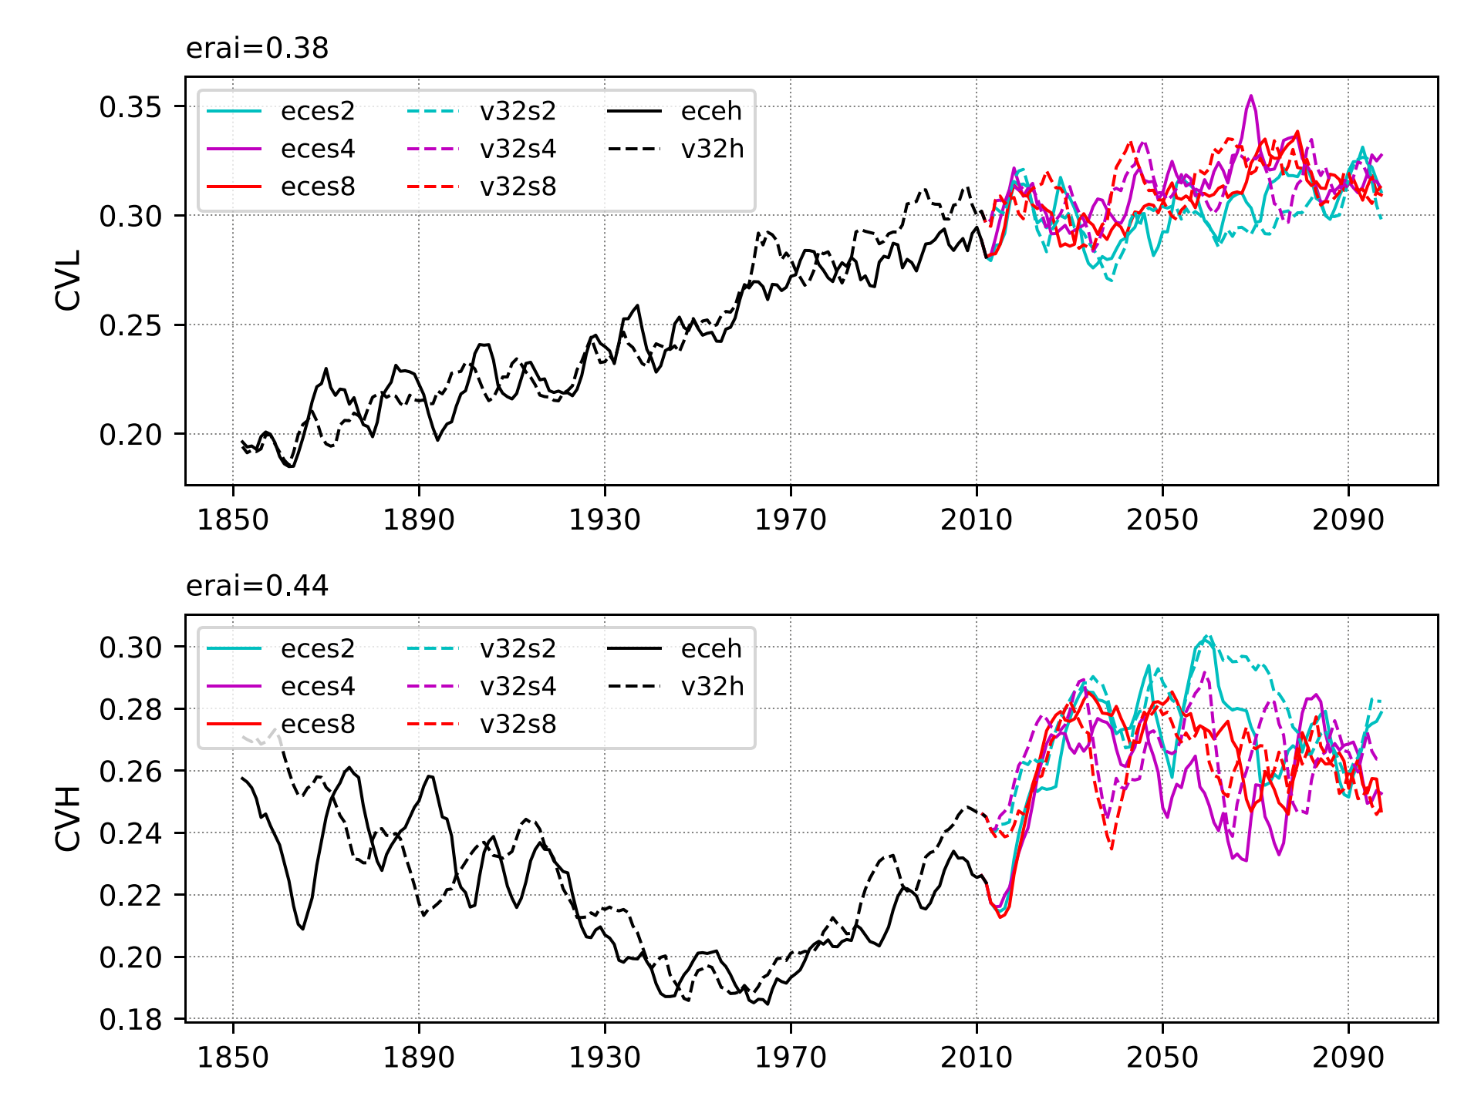
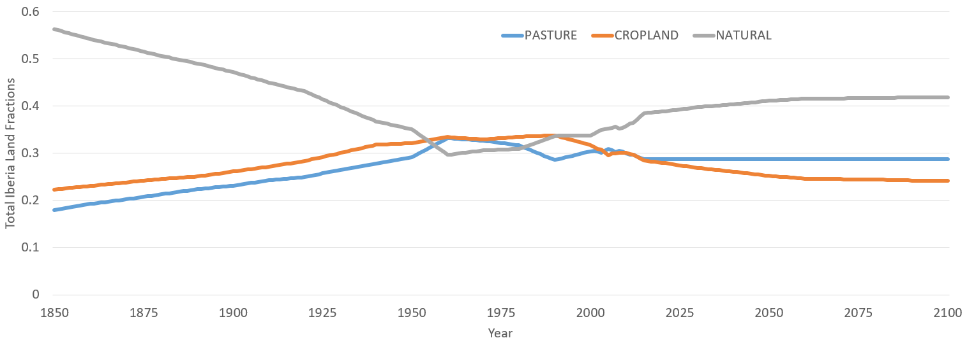
EC-EARTH3-veg- Vegetation evolution over Iberia
Annual mean evolution of low vegetation cover (CVL – top) and high vegetation cover (CVH-bottom) in CMIP6 simulations.
Historical simulations (black) have similar temporal evolution, as well as scenarios (colors). Only two ensemble members shown
Prescribed Land-use influences the vegetation evolution.

Slide 9
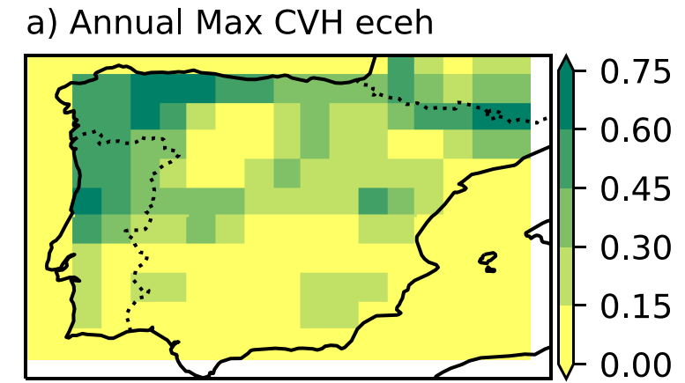
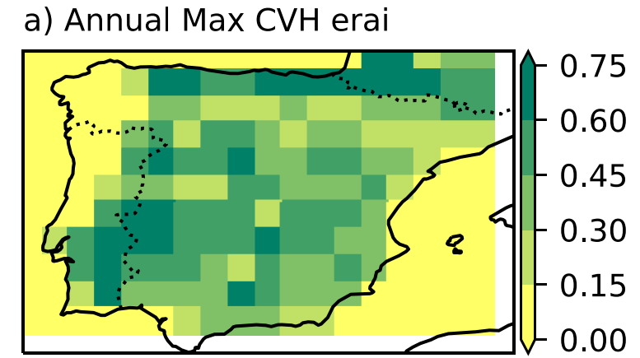
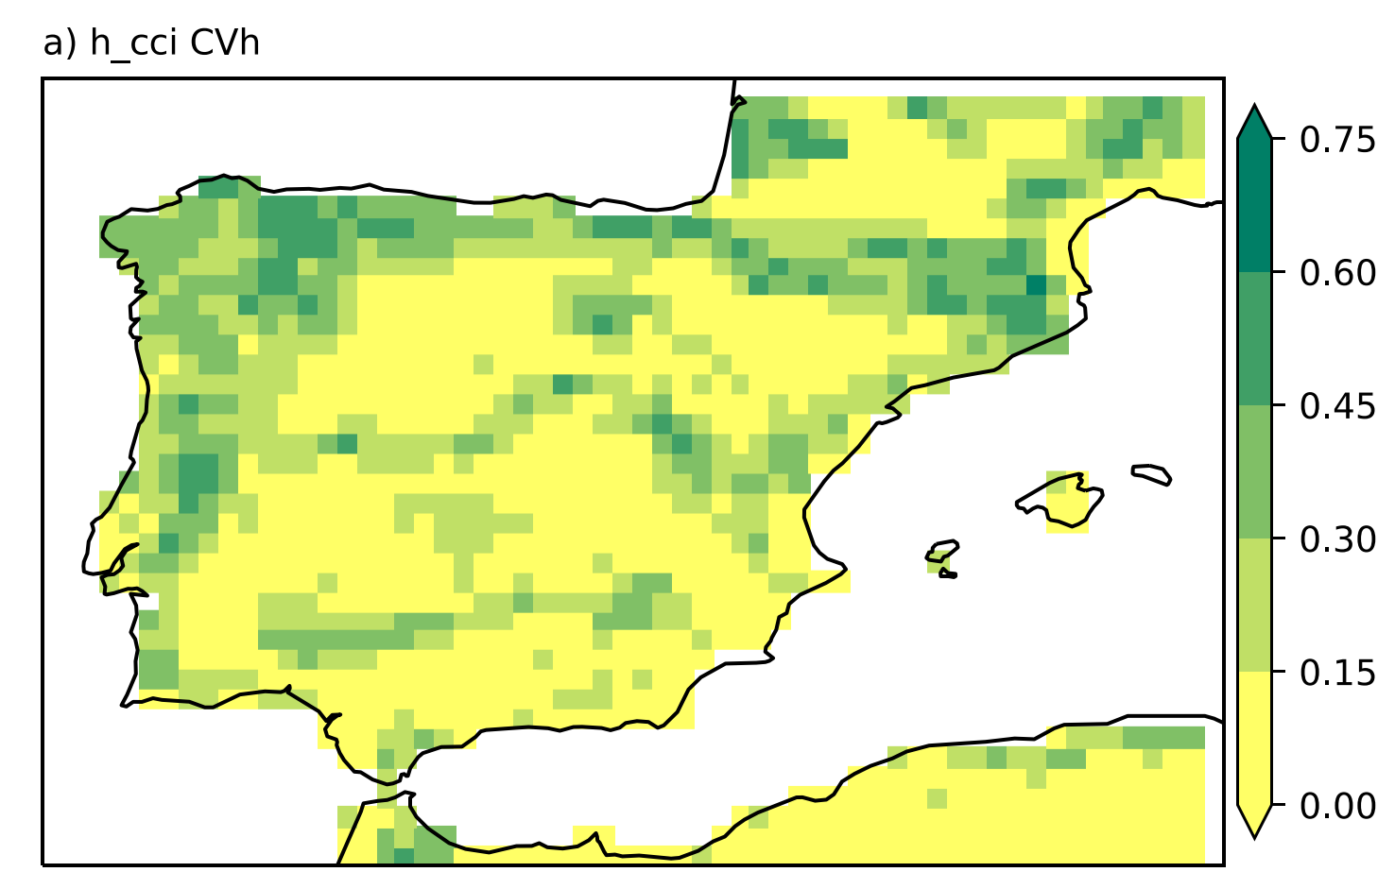
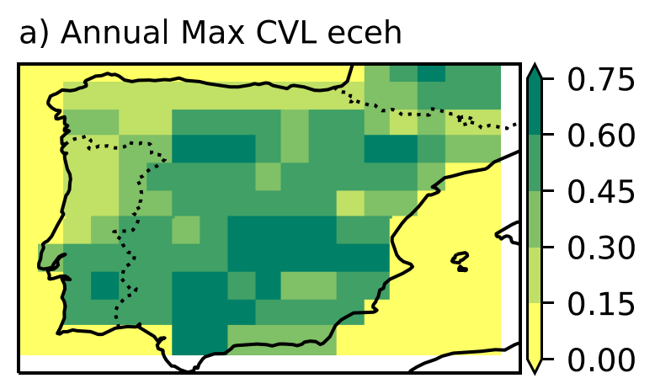
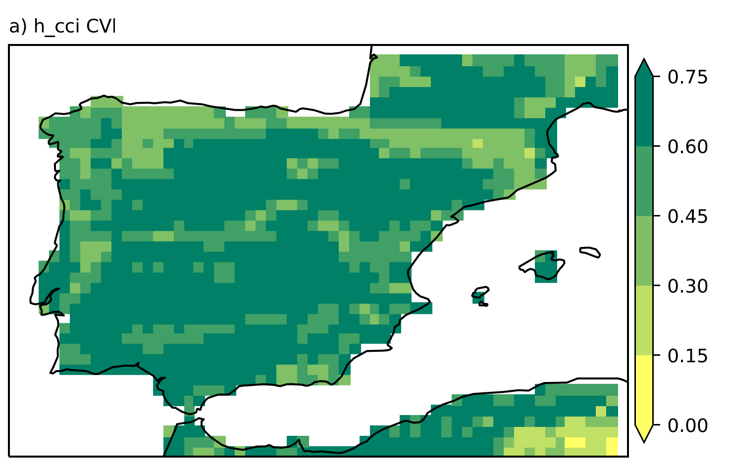
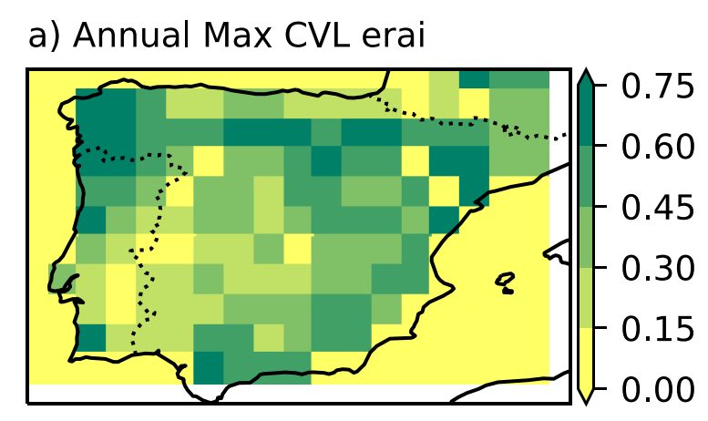
EC-EARTH3-veg: Mean vegetation
EC-EARTH3-Veg CMIP6
ESA-CCI
ERAI (&ERA5)
CVH
CVL
Annual maximum of CVH (top)/CVL (bottom) (last 10 years of historical simulations 2005-2014)
EC-EARTH3-Veg spatial patterns close to ESA-CCI;
ERAI/ERA5 CVL/CVH look like “swapped” – Explains the good results of the offline simulations;

Slide 10
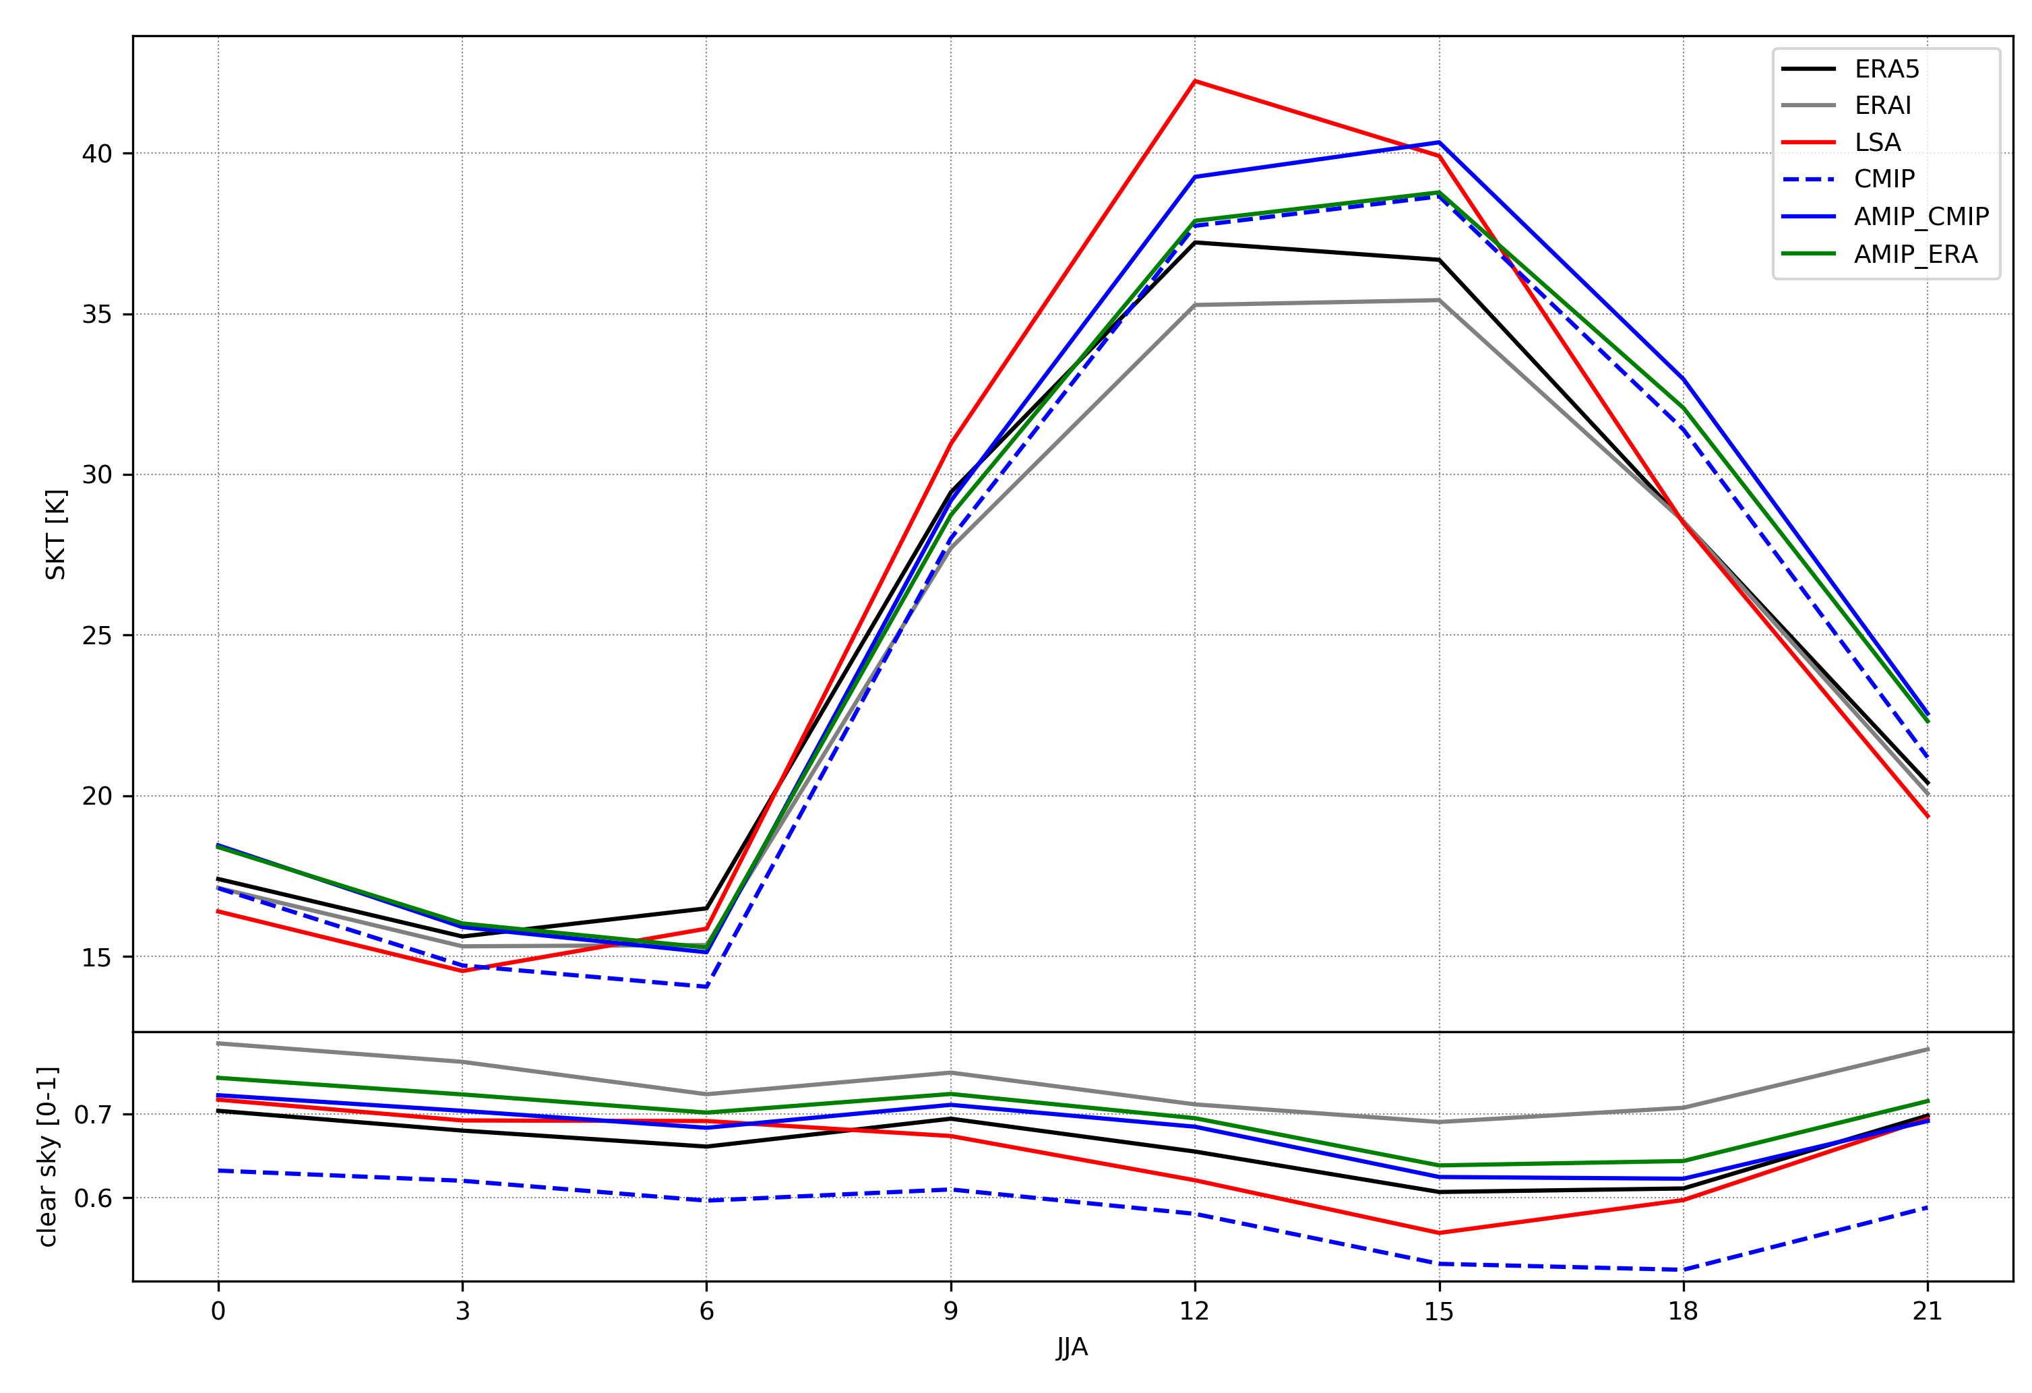
EC-EARTH3-Veg CMIP&AMIP LST
Mean diurnal cycle JJA averaged over Iberia
ERA5 ERAI Obs
CMIP(dashed) AMIP_CMIP
AMIP_ERA
3-hourly data mean diurnal cycle clear-sky conditions: TCC < 0.3 independently screened for each dataset ;
AMIP with CMIP vegetation (blue) warmer daytime LST when compared with AMIP with “ERA” vegetation (green)
CMIP simulation (dashed blue) systematically colder than AMIP_CMIP (1.5K) also nighttime. More cloud cover;
Away from offline constrained simulations, other confounding effects appear. Here the AMIP simulations help showing the benefit of the interactive vegetation in CMIP6.

Slide 11
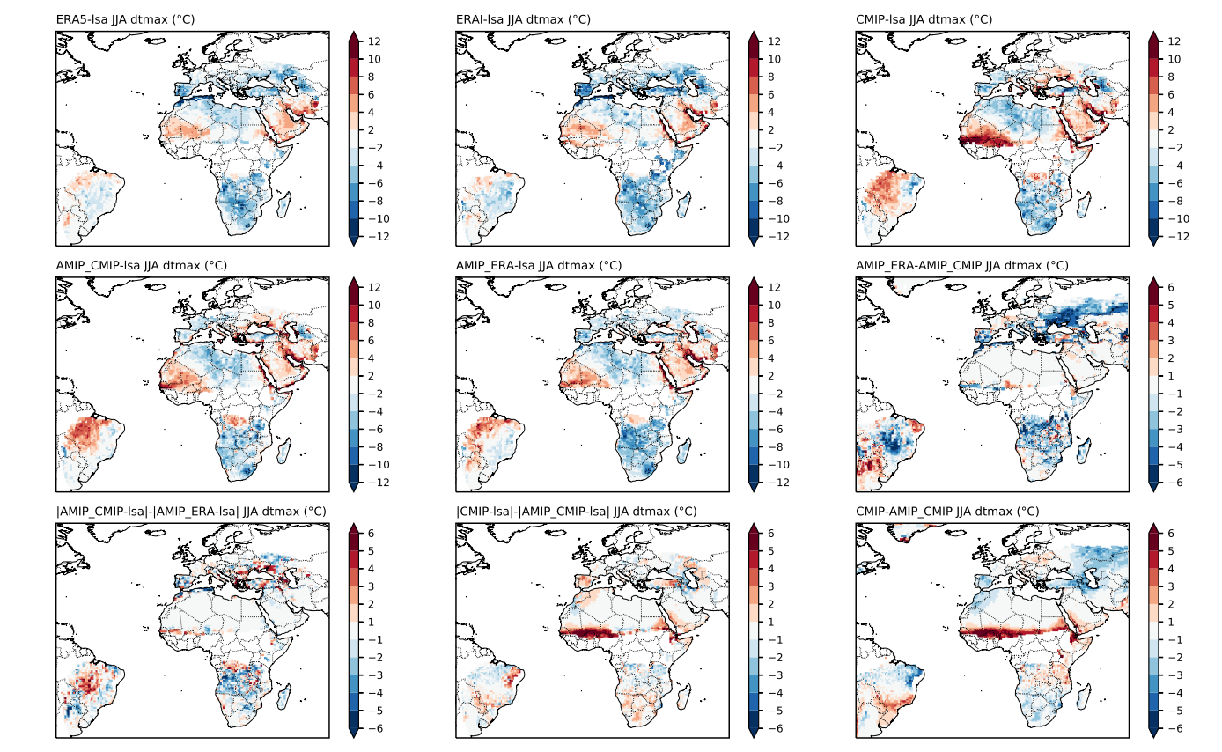
EC-EARTH3-Veg: JJA LSTmax
CMIP-OBS
AMIP_CMIP-OBS
AMIP_ERA-OBS
AMIP_ERA-AMIP_CMIP
|AMIP_CMIP-OBS|-|AMIP_ERA-OBS|
|CMIP|-|AMIP_CMIP-OBS|
“Similar error patterns between CMIP/AMIP and LSA-SAF
  West Africa, Arabian Peninsula, South East Brazil
AMIP with CMIP vegetation vs “ERA” vegetation: Shows bias reductions over Iberia (some other Mediterranean areas, South Africa)
CMIP is mostly worst than AMIP: Other biases (e.g. cloud cover in Iberia, ITCZ in West Africa)

Slide 12
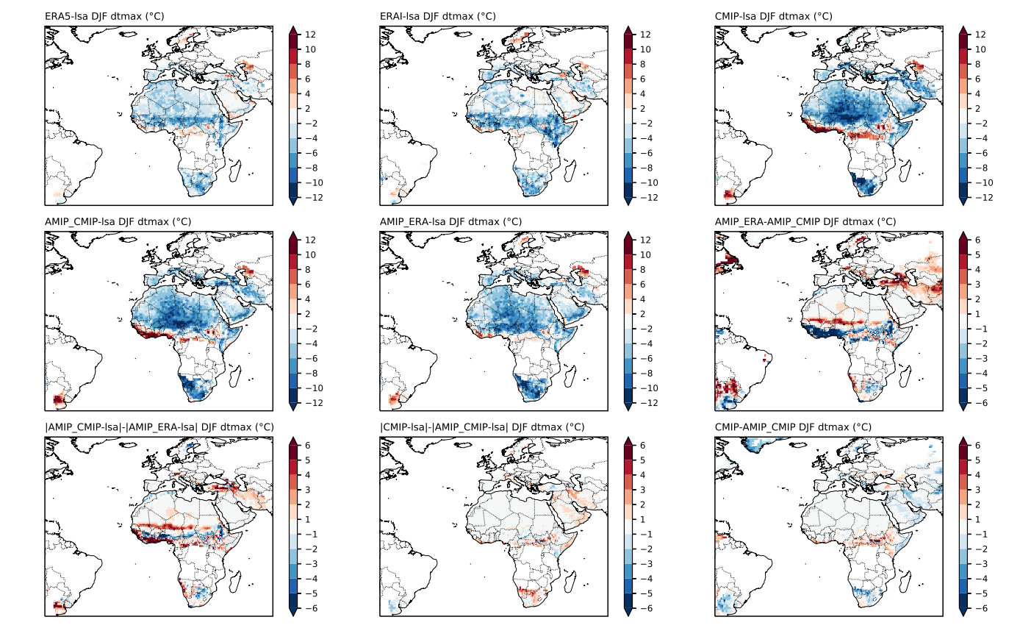
EC-EARTH3-Veg: DJF LSTmax
CMIP-OBS
AMIP_CMIP-OBS
AMIP_ERA-OBS
AMIP_ERA-AMIP_CMIP
|AMIP_CMIP-OBS|-|AMIP_ERA-OBS|
|CMIP|-|AMIP_CMIP-OBS|
Cold bias in CMIP & AMIP- (why?)
Small but negative impact of CMIP vegetation in AMIP simulations. Again ITCZ region is problematic: climate & vegetation feedback ? Cloud contamination / aerosols ?
How does the ECMWF model performs ?

Slide 13
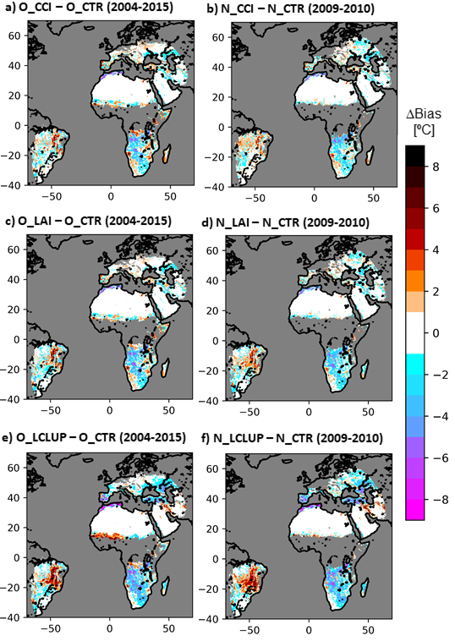
Offline vs. Atmospheric nudged (ECMWF IFS)
JJA LSTmax bias change in respect to Control between offline simulations (left panel) and Atmospheric nudged (1-year ) simulations
O_CCI / N_CCI : Updating to ESA-CCI land cover
O_LAI / N_LAI : … + CGLS LAI
O_LCLUP / N_LCLUP : … + Low vegetation seasonality (clumping)
1-year nudged vs 12 years offline validation: Similar biases changes patterns : Provides a strong confirmation of the offline setup to investigate LST (much cheaper computationally) ;
Benefits over Mediterranean, South Africa. Something suspicious over Brazil.
Despite many differences, similar patterns in EC-EARTH3-veg AMIP simulations;
And outside of the MSG disk ?

Slide 14
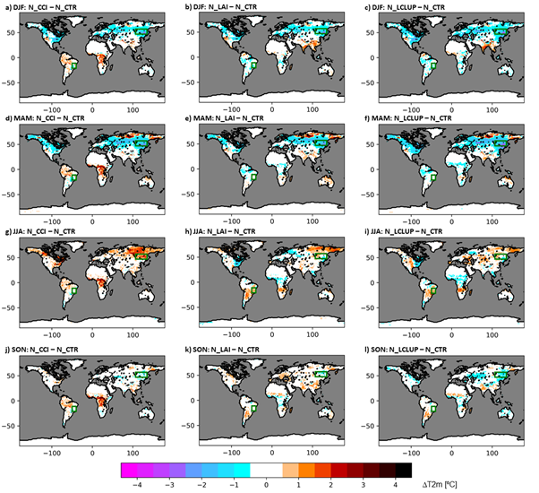
Beyond LST: T2m sensitivity in IFS nudged simulations
CCI-CTR
CCI+LAI-CTR
Clumping-CTR
T2M Sensitivity: experiment – control for each season
Large differences in areas/regions not seen before (outside of the MSG disk, cloud covered)
Winter/Spring cooling in Northern Forest regions : interaction of land-cover changes with shaded snow albedo
JJA warming in Iberia & South África : consistent with LST
Warming in South América consistent with detioratoin seen in LST.
DJF
MAM
JJA
SON

Slide 15
Final Remarks (1)
Land-cover in EC-EARTH / IFS and LST :
Focus over Iberia shows the positive impact on LST of updating land-cover and LAI in CHTESSEL/IFS (consistent with SURFEX, ECOCLIMAPII);
Similar (& independent) impact on EC-EARTH3-Veg climate model can be partially attributed to the coupling with the dynamical vegetation model LPJG;
Larger (& positive) signal on LSTmax, also in other Mediterranean regions and South África – Seen in offline, EC-EARTH3-Veg and IFS coupled nudging simulations;
Not all is perfect :
  Large errors in CMIP simulations (e.g. ITCZ);
  Some biases in Southern Brazil (land-cover related?)
  Large impact in Spring over Northern regions (interaction with snow albedo) ;
  LST Diurnal cycle shift (mostly numerical ?)

Slide 16

Final Remarks (2)
This work was driven by EO data: LST / land-cover / LAI;
  More effort required to use and prove the added value of these products in NWP and Climate modeling ;
Routine use of LST for model evaluation ? Can it guide model development ? YES
  Sampling of the diurnal cycle is essential;
  “Global” coverage;
  Product errors & uncertainties ;

