Slide 1
Regional and global trends in LST: A Stability Assessment of the LST_cci Products
Freya Aldred and Lizzie Good
Met Office Hadley Centre

Slide 2

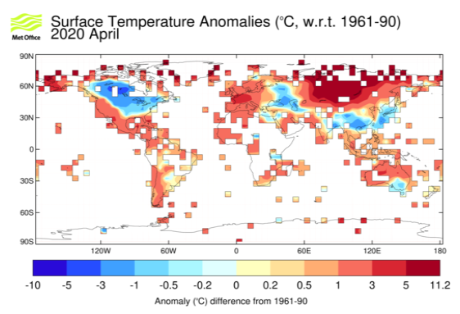
Motivation
Trends in 2m air temperature (T2m) are well established
  Obtained from network of weather stations – sparse in some regions
Satellite observed LST may be useful to complement T2m observations
  Independent information on changes in surface temperature
  To date hindered by lack of long term, stable LST climate data records
[https://www.metoffice.gov.uk/hadobs/crutem4/]

Slide 3
This Study
Aims:
Calculate global and regional trends using the LST_cci products
Compare with equivalent trends in T2m
This presentation:
Explore relationship between collocated LST_cci and T2m anomaly data​
Stability assessment of LST_cci data​
Preliminary look at trends in LST_cci data

Slide 4
The Data - LST
LST_cci InfraRed (IR) datasets:
Day and night overpasses for all IR instruments, time of overpass is different for each instrument, but it is stable within an instrument's lifetime
CDR contains ATSR-2 and AATSR data, with ATSR-2 overpass times corrected to AATSR overpass time, which is around 30 minutes different
Data are all at 0.05 degrees resolution
ERS-S ATSR-2 | August 1995 – June 2003
Envisat AATSR | July 2002 – April 2012
Terra MODIS | February 2000 – December 2018
Aqua MODIS | July 2002 – December 2018
Multi-sensor IR Climate Data Record (CDR) (ATSR series) | August 1995 – March 2012

Slide 5
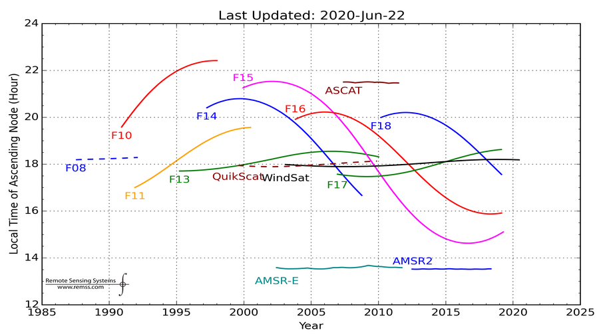
The Data - LST
LST_cci MicroWave (MW) datasets:
Multi-sensor MW CDR (SSMI/SSMIS) | January 1995 – December 2018
MW instruments are classified by ascending and descending orbits
The overpass time drifts throughout operational lifetime
The light blue box indicates the time range of data used
Data from F-13, F-17 and F-18 are included in the dataset
Data are all at 0.25 degrees resolution
[http://www.remss.com/support/crossing-times/]

Slide 6
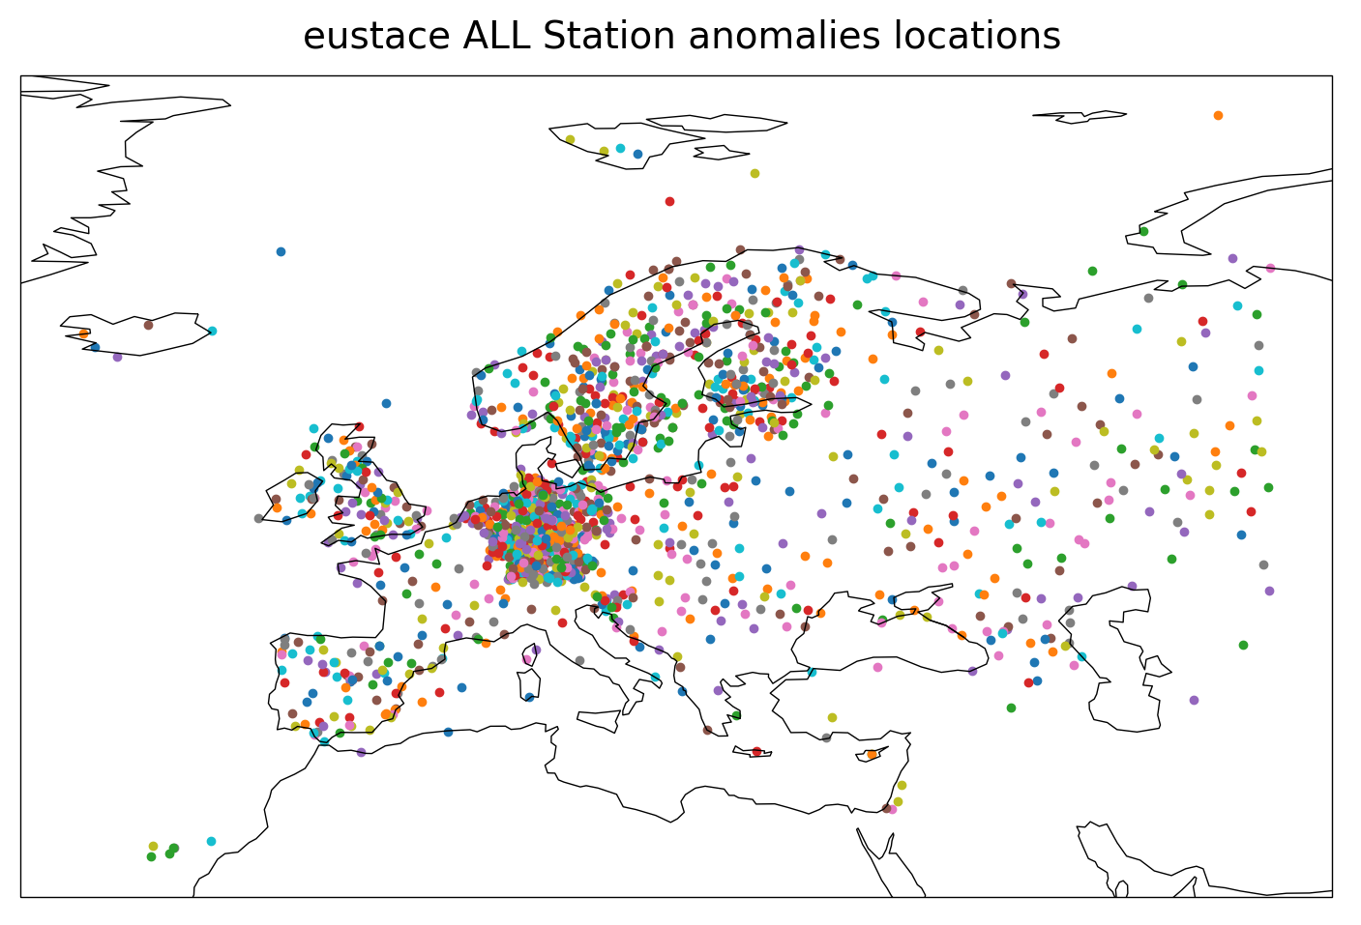
The Data – T2m
EU Surface Temperature for All Corners of Earth (EUSTACE) homogenised station 2m air temperature (T2m) data
Homogenised time series of daily temperature observations for meteorological stations throughout Europe and the Mediterranean
  Corrected to remove non-climatic discontinuities such as those from a change in station location
Based on the European Climate Assessment & Dataset (ECA&D) daily dataset
Tmin, Tmean and Tmax for each station
Very high density of stations in Germany
[https://catalogue.ceda.ac.uk/uuid/81784e3642bd465aa69c7fd40ffe1b1b]

Slide 7
Data Processing
Gridded LST products are spatially co-located with EUSTACE station locations
Tmin, Tmax and Tmean time series are created with the T2m and LSTmin, LSTmax, LSTmean time series created with LST data
LSTmax is extracted from the daytime overpass and LSTmin from the night time overpass, LSTmean is then calculated as the mean of these two values
FOR MW data, the descending overpass (~6-8 am) is matched with Tmax and the ascending overpass (~6-8 pm) is matched to Tmin
  Likely move to focusing on LSTmean / Tmean data

Slide 8
Anomaly Calculations
Climatologies (baseline climate conditions)
  Calculated for LST and T2m separately
  For each station location
  For each satellite time period (for LST and T2m so they are equivalent)
  Based on a 31 day moving mean window calculated each calendar day of the year (this is to ensure a sufficient data pool and smoothing)
Anomalies
  The median climatology is subtracted from the station data to calculate the anomalies:
LST_{anom} = LST_{observed} – LST_{climatology}
T2m_{anom} = T2m_{observed} – T2m_{climatology}

Slide 9
Relationship Between
LST and T2m Anomalies at Each Station Location

Slide 10
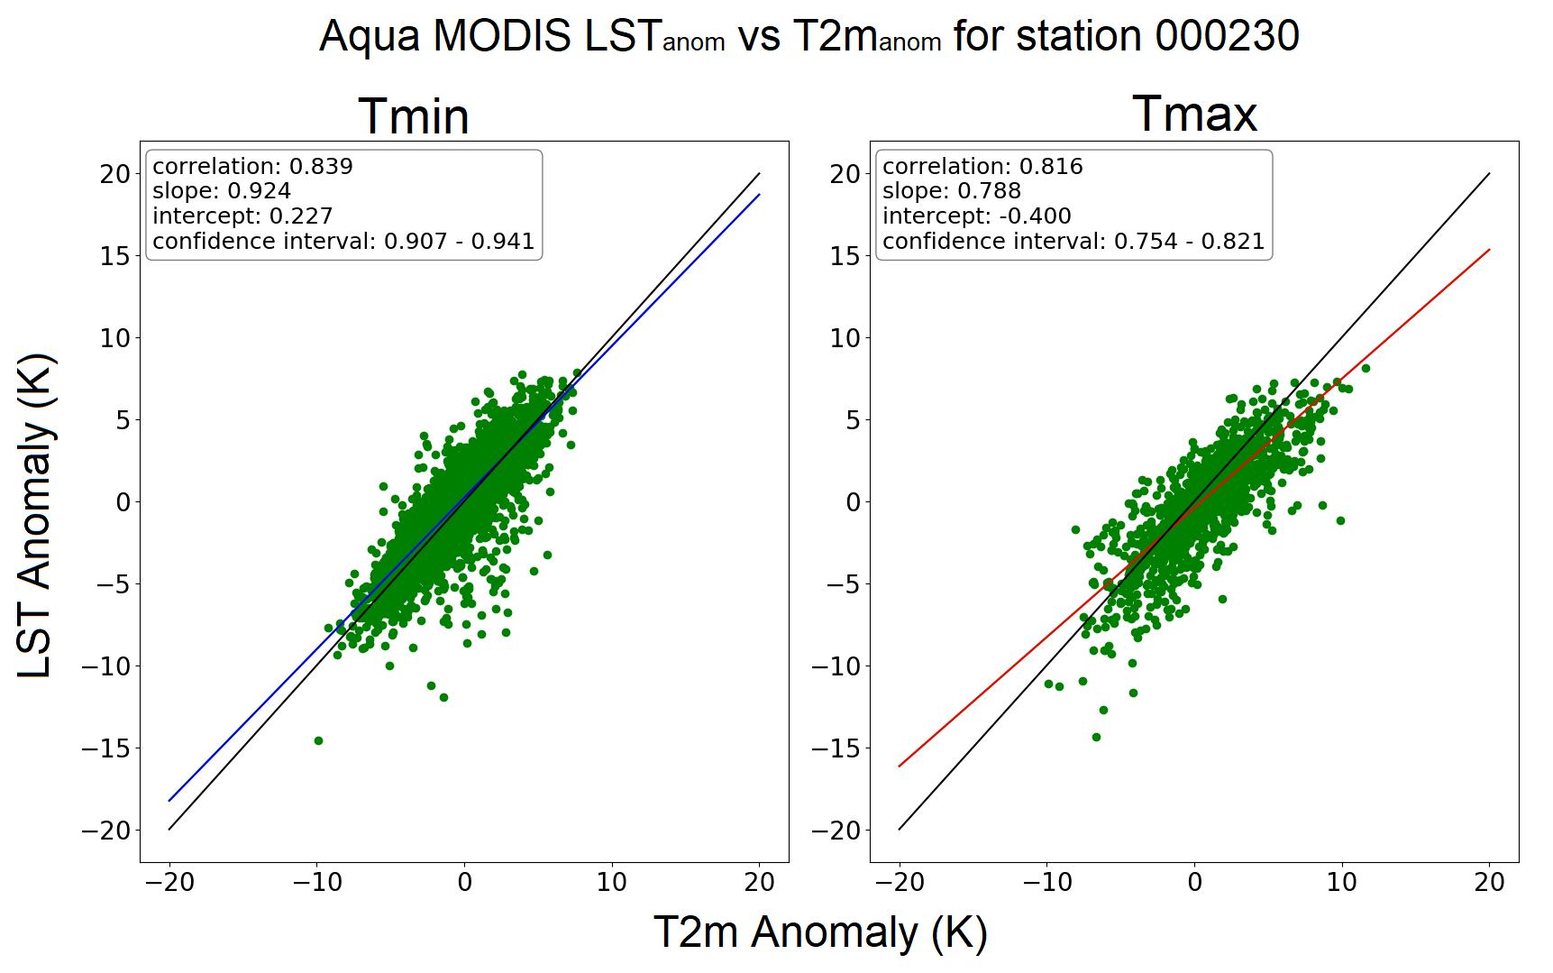
LST_{anom} vs T2m_{anom}
Example relationship between LST_{anom} and T2m_{anom} for Aqua MODIS
A perfect relationship would have a correlation r value of 1, the slope of the best fit line would be 1, and the intercept would be 0
Correlation is the r value
Slope refers to the slope of the best fit line of the relationship
Intercept is the intercept of this line

Slide 11
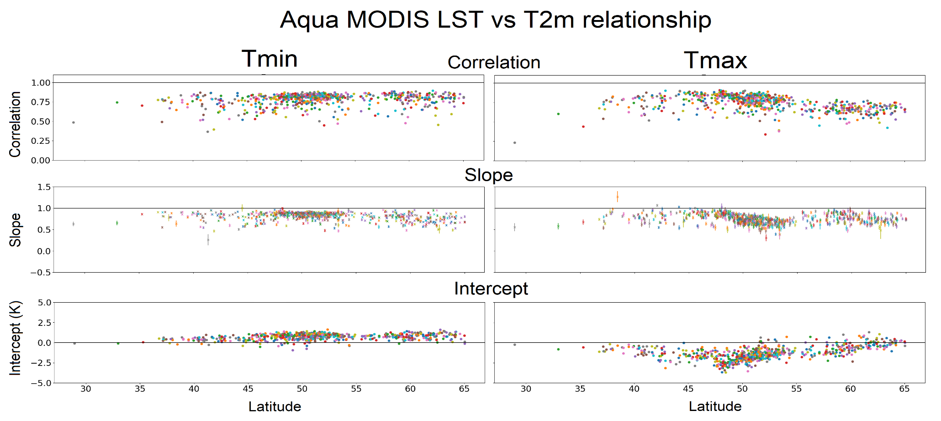
Anomaly Relationship
- MODIS
Both MODIS instruments have correlation values with T2m around 0.8, which decreases at higher latitudes during the day
LST vs T2m slope around 0.8
Intercept generally around 1 K at night, -2 to -1 K in the day, which becomes more positive with increasing latitude

Slide 12
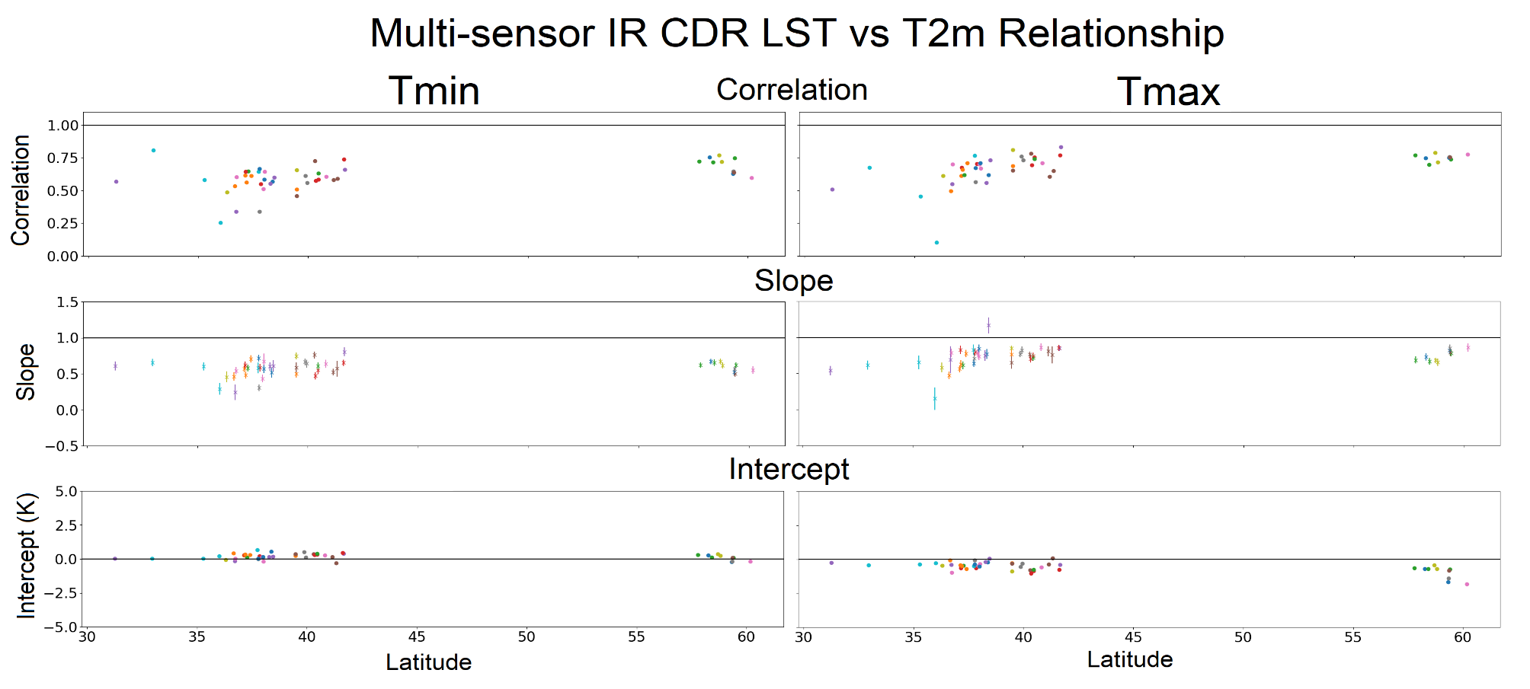
Anomaly Relationship
- ATSR Instruments
For the ATSR data sets there are very few data points
Correlations and relationship slopes are lower, around 0.6 – 0.7 and 0.5 – 0.7 respectively

Slide 13
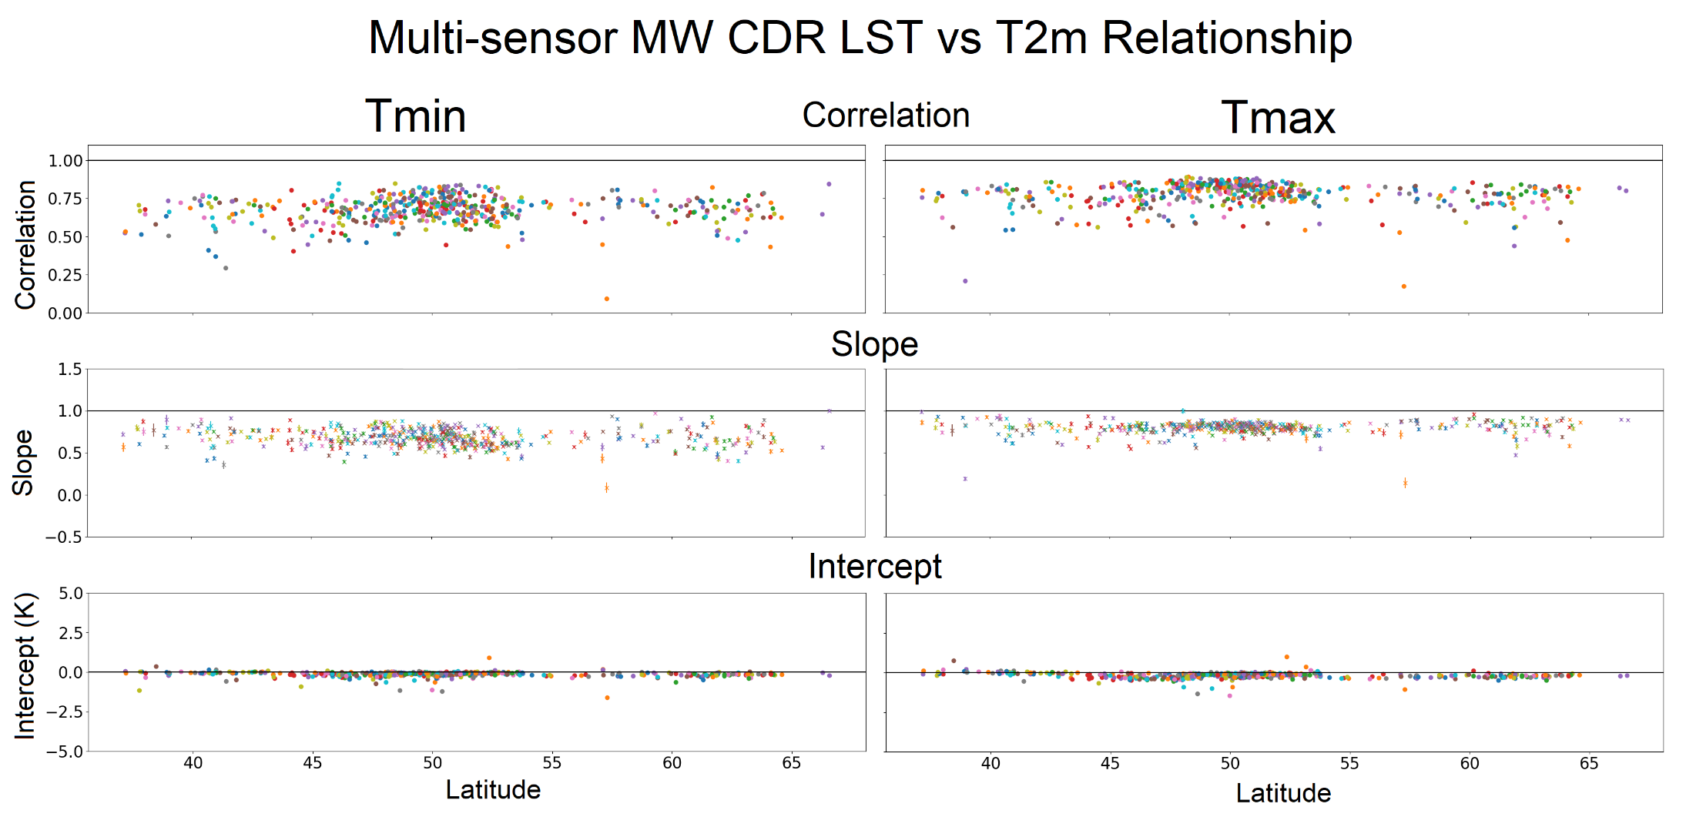
Anomaly Relationship
- Multi-sensor MW CDR
Similar results are found for the MW LST product to MODIS
Slopes and intercepts are more stable with latitude
Intercepts are nearly all negative

Slide 14
Stability Analysis

Slide 15
Stability Analysis
- Method
Observations are only used where both LST and T2m anomalies are available
  The high density of stations found in Germany in the EUSTACE dataset is reflected in the anomaly match ups for MODIS instruments and the MW product
  There are very few match ups for the ATSR instruments, partially because very few station locations have enough data to create the climatologies
Monthly mean anomalies are calculated for LST and T2m
These are spatially averaged in different ways e.g. over all of Europe, for each country, and for data in 5 degree latitude bands
Differences are calculated as:
Difference_{anom} = LST_{anom} – T2m_{anom}

Slide 16
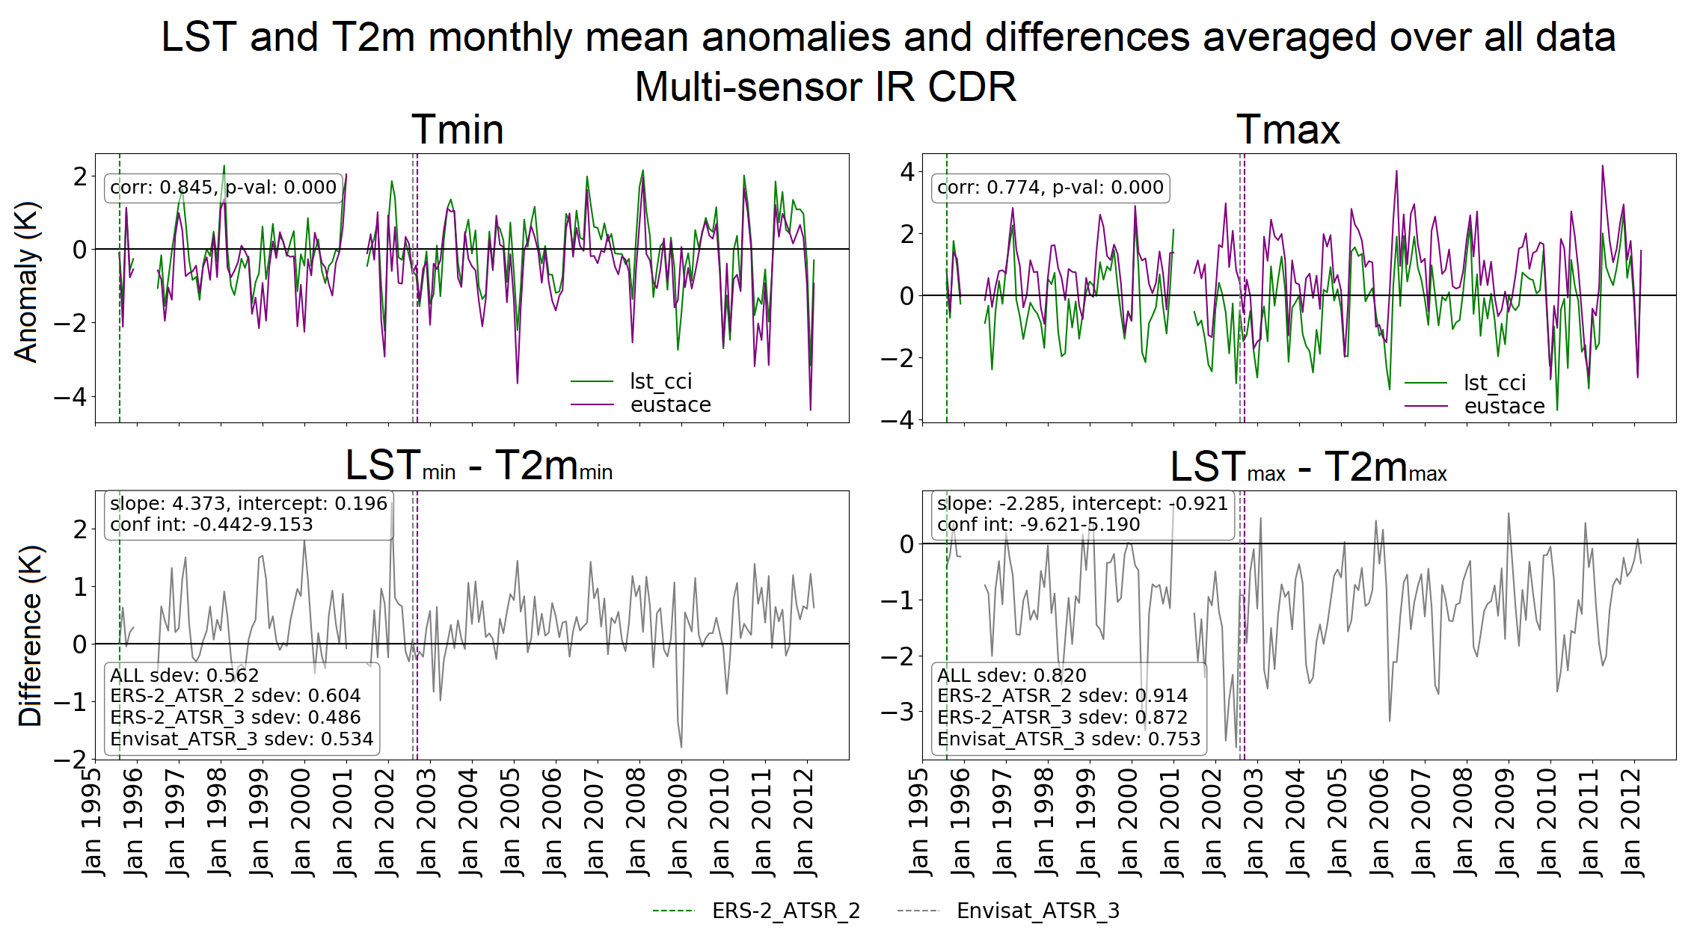
Anomaly Differences
- Multi-sensor IR CDR
LST and T2m follow same shape in monthly means
Correlation in monthly means higher for Tmin
ERS-2 and Envisat display different pattern in differences
  Visually obvious for Tmin
  Standard deviation is higher for ERS2 than Envisat (note ERS2 is corrected to Envisat overpass time)
Suggests data is not free from non-climatic effects and cannot be used for trend analysis

Slide 17
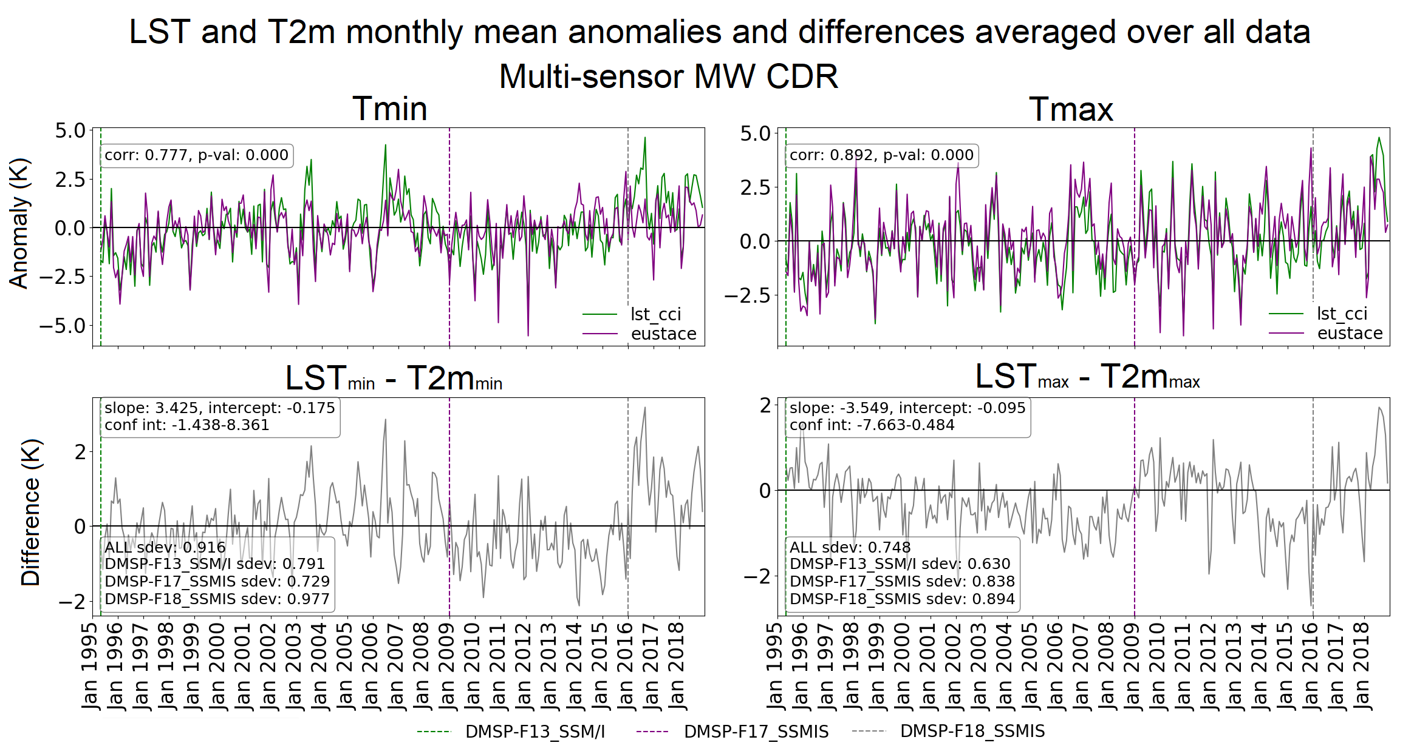
Anomaly Differences
- Multi-sensor MW CDR
LST and T2m monthly means generally have a very similar shape
Evidence of sensor drift in differences
Difference plots show different characteristics for each sensor
  It is clear where the sensor changes happen in the dataset visually
  Standard deviations vary for each sensor
Suggests dataset is not free from non-climatic effects and cannot be used for trend analysis

Slide 18
Preliminary Look at Trends

Slide 19
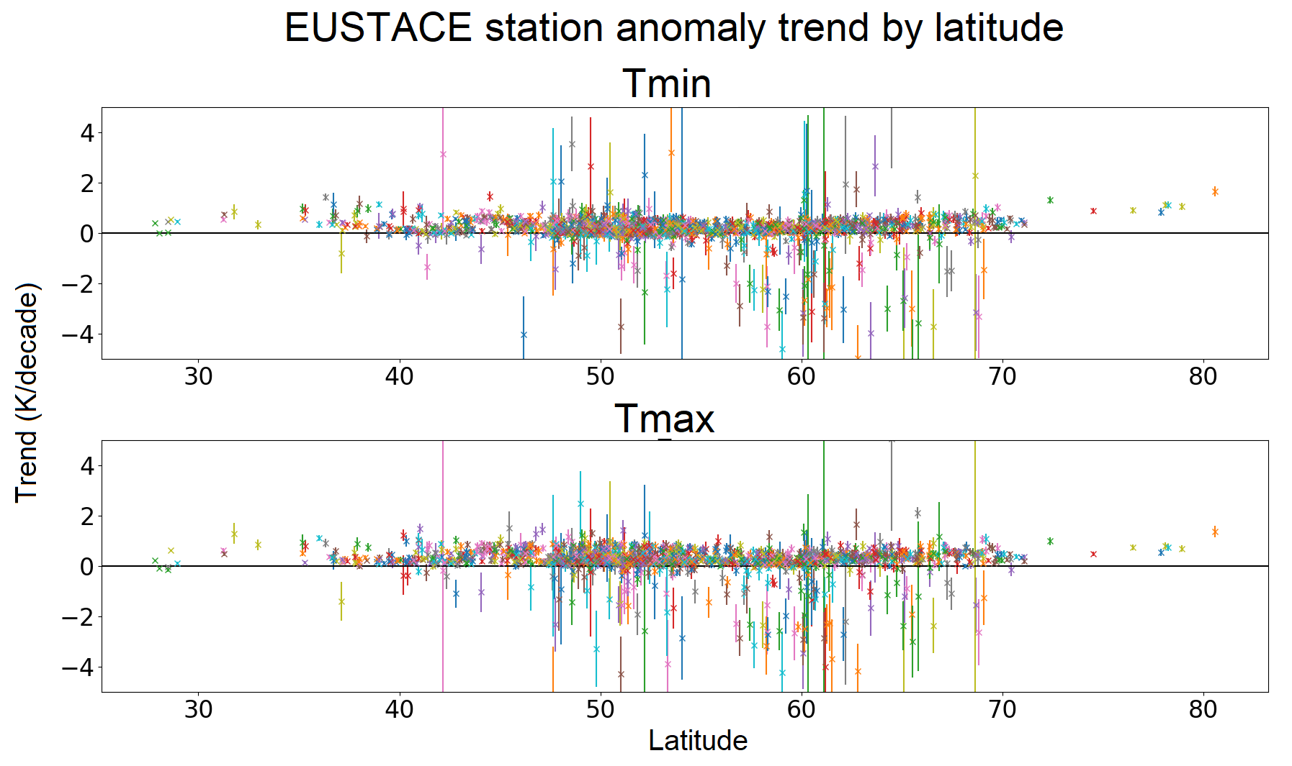
Anomaly Trends
- EUSTACE T2m
Most stations have positive trends between 0 and 1 K / decade
95% confidence intervals are mostly narrow and do not cross zero – these trends are statistically significant
Some stations are distinct outliers and have much wider confidence intervals

Slide 20
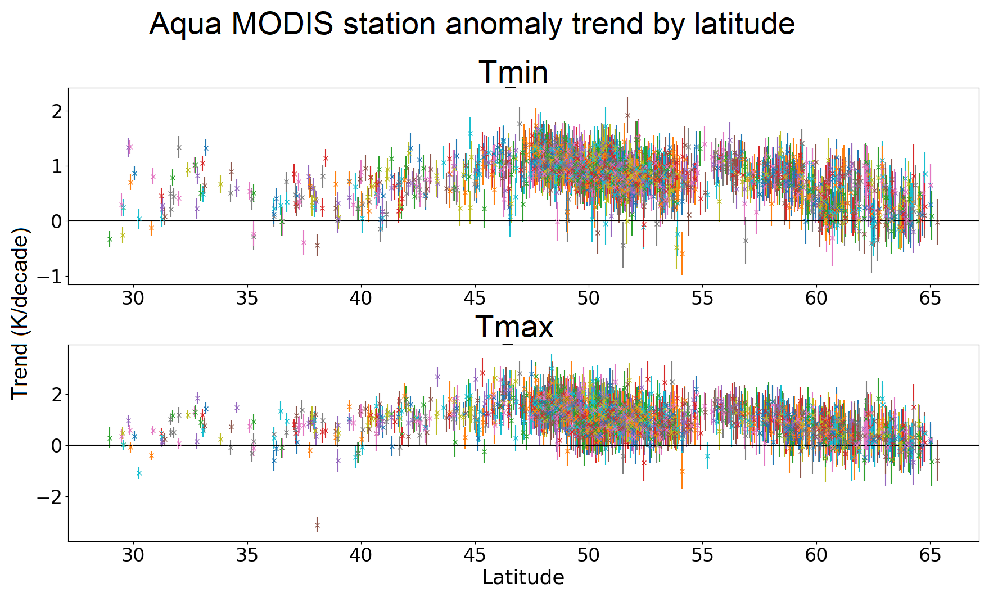
Anomaly Trends
- LST_cci MODIS
Trends are between 0 and 2 K / decade - larger than the T2m trends
Confidence intervals around 0.5 – 1 K / decade and generally don’t cross zero
Trends approach zero towards higher latitudes
Similar results for Terra

Slide 21
Summary
Generally good correlation between LST and T2m anomalies​
  Encouraging in terms of quality of LST_cci data sets and for the use of LST to complement T2m analyses​
Multi-sensor products show non-climatic discontinuities between different sensors, and drift in MW data
  We know IR CDR beta release has only been partly homogenised; the first official release will be much improved in this respect
  We also know work is ongoing to look at drift in the MW LST data
  The current versions cannot be used for trend analysis
Preliminary trend analysis of MODIS LST_cci data set looks promising​
  Generally similar trends in LST and T2m anomalies

