Slide 1
BAMS State of the Climate
Overview of “Global Climate” Chapter
Robert Dunn
https://www.ametsoc.org/ams/index.cfm/publications/bulletin-of-the-american-meteorological-society-bams/state-of-the-climate/

Slide 2
What is the “State of the Climate”
Peer reviewed report, published by BAMS
Coordinated by NOAA-NCEI
Each chapter has its own editor (team)
  I lead Chapter 2 – “Global Climate”
Aims to provide an authoritative, observation driven view on the previous calendar year
  Of course, for southern-hemisphere regions and phenomena allowances are made
Usually published around July
  Much later than e.g. WMO statement, or C3S monitoring statements
  Much broader in scope

Slide 3
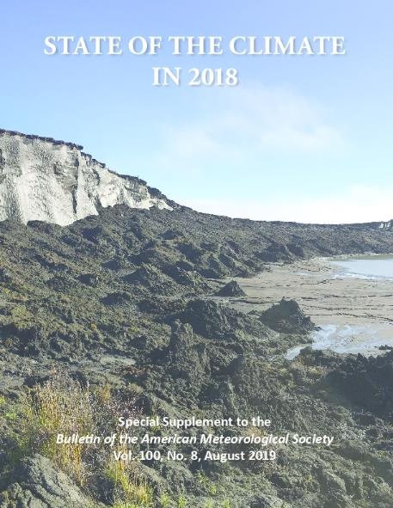
SotC remit
Many scientists from many disciplines from around the world fit the pieces of Earth’s climate system and its changes together to connect the dots
Dozens of essential climate indicators, extreme weather and climate events, historical context
This report does not pursue “attribution” or contain forecasts, scenarios, or projections
Chapters on Global Climate, Oceans, The Tropics, The Arctic, Antarctica, & Regional Climates
Peer reviewed, observation based and authoritative on what happened in the climate during the past year.

Slide 4
State of the Climate (SotC) 2019
The process:
  Early November 2019 – first editor teleconference
  Authors and reviewers contacted
  First draft – mid-February 2020
  Internal reviews – early March
  External reviews – April/May.
    Handled by the Bulletin of the American Meteorological Association (BAMS)
  Final submission June
  Publication by BAMS – July/August
COVID-19 has impacted some colleagues, but remarkably we’re on time!
We’re here – provisionally accepted!

Slide 5
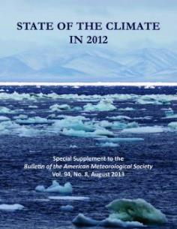
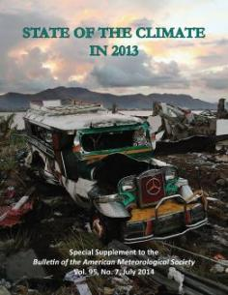
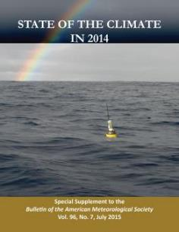
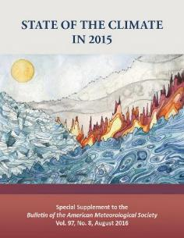
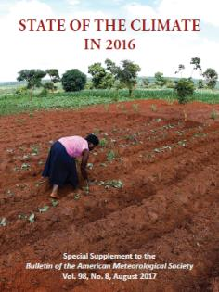
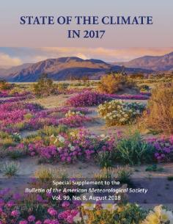
SotC Ch2 in numbers
This year’s report is the 30th
Chapter 2 – Global Climate has:
  30,000 words
  175 authors
  75 figures
  7 domains covering 39 observables
    Temperature
    Cryosphere
    Hydrological Cycle
    Atmospheric Circulation
    Radiation
    Atmospheric Composition
    Land Surface Properties

Slide 6
Chapter 2 – Global Climate
We ask authors to place the “current” year in context
Many show a global anomalies map for the year
  These are collected at the front of the Chapter in a Plate.
Many show timeseries or Hovmüller plots for the temporal behaviour
  Images of specific events or conditions are also included.
We ask for as many products to be included as possible
  In-situ, reanalyses, satellite & model (if appropriate)
  Uncertainties where possible (reviewers regularly ask for these!)
As well as established sections, we have “Sidebars”
  Slightly longer pieces to introduce a new variable or highlight a specific event.

Slide 7
SotC 2019
Although the chapter has been provisionally accepted, the report has not been published yet (23/6/2020)
Hence I will show you 2018’s plots and results for a flavour of what it contains
  Stronger focus on the temperature section but other highlights as well.

Slide 8
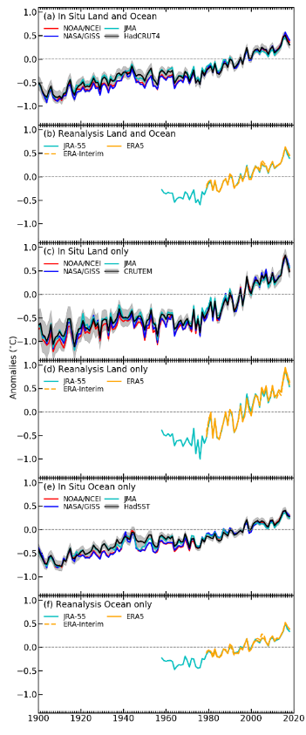
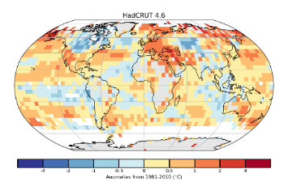
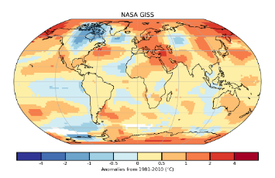
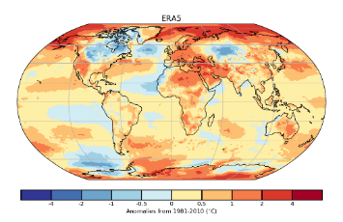
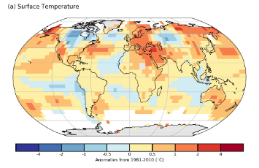
Temperature
Surface Air Temperature
2018 was the 4th warmest after 2016, 2015 & 2017
  Also for land and ocean separately
Every year since 2000 has been above the 1981-2010 average.
Some regions were cooler, but do not dominate the global signal

Slide 9
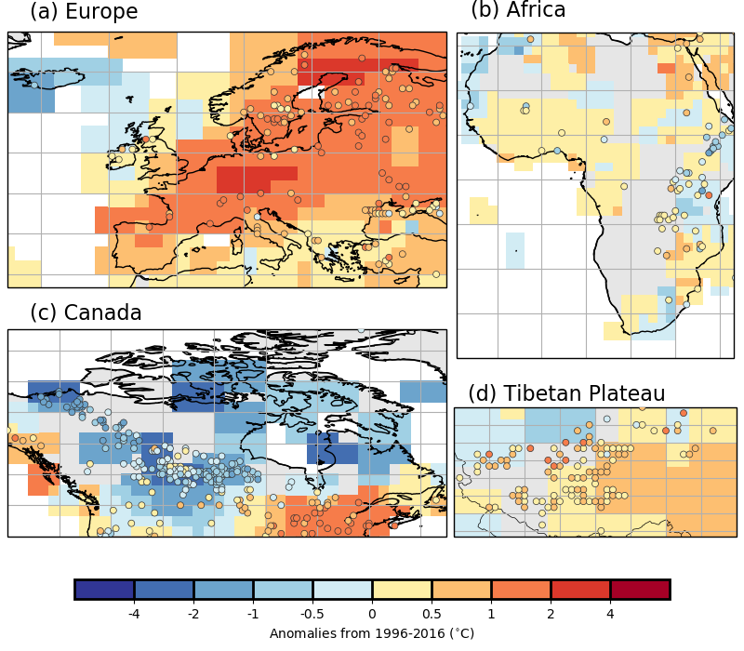
Temperature
Lake Temperature
Satellite derived lake temperatures
Warming trend has continued
  0.27°C per decade
In 2018
  60% show above average temperatures
  40% show below average temperatures

Slide 10
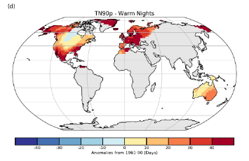
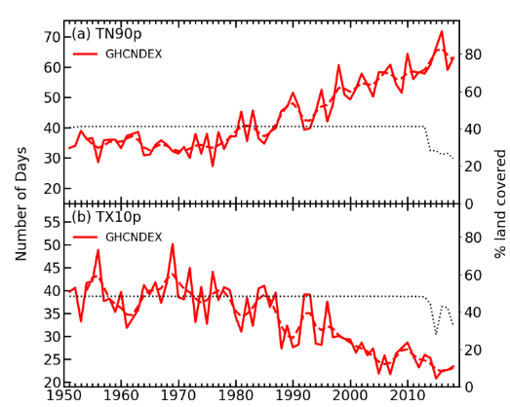
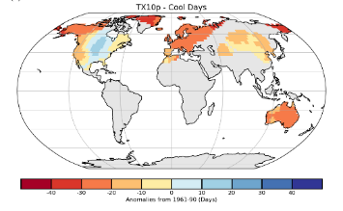
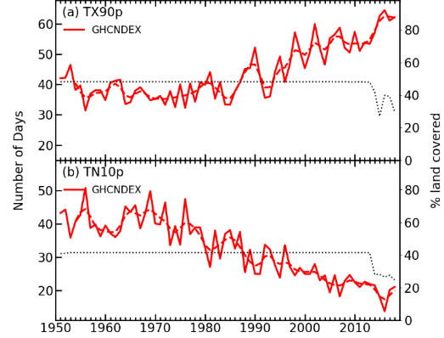
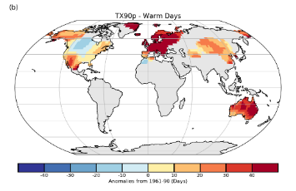
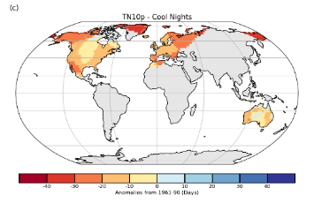
Temperature
Warm nights
Temperature Extremes
Cool days
More frequent warm extremes
  Warm weather in Europe, US &
  East Asia
  New records in Japan, Canada &
  Algeria)
Less frequent cool extremes
  New record low daily March Tmax in UK
  Cool autumn in eastern US
Warm days
Cool nights

Slide 11
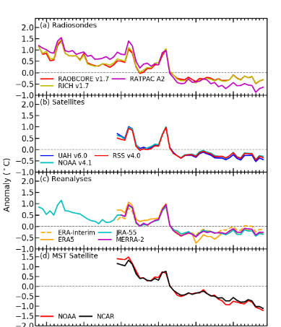
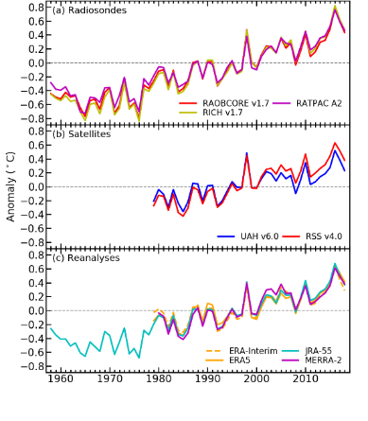
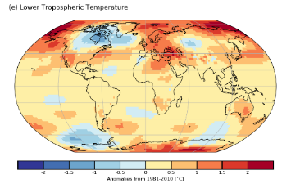
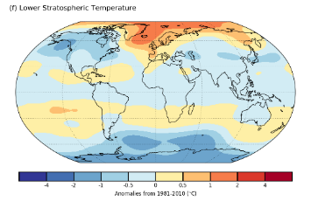
Temperature
Atmospheric Temperature
Stratosphere
Lower troposphere 3rd to 7th warmest in 2018
  Also land and ocean separately
More regions experienced highest monthly temperature than the lowest
Stratospheric temperatures were around 5th coldest
Troposphere

Slide 12
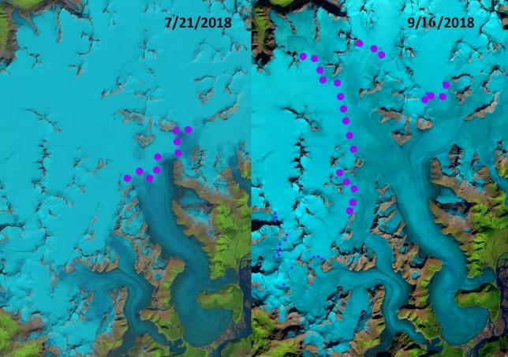
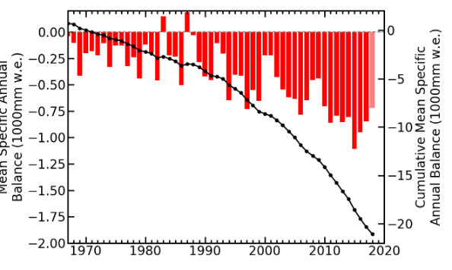
Cryosphere
Snow line July (975m) versus September (1400m, highest in 73 year record). [Taku, Alaska]
Glaciers
Mean annual glacier mass balance from all 142 monitored glaciers was 951mm in 2018
Cumulative mass balance from 1980 to 2018 was -21.7m (water equivalent)
The equivalent of taking 24m off the top surface of an average glacier

Slide 13
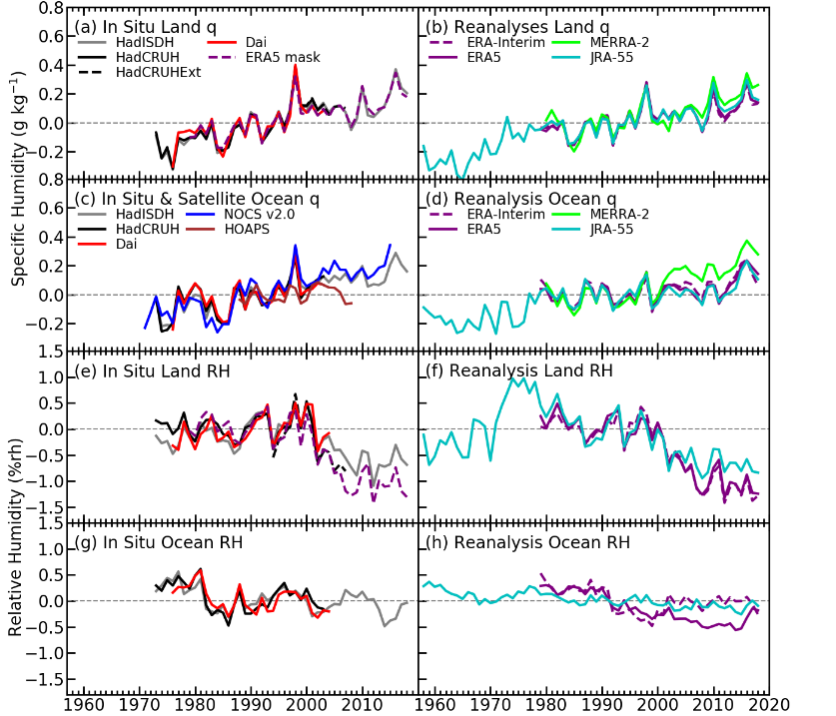
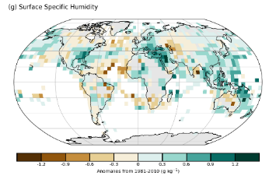
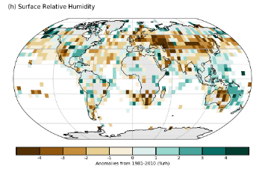
Hydrological Cycle
Surface Humidity
Specific humidity (g/kg) lower than 2016 peak but still higher than average
  Also land and ocean separately
Relative humidity (%) lower than average over land
  But close to average over oceans

Slide 14
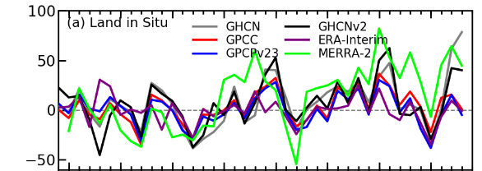
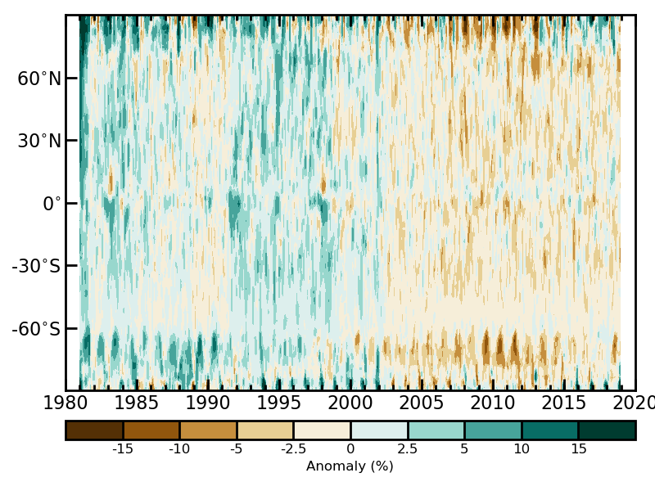
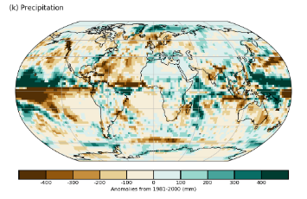
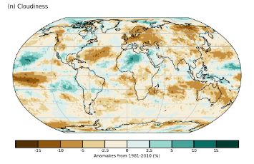
Hydrological Cycle
Rainfall
Rain and clouds
Wide range of estimates of global precipitation, depending on product used
  Cluster around normal, and a cluster much wetter (~50mm)
2018 fractionally cloudier than 2017
  Changes in instruments and few early records are likely cause of different behaviour prior to ~2000
Clouds

Slide 15
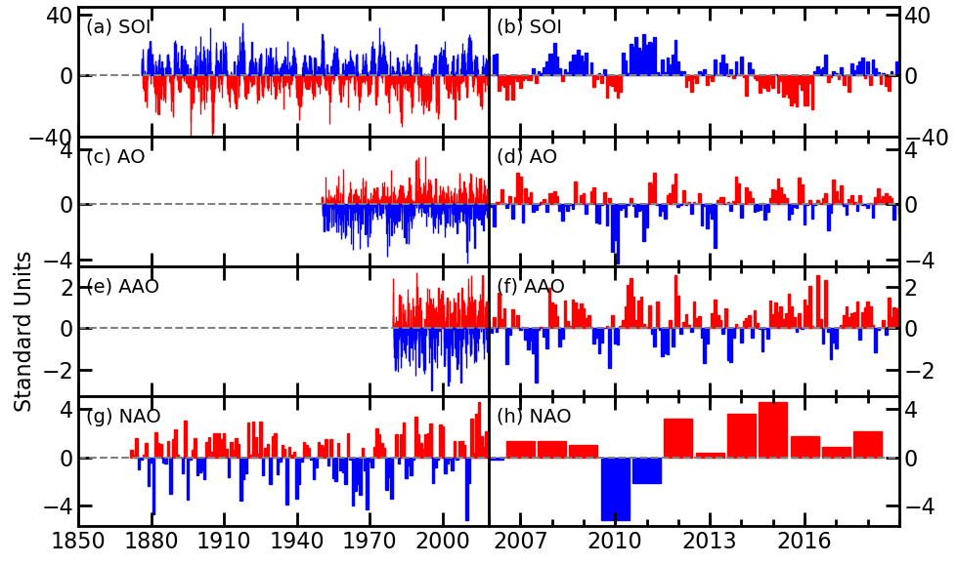
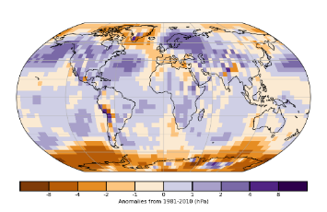
Atmospheric Circulation
Modes of variability
ENSO on average neutral
Hence cooler/drier than 2016
Oceanic ENSO measures showed an El Niño starting during the summer
  Atmospheric measures only followed in the winter

Slide 16
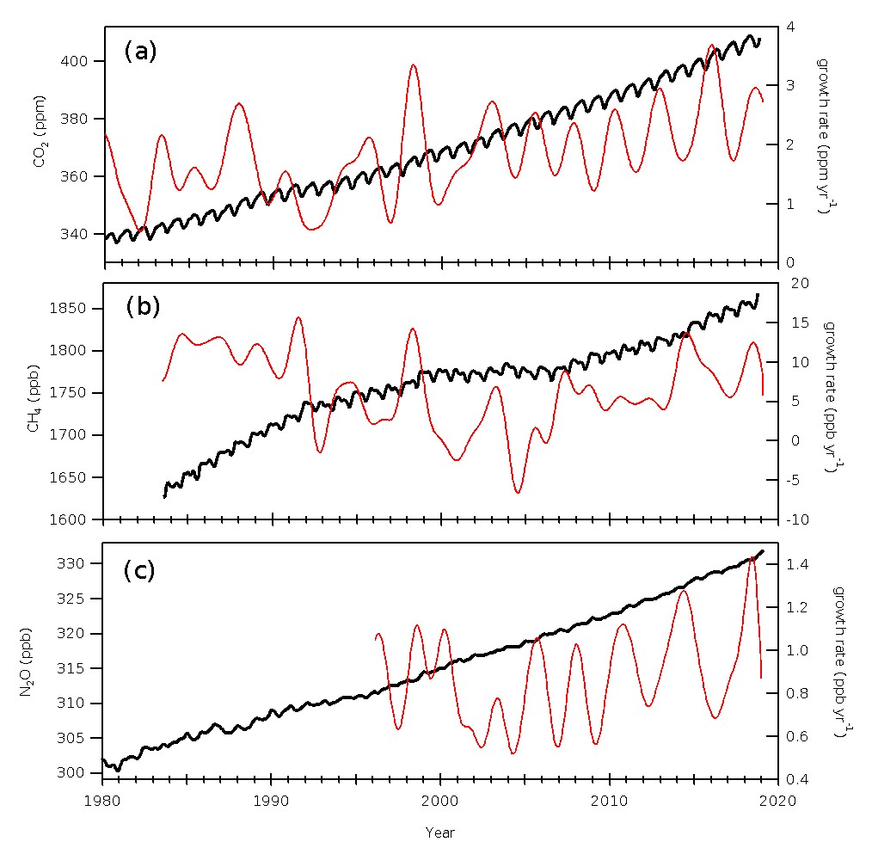
Atmospheric Composition
GHGs
Main drivers of anthropogenic climate change – CO₂, CH₄, N₂O
In 2018, CO₂ concentrations reached 408.5ppm at Mauna Loa
  compared to 315ppm in 1958
  And 278ppm in 1750
Methane reached 1858ppb
Nitrous Oxide reached 330.0ppb

Slide 17
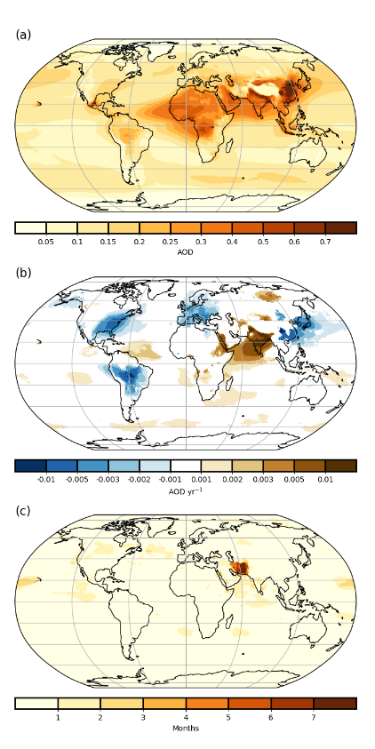
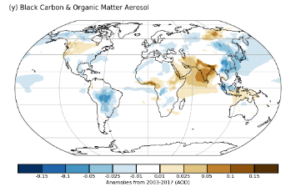
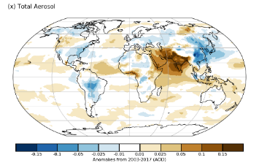
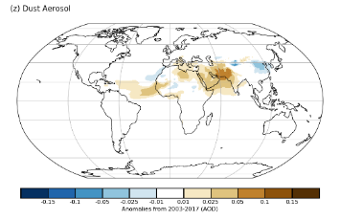
Atmospheric Composition
Total Aerosols
Aerosols
Aerosols affect short- and long-wave radiation as well as cloud properties, and human health
Seasonality from desert dust and biomass burning
Extreme aerosol loading over Iran and Pakistan from dust storms between April and June
Aerosol Trends
Extreme

Slide 18
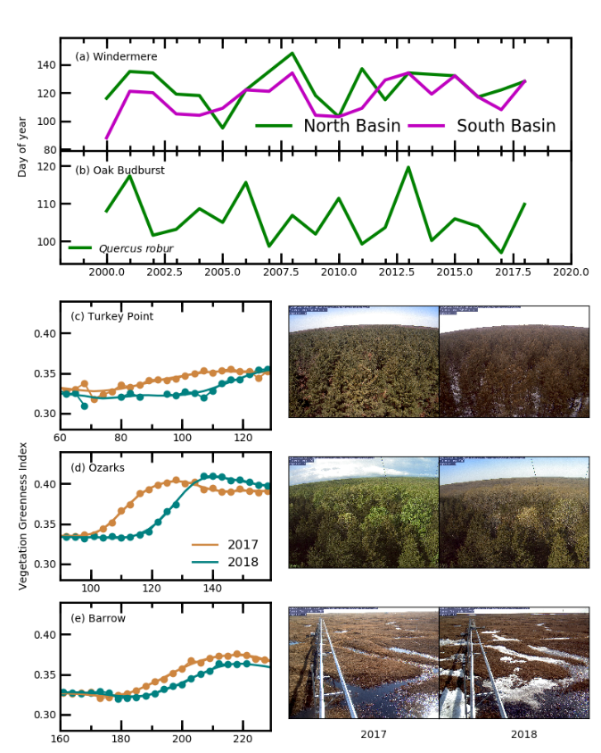
Land Surface
Phenology
New main section, building on Sidebar from last year
Highlights include
  Date of plankton peak in Windermere
  Oak budburst date from Nature’s Calendar
    Both later, likely due to “Beast from the East”
  PhenoCam network for Vegetation Greeness in North America
    2018 also later than 2017

Slide 19
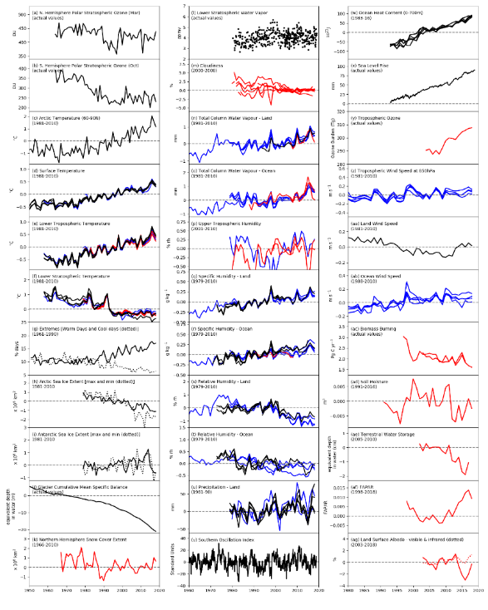
Many indicators of change
33 variables
In Situ, Reanalyses and Satellite data combined
Many show correlations in change over the last 150/100/50 years
Most consistent with rising temperatures

Slide 20

Summary & Questions
State of the Climate summarises the recent calendar year from an observations perspective
  Satellite, in-situ and reanalyses all used to characterise the year and place in context against the record.
Report on 2019 likely to be published in the next month
https://www.ametsoc.org/ams/index.cfm/publications/bulletin-of-the-american-meteorological-society-bams/state-of-the-climate/

Slide 21
Questions?

