Slide 1
Investigating the Seasonal SUHI Intensity Hysteresis Curves in Europe
Panagiotis Sismanidis, Benjamin Bechtel, Matthias Demuzere

Slide 2
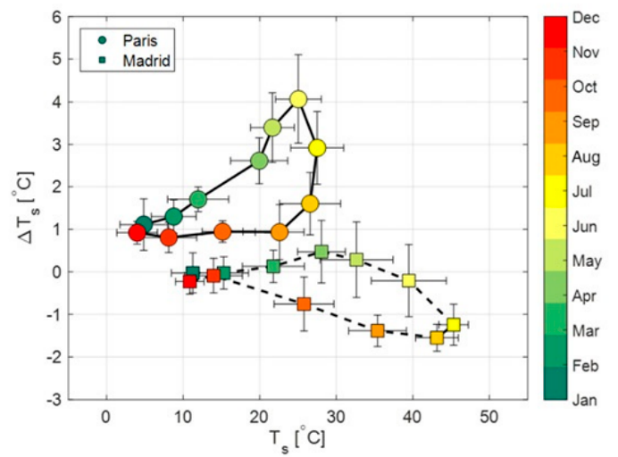
SUHII Seasonal Hysteresis Curves
The Intensity of Surface Urban Heat Islands (SUHII) exhibit distinctive hysteretic cycles, whose shape and looping direction vary across climatic zones.
It is hypothesized that this phenomenon is the result of time lags between the surface energy budget of cities and the energy / water budget of rural areas
Manoli et al. (2020), PNAS

Slide 3
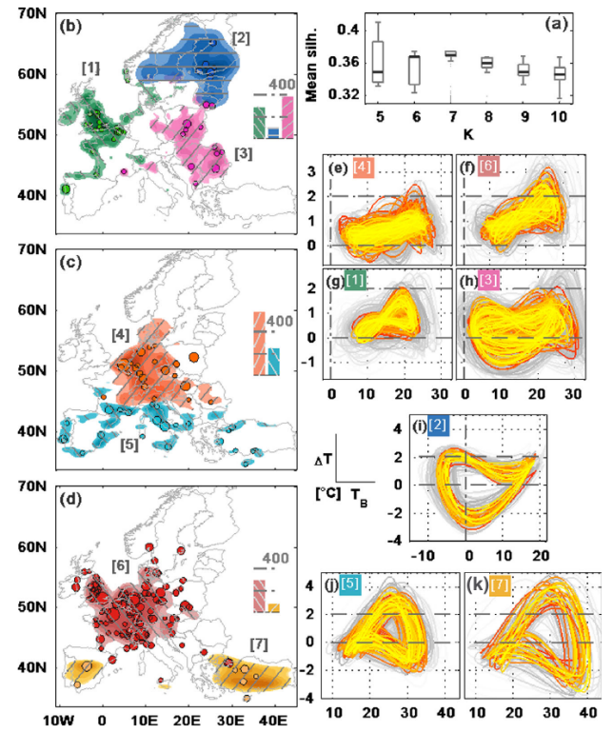
Relevant Works (1/2)
Zhou et al. (2013) in GRL
  Statistical Analysis
  Daytime MYD11A2 v5
  2006-2011
  All European cities
  Main Finding: the regional patterns that emerge, suggest that the UHI seasonality is not random, but stems from local climate conditions
Zhou et al. (2013), GRL

Slide 4
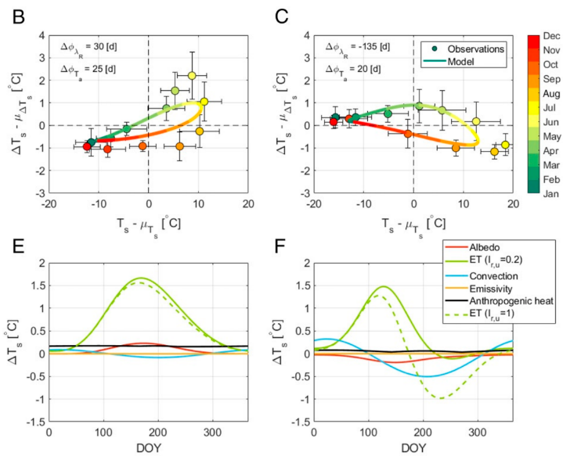
Relevant Works (2/2)
wet
dry
Manoli et al. (2020) in PNAS
  Model-based study
  Uses the data from Zhou et al. (2013)
  Paris, Milan, Madrid, Nicosia, London
  Wet vs Dry climate
  Main Finding: time lags between radiation forcing, air temperature, and rainfall explained the observed SUHII seasonal variations
Manoli et al. (2020), PNAS

Slide 5
Relevant Works (2/2)
Manoli et al. (2020) in PNAS
Cities in wet or relatively wet climates will show a concave up hysteresis characterized by peak SUHI in summer and a positive SUHII throughout the year.
Cities in dry regions will show a concave down curve with peak SUHI in spring and a negative SUHII during summer and autumn.
Manoli et al. (2020), PNAS

Slide 6
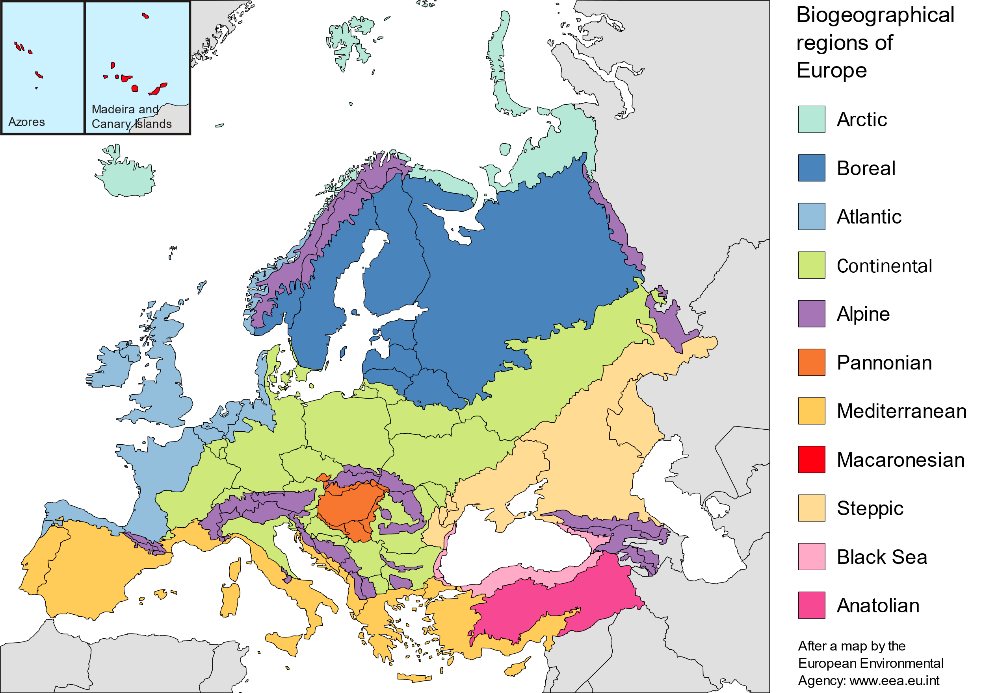

Research Questions
Build upon Manoli et al. (2020) and Zhou et al. (2013)
  Use the CCI LST to investigate how the seasonal SUHII hysteresis curves differ between Europe’s main Biogeographic Regions
  Investigate if and how the daytime and nighttime SUHII curves differ.

Slide 7
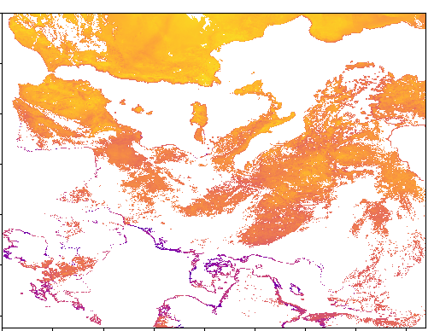
Data & Study Area
Study Area: Europe
1. ESACCI Terra MODIS LST
    0.01 deg x 0.01 deg
    Daily
    2013 - 2018
    Variables:
        LST
        LST Uncertainty
        Satellite View Zenith Angle
        Local Solar Time
  2. ASTER GTM DEM v003
  3. ESACCI Land Cover Classes (LCC)
      Resampled to 0.01 deg by calculating the LCC fractions for each pixel
      2013 - 2018
4. EEA Biogeographic Regions Vector Data

Slide 8
Methodology: Overview
Identify Cities
Select rural pixels for each city
Calculate SUHII
We apply this workflow iteratively for each year:

Slide 9
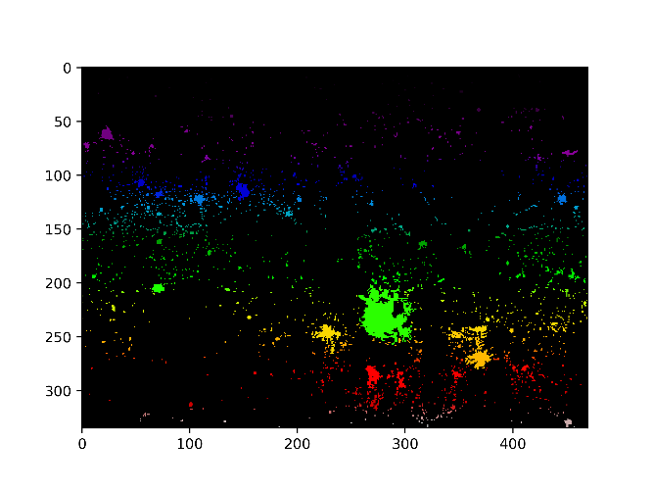
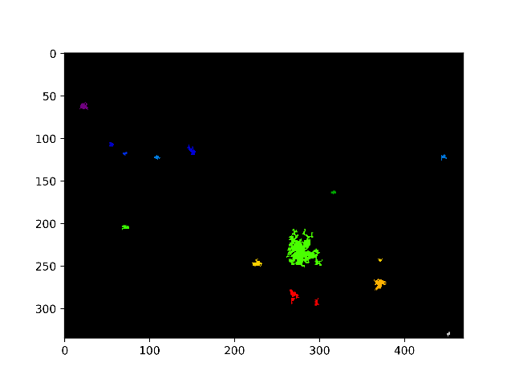
Methodology: Extraction of Urban Areas
We select the Urban Areas using the ESACCI LCC data
We define as a city, any cluster of 9 or more pixels, where the urban fraction and the water fraction of each pixel is >= 70% and 0.0%, respectively, and each pixel is >= 5 km away from the sea.
Potential Cities
urban frac > 0
Selected Cities
size >=9 pxls AND urban frac > 0.7 AND water frac = 0

Slide 10
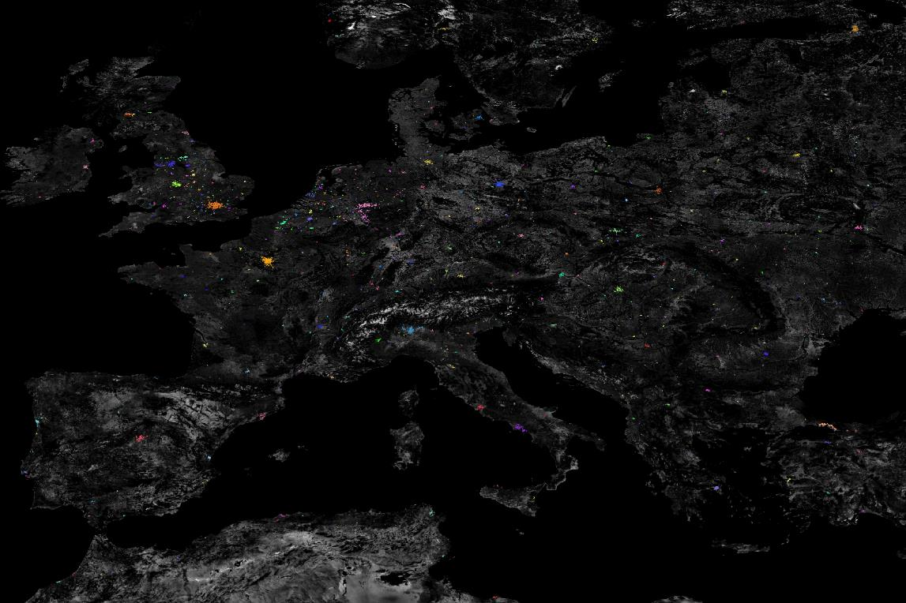
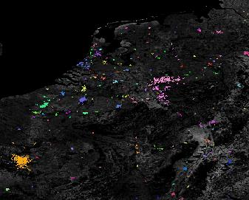
Methodology: Extraction of Urban Areas
Year | Cities
2013 | 975
2014 | 989
2015 | 995
2016 | 1007
2017 | 1014
2018 | 1022
Each color is a city

Slide 11
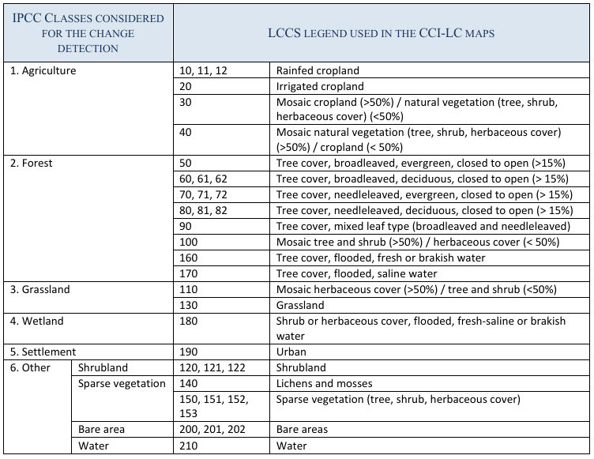
Methodology: Selection of Rural Areas
We define as rural pixels all the pixels where the sum of the cropland, grassland, shrublands and sparse vegetation LCC fractions is >= 70%
Approx. LCZ C + D

Slide 12
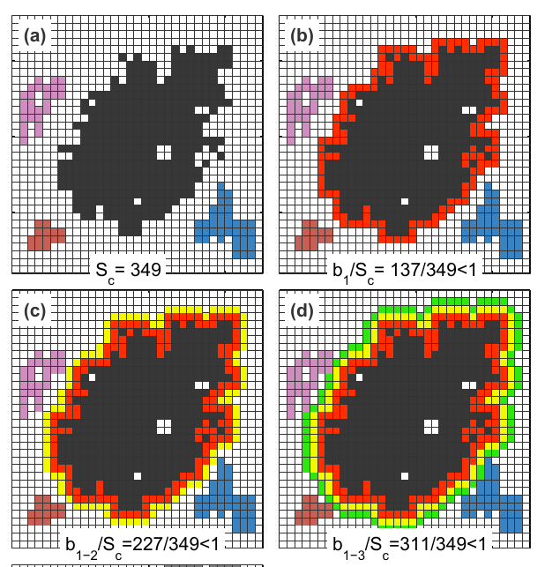
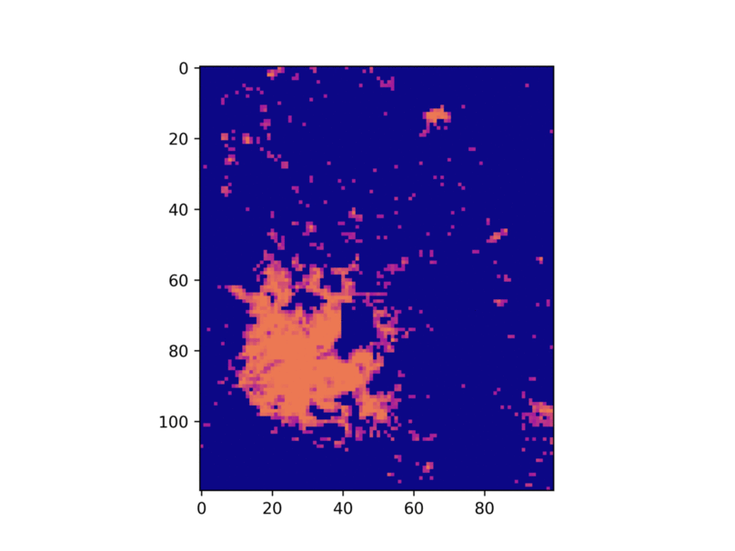
Methodology: Selection of Rural Areas
We select the rural areas using the algorithm of Zhou et al. (2013, GRL)
This method considers:
  that the rural area and the city area should have comparable size
  a rural pixel can belong to more than one urban areas
  However, in our implementation we do not use all the pixels, but we filter them using the LCC and DEM data:
  The elevation of each rural pixel should not differ more than +/- 200 m from the median elevation of the urban core.
  The rural pixels should have
    An urban fraction = 0
    A water fraction = 0

Slide 13
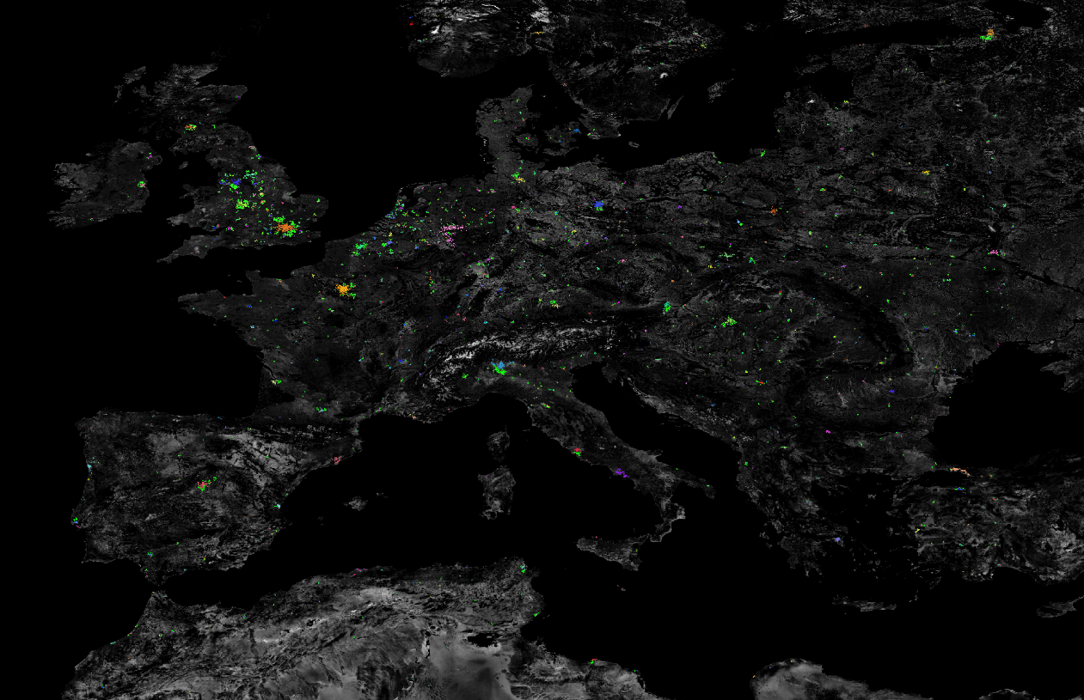
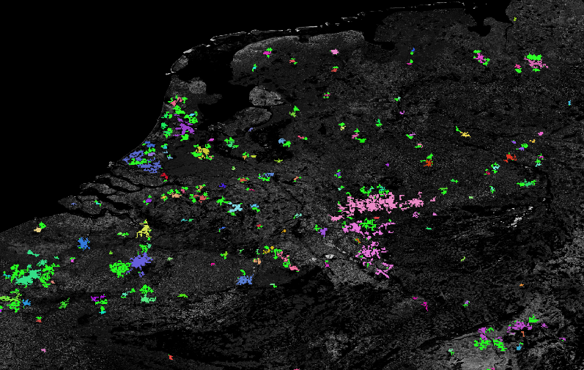
Methodology: Selection of Rural Areas
The bright green are the selected rural areas

Slide 14
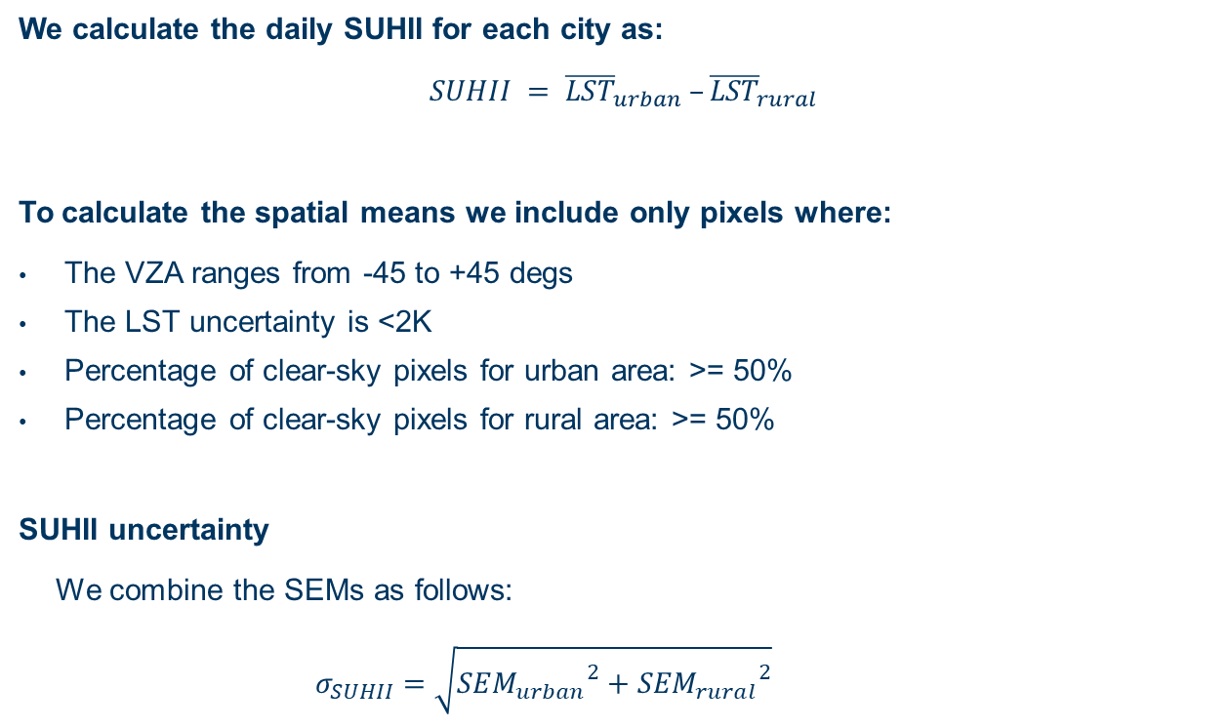
Methodology: SUHII Calculation
We calculate the daily SUHII for each city as:
$$SUHII = {\overline{LST}}_{urban} –{\overline{LST}}_{rural}$$
To calculate the spatial means we include only pixels where:
  The VZA ranges from -45 to +45 degs
  The LST uncertainty is <2K
  Percentage of clear-sky pixels for urban area: >= 50%
  Percentage of clear-sky pixels for rural area: >= 50%
SUHII uncertainty
  We combine the SEMs as follows:
    $$σ_{SUHII}=\sqrt{{{SEM}_{urban}}^{2}+{{SEM}_{rural}}^{2}}$$

Slide 15
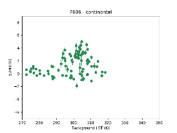
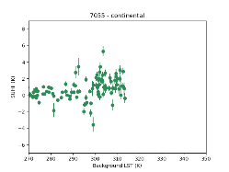
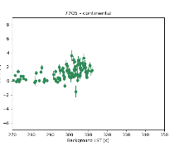
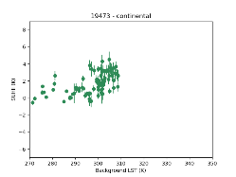
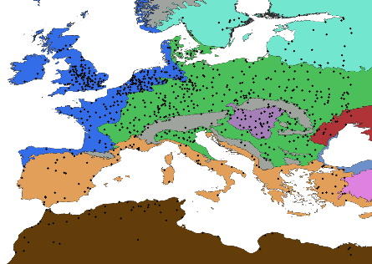
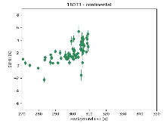
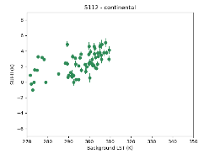
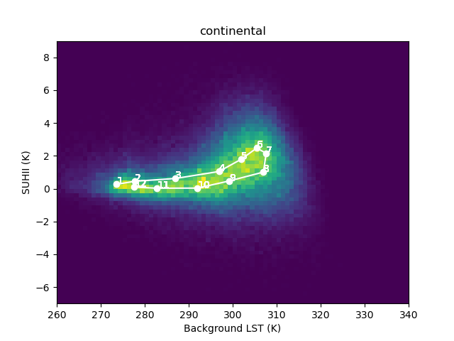
Data Aggregation
2013 – 2018, Continental Cities
Each plot corresponds to a single year and a single city
2013 - 2018
…
2018
Number of Cities with data for 2018
Alpine: 17
Anatolian: 2
Atlantic: 270
Boreal: 33
Continental: 324
Mediterranean: 79
Outside (i.e. North Africa): 44
Pannonian: 44
Steppic: 14
Total: 824

Slide 16
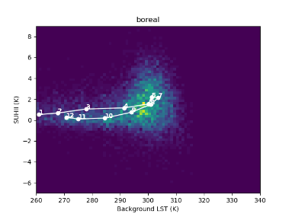
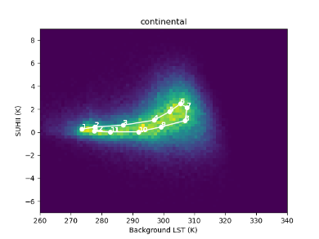
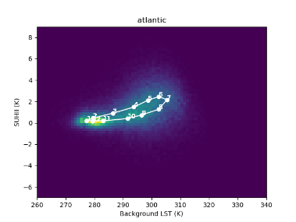
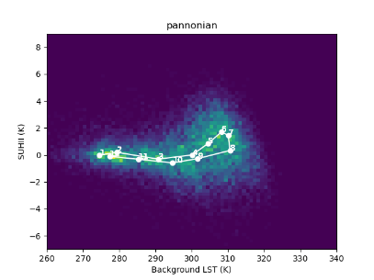

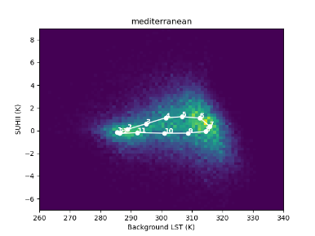
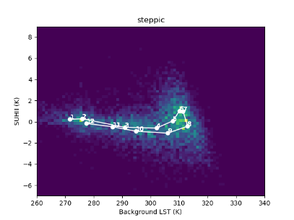
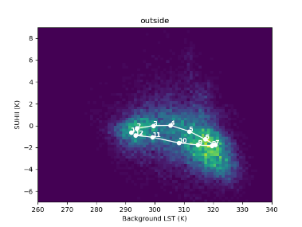
Results: Daytime SUHII

Slide 17
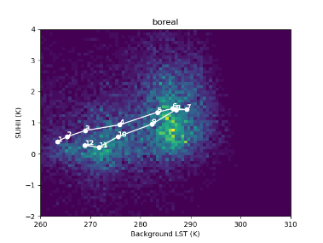
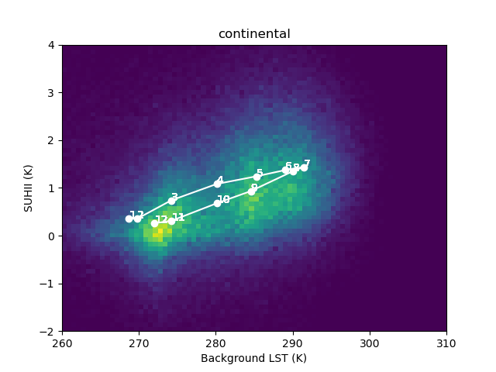
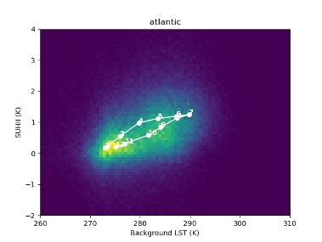
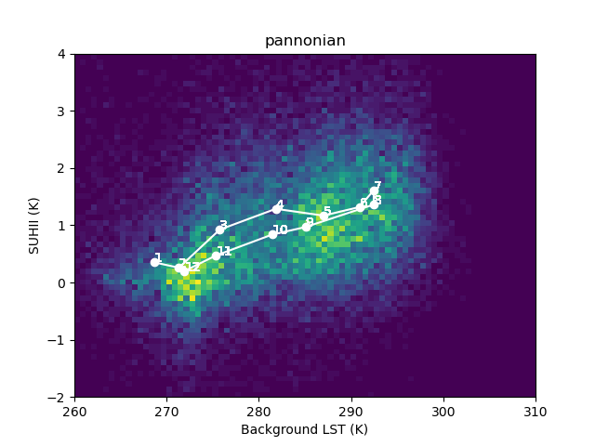
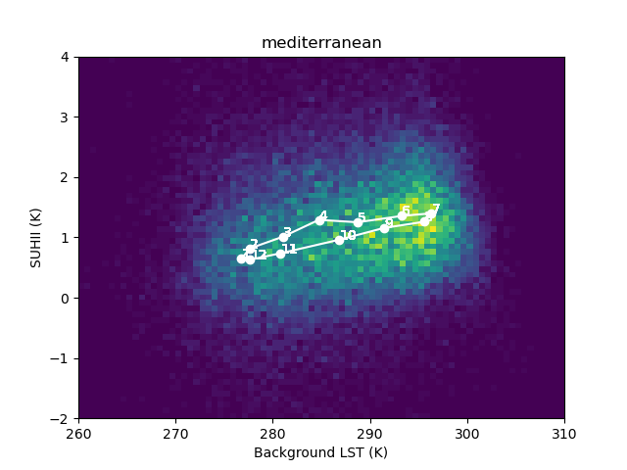
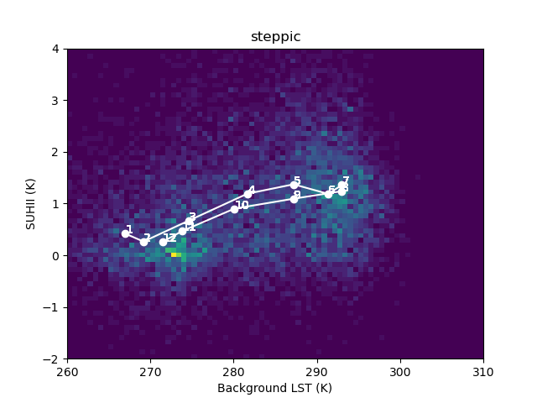
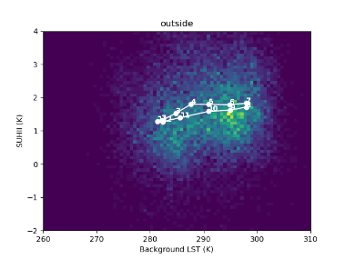
Results: Nighttime SUHII

Slide 18
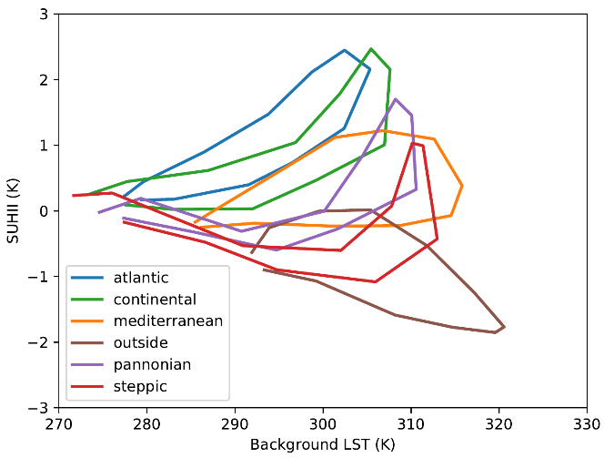
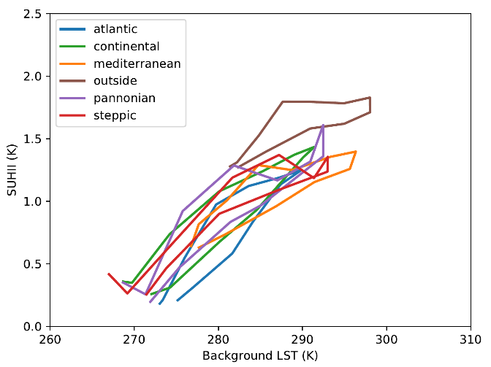
Results: Monthly Means
Daytime SUHIIs
Nighttime SUHIIs
Daytime curves corresponding to wet climates differ considerably from those of dry climates
Nighttime curves are almost the same and always positive
Clockwise Direction
Highest Daytime SUHII corresponds to the Atlantic BioGeo
Daytime SUHIIs are warmer in Spring than in Autumn

Slide 19
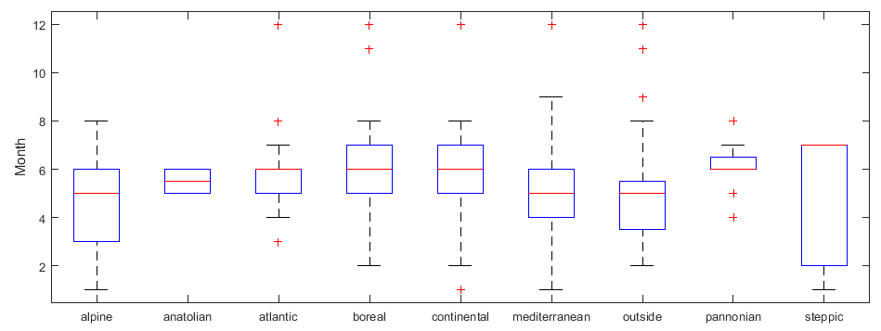
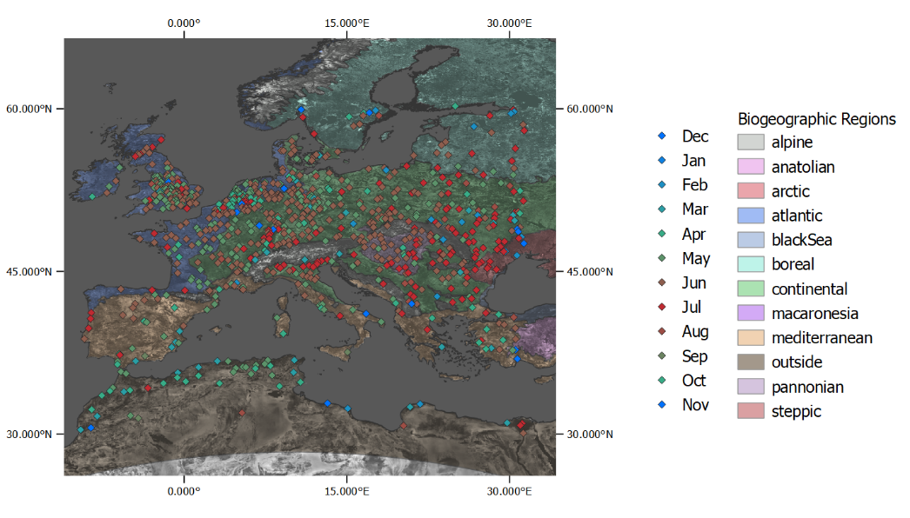
Results: Monthly Means
In dry climates SUHII peaks earlier than in wet climates

Slide 20
Conclusions
SUHIIs exhibit distinctive hysteretic cycles, whose shape and looping direction vary across climatic zones.
Cities in wet or relatively wet climates show a concave up hysteresis characterized by peak SUHI in summer and mostly positive SUHII throughout the year.
Cities in dry regions will show a concave down curve with peak SUHI in spring and a negative SUHII during summer and autumn.
Nighttime SUHII Curves are almost the same between Europe’s biogeographic regions.
Thank you!

