Slide 1




LST CCI User Workshop 2020
UK Met Office, Exeter, 24-26 June 2020
Country-Scale Climatology of the Surface Urban Heat Island using MODIS LST products
Sorin Cheval (1,2), Alexandru Dumitrescu (2), Vlad Amihăesei (2), Alexandru Antal (3)
“Henri Coandă” Air Force Academy Brașov, Romania
National Meteorological Administration, Bucharest, Romania
(3) University of Craiova, Romania

Slide 2

Rationale. Objectives
LST retrieval from MODIS. Data and methods
Quantifying the SUHI intensity
Assessment of thermal hazard-risk associated to intense SUHI
Land Surface Temperature CCI project

Slide 3
Rationale. Objectives
LST retrieval from MODIS. Data and methods
Quantifying the SUHI intensity
Assessment of thermal hazard-risk associated to intense SUHI

Slide 4
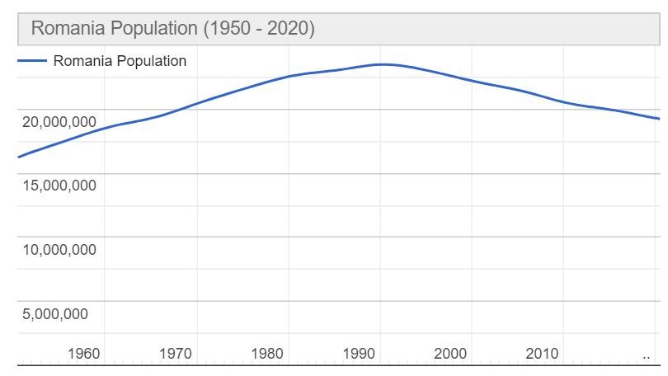
Rationale:
The current population of Romania is 19,239,367 as of Wednesday, June 24, 2020, based on Worldometer elaboration of the latest United Nations data.
Romania 2020 population is estimated at 19,237,691 people at mid year according to UN data.
Romania population is equivalent to 0.25% of the total world population.
Romania ranks number 61 in the list of countries (and dependencies) by population.
The population density in Romania is 84 per Km² (216 people per mi²).
The total land area is 230,170 Km2 (88,869 sq. miles)
54.6 % of the population is urban (10,507,365 people in 2020)
The median age in Romania is 43.2 years.
https://www.worldometers.info/world-population/romania-population/

Slide 5
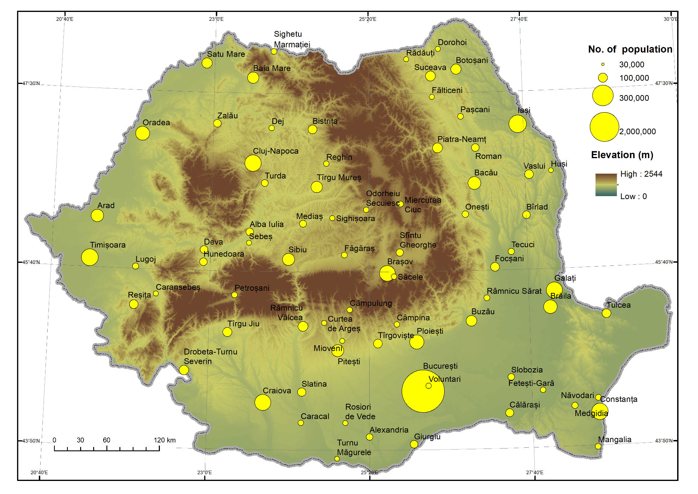
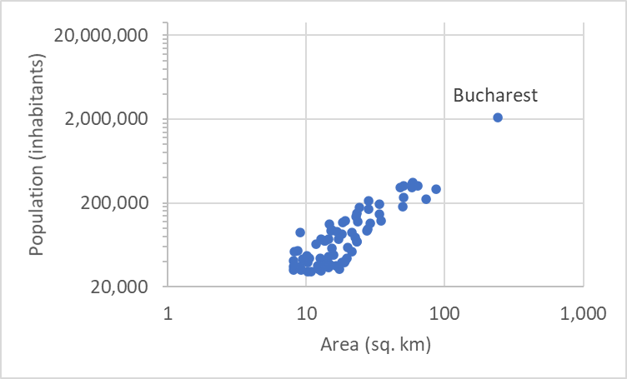
Urban areas with more than 30,000 inhabitants in Romania
High-temperature hazard-risk in urban areas quite common in the Southern part of Romania
319 urban settlements (2019)
  77 cities > 30,000 inhabitants
  24 cities > 100,000
  11 cities > 200,000
  7 cities > 300,000
  1 city > 2,000,000
Country-Scale Climatology of the Surface Urban Heat Island using MODIS LST products

Slide 6
Objectives:
Investigating the SUHI using MODIS LST at country scale
Identifying geographical patterns of the SUHI
Investigating seasonal difference in the SUHI
Temperature hazard-risk assessment using MODIS LST
Country-Scale Climatology of the Surface Urban Heat Island using MODIS LST products

Slide 7
Rationale
LST retrieval from MODIS. Data and methods
Quantifying the UHI intensity
Assessment of thermal hazard-risk associated to intense UHI
Country-Scale Climatology of the Surface Urban Heat Island using MODIS LST products

Slide 8
Data:
MODIS LST data retrieved from http://gws-access.ceda.ac.uk/public/esacci_lst/
Period: 2000-2018
Daytime and nighttime LST
Quality Control (i.e. 50% data coverage/city and outliers eliminated)
Comparison LST – Air Temperature
Country-Scale Climatology of the Surface Urban Heat Island using MODIS LST products

Slide 9
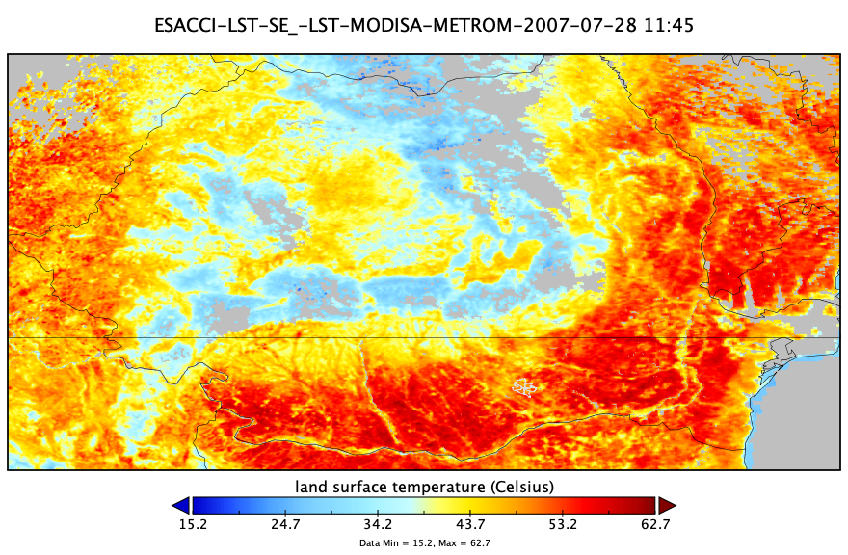
MODIS LST over Romania at
28 July 2007
Country-Scale Climatology of the Surface Urban Heat Island using MODIS LST products

Slide 10
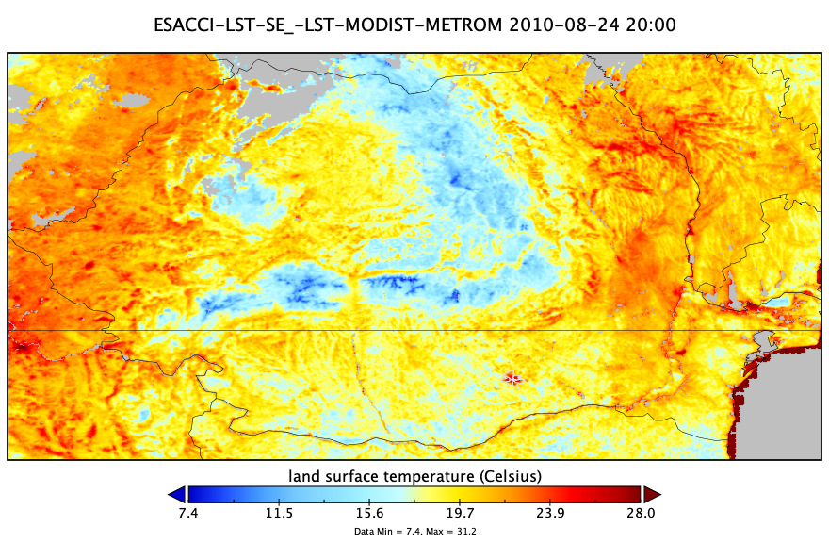
MODIS LST over Romania at
28 August 2010
Country-Scale Climatology of the Surface Urban Heat Island using MODIS LST products

Slide 11
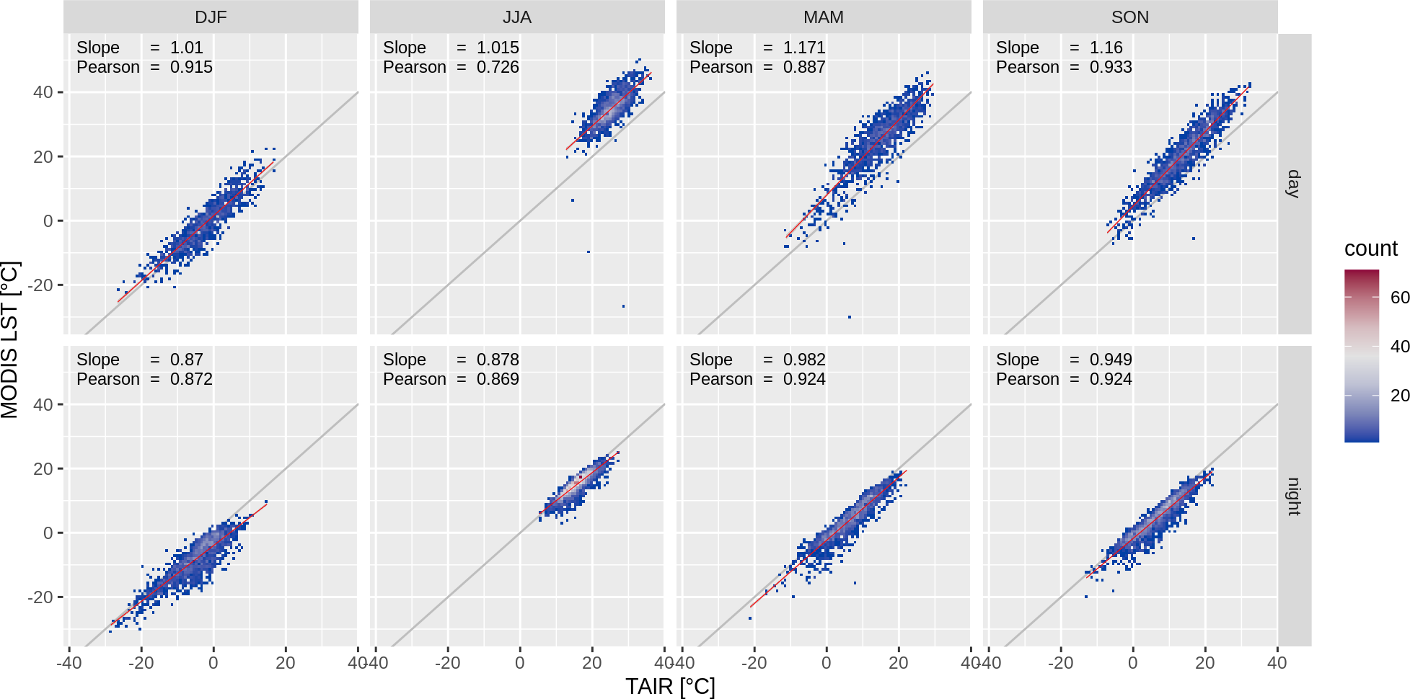
Air temperature vs MODIS LST
Brașov (291 k; mountain area)
Country-Scale Climatology of the Surface Urban Heat Island using MODIS LST products

Slide 12
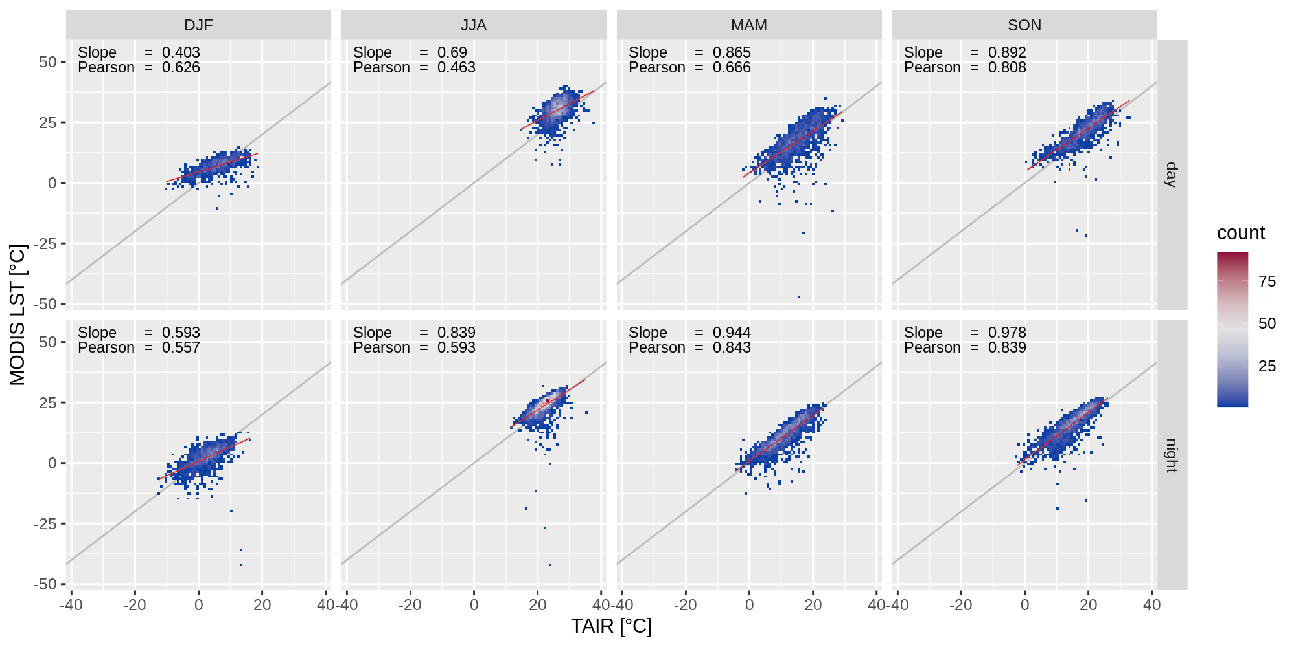
Constanța (320 k; Black Sea coast)
Country-Scale Climatology of the Surface Urban Heat Island using MODIS LST products

Slide 13
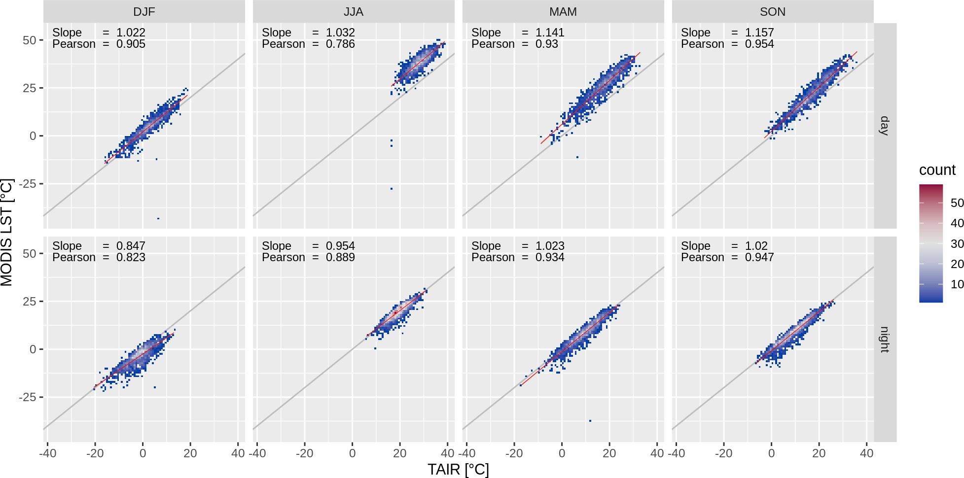
Timișoara (333 k; plain area)
Country-Scale Climatology of the Surface Urban Heat Island using MODIS LST products

Slide 14
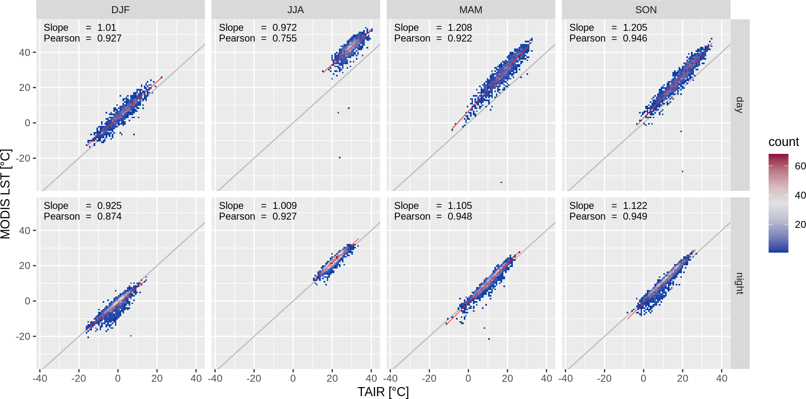
Bucharest-Filaret (2,100 k; urban station)
Country-Scale Climatology of the Surface Urban Heat Island using MODIS LST products

Slide 15
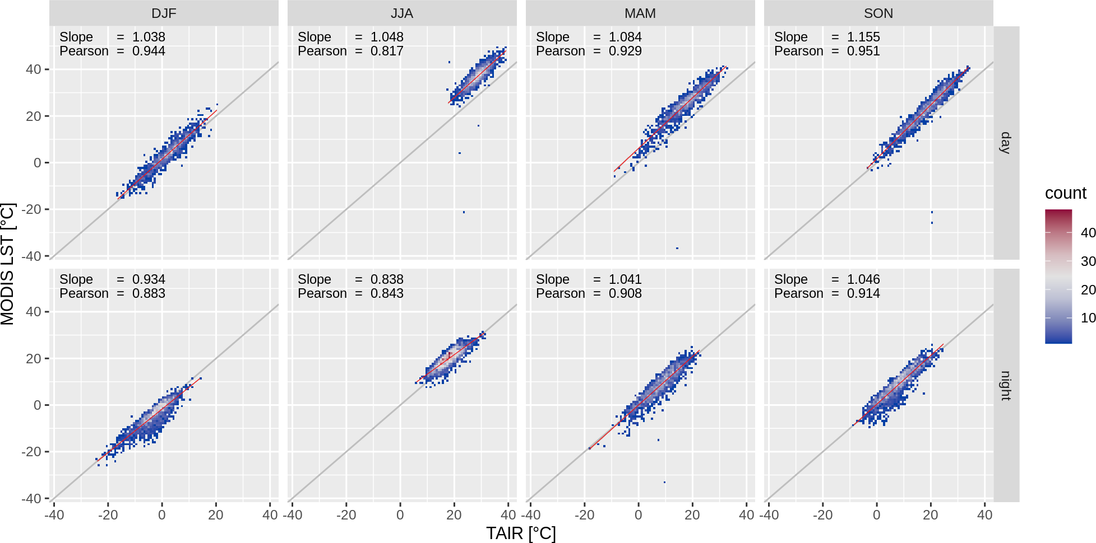
Bucharest-Băneasa (2,100 k; peri-urban station)
Country-Scale Climatology of the Surface Urban Heat Island using MODIS LST products

Slide 16
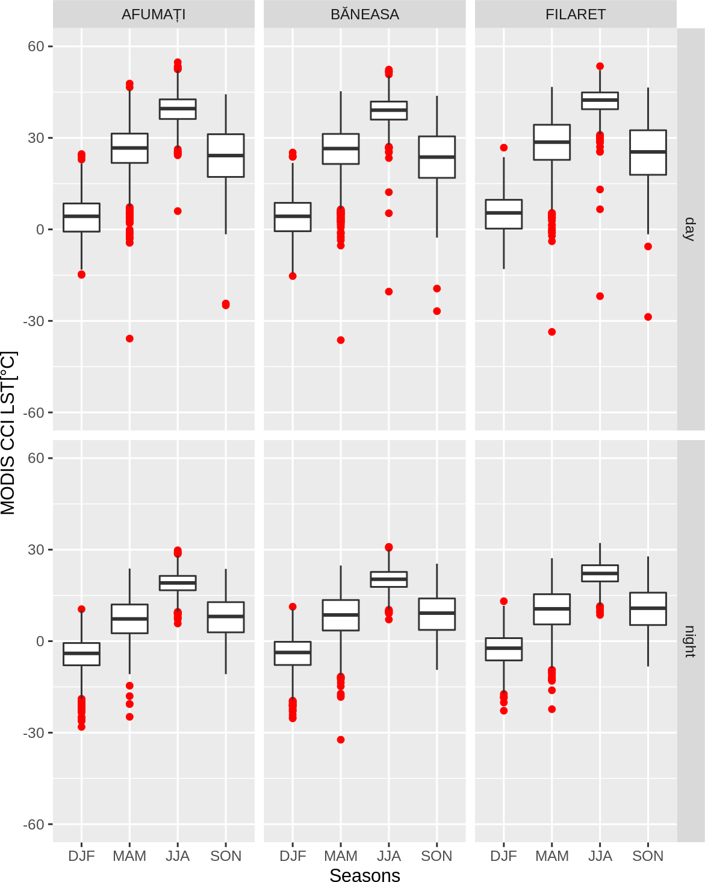
Peri-urban
Peri-urban
Urban
MODIS LST over urban and peri-urban weather stations, Bucharest (Romania)

Slide 17
Rationale
LST retrieval from MODIS. Data and methods
Quantifying the SUHI intensity
Assessment of thermal hazard-risk associated to intense SUHI
Country-Scale Climatology of the Surface Urban Heat Island using MODIS LST products

Slide 18
SUHI = LST_U – LST_R
SUHI: Surface Urban Heat Island
LST-U: urban pixels from built-up administrative perimeter
LST-R: non-urban pixels from rural buffer
Rural buffer: buffer around the built-up perimeter; (1/2 * Average distance between the city centroid and the urban perimeter nodes)
Country-Scale Climatology of the Surface Urban Heat Island using MODIS LST products

Slide 19
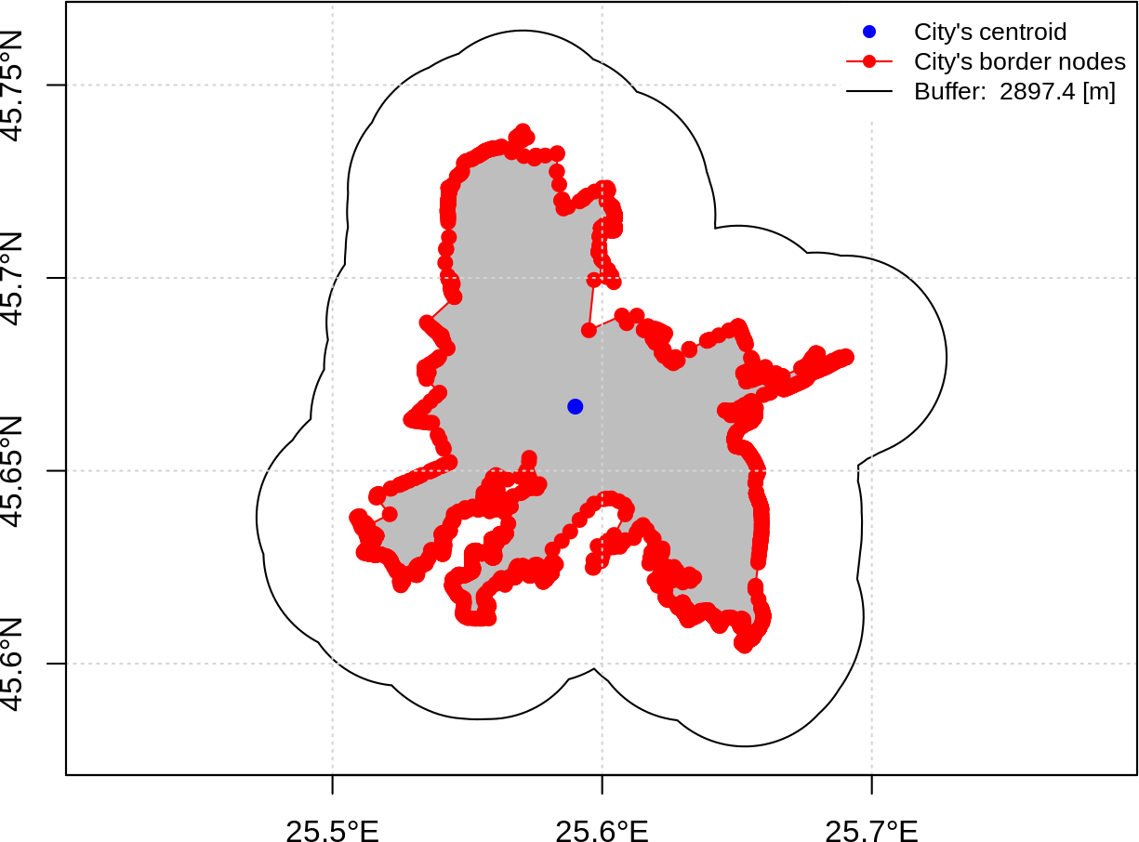
SUHI = LST_U – LST_R
LST_R
LST_U
Rural buffer for Brașov. Average distance between the city centroid and the urban perimeter nodes

Slide 20
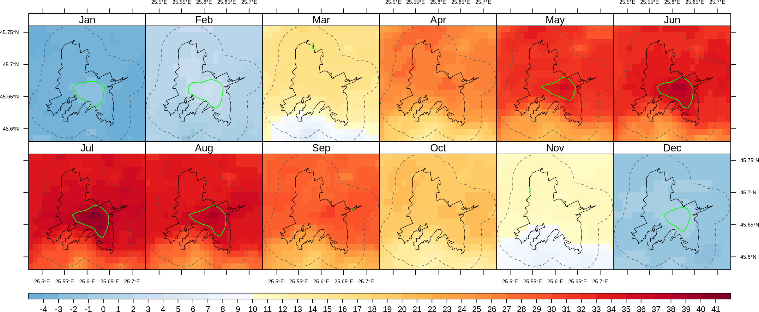
Monthly LST - Daytime
Green line = LST > the 95th percentile
White pixels = water
Black line = built-up area
Dot line = rural buffer
Brașov (291 k; mountain neighborhood in South)

Slide 21
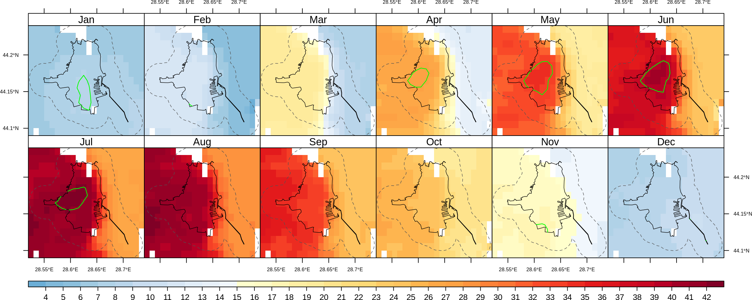
Monthly LST - Daytime
Green line = LST > the 95th percentile
White pixels = water
Black line = built-up area
Dot line = rural buffer
Constanța (319 k; Black Sea Coast)

Slide 22
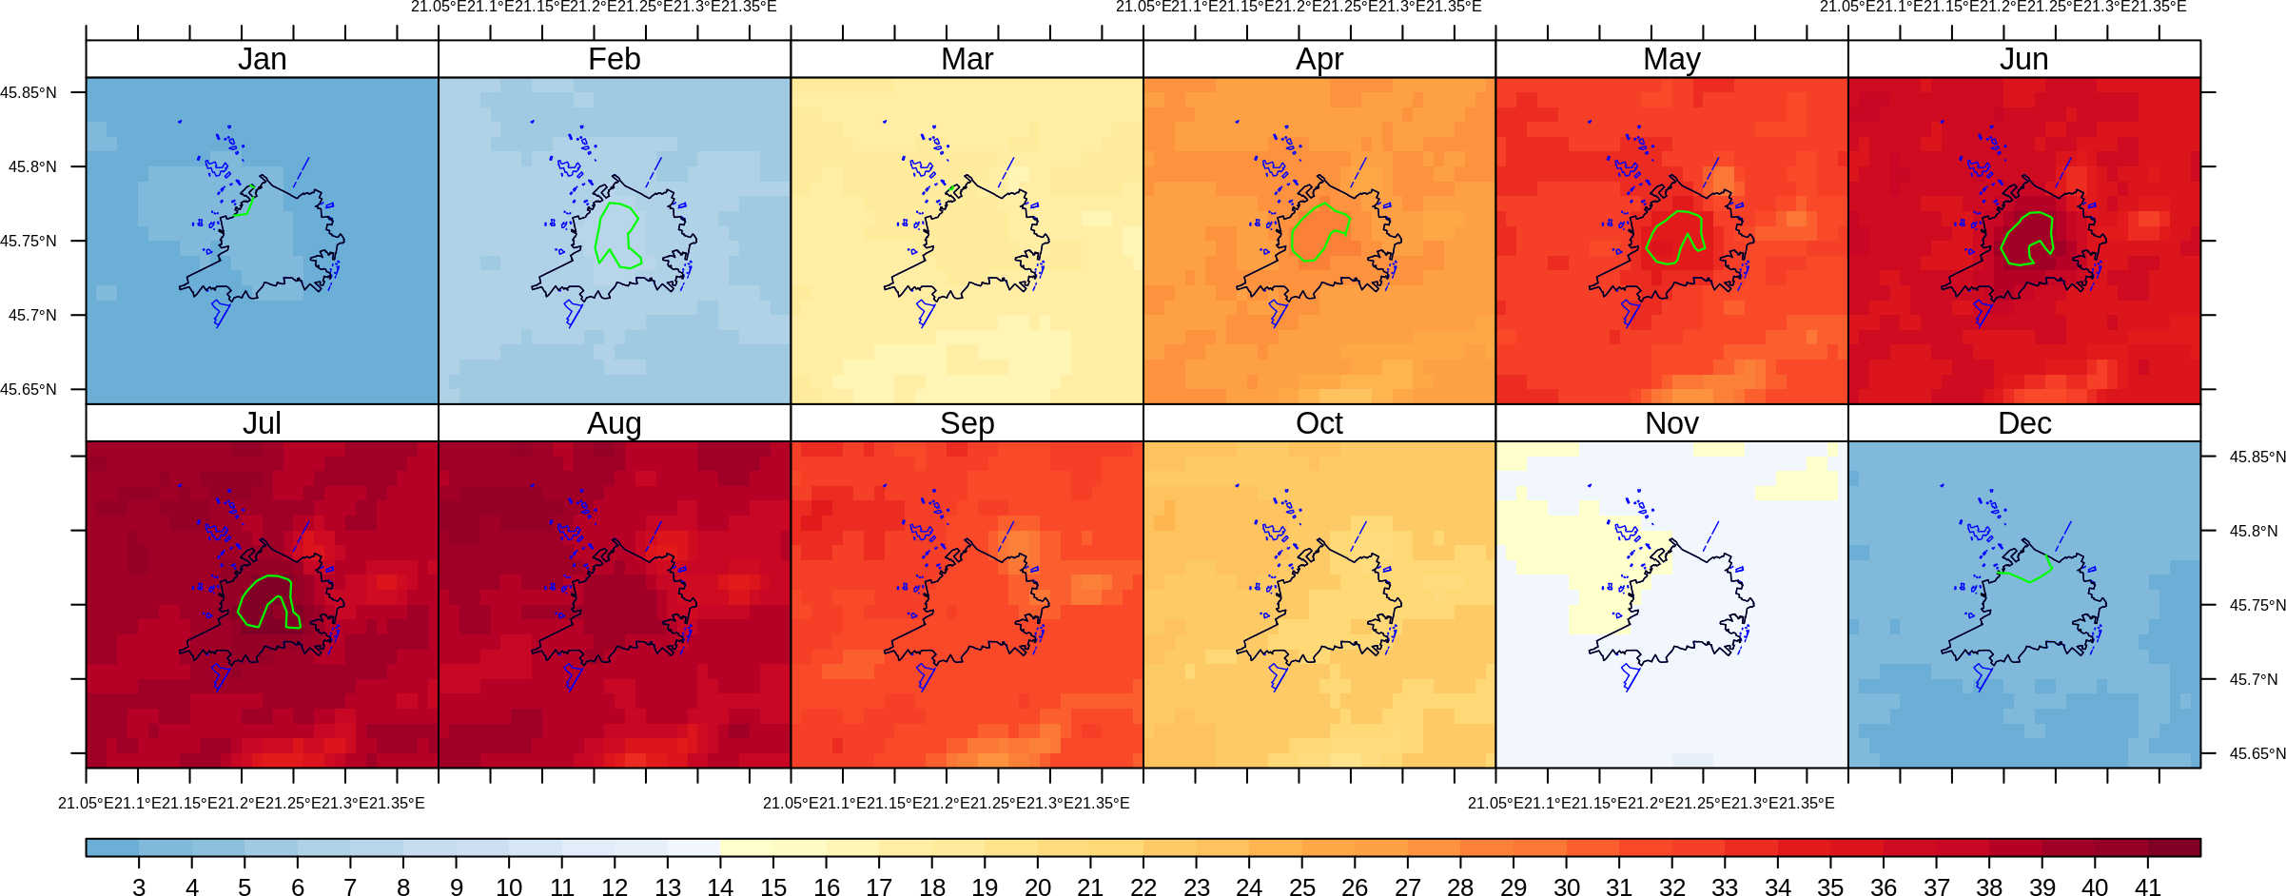
Monthly LST - Daytime
Green line = LST > the 95th percentile
White pixels = water
Black line = built-up area
Dot line = rural buffer
Timișoara (333 k; plain area)

Slide 23
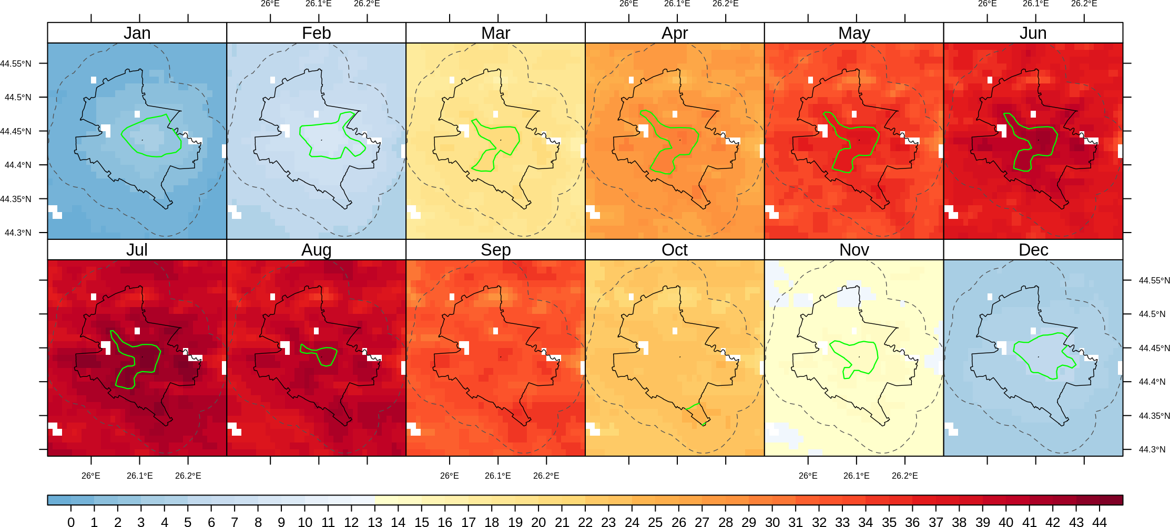
Monthly LST - Daytime
Green line = LST > the 95th percentile
White pixels = water
Black line = built-up area; Dot line = rural buffer
Bucharest (2,100 k; plain area)

Slide 24
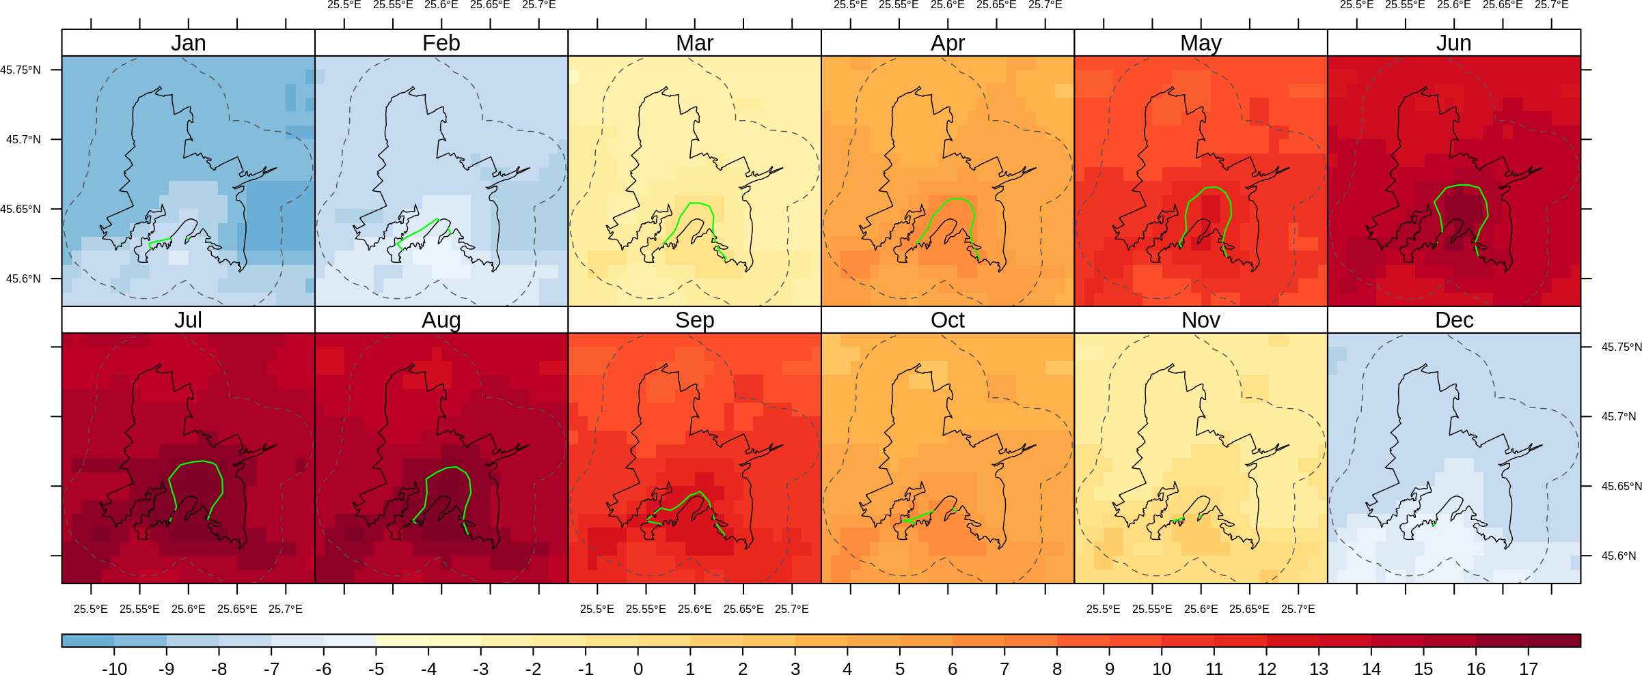
Monthly LST - Nighttime
Green line = LST > the 95th percentile
White pixels = water
Black line = built-up area
Dot line = rural buffer
Brașov (291 k; mountain neighborhood in South)

Slide 25
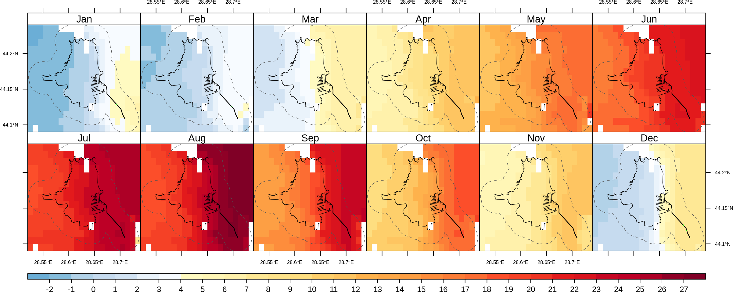
Monthly LST - Nighttime
Green line = LST > the 95th percentile
White pixels = water
Black line = built-up area
Dot line = rural buffer
Constanța (319 k; Black Sea Coast)

Slide 26
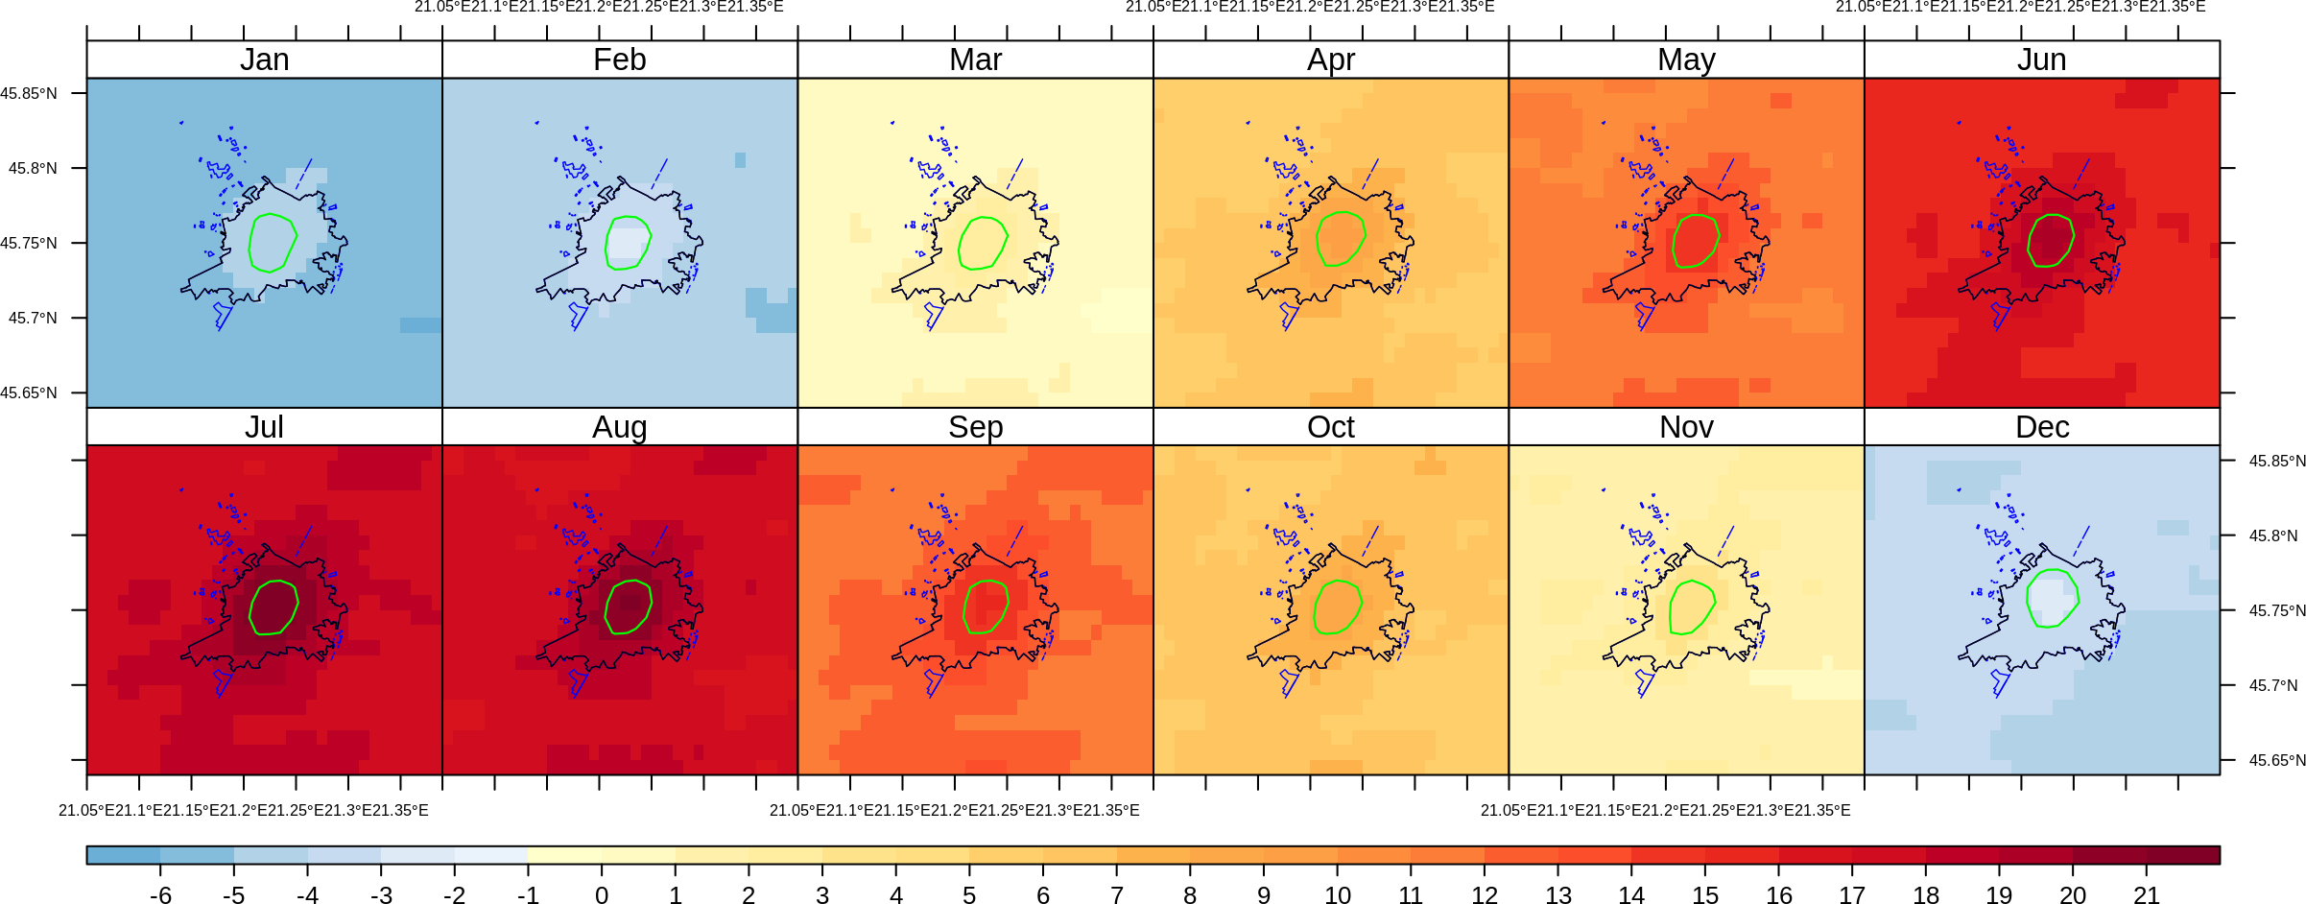
Monthly LST - Nighttime
Green line = LST > the 95th percentile
White pixels = water
Black line = built-up area
Dot line = rural buffer
Timișoara (333 k; plain area)

Slide 27
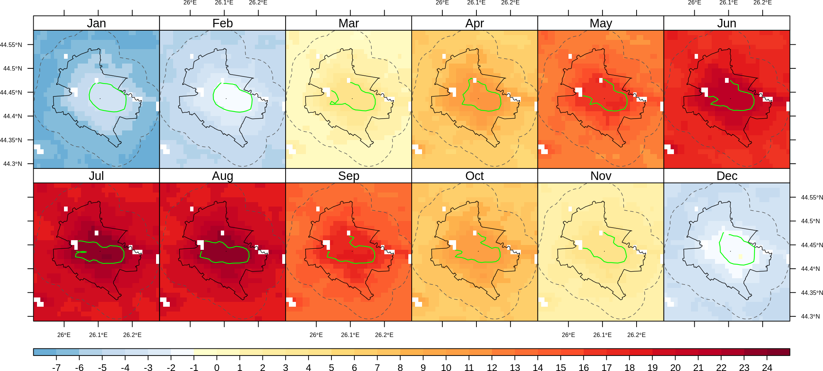
Monthly LST - Nighttime
Green line = LST > the 95th percentile
White pixels = water
Black line = built-up area; Dot line = rural buffer
Bucharest (2,100 k; plain area)

Slide 28
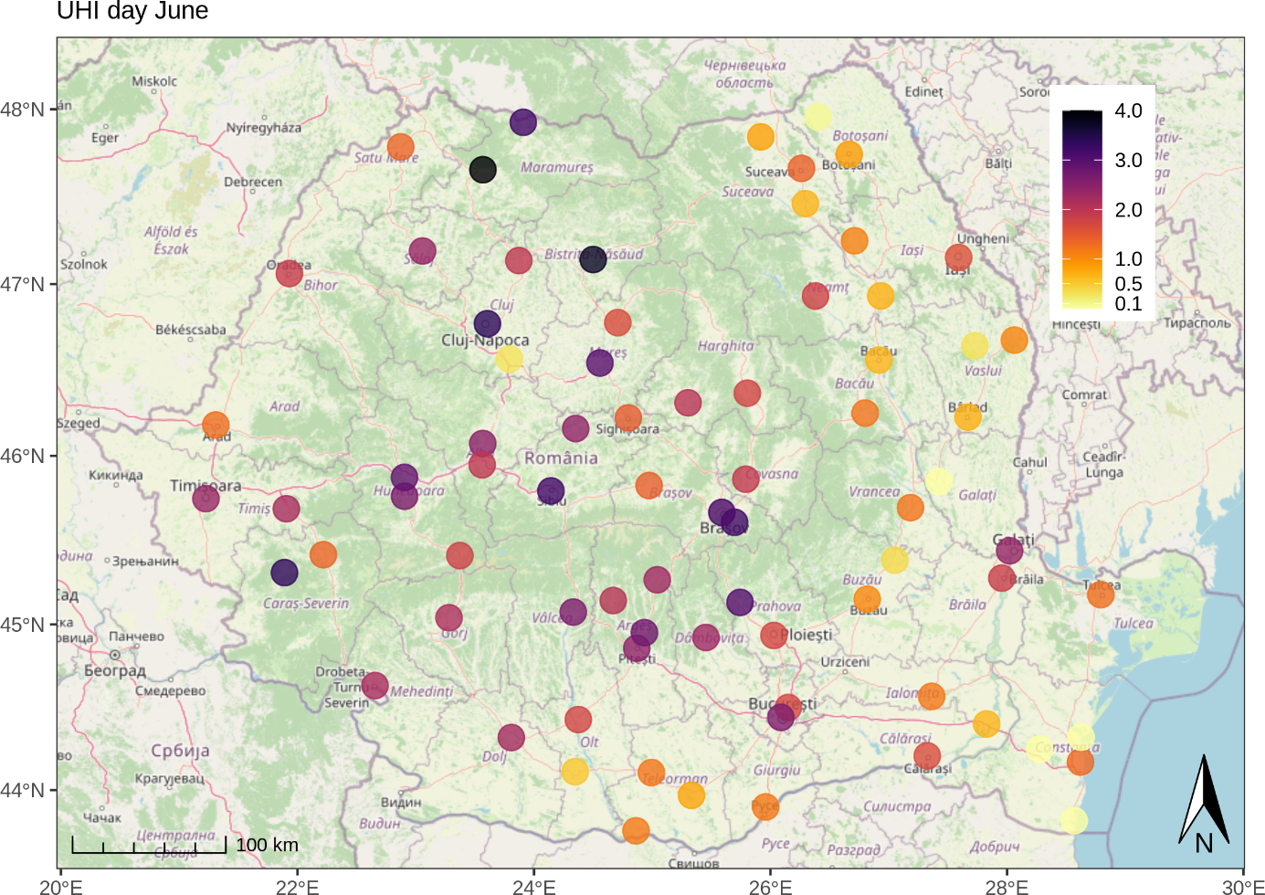
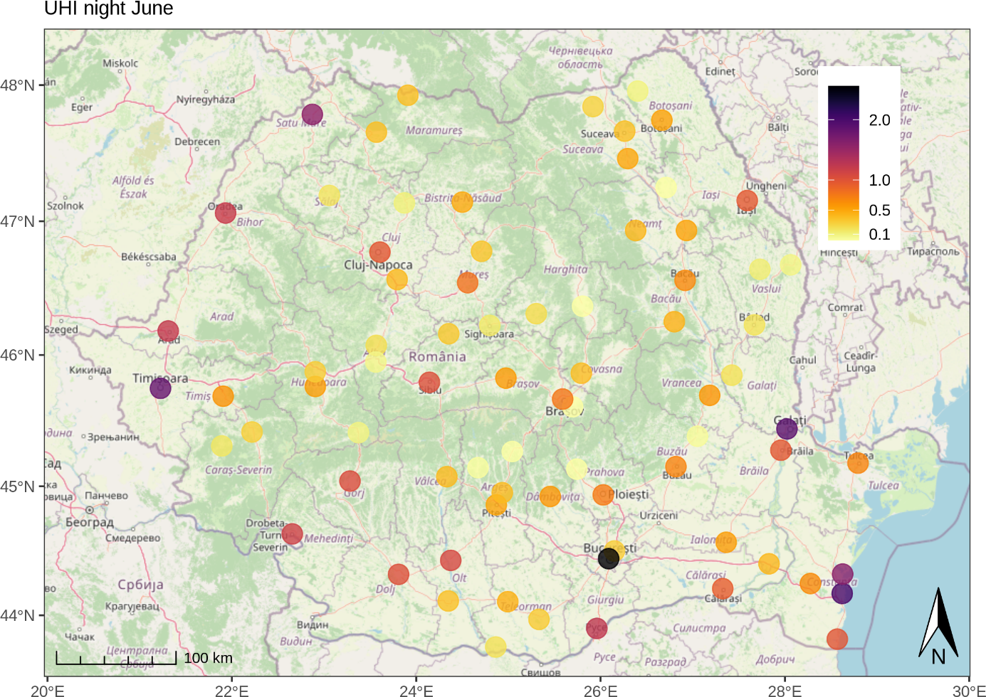
Daytime and nighttime average SUHI (°C) in June
Country-Scale Climatology of the Surface Urban Heat Island using MODIS LST products

Slide 29
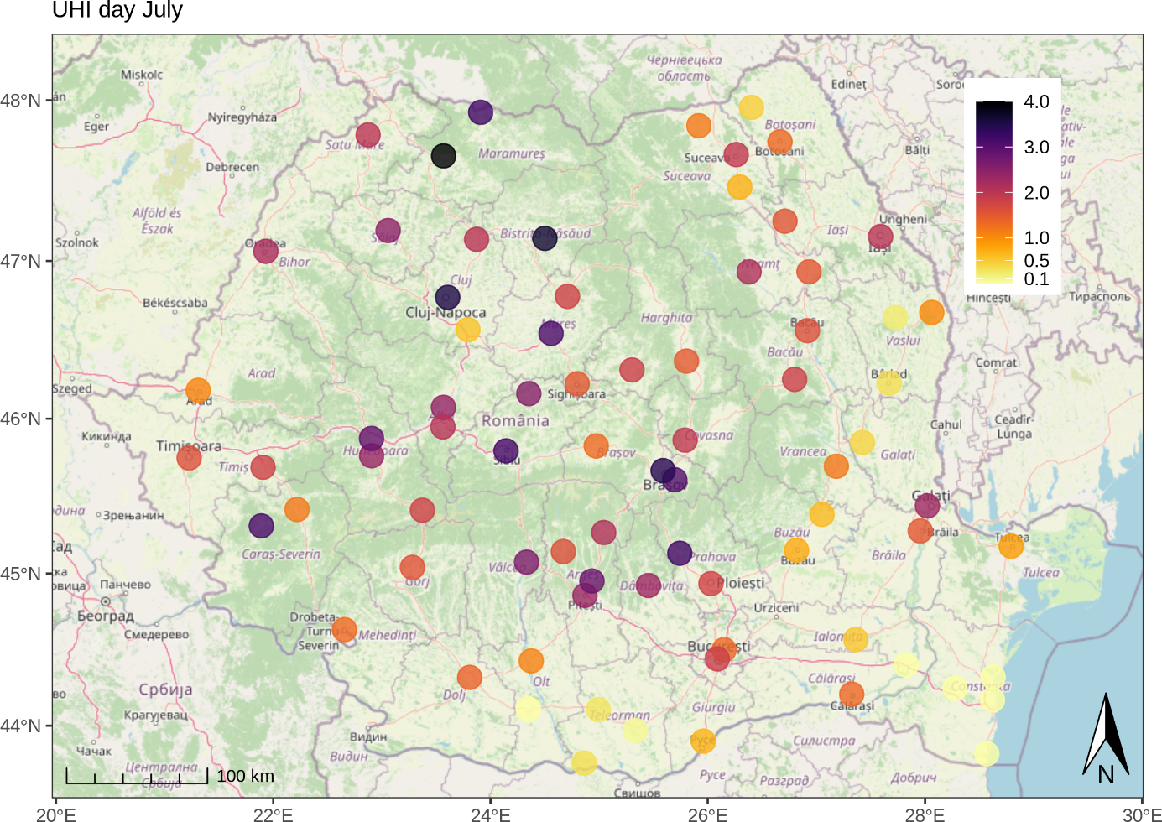

Daytime and nighttime average SUHI (°C) in July
Country-Scale Climatology of the Surface Urban Heat Island using MODIS LST products

Slide 30
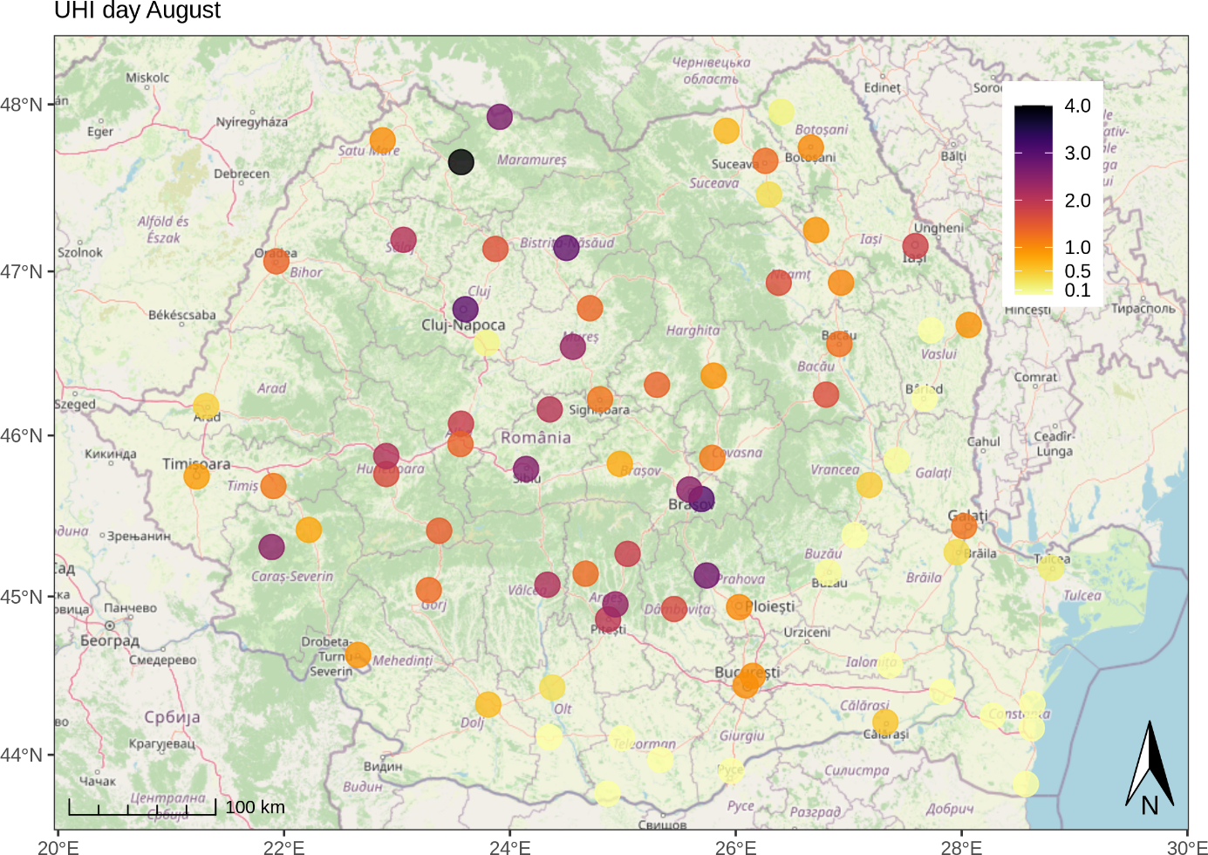

Daytime and nighttime average SUHI (°C) in August
Country-Scale Climatology of the Surface Urban Heat Island using MODIS LST products

Slide 31
Average UHI vs Urban surface areas
Average UHI vs Population
Daytime
Nighttime
Country-Scale Climatology of the Surface Urban Heat Island using MODIS LST products

Slide 32
Maximum UHI vs Urban surface areas
Maximum UHI vs Population
Daytime
Nighttime
Country-Scale Climatology of the Surface Urban Heat Island using MODIS LST products

Slide 33
Rationale
LST retrieval from MODIS. Data and methods
Quantifying the UHI intensity
Assessment of thermal hazard-risk associated to intense UHI

Slide 34
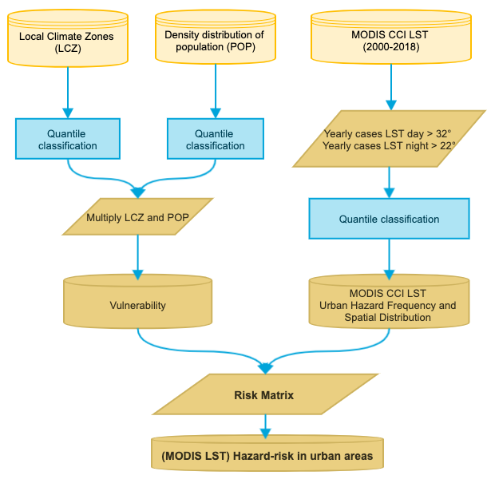
Workflow Diagram –
Computing the thermal hazard-risk in urban areas from MODIS LST and ancillary data
Country-Scale Climatology of the Surface Urban Heat Island using MODIS LST products

Slide 35
RISK = Hazard (MODIS LST) x Vulnerability (LCZ; POP)
RISK = Temperature Hazard-Risk in Urban Areas
Hazard (MODIS LST) = Cumulated frequency of daytime LST > 32°C AND nightime LST > 22°C
Vulnerability (LCZ; POP) = quintile classified LCZ; quintile classified population density
Data sources:
POP: Joint Research Centre (JRC), GHS resident population grid https://www.eea.europa.eu/data-and-maps/data/external/ghs-resident-population-grid
LCZ: Demuzere M, Bechtel B, Middel A, Mills G (2019) Mapping Europe into local climate zones. PLoS ONE 14(4): e0214474. https://doi.org/10.1371/journal.pone.0214474

Slide 36
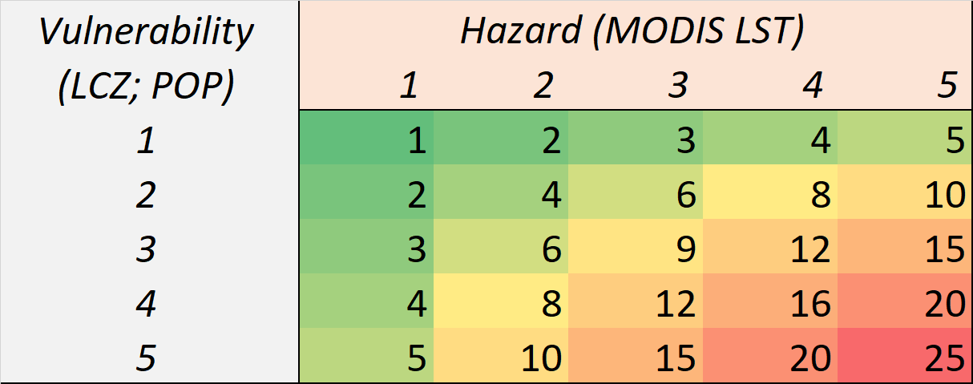
Thermal hazard-risk matrix
1 = lowest risk
25 = highest risk

Slide 37
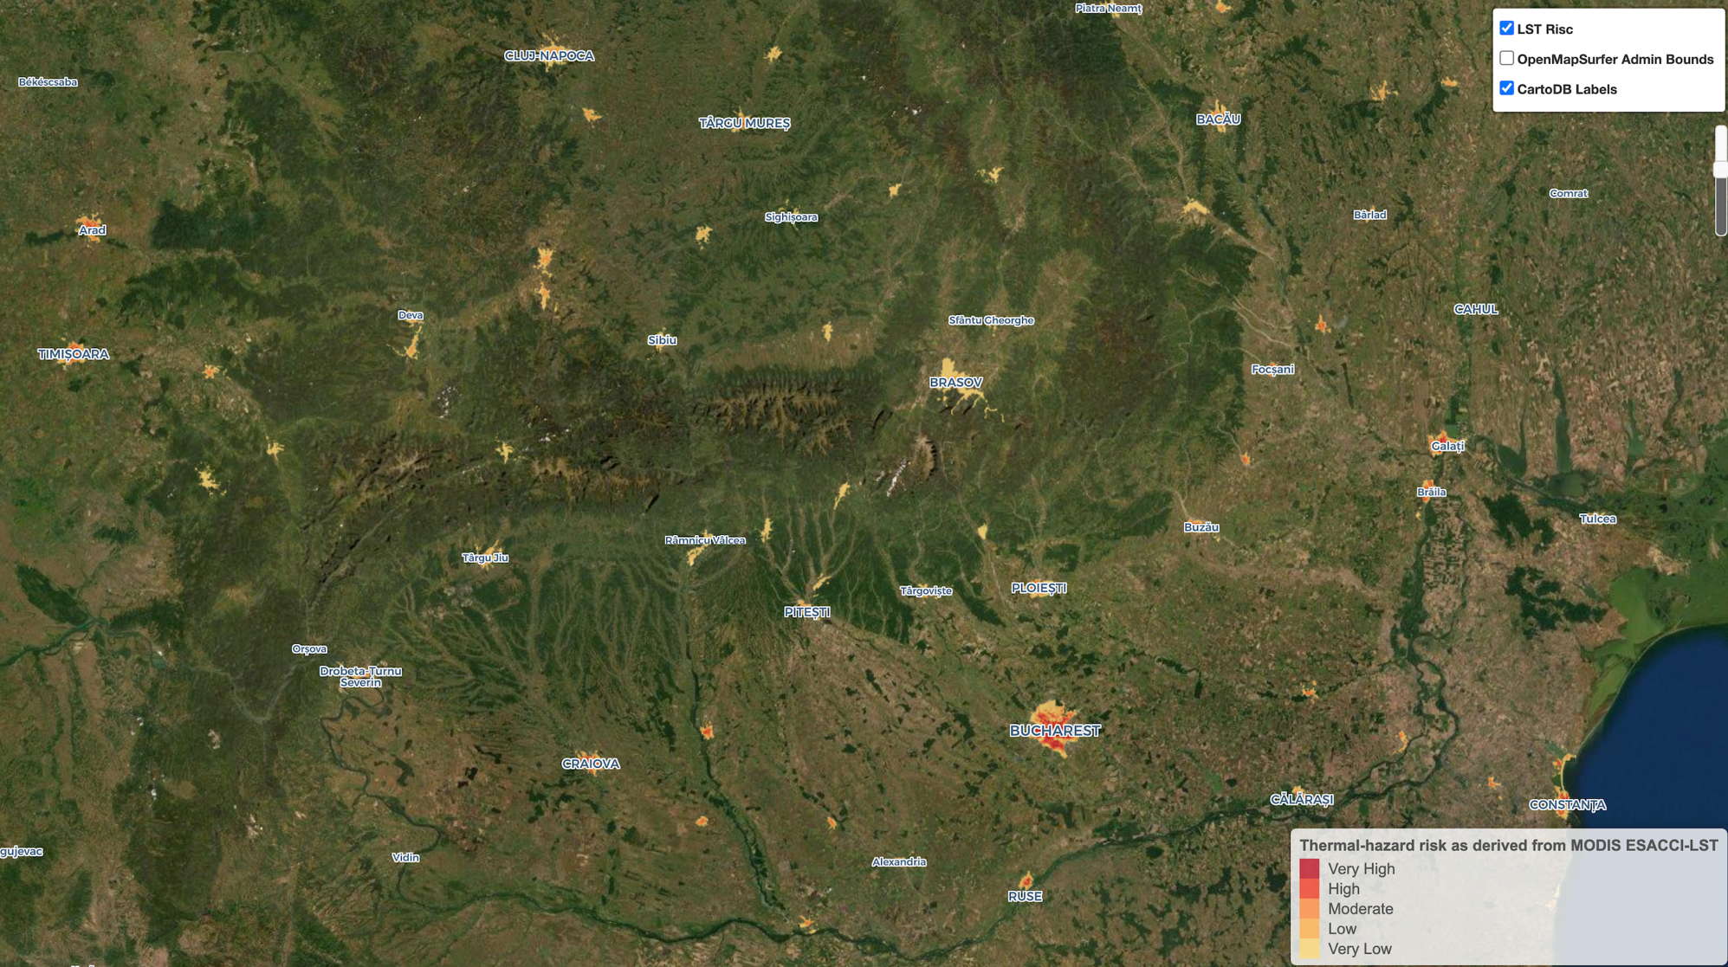
Temperature Hazard-Risk in Urban Areas in Romania

Slide 38
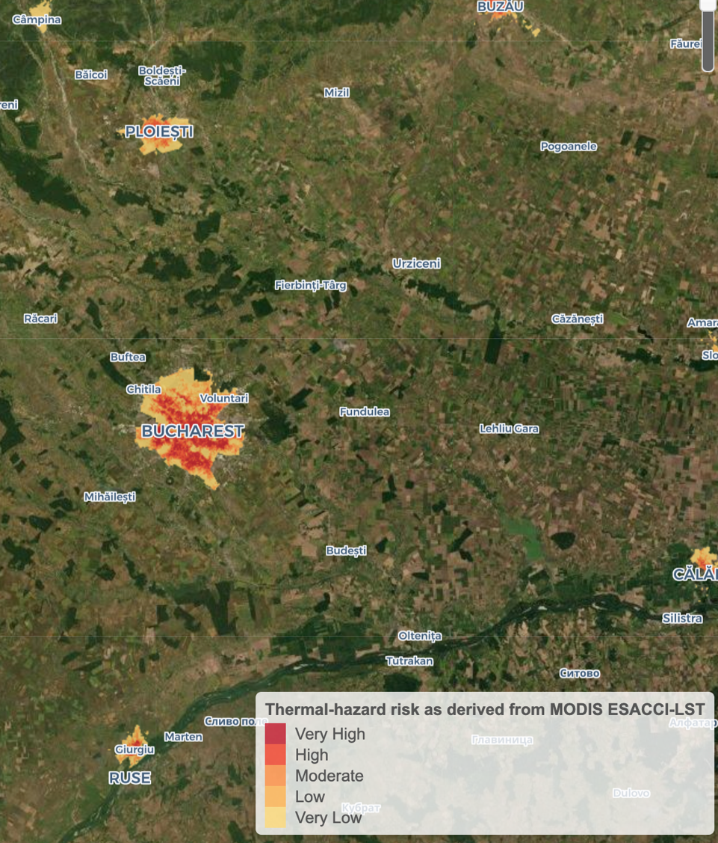
Temperature Hazard-Risk in Urban Areas in Romania, Bucharest area

Slide 39
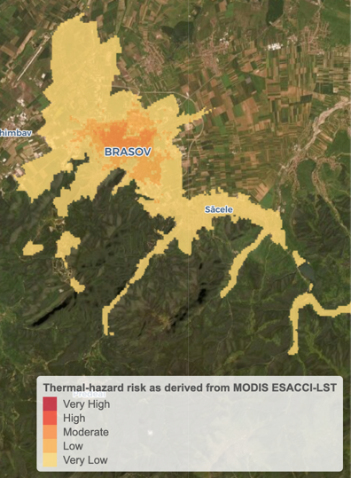
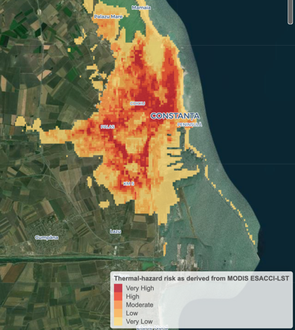
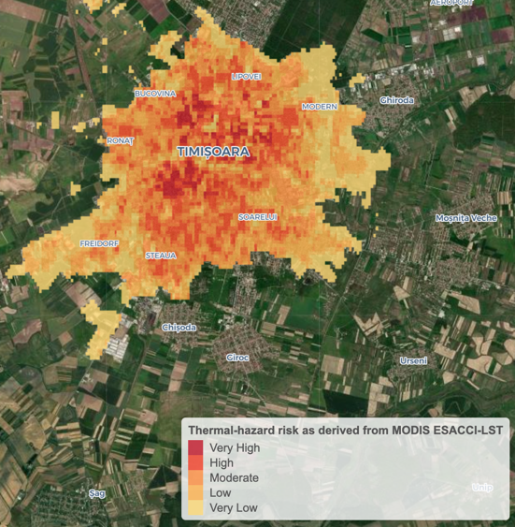
Brașov (291 k; mountain)
Temperature Hazard-Risk in Urban Areas of Romania
Constanța (319 k; Black Sea coast)
Timișoara (333 k; plain area)

Slide 40
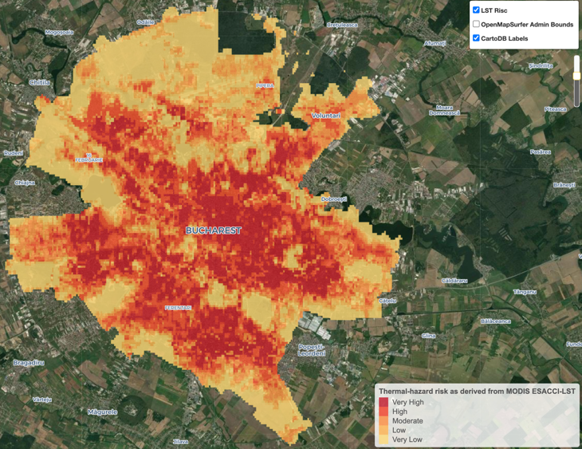
Temperature Hazard-Risk in Urban Areas in Bucharest, Romania

Slide 41
Summary
1. Done:
LST, SUHI and high temperature-hazard risk for all cities above 30,000 inhabitants in Romania using MODIS products and some ancillary data
2. To do:
To analyse the results in combination with drivers (e.g. land cover, land use, more demographic factors)
Country-Scale Climatology of the Surface Urban Heat Island using MODIS LST products

