Slide 1

Heritage Space Programme (LTDP+)
Mirko Albani, Heritage Space Programme Manager (EOP-GM)

Slide 2






Heritage Space Programme
→ Capability to look back in time
Coordinated action to maintain ESA heritage space data and to enable long-term studies (e.g. in Earth Observation or in Astrophysics)
Inter-directorate activity (EOP, SCI, HRE, OPS, DG Cabinet)
Covering 60+ ESA missions (e.g. ERS, Envisat, GOCE, Giotto, ISO, etc.)
Ensuring data continuity with current/future missions in support to research & applications requiring long time data series (e.g. climate change)
PRESERVE AND KNOW THE PAST
UNDERSTAND THE PRESENT
SHAPE AND ENABLE THE FUTURE

Slide 3
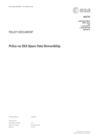

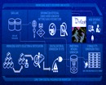
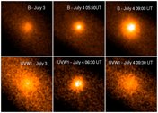
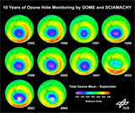


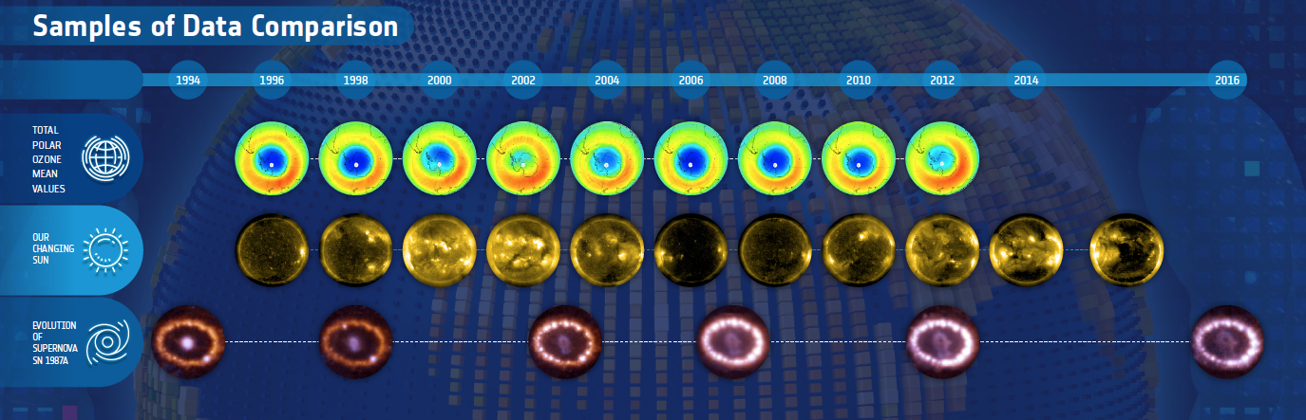

Heritage Space Programme Activities
Inter-directorate Joint Activities
Coordinating efforts and removing barriers
Directorates Specific Activities
Addressing heritage missions specific needs and filling known gaps wrt common strategy & standards
Space Data & Information Preservation
Envisat
XMM
ESA Space Data Management and Curation Policy
Shared Systems & Services
ESA Data Discovery Portal
Joint contribution to standardization bodies

Slide 4
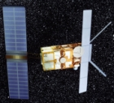
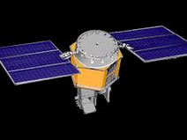

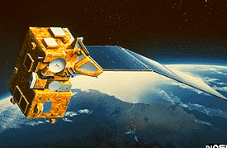
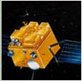
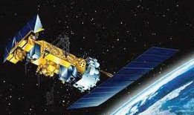
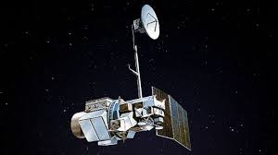
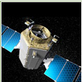






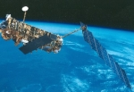
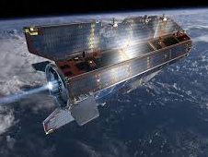
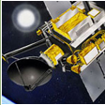
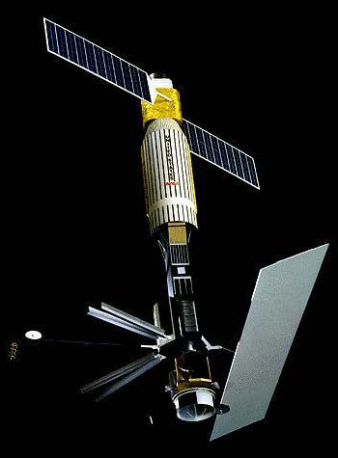
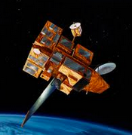

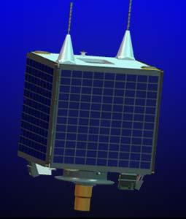

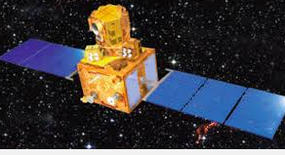



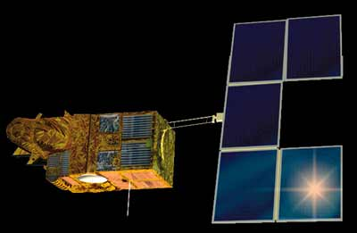

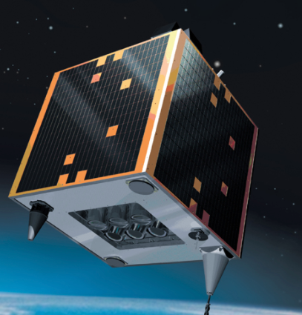
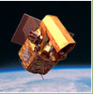






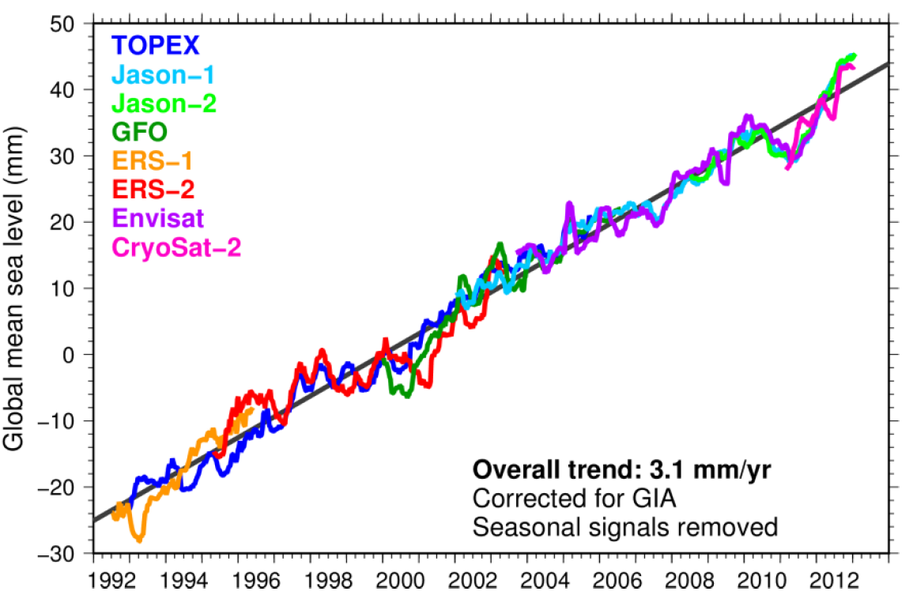
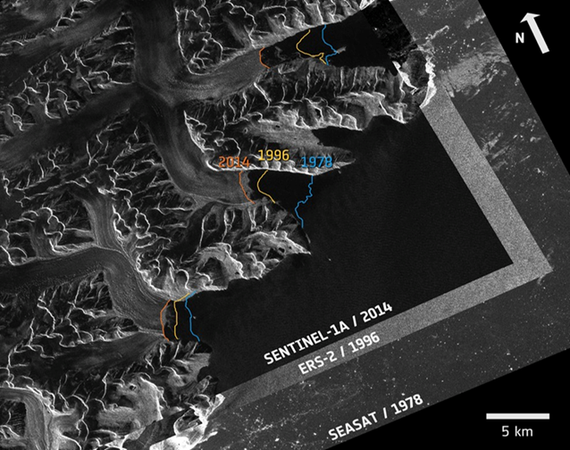
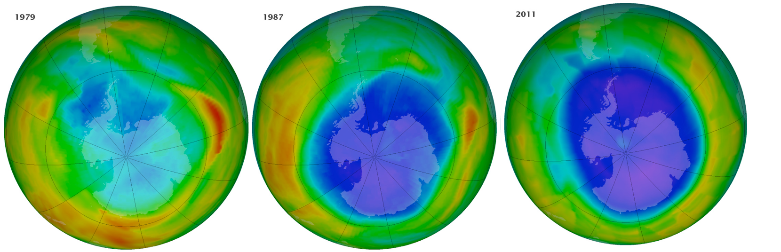
Earth Observation Heritage Missions
ESA Heritage Missions
ESA Heritage
Third Party Missions
ERS-1
ERS-2
HCMM
Nimbus 7
MOS-1/1b
JERS-1
NOAA POES
Landsat 1-5
Kompsat-1/2
Landsat-1/5
SEASAT
ADEOS-1
ALOS
DMC-UK-1
IRS-P6
Quickscat
Envisat
GOCE
Ikonos-2
SPOT 1-2-3
IRS-P3
Orbview-2
DEIMOS-1
Notes:
These data must be preserved, kept discoverable and accessible to all users with latest tools and technologies, and continuously improved to ensure fitness for purpose and continuity with present and future missions.

Slide 5
Heritage Space Joint and EO Specific Activities
  Basic data quality and valorisation activities to enable and facilitate exploitability & usability for some high priority EO heritage missions
  Generation of 2 Fundamental Data Records
  Full reprocessing of ERS/Envisat SAR data and generation of Analysis Ready Data (ARD)
  Data valorization and long time series generation for all heritage missions
  Generation of remaining 8 Fundamental Data Records (FDRs)
Activities foreseen in PB-EO original proposal
Activities foreseen with Space 19+ budget
Heritage Data Valorisation and Fundamental Data Records (FDR)
  Discoverability and accessibility for high priority missions possibly with similar performances & tools as newer missions; basic for other missions
  Advanced discovery and access through state of art technologies and tools (e.g. data cubes, primitive features extraction, processing on demand)
  Support and resources for End Users research and pilot activities
EO Heritage Data
Discovery & Access
  For all EO heritage missions: data & information consolidation, archiving & preservation to prevent loss
  Full application of international preservation standards
  Recovery and consolidation of additional data (e.g. from third parties) to enlarge ESA heritage data sets
EO Heritage Data and
Information Preservation
ESA-Wide Joint Activities & Coordination with MSs
  Continuation of on-going Joint Activities for ESA heritage space data and information preservation and discovery
  Coordination with ESA Member States
  New cooperation activities for ESA heritage data & information management, valorization and use

Slide 6
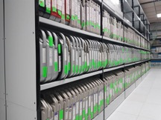
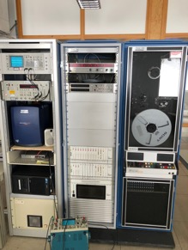
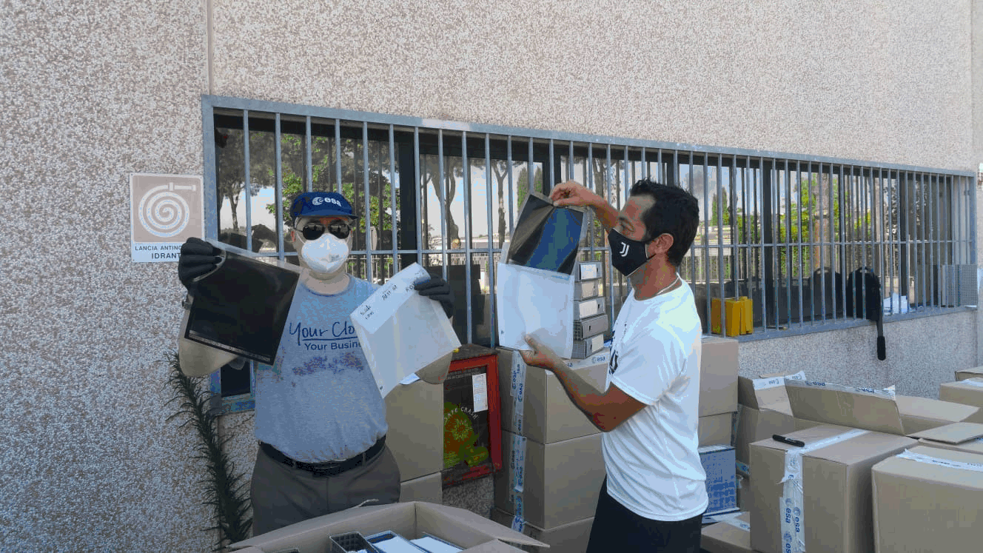
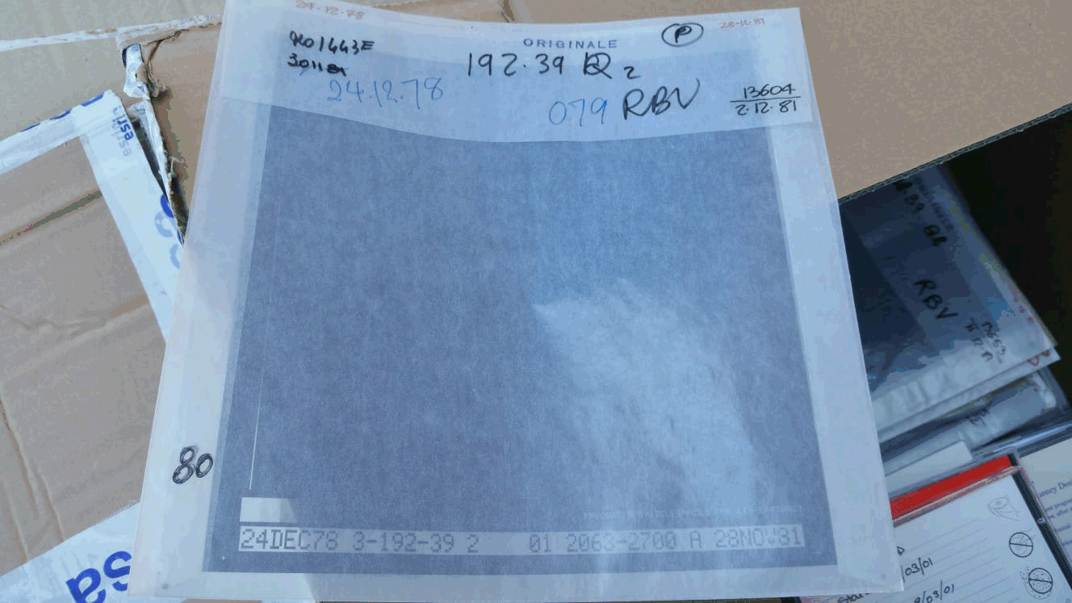
EO Heritage Data Transcription and Recovery
ERS LBR data to fill identified gaps in Master Datasets
ERS SAR data from National and Foreign Stations: ASF (USA), Japanese Stations, INPE (Brazil), CCMEO (Canada); others being considered.
Photographic negatives of Landsat RBV (Return-Beam Vidicon) instrument: 80m resolution (Landsat 2) and 40m (Landsat 3).
Unique data acquired in late 70’s at Fucino ground station, no other copies exist !!
Negatives will be digitalized and made accessible to the user community.

Slide 7
Newly available or upcoming Heritage Datasets
(excerpt)

Slide 8
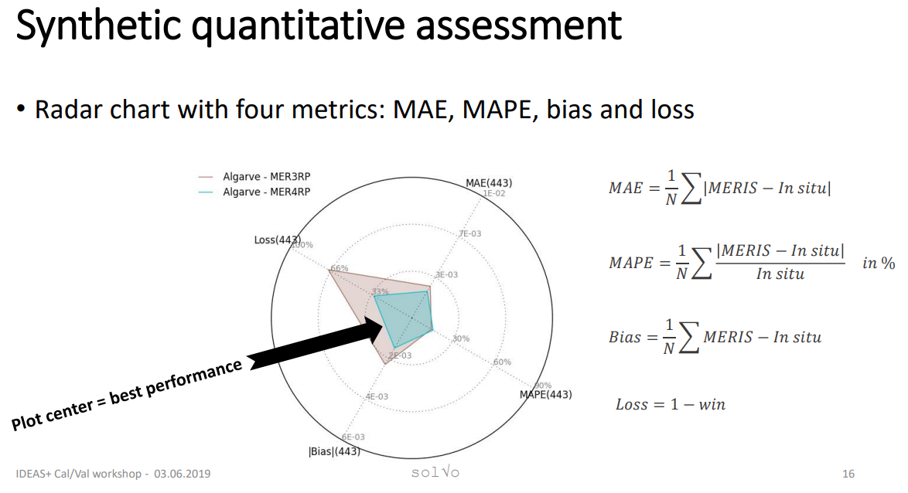
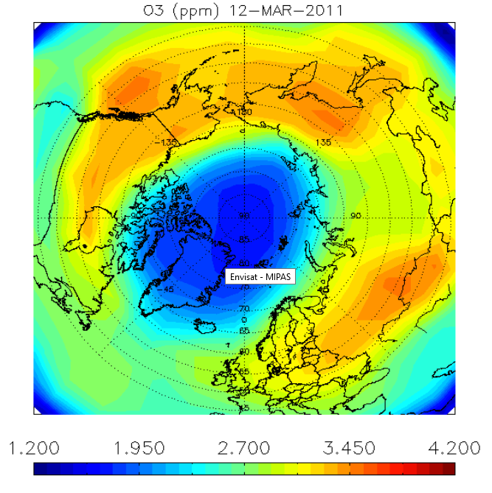
ENVISAT MERIS & MIPAS
MERIS
Completed 4th Reprocessing and Quality Control of Full Resolution (FR) & Reduced Resolution (RR) data of the full mission.
Ensured alignment with the Copernicus Sentinel-3 OLCI data set, including ortho-geolocation.
Released to users in July 2020.
MIPAS
MIPAS L1 data (V7) disseminated to users on January 2019.
Reprocessing campaign of L2 data completed and QC activities ongoing.
Release to users by end 2020.
MERIS 4th reprocessing assessment, C. Mazeran IDEAS+
MIPAS ozone daily map at 19 km (490 K)

Slide 9
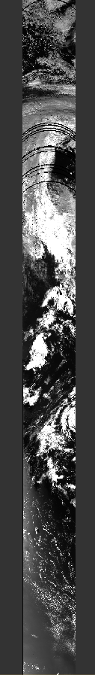
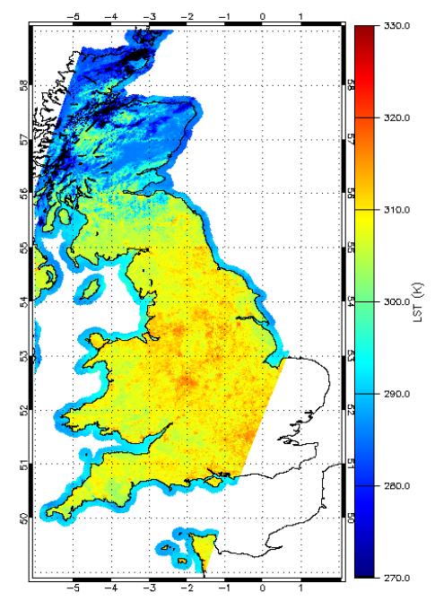
ERS/ENVISAT – (A)ATSR series
The Envisat AATSR data set reprocessing campaign from L0 to L1a was completed including the AATSR 12μm correction.
Stitching of the ERS-1 and -2 UBT scene to L1a orbit was completed.
Complete series reprocessing from L1a to L1b, which will ensure alignment with the Copernicus Sentinel-3 SLSTR data set and basic cloud masking: to be started.
Cloud masking for SST and LST to be implemented as further step after L1b products are generated.
ATSR-2 Land Surface Temperature (LST)
ATSR-1 L1A UBT orbit on 13 September 1991

Slide 10
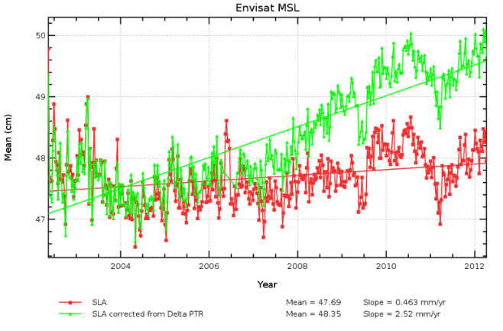
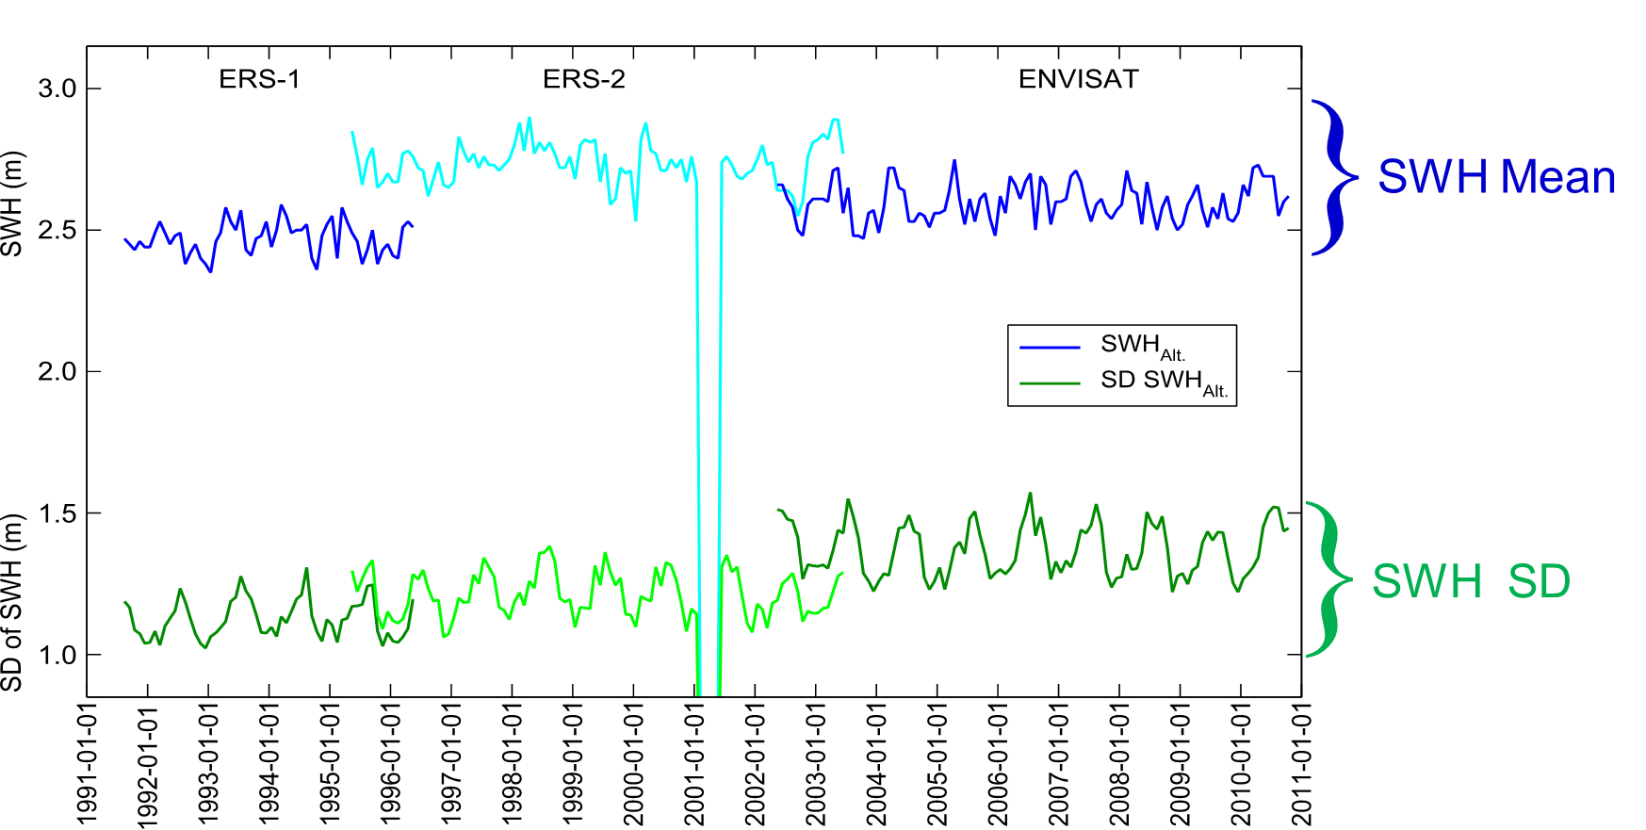
Fundamental Data Records (FDR)
→ A long-term data record of calibrated and QC sensor data
Two projects started in Q3 2019 with the goal to generate homogeneous accurate stable products (long time series):
Basis for higher level products or parameters (ECV).
Rigorous metrology processes → well characterized uncertainties, traceable ideally to standard.
  FDR for Altimetry (FDR4ALT)
FDR for Atmospheric composition (FDR4ATMOS)
ERS-1, ERS-2 and Envisat Radar Altimeter (RA) and Micro-Wave Radiometer (MWR)
ERS/Envisat GOME, SCIAMACHY
Output:
Two Level 1 FDRs and five Level 2 Thematic Data Products.
Continuity with CryoSat SIRAL and Sentinel-3 SRAL sensors.
Output:
Three Level-1 FDRs providing continuity between GOME, SCIAMACHY and Sentinel-5P, Sentinel-4 and Sentinel-5.
https://www.fdr4alt.org/
https://earth.esa.int/eogateway/documents/20142/1484253/ESA-Fundamental-Data-Records-for-Atmospheric-Composition-%28FDR4ATMOS%29-status-and-updates.pdf

Slide 11
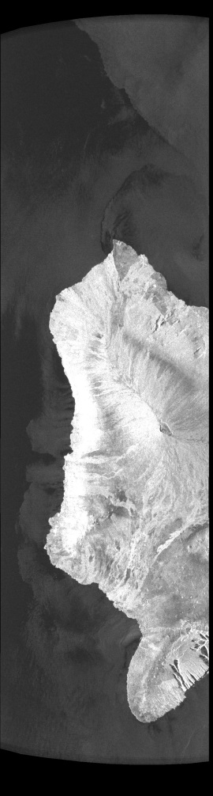
ERS/ENVISAT – (A)SAR series
ASAR (IM, AP, WS) and ERS-1/2 SAR (IM) data accessible through the On-the-Fly system based on user requests.
Master dataset enlarged with new recovered data
ASAR medium resolution products (WSM, GMM, IMM and APM) bulk reprocessing for 2006-2012 completed and QC on-going. Full mission reprocessed.
IPF update being considered to improve ERS SAR geolocation
ASAR Image Mode Medium Resolution Image acquired on 6 June 2005 and the corresponding Doppler Centroid

Slide 12
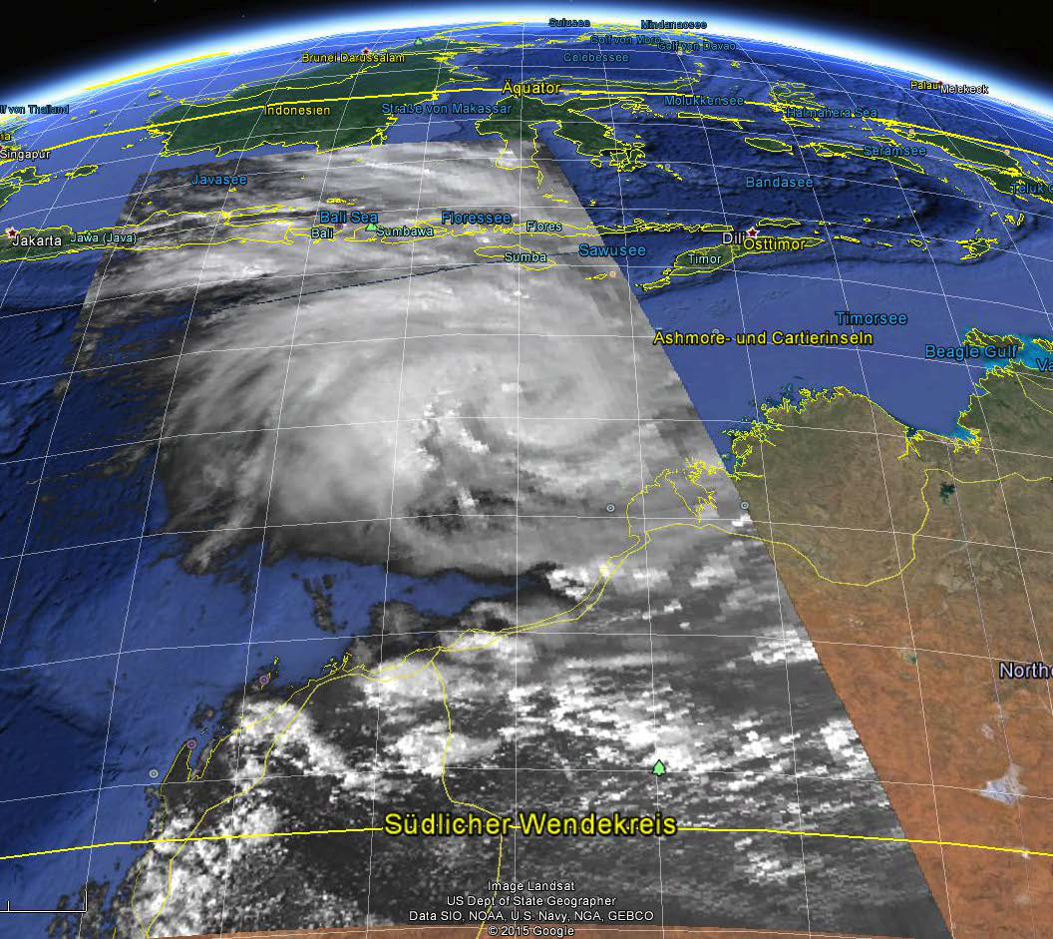
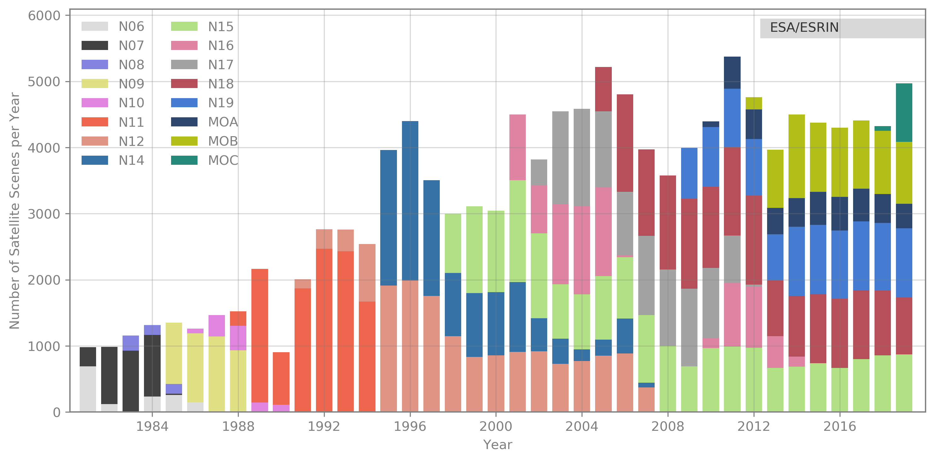
AVHRR (NOAA, Metop)
A Harmonised European AVHRR Level-1b Master dataset, consisting of about 234 thousands products, and covering Europe from 1981 to 2019 has been generated combining and reprocessing the ESA, UniBern and University of Dundee data archives.
The dataset is archived for unlimited time by ESA and accessible to users online free of charge through the ESA dissemination services.
The project will now focus on enlarging the new dataset with the “1Km AVHRR data” acquired in the frame of the dedicated worldwide campaign project run at the end of 90s’, and in further processing the dataset into Level-1c (geocoded, orthorectified and calibrated).
NOAA-6 VIS, 20. January 1980

Slide 13
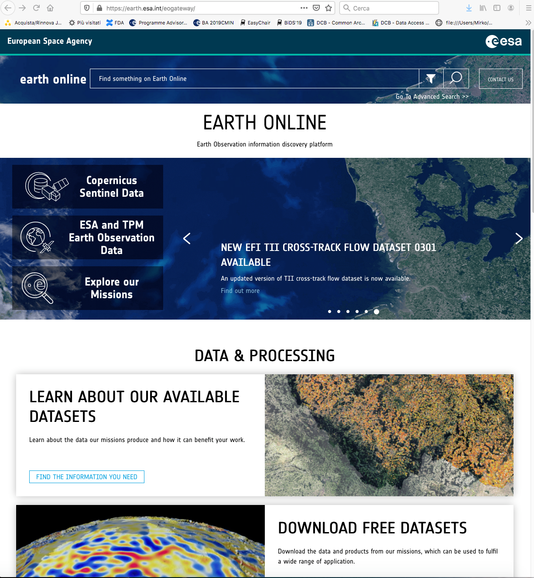
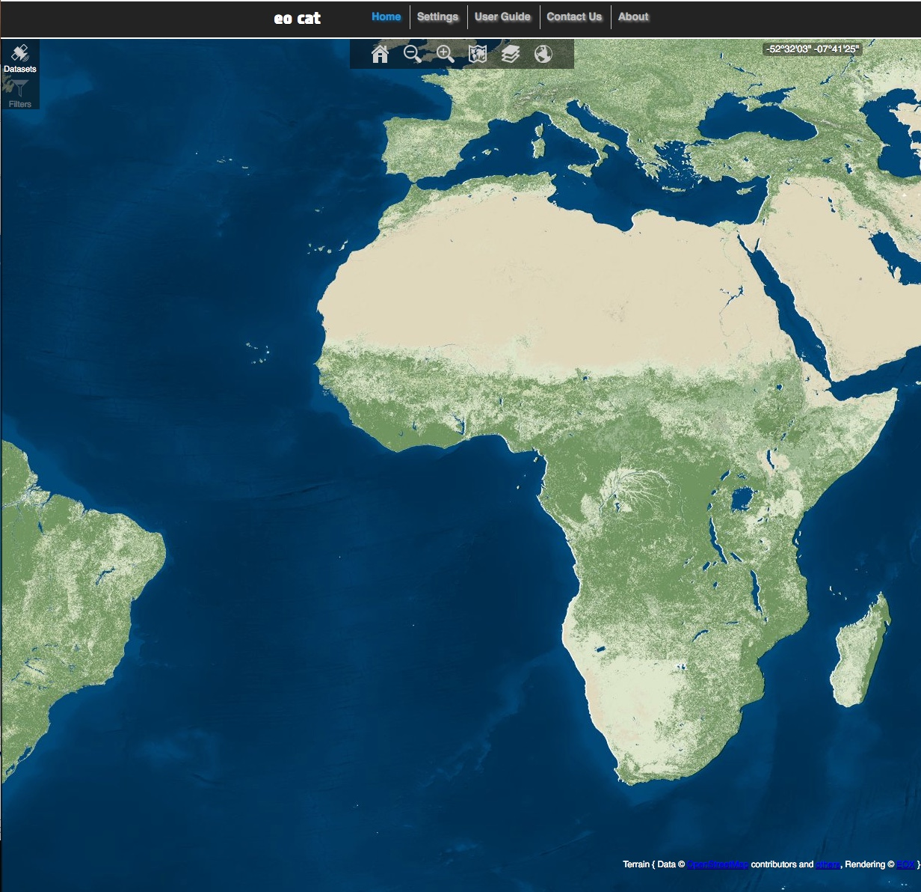
Earth Observation Heritage Data Access
https://earth.esa.int/eogateway/

Slide 14
Some final thinking…
Should we systematically ensure long term preservation and accessibility of Climate Data Records and ECVs generated in the frame of CCI activities (including technical information like algorithms, CAL/VAL databases, quality, visualization and processing tools) ?
What additional heritage datasets, not accessible today, would be of high value for CCI activities ?
What activity/improvement should be done to further increase ESA heritage data value for CCI ?

Slide 15
Thank You !!
Contacts: Mirko.Albani@esa.int

