Slide 1



Transforming Carbon Emission Estimates with ESA CCI Data
Insights from the University of Exeter Carbon Cycle group
Dr. Thais M. Rosan | University of Exeter | 40TH ISRSE

Slide 2
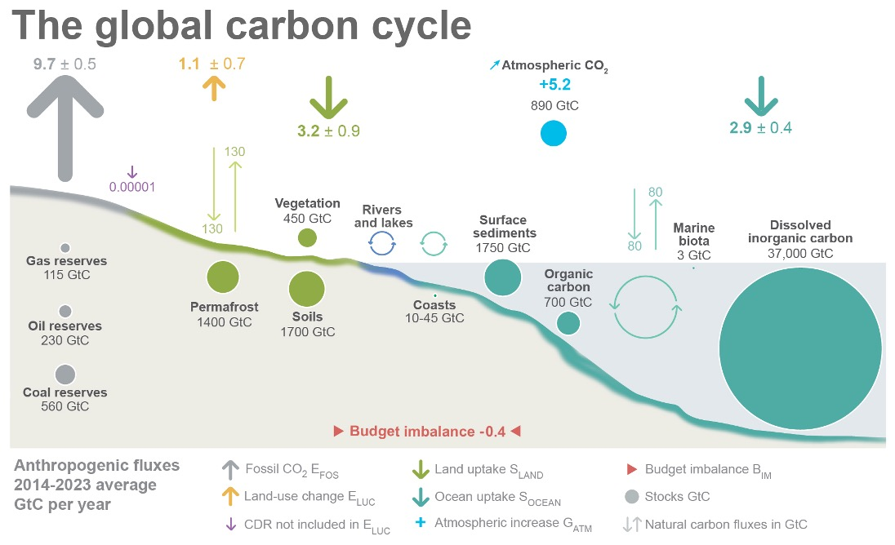
The Importance of Accurate CO₂ Estimation
“To effectively mitigate climate change, we need precise and up-to-date estimates of carbon fluxes”
Source: NOAA-GML; Friedlingstein et al 2024; Canadell et al 2021 (IPCC AR6 WG1 Chapter 5);Global Carbon Project 2024

Slide 3
To effectively mitigate climate change, we need precise and up-to-date estimates of carbon fluxes
The Importance of Accurate CO₂ Estimation

Slide 4
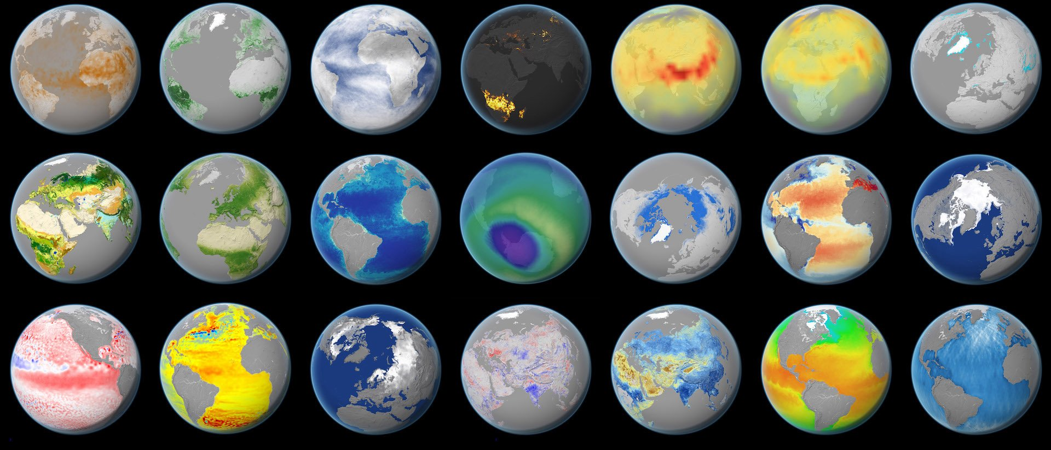
Satellites offers continuous and large-scale observations
https://climate.esa.int/en/data/#/dashboard
Notes:
“Traditional ground-based methods for tracking emissions are limited in coverage and can’t provide the global view needed for climate action. Satellites overcome this limitation by offering continuous, large-scale observations of carbon sources and sinks.”
Earth Observation (EO) data strengthens estimates

Slide 5
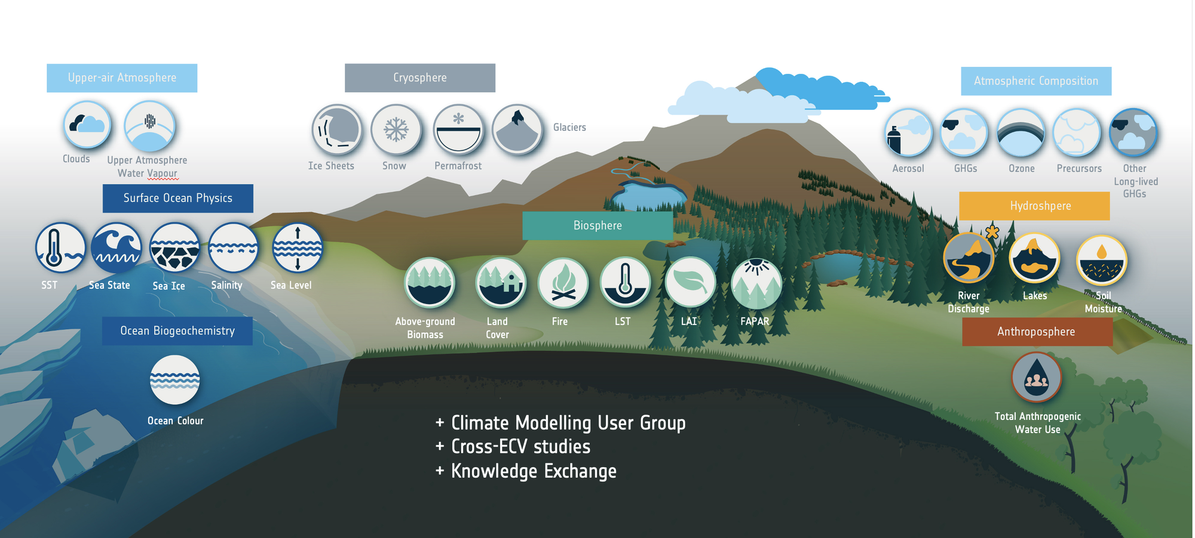
ESA’s Climate Change Initiative (CCI)
https://climate.esa.int/en/about-us-new/climate-change-initiative/Climate-Change-Initiative/
Notes:
“ESA’s Climate Change Initiative provides high-quality, long-term satellite datasets that are essential for refining carbon budget assessments. These datasets span biomass, fire, greenhouse gases, and land cover, among others.”
“By integrating these datasets, we can improve the accuracy of emissions estimates and better inform climate policy.”

Slide 6
Insights from the University of Exeter Carbon Cycle group

Slide 7
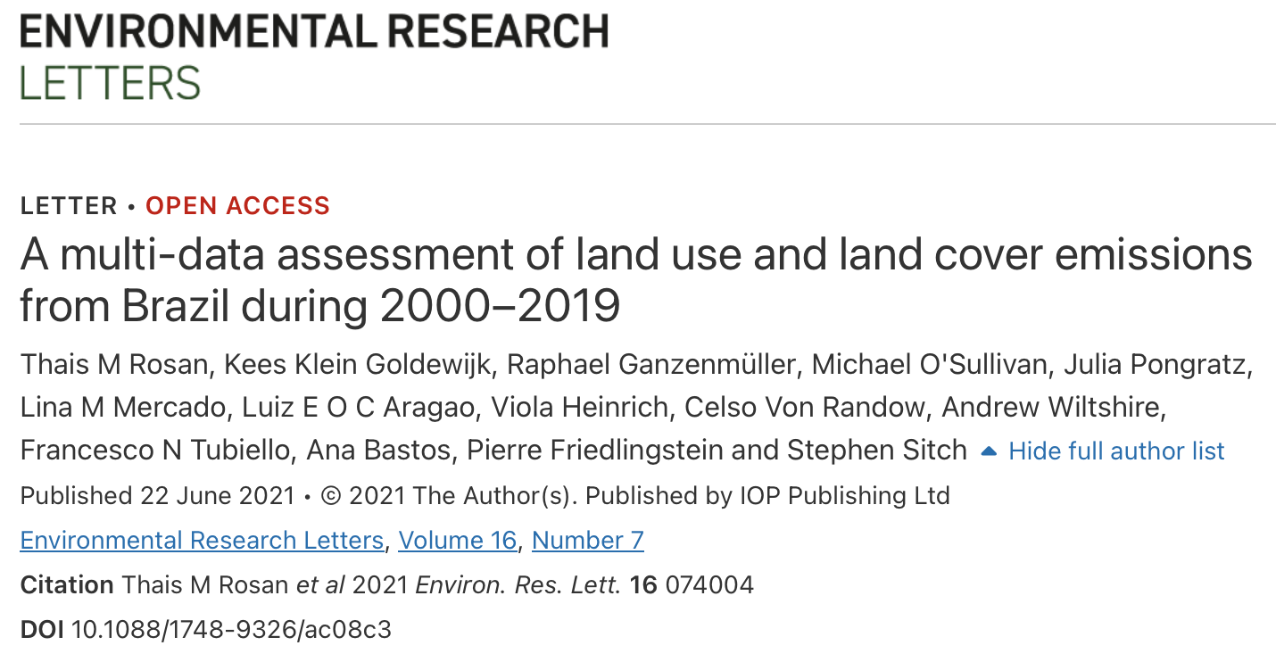
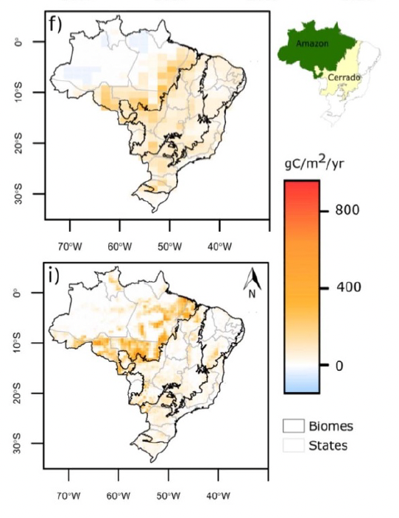
Improving Land-Use Emissions in the Global Carbon Budget
JULES DGVM
BLUE BK
“Using ESA CCI land cover maps in global LU datasets improved the spatial allocation of land use changes and emissions trends in Brazil”
REgional Carbon Cycle Assessment and Processes (RECCAP Project)
Notes:
The ESA CCI satellite-based land cover data has significantly enhanced the spatial representation of land use and land cover change (LULCC) in Brazil, improving the accuracy of global datasets like HYDE 3.3 and strengthening model estimates of LULCC emissions, ultimately reducing uncertainty in global carbon budget assessments.

Slide 8
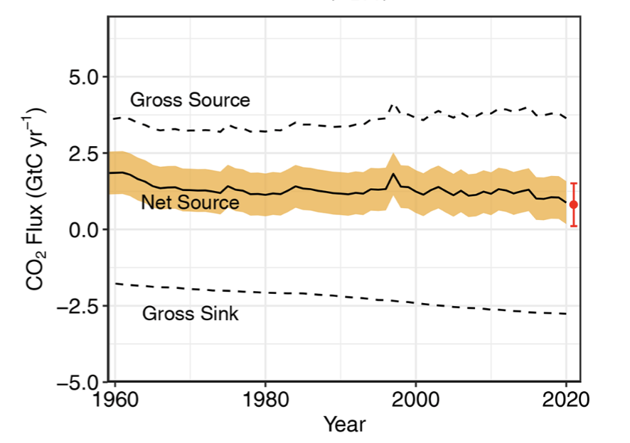
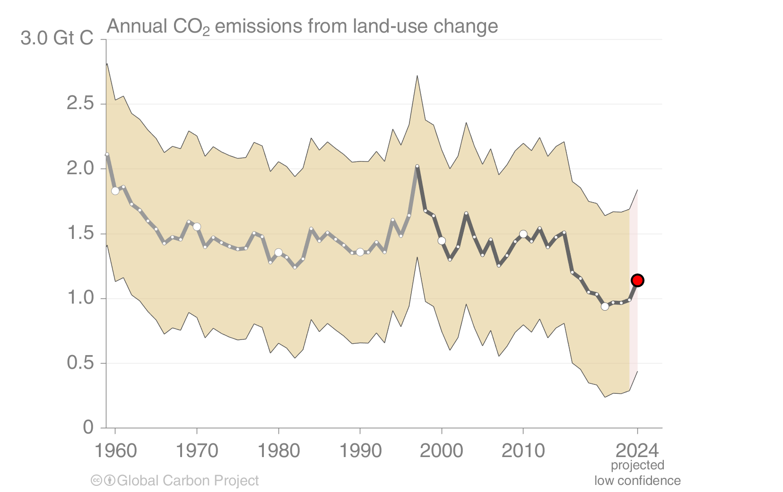
Improving Land-Use Emissions in the Global Carbon Budget
GCB 2021
GCB 2024
Deforestation
Regrowth - secondary forest

Slide 9
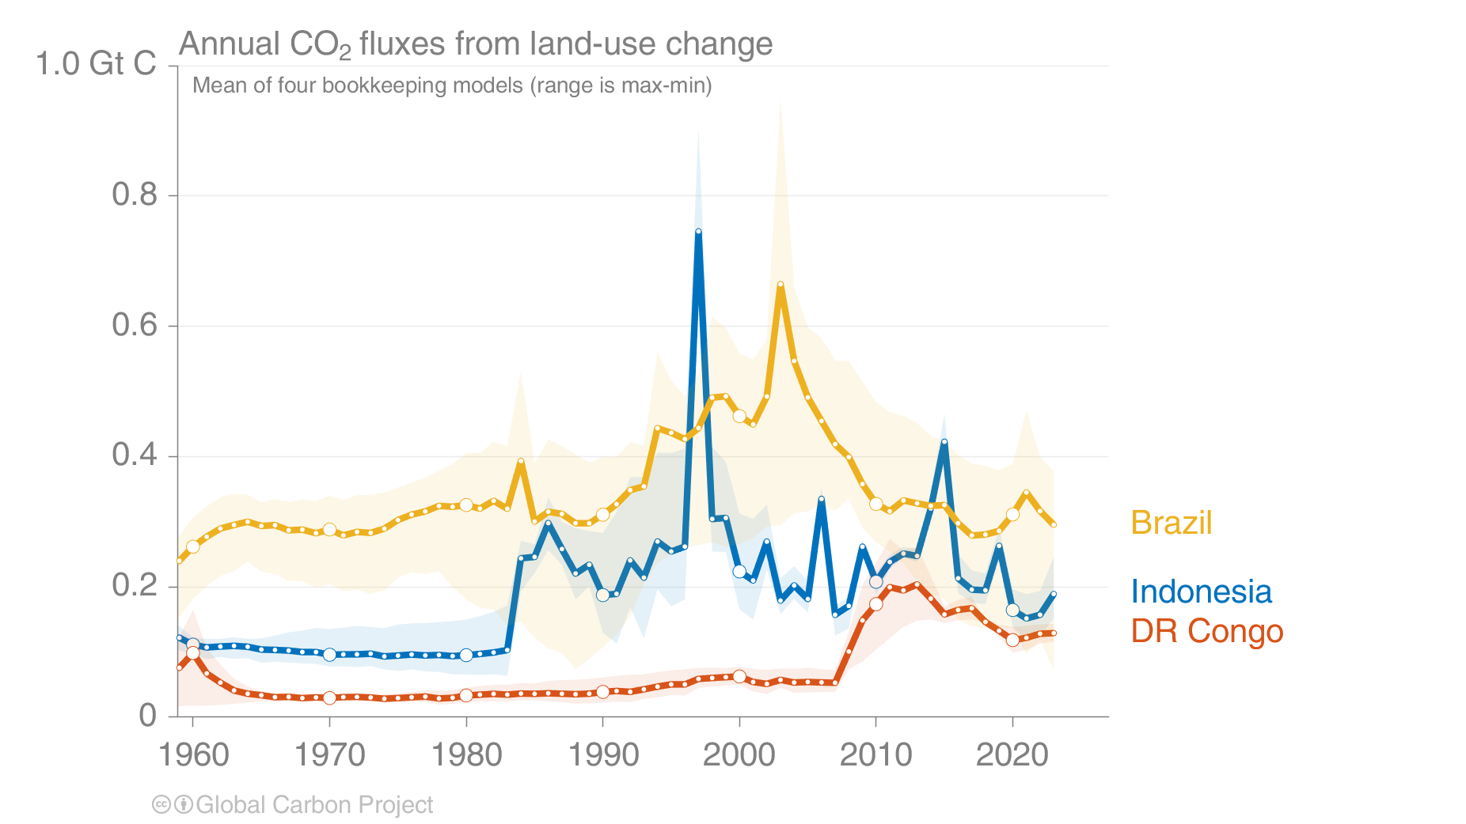
Improving Land-Use Emissions in the Global Carbon Budget
Estimates from four bookkeeping models
Source: Friedlingstein et al 2024; Global Carbon Project 2024
Notes:
Relevance for COP, national GHG inventory

Slide 10
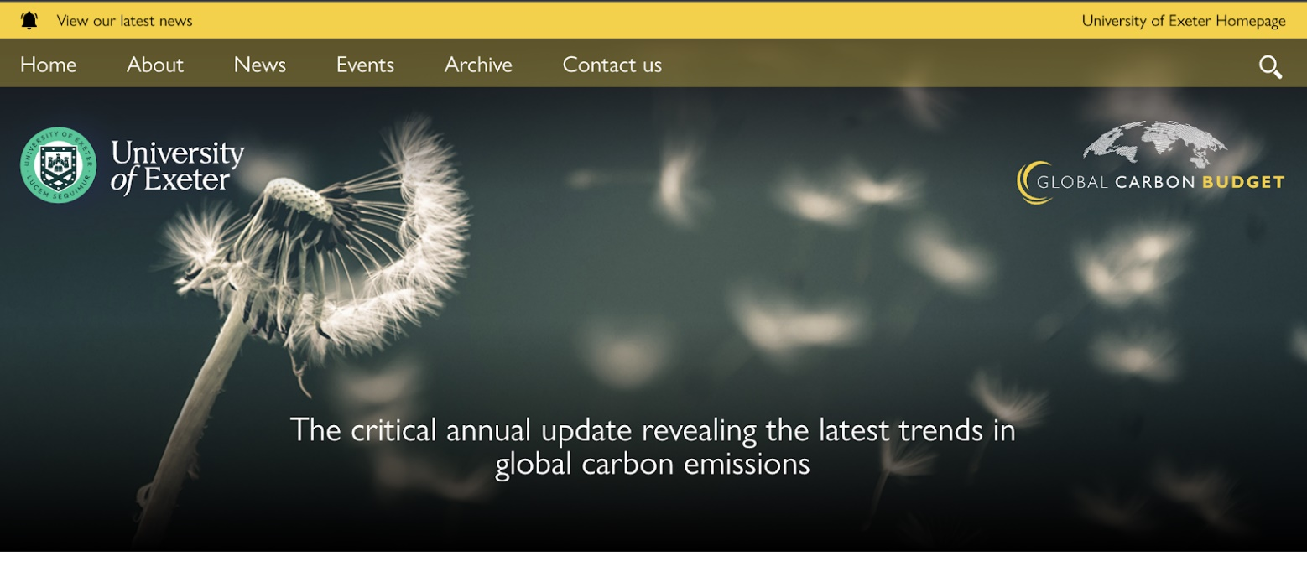
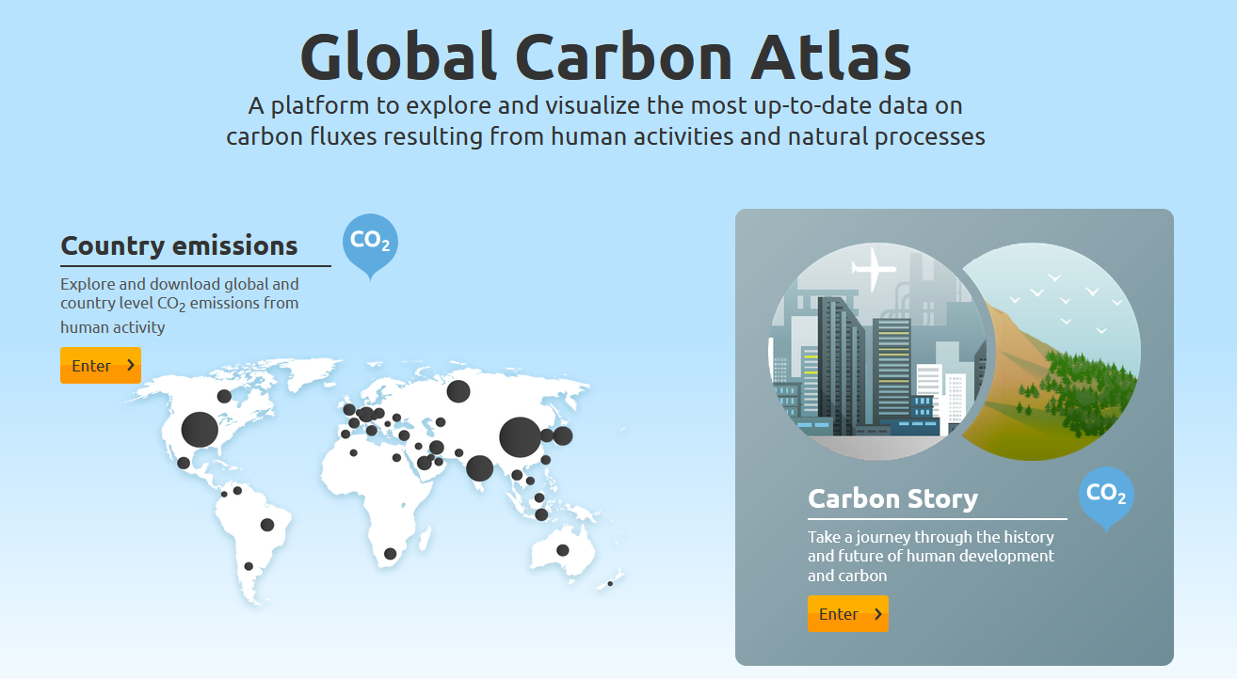
Global Carbon Budget
More information, data sources and data files:
https://globalcarbonbudget.org/carbonbudget
https://globalcarbonatlas.org

Slide 11
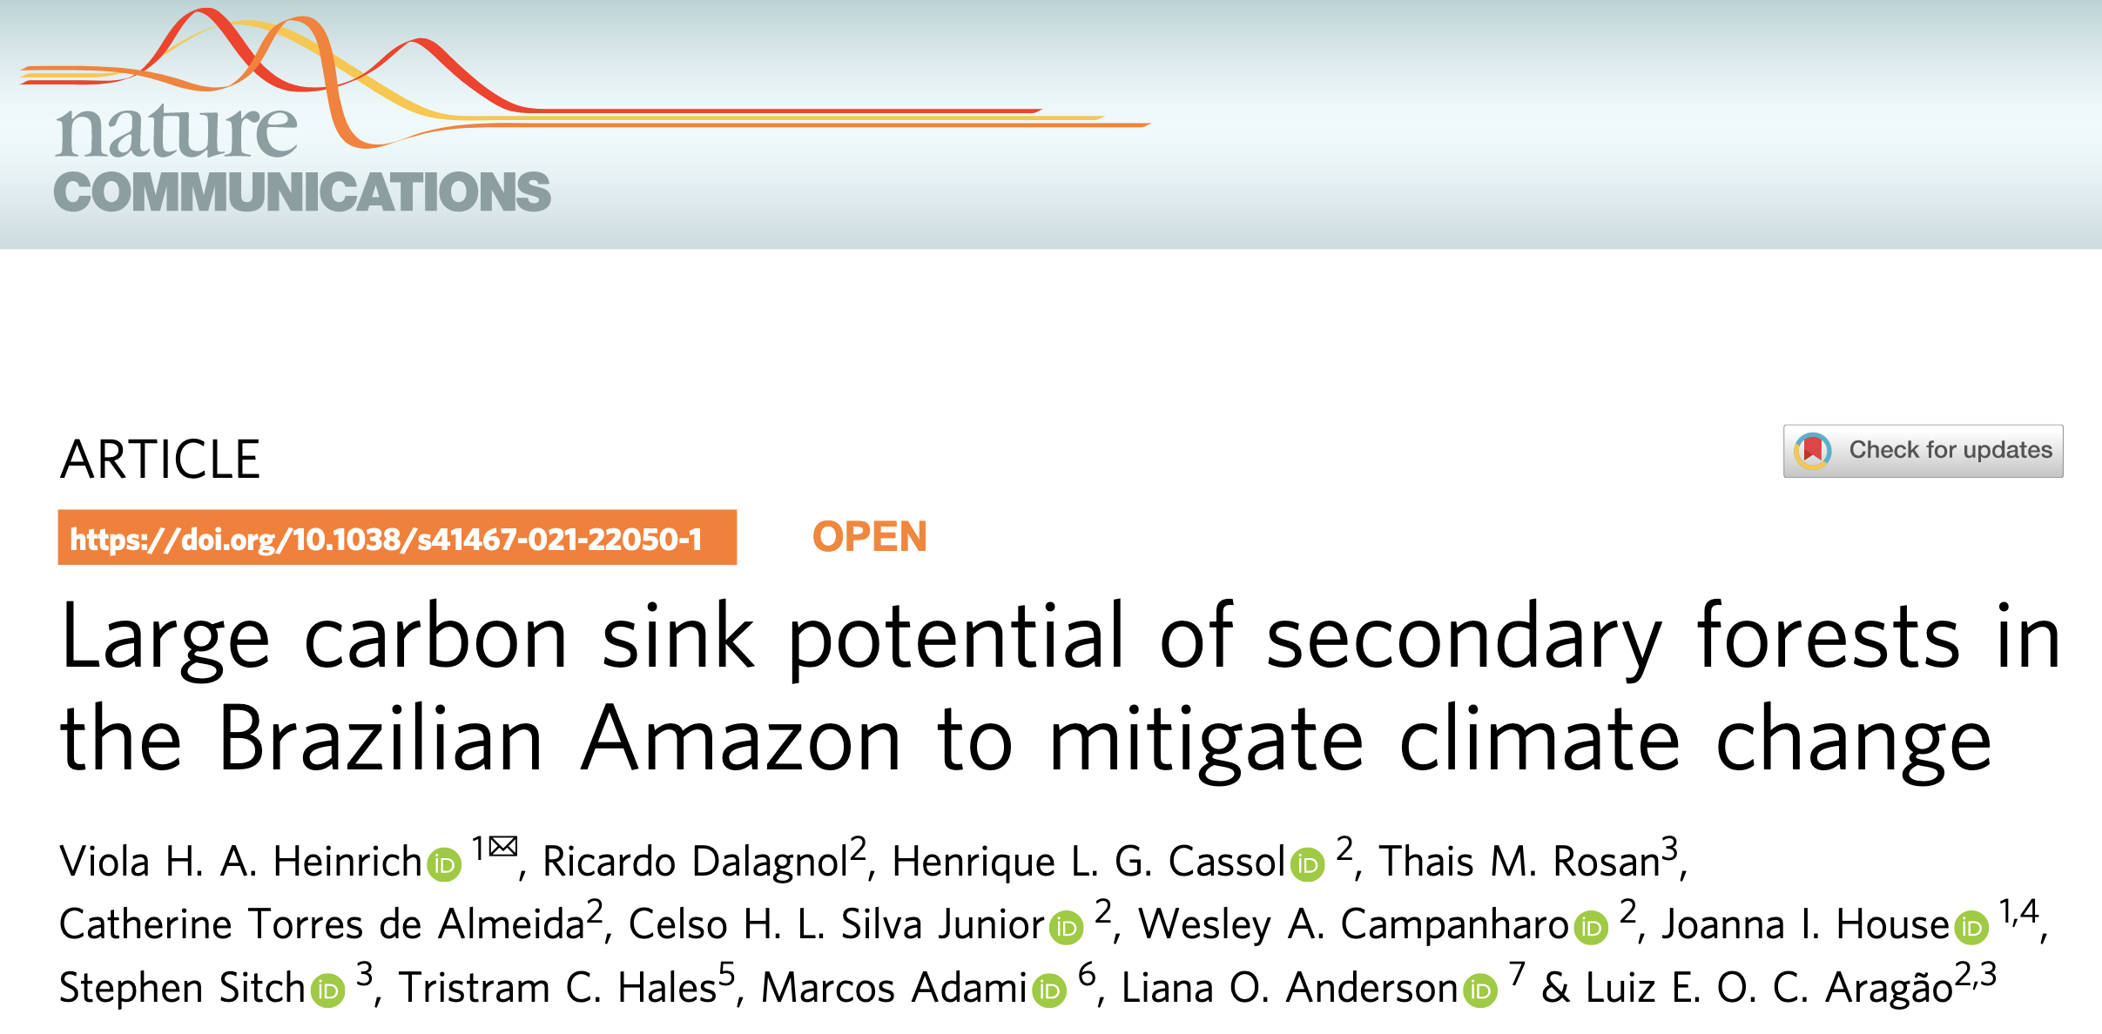
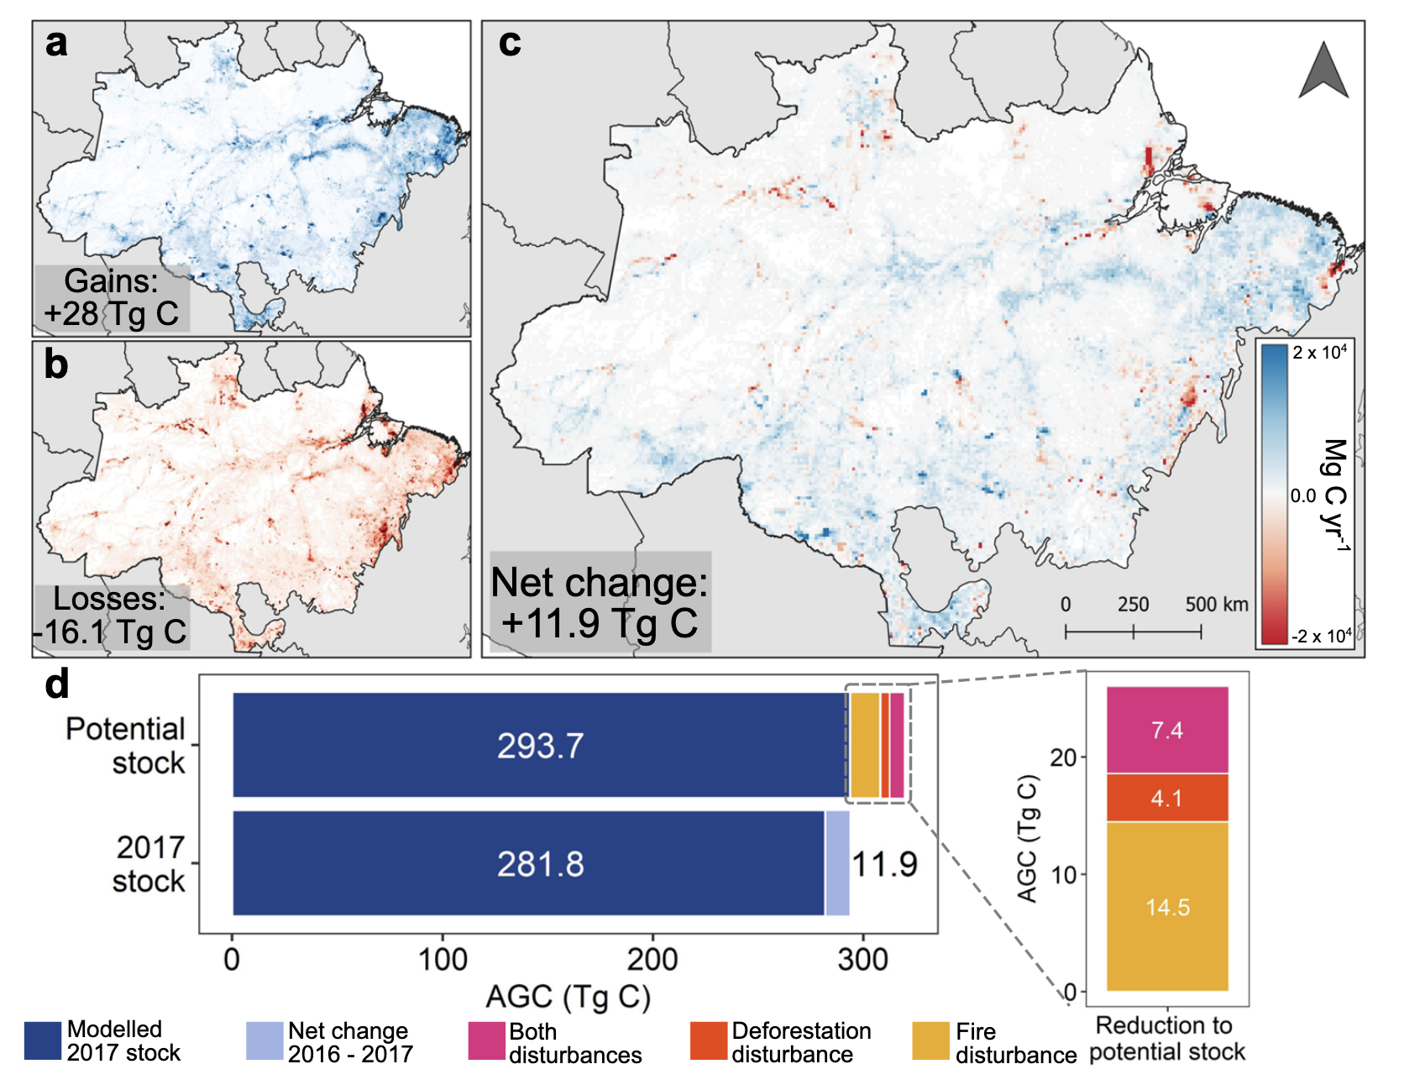
Estimating the carbon potential of secondary forests in the Amazon
“Utilizing ESA CCI aboveground biomass and secondary forest age maps, we modeled the regrowth rates of secondary forests and their carbon sink potential.”
Notes:
Using ESA CCI Biomass maps + secondary forest age maps – space for time substitution

Slide 12
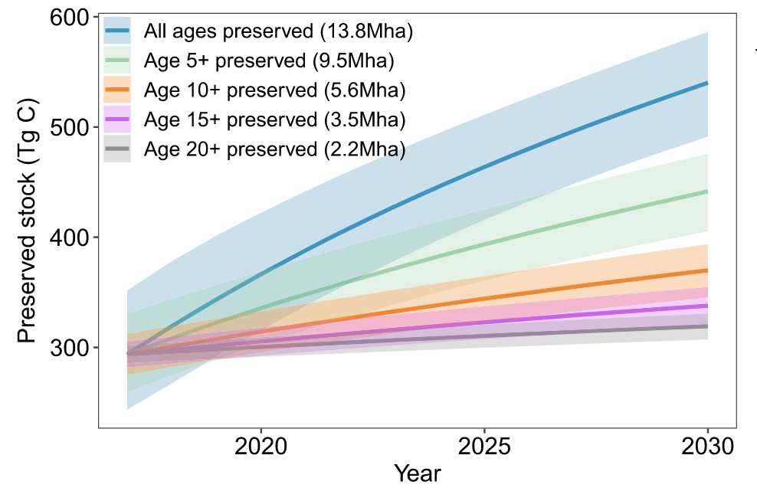
Estimating the carbon potential of secondary forests in the Amazon
Fires & deforestation reduce regrowth by 8–55%
Protecting secondary forests enhances their carbon sink potential and can contribute to reduction emissions targets
Notes:
Using ESA CCI Biomass maps + secondary forest age maps – space for time substitution

Slide 13
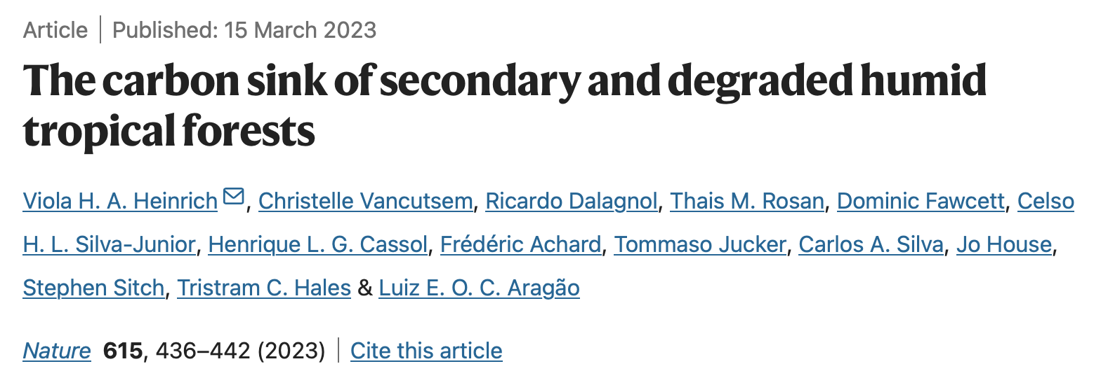
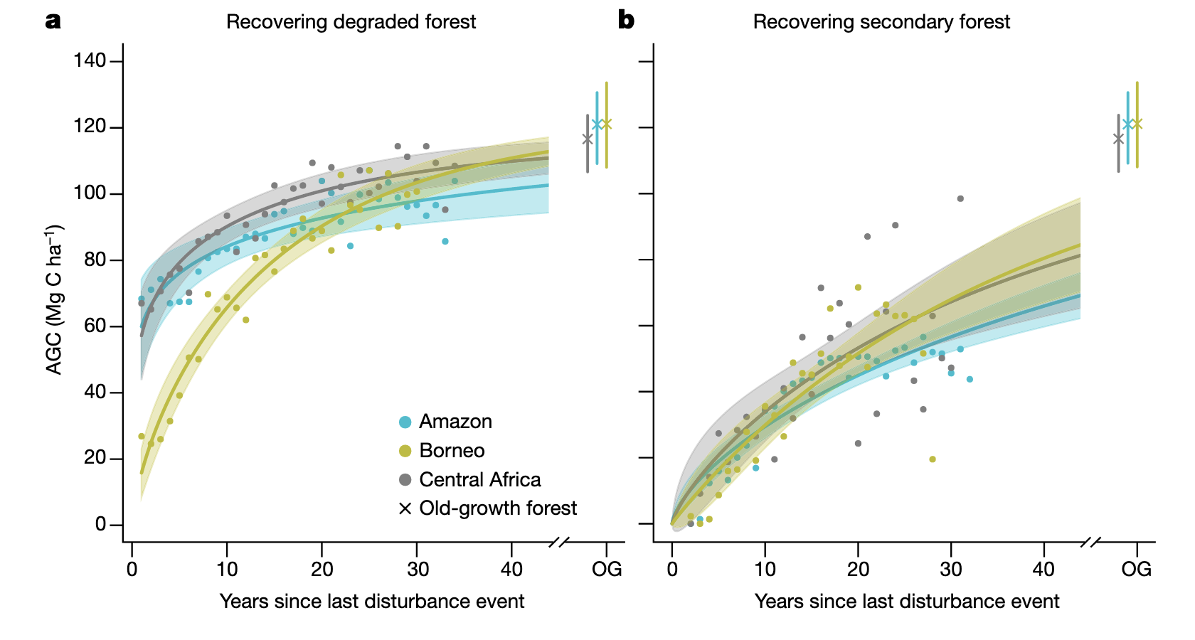
Estimating the carbon sink of secondary and degraded humid forests
In the first 20 years of recovery, regrowth rates in Borneo were up to 45% and 58% higher than in Central Africa and the Amazon, respectively.
Understanding regional variations in forest regrowth can guide tailored reforestation and conservation strategies, optimizing carbon sequestration outcomes.

Slide 14
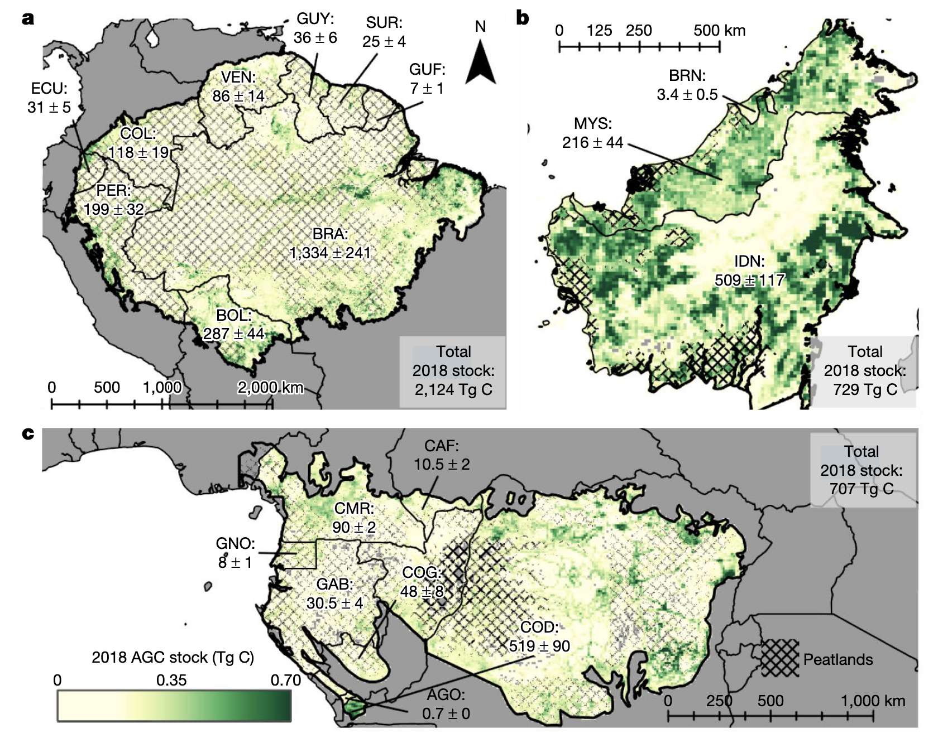
Estimating the carbon sink of secondary and degraded humid forests
“Regrowing degraded and secondary forests accumulated 107 Tg C year⁻¹ between 1984 and 2018, counterbalancing 26% (21–34%) of carbon emissions from humid tropical forest loss during the same period”

Slide 15
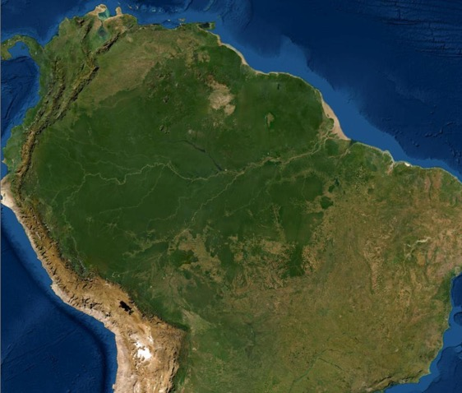
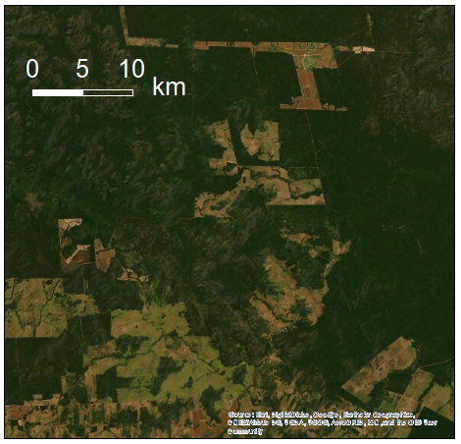
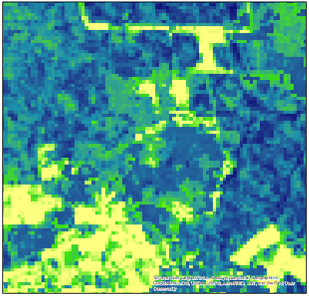

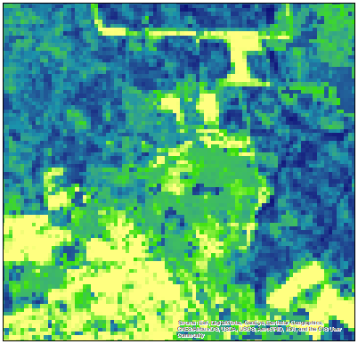
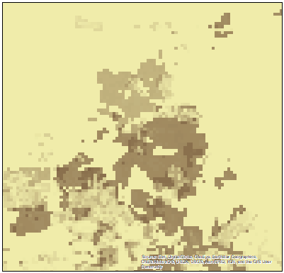

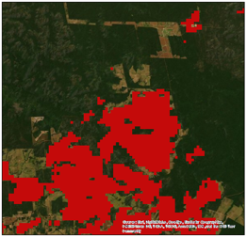
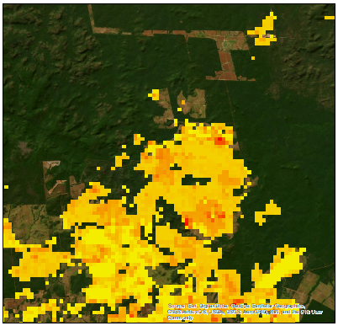
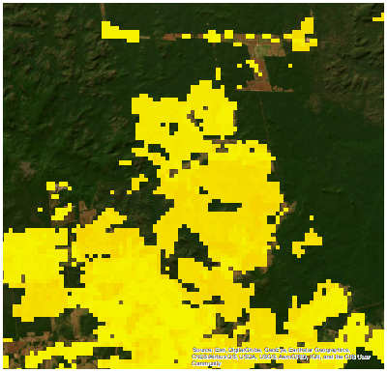
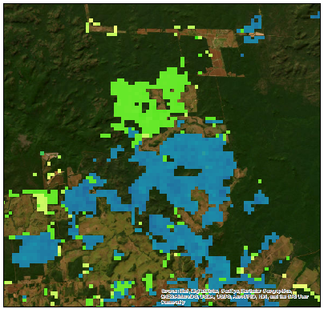


Fire Emissions Monitoring in the Amazon
Pre fire AGB
Post fire AGB
Mg ha⁻¹
Mg ha⁻¹
250
250
0
0
  Spatial resolution
  Woody biomass density with regional variability
  Biome specific estimates of post-fire mortality and legacy fluxes
Post-fire Mortality,
Deforestation
ESA CCI Biomass, ML
(Mapbiomas)
Dead wood pool
Mg ha⁻¹
125
Fuel load
0
Fire (Burned area)
Combustion
Decomposition
Regrowth
Emissions
Mg ha⁻¹ yr⁻¹
Mg ha⁻¹ yr⁻¹
MCD64A1,
MOD43
200
25
0
0
ESA CCI fire
Notes:
ESA CCI biomass
Aim is to use a range of fire data, including ESA FIRE CCI

Slide 16
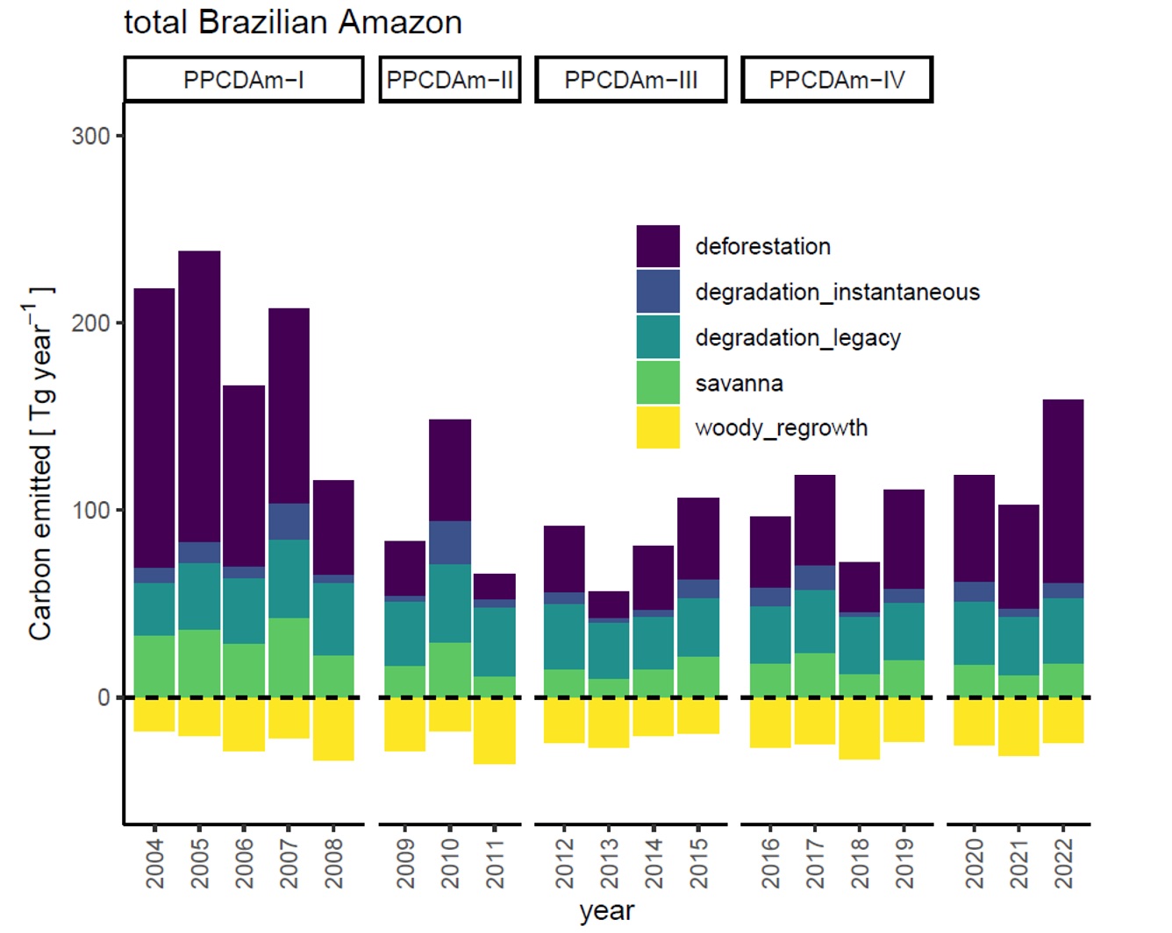
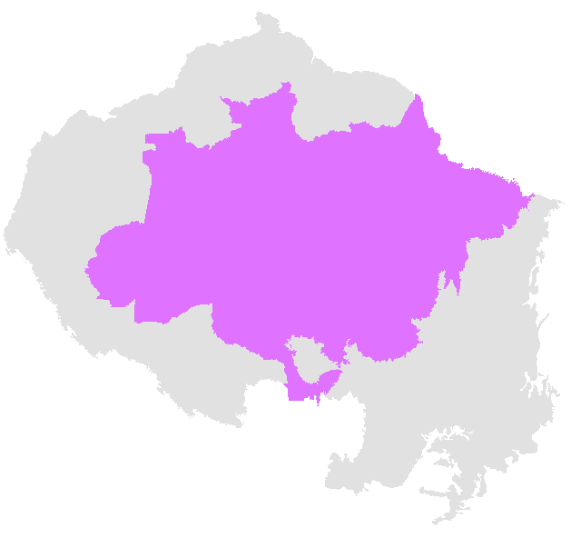
Fire Emissions Monitoring in the Amazon
“While instantaneous degradation emissions are comparatively small (9.5% of total instantaneous emissions), legacy fluxes account for 30.3% of gross emissions on average”
Fawcett et al., in prep

Slide 17
Near-Real-Time terrestrial carbon balance
DGVMs allow to estimate anomalies in carbon fluxes (and other variables) that are not directly or easily observed
Notes:
DGVMs biogeochemical processes not directly observed

Slide 18
Near-Real-Time terrestrial carbon balance
Preliminary Results for summer heatwave 2023
DGVMs Simulations targeted to extreme events that impacts the terrestrial carbon balance
Climate data from ESA ERA5 Reanalysis
Notes:
Aim to expand it by using fire cci data to prescribe fires in the DGVMs; track extreme fire events
Prescribe PFT from ESA CCI land cover

Slide 19
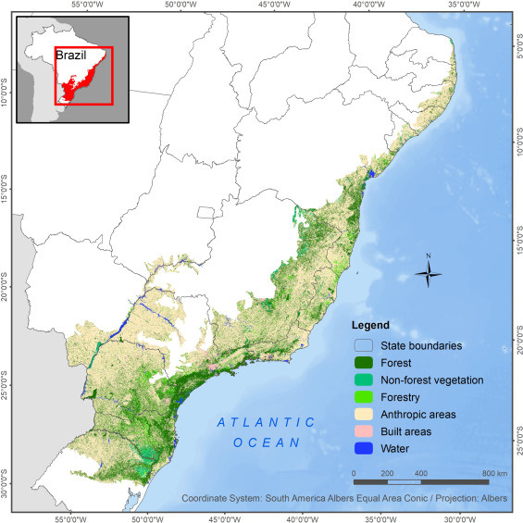
Carbon Sequestration Potential in the Brazilian Atlantic Forest
Biodiversity Hotspot – home to 20,000+ plant species and unique wildlife
Deforestation & Habitat Loss – Over 85% of its original area has been lost due to urbanization and agriculture
Highly fragmented landscape
Atlantic Forest – a restoration hotspot
21.6Mha – 36Mha of land potentially available for regeneration (Barros et al., 2023; Crouzeilles et al., 2020)

Slide 20




Carbon Sequestration Potential in the Brazilian Atlantic Forest
SECONDARY FOREST AGE
ABOVEGROUND CARBON
ENVIRONMENTAL VARIABLES
Age in 2020 (1986-2020)
Estimated based on the land cover changes (GEE code) collection 7.1 MapBiomas (; Silva Jr., et al, 2020; Heinrich et al., 2021)
ESA CCI ABOVEGROUND BIOMASS (2020)
Conversion factor of 0.47 (IPCC)
  Landscape fragmentation / connectivity
  MCWD
  Terrain slope
  Average maximum temperature
  Size of fragment

Slide 21
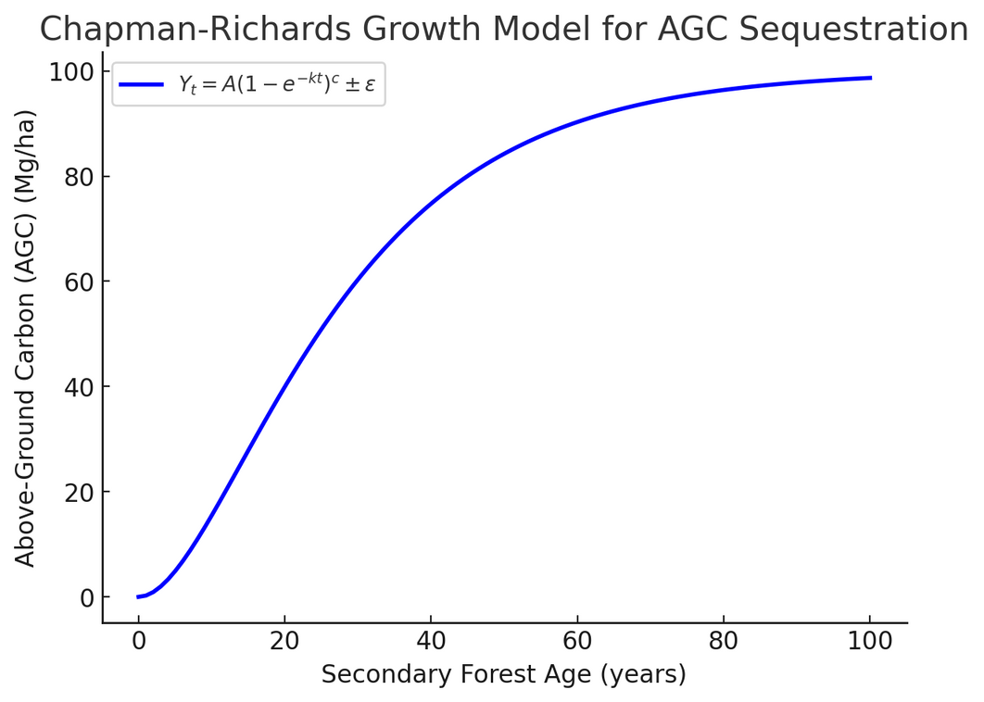
Carbon Sequestration Potential in the Brazilian Atlantic Forest
  A widely used sigmoidal growth function in forestry and ecological modeling
  the Yt refers to the AGC at each secondary forest age (t);
  A is the AGC asymptote, here defined as the AGC of old-growth forest;
  k is the growth rate coefficient of Y as a function of age (t);
  c is a coefficient that determines the shape of the growth curve, and Ɛ is the error term of the equation.

Slide 22
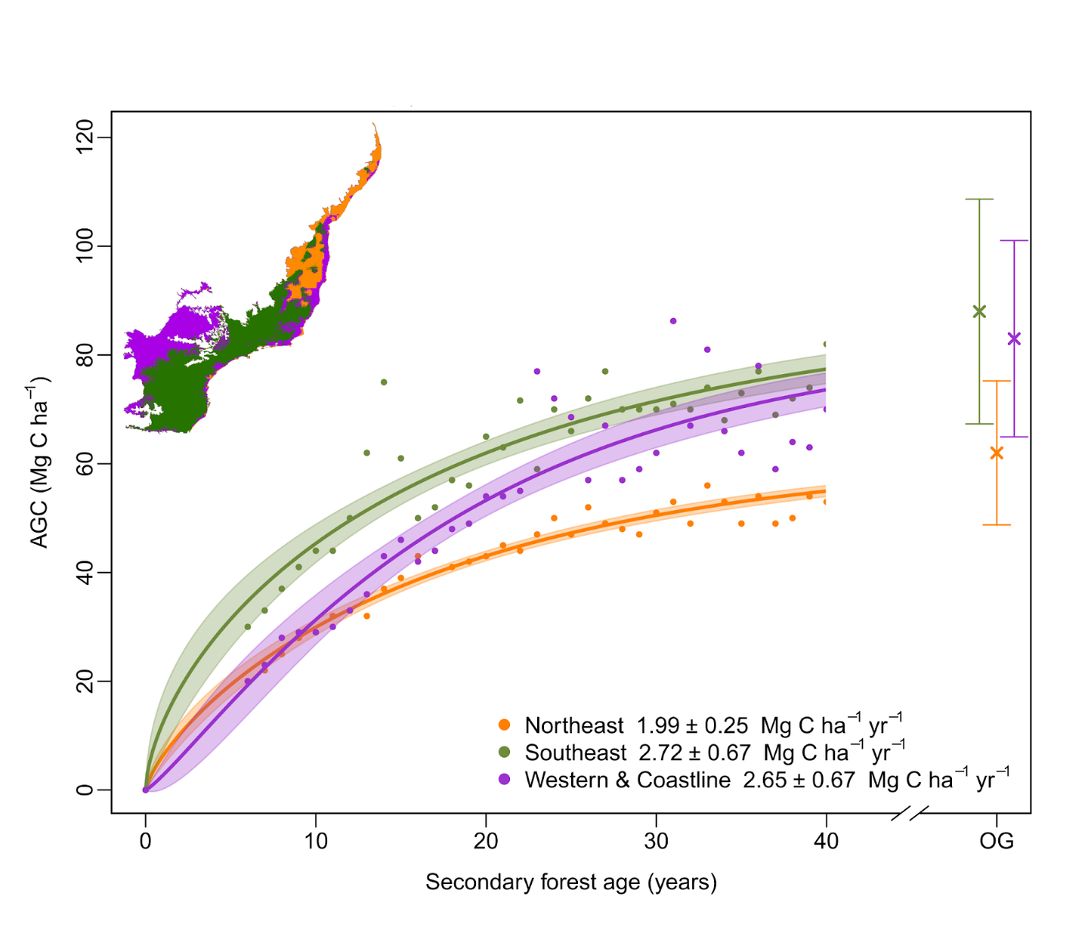
Carbon Sequestration Potential in the Brazilian Atlantic Forest
SE region (green) highest regrowth rates
  Greater fraction of old-growth forests
  Higher frequency of connected fragments

Slide 23
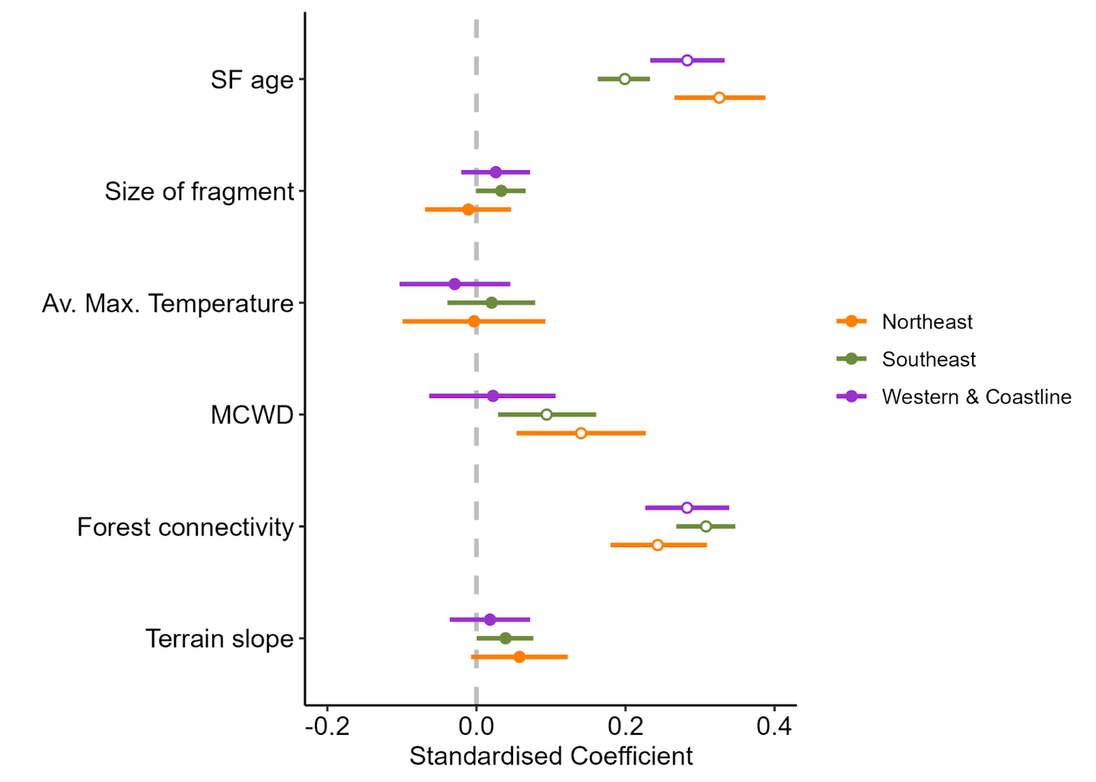
Carbon Sequestration Potential in the Brazilian Atlantic Forest
Multilinear analysis (GLS with spatial correlation structure)
“Forest connectivity was the main significant driver in all regions”

Slide 24
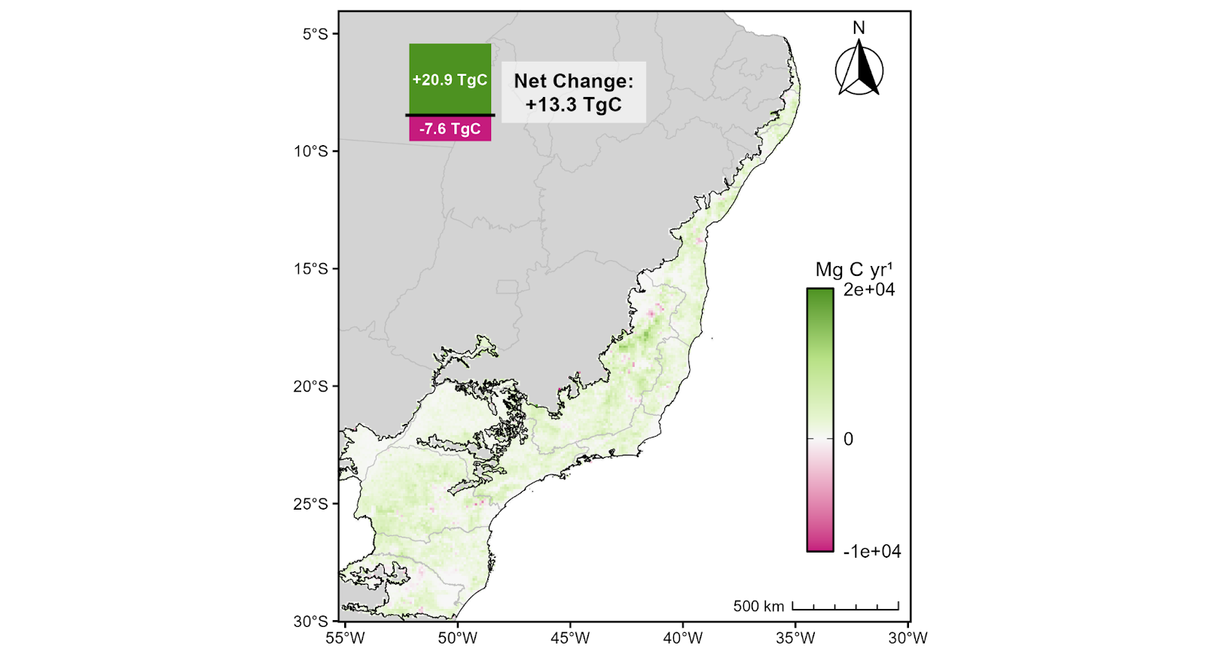
Carbon Sequestration Potential in the Brazilian Atlantic Forest
Net carbon sink from secondary forests 13.3 Tg C (2020)
Gross emissions from old-growth forest loss 10.3 Tg C (2020)
Atlantic Forest – a carbon sink
“By safeguarding old-growth and secondary forests, Brazil could significantly enhance its carbon sink capacity and contribute to NDC targets”
Secondary forest AGC change 2019-2020

Slide 25
Summary
Science-based evidence to support progress toward the UNFCCC Paris Agreement goals.
Earth Observation data has the potential to revolutionize carbon budget analysis at regional and global levels.
ESA CCI provides Essential Climate Variables (ECVs) to support climate modeling, research, and services—informing policy and action on climate change.
The upcoming ESA Biomass mission will deliver critical insights into forest conditions and their changes over time.
Notes:
EO revol. for regional carbon budgets – fire dynamics, secondary
Nature based solutions
ECVs
Moving forwards – biomass satellite
Improving representation

Slide 26
Thank you!
Q&A
T.Rosan@exeter.ac.uk
Notes:
EO revol. for regional carbon budgets – fire dynamics, secondary
Nature based solutions
ECVs
Moving forwards – biomass satellite
Improving representation

