Slide 1
ESA’s Sea Level
Climate Change Initiative
Sea-Level CCI
Phase 1 results and Phase 2 plans
M Ablain¹, G. Larnicol¹, A.Cazenave², B. Meyssygnac², J.Legeais¹, Y.Faugere¹, J.Johannessen³, D.Stammer⁴, G.Timms⁵, P.Knudsen⁶, P.Cipolini⁷, M.Roca⁸, S.Rudenko⁹, J.Fernandes¹⁰, M.Balmaseda¹¹, G. Quartly¹², L. Feneglio¹³ J.Benveniste¹⁴
¹ CLS, ²LEGOS, ³ NERSC, ⁴University of Hamburg, ⁵ LOGICA,⁶ DTU, ⁷ NOCS,⁸IsardSat, ⁹GFZ, ¹⁰ University of Porto, ¹¹ ECMWF, ¹² PML, ¹³ TUD, ¹⁴ESA
Notes:
ajouté le nom de Luciana et le logo. C’est fait pour les prochaines fois

Slide 2
Outlines
Sea-Level CCI Products :
Description of release V1.1
On-going work
Phase 2 objective: producing more/improved sea level products
Assessment by CRG group
Sea-level closure budget
Comparisons with models
Objectives for phase 2
Sea-level error characterisation
Budget error and comparison with users requirements
Objectives for phase 2

Slide 3
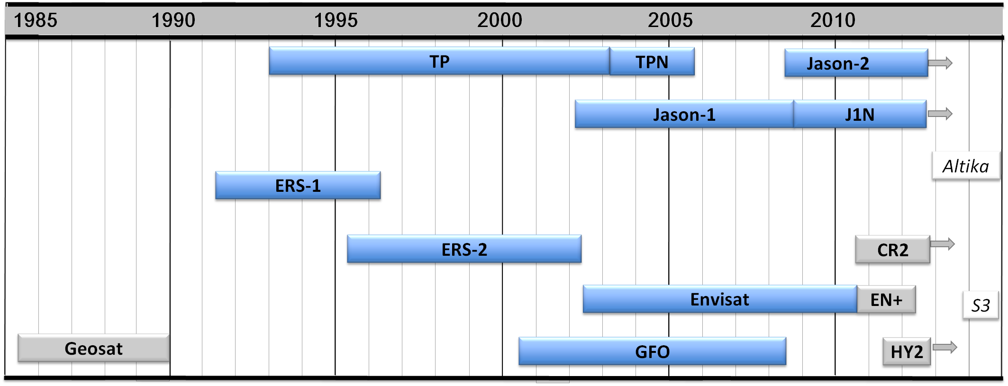
1) Sea Level ECV products
Level 2 product
7 missions (re)processed:
(T/P, Jason1/2, ERS-1/2, ENVISAT & GFO)
Period: [1993-2010]
50 years of data (re)processed
Based on SSALTO/DUACS infra-structure
Input data acquisition
Pre Processing
Orbit, Instrum & Geophysical corr, including CCI corrections
Multimission calibration
Orbit / Long Wave Lenght Error
including the new CCI methodology
Mapping including including the new CCI methodology
Indicators computation

Slide 4
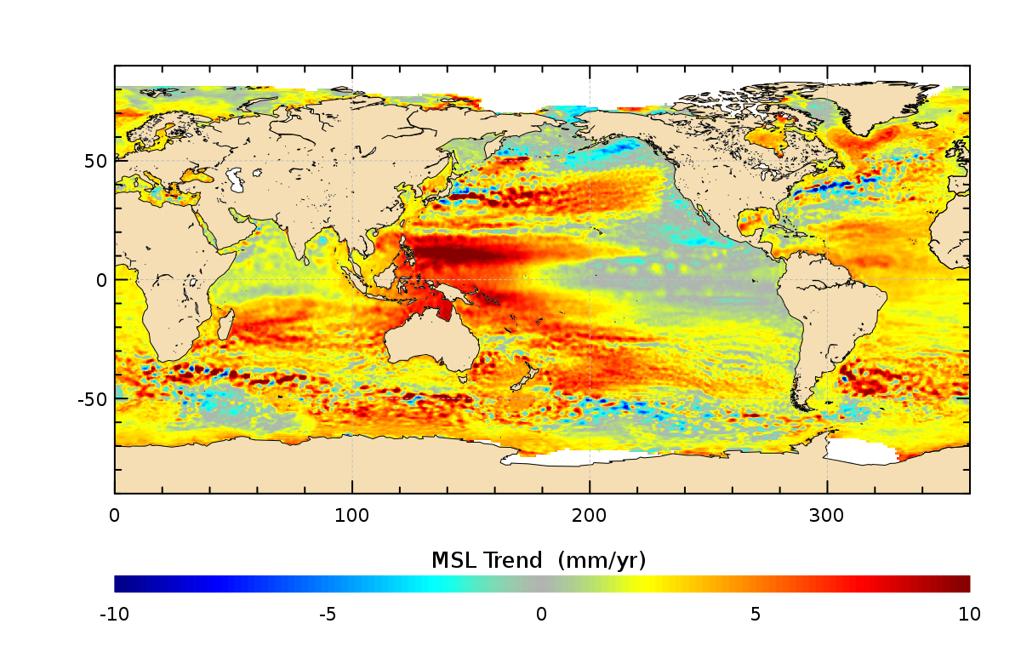
1) Sea Level ECV products
SLCCI ECV release : V1.1
available via: http://www.esa-sealevel-cci.org/
Please contact us: info-sealevel@esa-sealevel-cci.org
¼° Gridded Monthly mean

Slide 5
1) Sea Level ECV products
The Sea Level ECV (V1.1) will be extended by December 2014 over the [1993, 2013] period
Phase 2 on-going work
During phase 2 : the length of time series will be regularly updated and lengthened
A full reprocessing is planned in June 2016 (→V2.0 ) over the period [1993,2014]
V1.1 SL ECV
Extension
[2011-2013]
V1.1 SL ECV
Extension
[2014]
V2.0 SL ECV
Reprocessing
[1993-2014]
V2.0 SL ECV
Extension
[2015]
J
J
A
S
O
N
D
J
F
M
A
M
J
J
A
S
O
N
D
J
F
M
A
M
J
J
A
S
O
N
D
2014
2015
2016
Notes:
Dans la manière de présenter, je trouve bien de commencer par dire que l’on fournit un nouveau Reprocessing (cycle à 3 ans) qui est complété par des extensions annuelles pour essayer de coller au présent

Slide 6
1) Sea Level ECV products
For the 2016 reprocessing (V2.0), several improvements are foreseen :
Integration of new altimeter missions: Cryosat-2 (April 2010), SARAL/Altika (February 2013), Sentinel-3 (from July 2015 ) and Jason-3 ( from April 2015)
Development, evaluation and selection of new sea level corrections and algorithms: use of ERA-sat reanalyses, new orbit solutions, new ocean tidal models, …
Improvement of sea level calculation in coastal areas
Improvement of sea level calculation in Arctic ocean : increase data coverage near-by and under sea-ice
Notes:
Rappeler les dates de lancement…
Modif de forme

Slide 7
2) Assessment by CRG group
Products are used by the climate modelling/validation sub-group:
UoH (D.Stammer) : assimilation of sea-level ECV in model (along-track product)
ECMWF (M. Balmaseda) : assimilation of sea-level ECV in model (along-track product) and also the Global MSL indicator
NERSC (J. Johannessen) : comparison of sea-level ECV (grids) with model outputs
LEGOS (A. Cazenave, B. Meyssignac) : use of sea-level ECV (grids + indicator) for closure budget studies
External users have also uploaded the SL-CCI products :
NASA Earth Observatory (USA), U. Colorado (USA), University of Edinburgh (UK), Mercator Océan (France), IMEDEA (Spain), …
For phase 2, the objective is to increase the number of users

Slide 8
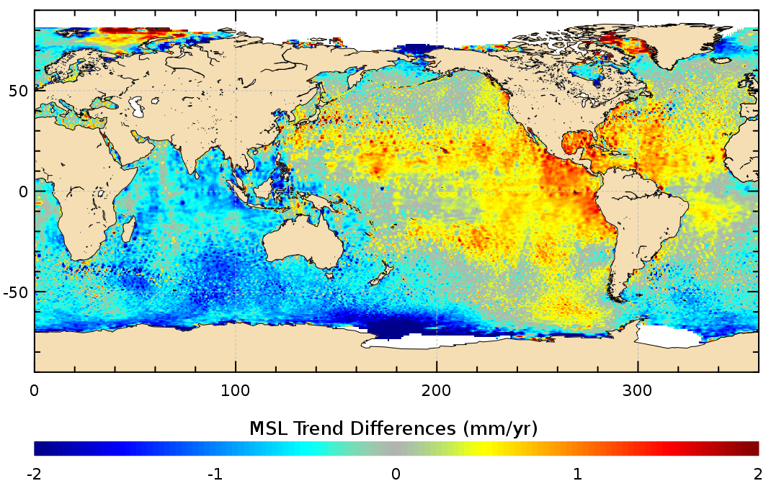
2) Assessment by CRG group
The regional Mean Sea Level trends have been significantly improved :
differences in the range +/- 2 mm/yr at regional scales
these differences are significant since regional Mean Sea Level trends are ranging between +/- 10 mm/yr from 1993 onwards
Regional MSL trends from SLCCI project
Improvements of SLCCI project on regional MSL trends
1993-2010

Slide 9
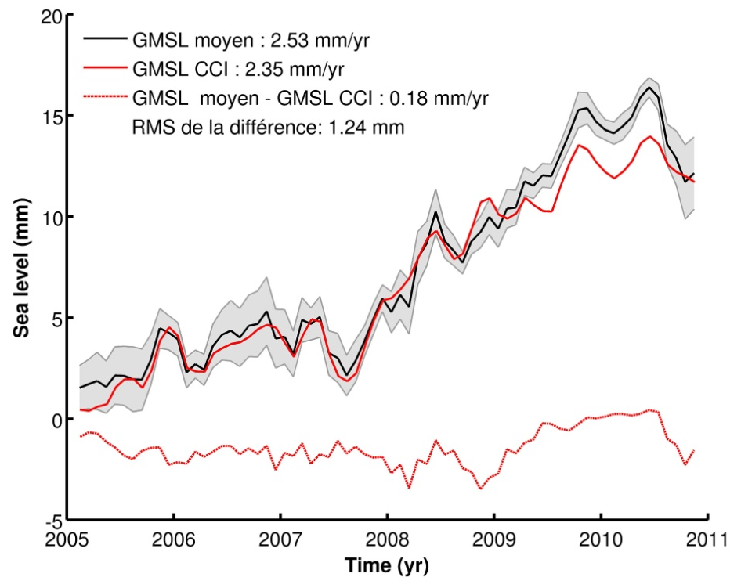
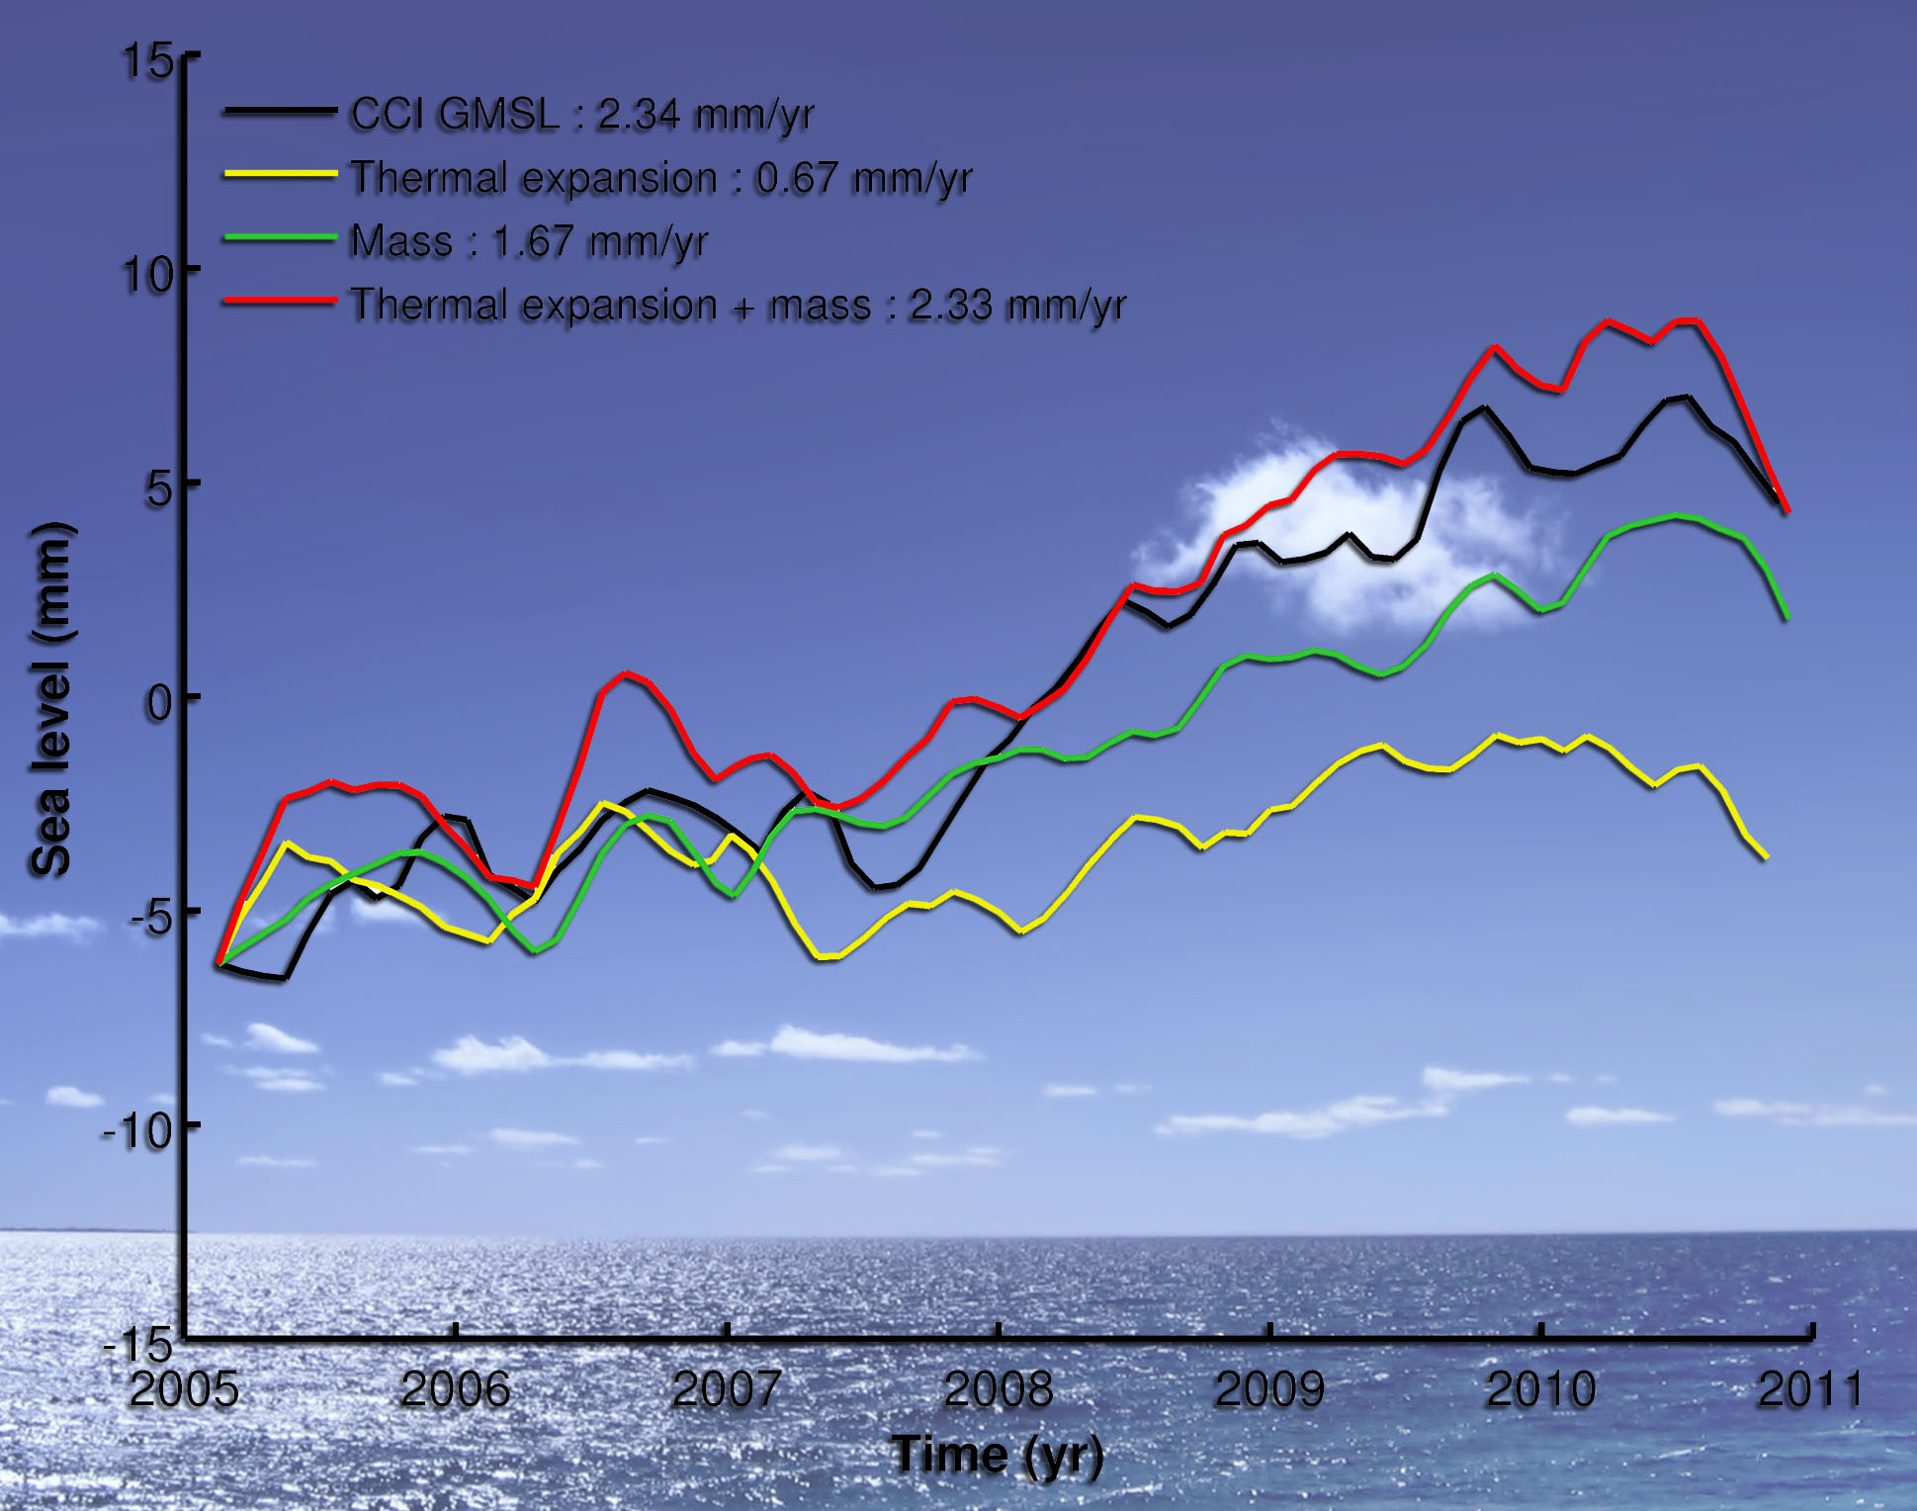
2) Assessment by CRG group
Assessment of SL-CCI ECV products via sea level budget studies at inter-annual scale (LEGOS) :
Differences with other GMSL products from international groups have been analyzed
Better agreement found between GMSL and the sum of mass and steric components when using the SL-CCI (over the 2005-2010 time span where GRACE and Argo data are available)
Black : mean of 5 GMSL products

Slide 10
2) Assessment by CRG group
ECV assessment by climate users:
SL CCI products use for assimilation in models and for validation
ECV CCI V1.0 – Ref (AVISO)
Orca 1 Model - Ref (AVISO)
Work still in progress
By M. Balmaseda (ECMWF)
-5 mm/yr + 5 mm/yr
-10 mm/yr + 10 mm/yr
Currently, SL CCI mainly use as a reference product (maps, GMSL) for validation
The stake for the model is to be able to assimilate the large scale/low frequency part of the signal observed by altimetry.

Slide 11
3) Sea-level error characterisation
During phase 1 : Altimetry measurement errors at climate scales have been characterized (Ablain et al, 2012)
Spatial Scales | Temporal Scales | User Requirements | Altimetry errors CCI products
Global Mean Sea Level (10-day averaging) | Long-term evolution (> 10 years ) | 0.3 mm/yr | < 0.5 mm/yr
 | Inter annual signals (< 5 years) | 0.5 mm over 1 year | < 2 mm over 1 year
 | Periodic signals (Annual, 60-days,…) | Not defined | Annual < 1 mm 60-day < 5 mm
Regional Mean Sea Level (2x2 deg boxes and 10-day averaging) | Long-term evolution (trend) | 1 mm/yr | < 3 mm/yr
 | Inter annual signals (> 1 year) | Not Defined | Not evaluated
 | Periodic signals (Annual, 60-days,…) | Not Defined | Annual < 1mm 60-day < 5 mm

Slide 12
3) Sea-level error characterisation
Information requested by users or climate modellers :
1) Refine the error budget at interannual time scale
Spatial Scales | Temporal Scales | Altimetry errors [1993-2002] | Altimetry errors [2003,2013]
Global Mean Sea Level (10-day averaging) | Long-term evolution (> 10 years ) | 0.7- 0.8 mm/yr | < 0.5 mm/yr
 | Inter annual signals (< 5 years) | < 5 mm over 1 year | < 2 mm over 1 year
 | Periodic signals (Annual, 60-days,…) | Annual < 1 mm 60-day < 5 mm | Annual < 1 mm 60-day < 2 mm
Regional Mean Sea Level (2x2 deg boxes and 10-day averaging) | Long-term evolution (trend) | < 4 mm/yr | < 2 mm/yr
 | Inter annual signals (> 1 year) | Not evaluated | Not evaluated
 | Periodic signals (Annual, 60-days,…) | Not evaluated | Not evaluated
Phase 2 on-going work
Notes:
Message super important et interessant ! => message : super important de travailler sur les vielles missions

Slide 13
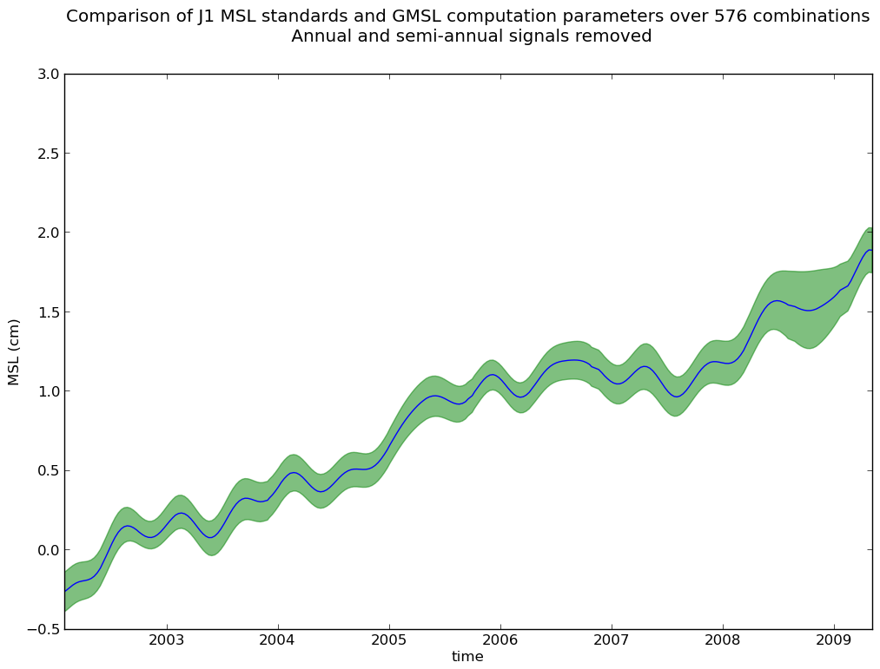
3) Sea-level error characterisation
Information requested by users or climate modellers :
2) Define the GMSL error or confidence envelope
Phase 2 on-going work

Slide 14
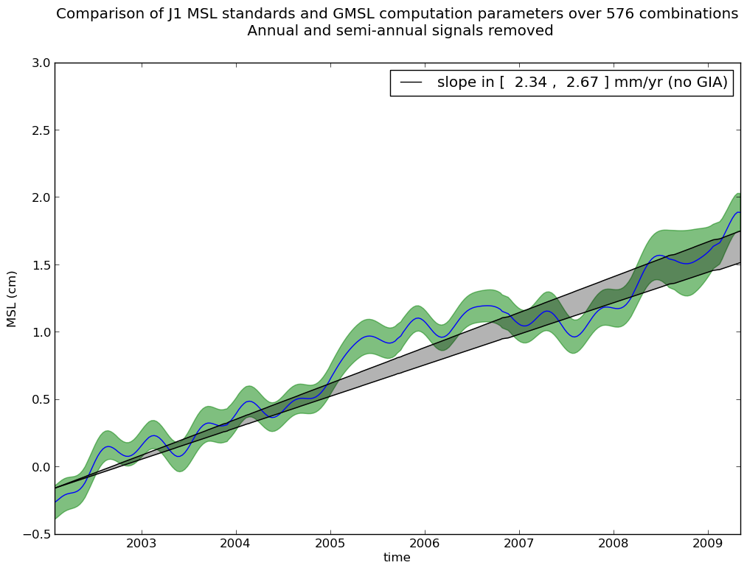
3) Sea-level error characterisation
Information requested by users or climate modellers :
2) Define the GMSL error or confidence envelope
Phase 2 on-going work
Notes:
Quel interet pour les models ? Comment peuvent-ils exploiter cette information

Slide 15
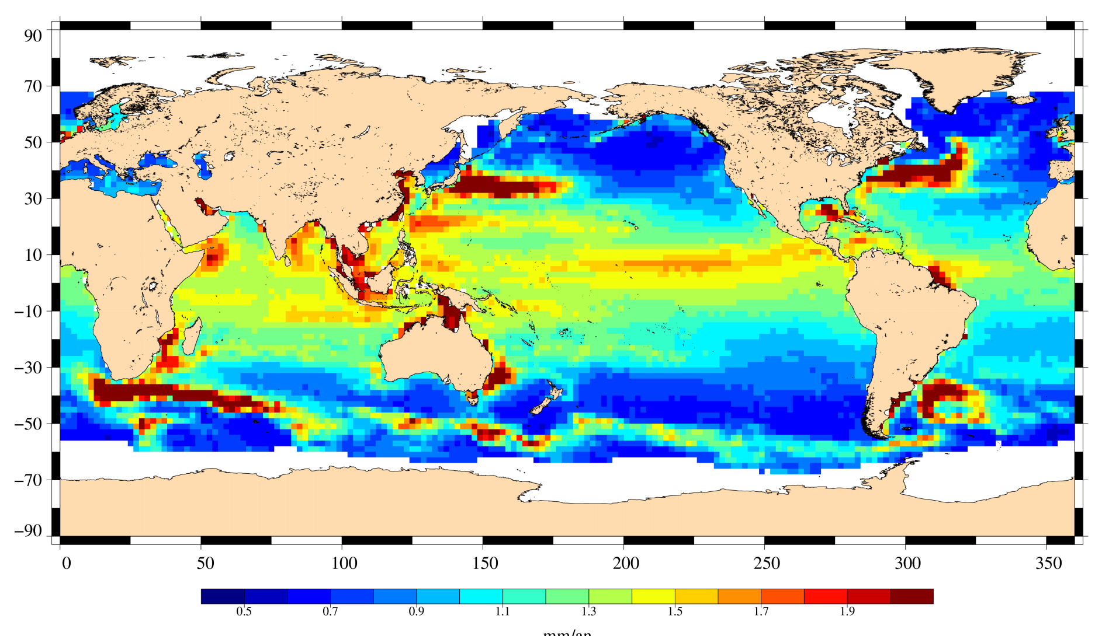
3) Sea-level error characterisation
Information requested by users or climate modellers :
3) Provide regional sea level trend error maps
Phase 2 on-going work
0 mm/yr 2 mm/yr

Slide 16
Conclusions
Sea-Level CCI Products :
Phase 1 : V1.1 release available over 1993-2010
Phase 2 : Full reprocessing in 2016 (V2.0), extension at the end of each year, improvements of sea level corrections and algorithms
Sea-level error characterisation
Phase 1 : Budget error and comparison with users requirements
Phase 2 : GMSL error or confidence envelope, regional sea-level trend
Feedbacks to
Earth Observation
Information
and Products
used by CRG
Assessment by CRG group
Phase 1 : MSL closure budget studies and validation of models using new sea level ECV
Phase 2 : continuing same activities started in phase 1, improve the link with the EO team, Organisation of the Intercomparison exercice for GMSL

