Slide 1


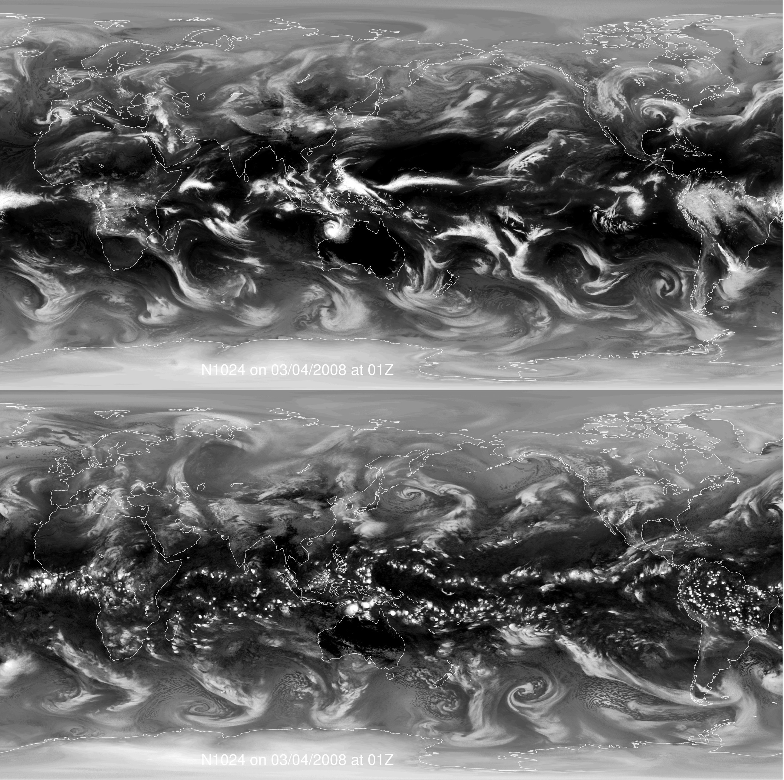



PRIMAVERA: High resolution climate modelling – what are the requirements from ECVs?
Malcolm Roberts,
Met Office Hadley Centre
Pier Luigi Vidale,
NCAS-Climate, University of Reading
Rein Haarsma, KNMI
With thanks to many other contributors, including:
A. Shelly, P. Hyder, T. Johns, N. Rayner, C. Birch
M.-E. Demory, R. Schiemann
T. Koenick, P. Doblas-Reyes, O. Bellprat,
C. Prodhomme
CCI-CCI-CMUG meeting, Norrköping, May 2015

Slide 2
Talk outline
Overview of H2020 PRIMAVERA and CMIP6 HighResMIP
Examples of science questions
Requirements of ECVs
  Examples of how ECVs are or could be used
Some initial Met Office work with CCI SST

Slide 3
















Malcolm Roberts, Met Office (coordinator)
Pier Luigi Vidale, Univ. of Reading (scientific coordinator)
PRocess-based climate sIMulation: AdVances in high resolution modelling and European climate Risk Assessment
Goal:
to deliver novel, advanced and well-evaluated high-resolution global climate models (GCMs), capable of simulating and projecting regional climate with unprecedented fidelity, out to 2050.
To deliver:
innovative climate science and a new generation of European advanced GCMs.
improve understanding of the drivers of variability and change in European climate, including extremes, which continue to be characterised by high uncertainty
new climate information that is tailored, actionable and strengthens societal risk management decisions with sector-specific end-users
new insights into climate processes using eddy-resolving ocean and explicit convection atmosphere models
To run for 4 years from Nov 2015 including 19 partners across Europe, funded by the Horizon 2020 call SC5-1-2014 - Advanced Earth System Models
proj.badc.rl.ac.uk/primavera
Core integrations in PRIMAVERA will form much of the European contribution to CMIP6 HighResMIP
http://www.wcrp-climate.org/index.php/modelling-wgcm-mip-catalogue/429-wgcm-hiresmip
Notes:
Note: the use of both AMIP-style and coupled integrations – it is not necessary to do both, if that is not possible. An AMIP comparison would lead to significant increased understanding in itself.
Coupled models consist of pairs of control (using fixed 1950’s forcing) and experiment with historic and then projection forcings to 2050
Both the aerosol concentrations and the SST and sea-ice forcing datasets and tools will be supplied, as far as is possible – for AMIP-style the historic period will use HadISST, while the future will use the methodology of Mizuta et al from MRI.
Input to aerosol concentrations are expected from RFMIP.

Slide 4
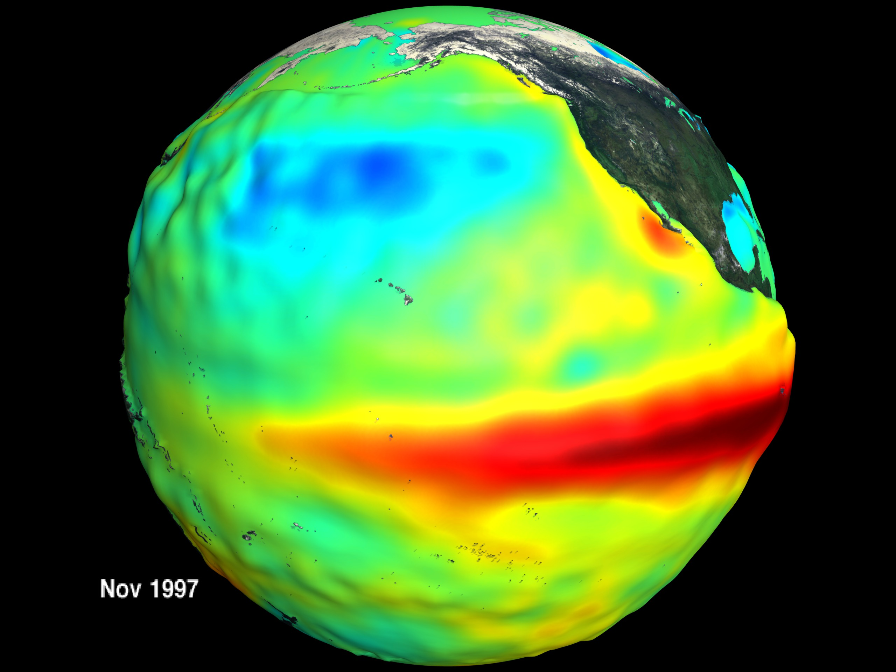
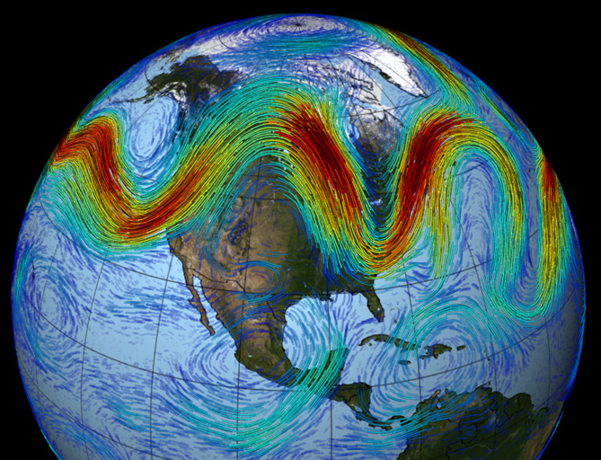
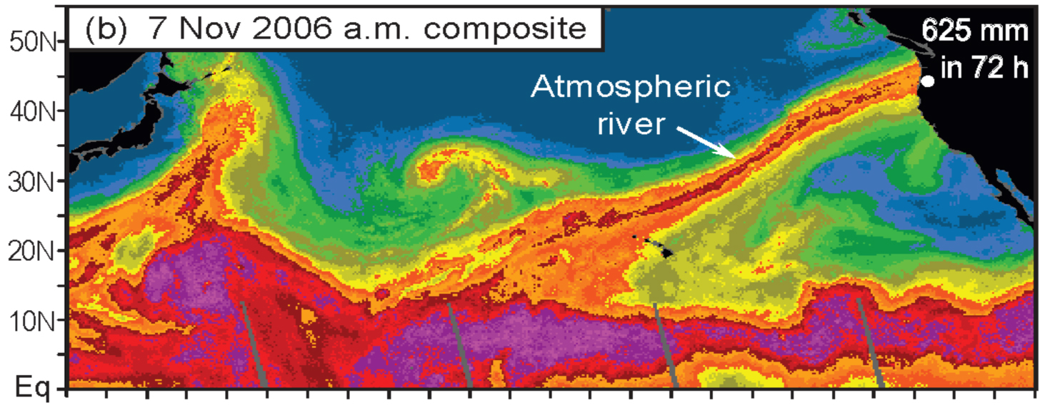
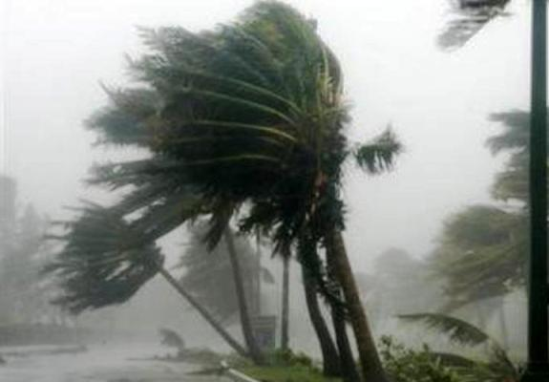
Rein Haarsma KNMI (lead)
Malcolm Roberts Met Office (co-lead)
CMIP6 HighResMIP
Important weather and climate processes emerge at sub-50km resolution
They contribute significantly to both large-scale circulation and local impacts, hence vital for understanding and constraining regional variability
How robust are these effects?
Is there any convergence with resolution across models?
Need coordinated, simplified experimental design to find out
http://www.wcrp-climate.org/index.php/modelling-wgcm-mip-catalogue/429-wgcm-hiresmip
Global drivers
Regional variability
Feedbacks
to large
scale
Experimental protocol:
Global models – AMIP-style and coupled
Physical climate system only
Integrations: 1950-2050
Ensemble size: >=1 (ideally 3)
Resolutions: <25km HI and ~60-100km STD
Aerosol concentrations specified
Local processes
e.g. Zhao et al, 2009; Haarsma et al, 2013; Demory et al, 2013
Impacts, extremes
Notes:
Note: the use of both AMIP-style and coupled integrations – it is not necessary to do both, if that is not possible. An AMIP comparison would lead to significant increased understanding in itself.
Coupled models consist of pairs of control (using fixed 1950’s forcing) and experiment with historic and then projection forcings to 2050
Both the aerosol concentrations and the SST and sea-ice forcing datasets and tools will be supplied, as far as is possible – for AMIP-style the historic period will use HadISST, while the future will use the methodology of Mizuta et al from MRI.
Input to aerosol concentrations are expected from RFMIP.

Slide 5
HighResMIP and PRIMAVERA
Horizon 2020
PRIMAVERA
European focus
Model assessment
Model development
Frontier simulations
Drivers of clim var
Inform climate risk
CMIP6
HighResMIP
International community
Multi-model global high & std resolution climate simulations
Main European
contribution to
HighResMIP
Resolution is our chosen tool for investigation and understanding
Ensembles, complexity, parameter uncertainty and initialisation are other axes
All need suitable datasets for assessment

Slide 6
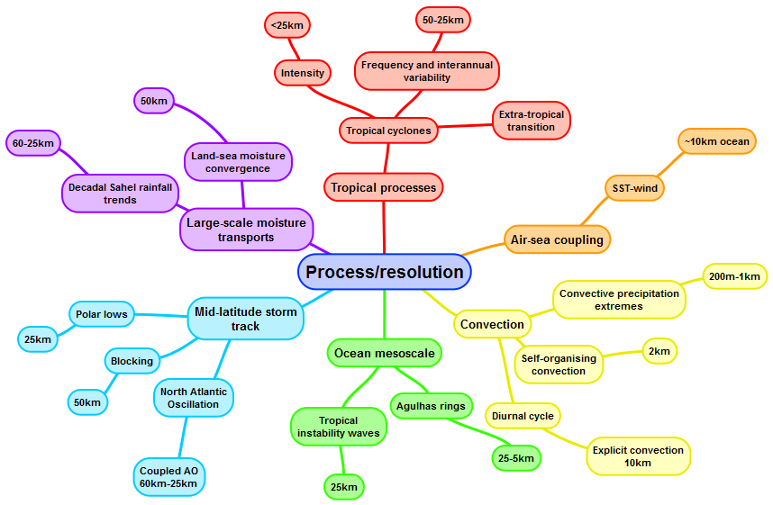
Example map of climate process and model resolution required
Aim: to discover at what resolution climate processes are robustly simulated across multi-model ensemble

Slide 7
HighResMIP – pushing the boundaries of CMIP
Detailed model process evaluation
  Moving away from using monthly means and climatologies towards high frequency interactions and extreme processes
  Requires much more detail from observations and reanalyses
Requirements for simulations:
  High resolution, daily SST and sea-ice forcing (cf monthly mean, ~1˚)
  High frequency output – 6hr, 3hr and 1hr diagnostics, particularly for extreme processes (precipitation, cyclones) and interactions (e.g. air-sea, land-atmosphere)
  Longer integrations of AMIP-style forced-atmosphere to sample phases of climate modes such as AMO, PDO and their teleconnections
14 international groups have committed to AMIP-style HighResMIP simulations (1950-2050) at both a standard (~100km) and a high resolution (~25km)
Opportunity for modelling and observational communities since we are studying similar space and timescales

Slide 8
European HighResMIP resolutions
(as part of PRIMAVERA)
Concentrate on horizontal resolution – keep vertical resolution the same
Global atmosphere resolutions: range from 150km to 6km
Global ocean resolutions: from 1˚ to 1/12˚

Slide 9
PRIMAVERA themes and work packages

Slide 10
PRIMAVERA work areas
European climate process focus
Development of metrics for model assessment
  Work on UK Auto-assess package
  Plan to merge with ESMValTool later in 2016
Requirements
  Assess impact of model resolution, model physics and sub-grid scale processes (parameterisations)
  Range of timescales – hours to decades
  Focus on variability and extremes
  Use them to understand and constrain spread in climate projections (interactions between processes)
  Provide policy-relevant climate information

Slide 11
Process understanding
Precipitation and energy
  Precip over land, sea, orography
  Using models to try and interpret observations, constraints
  Understand whether model or observational biases
  Demory-ogram – hydrological cycle, tying together energy and water
Air sea interactions
  Models typically have weaker coupling than “observed”
  Possibly relates to weak signal to noise – e.g. Large ensembles required
  Need co-located SST, wind, flux, moisture in order to understand interactions, at high frequency
Diurnal cycle
  Cloud, soil moisture, water vapour, temperature, precipitation

Slide 12
Constraining the global energy and water budgets and transport
How well do models compare with observations
  Can observations “rule out” any models
Models are energetically consistent
  unlike different observational datasets
  Can models help to understand and constrain observations
Transport of water and its change (either via variability or global warming) key for impacts
What impact does horizontal resolution have
Want models to be able to represent correct budgets and transports
  To give confidence in any changes they may project
  Changes will be much smaller than means – challenging problem

Slide 13
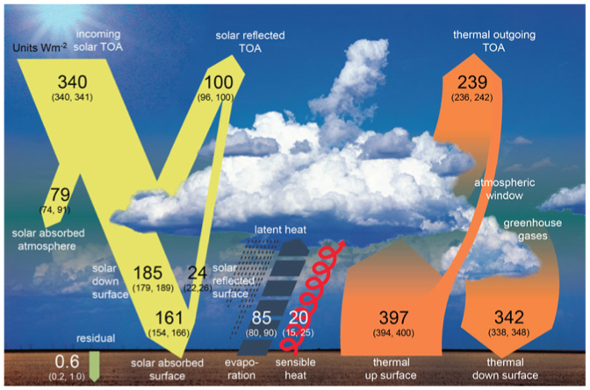
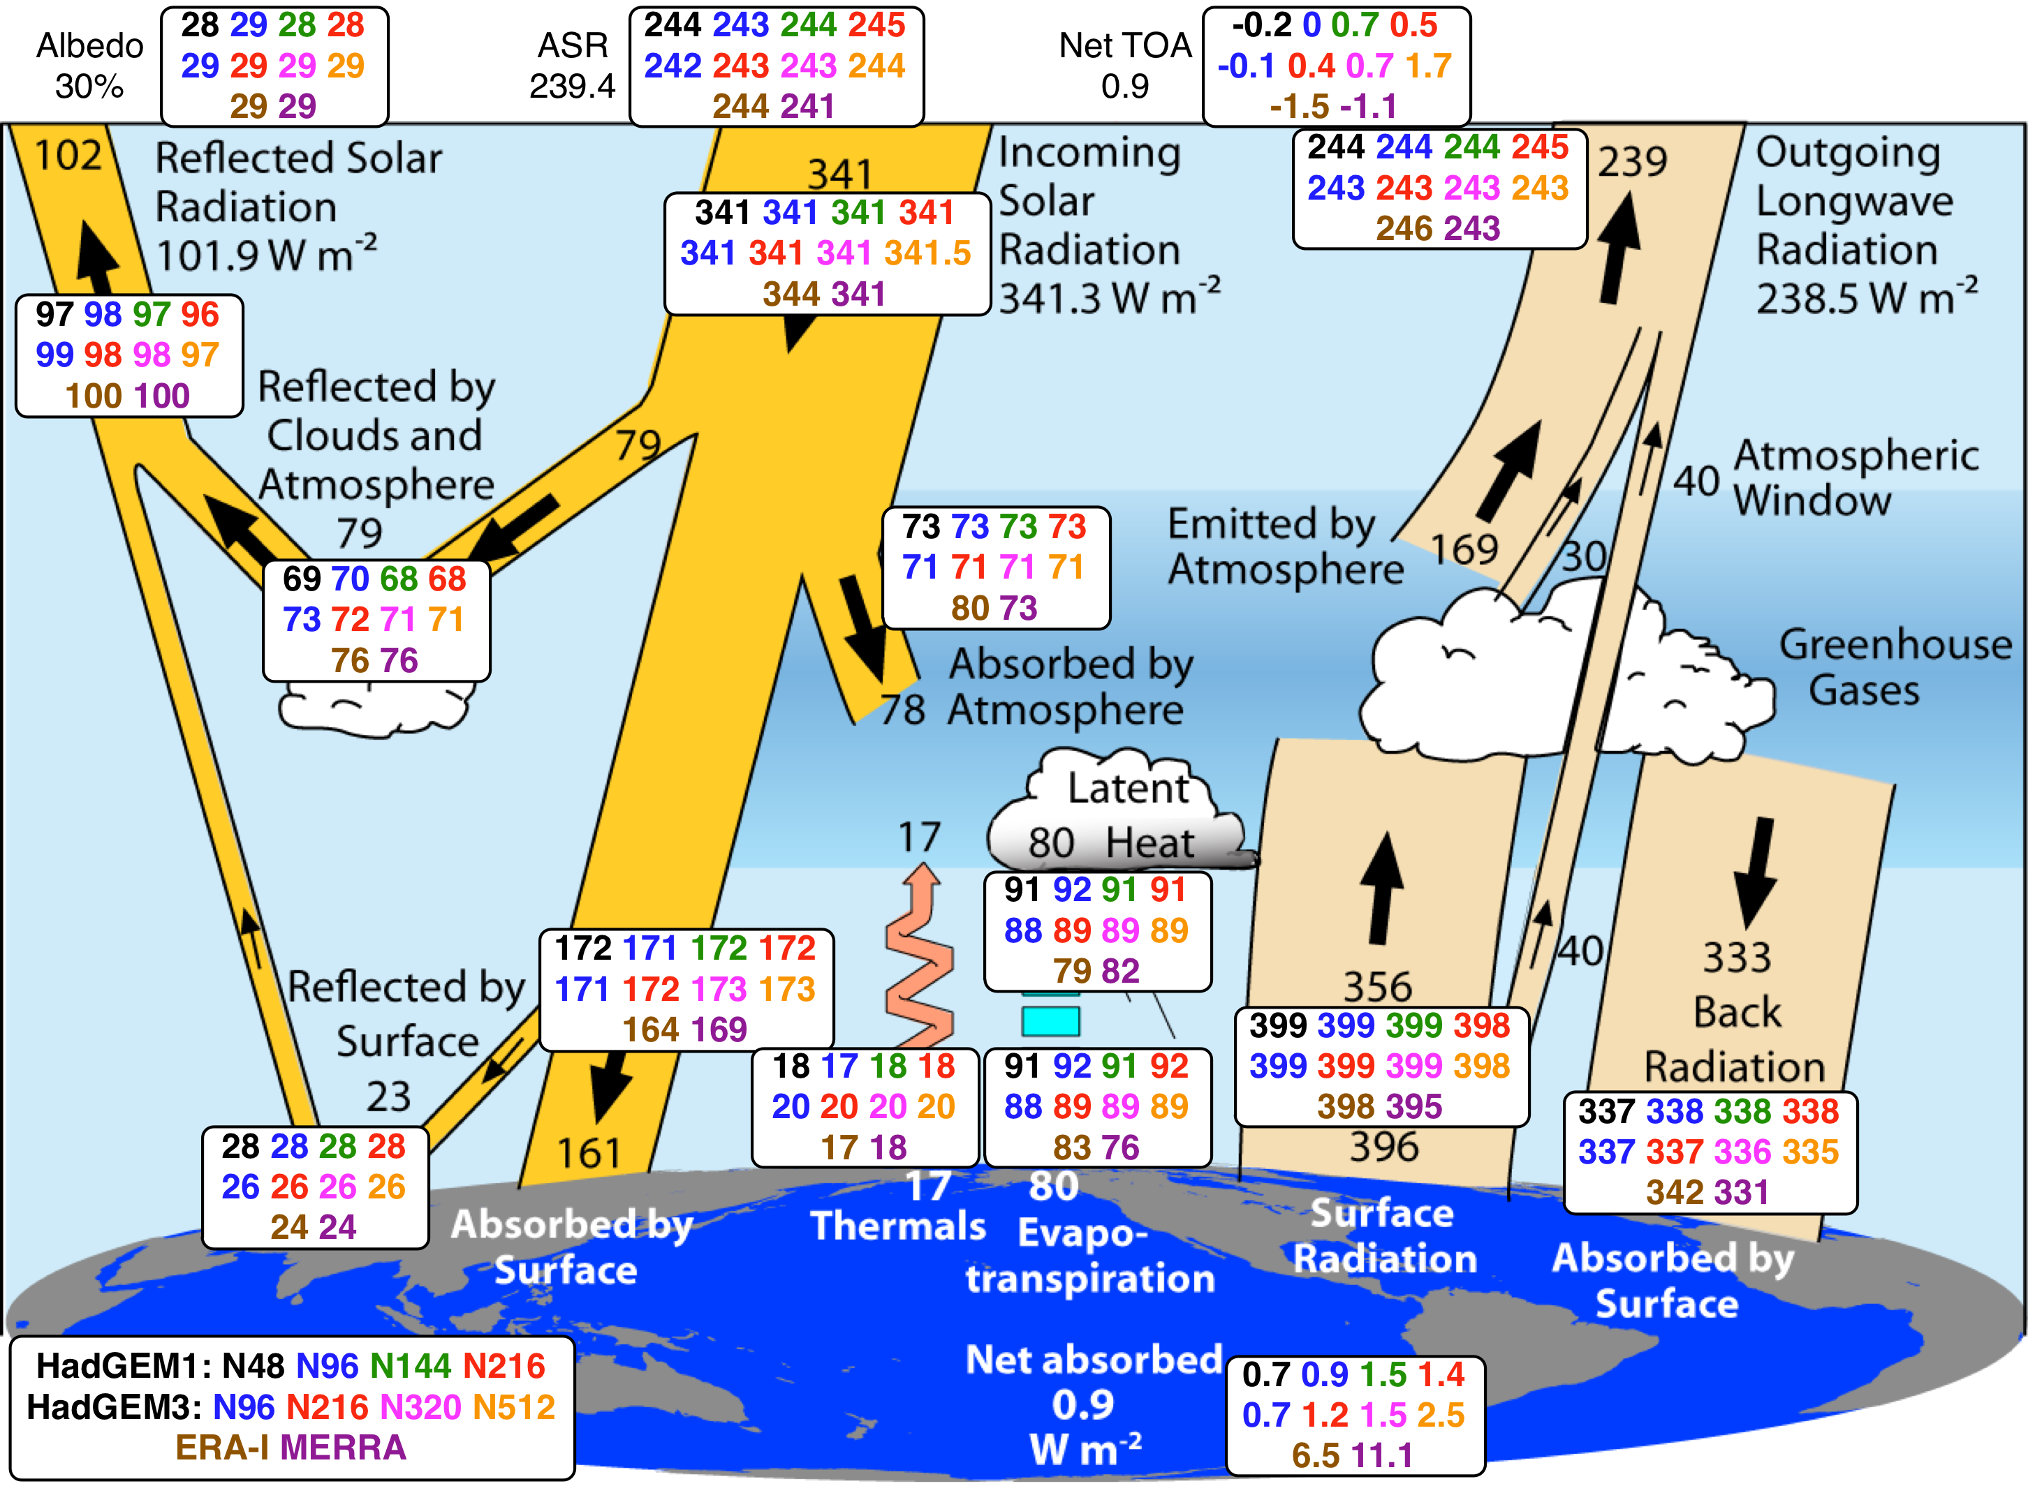
What does not change with resolution?
The global energy budget
Wild et al, 2012
Equivalent estimates in Stephens et al, 2012
Resolution at 50N:
270 km
135 km
90 km
60 km
40 km
25 km
Demory et al., Clim. Dyn., 2014
Figure adapted from Trenberth et al, 2009
Fluxes: W/m²
Notes:
On the energy budget plot:
Background numbers from Trenberth et al 2009: period 2002-2008
+ HadGAM at various resolutions: N48 (270km)-black, N96 (135km)-blue, N144 (90km)-green, N216 (60km)-red: period 1979-2002
+ HadGEM3-A at various resolutions: N96-blue, N216-red, N320 (40km)-pink: period 1979-2002, and N512 (25km)-orange: 5 years so far… (1986-1990)
+ 2 most recent reanalyses products: ERA-Interim (brown) and MERRA (purple): period 2002-2008
Note that:
Surface back longwave radiation in Trenberth’s numbers are retrieved from surface energy balance
Energy balance at TOA and surface
Globally too much surface SW radiation compared to observations and reanalyses
Excess in latent heat and precipitation consistent with excess in OLR

Slide 14
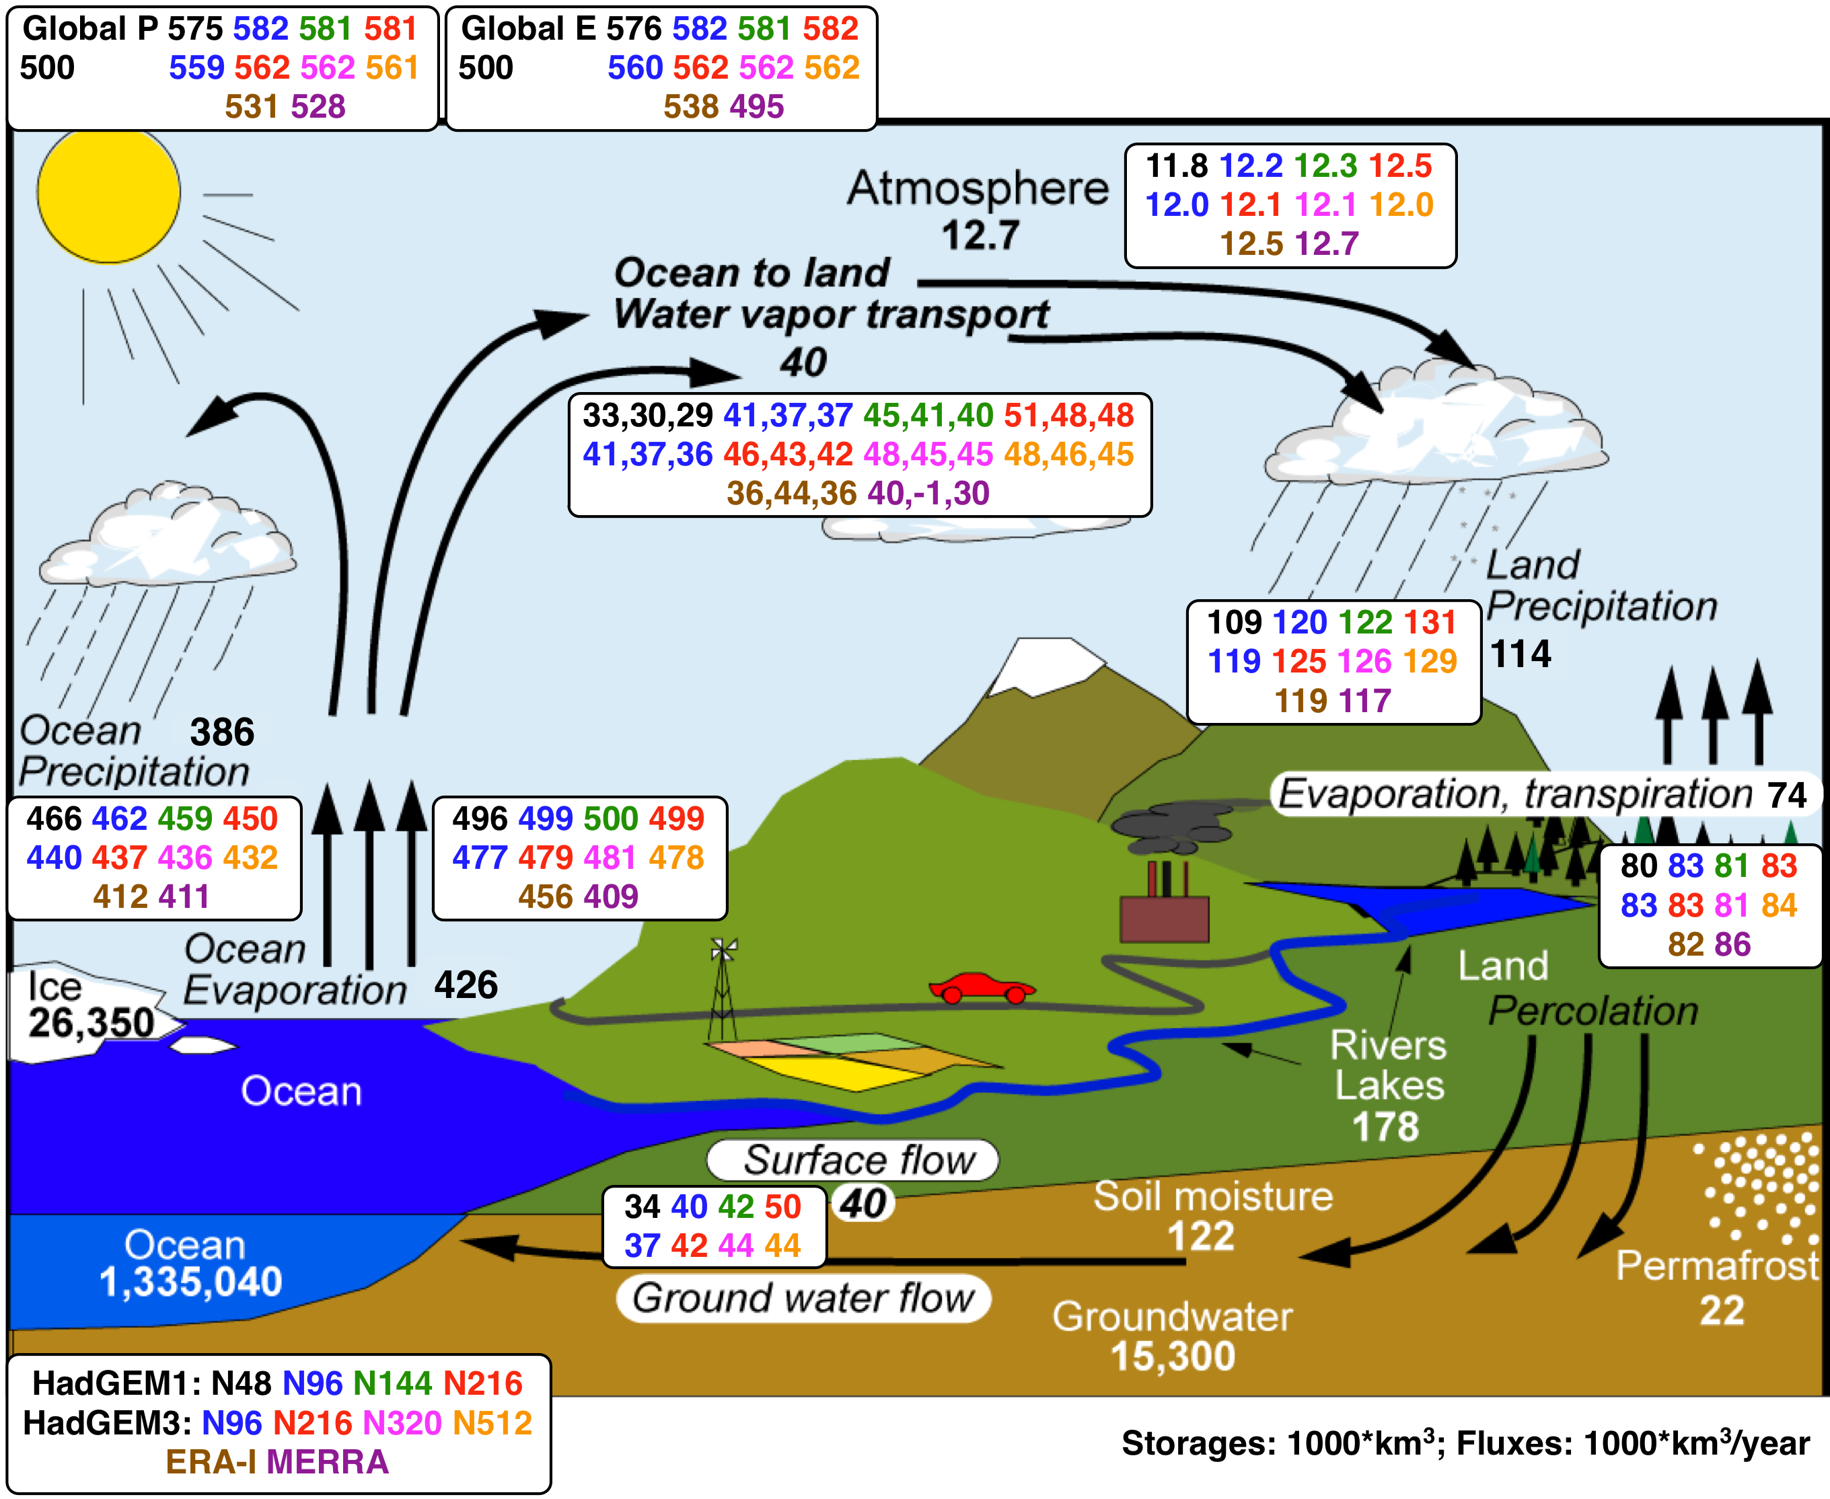
What does change with resolution?
The global hydrological cycle
Classic GCMs too dependent on physical parameterisation because of unresolved atmospheric transports
Role of resolved sea->land transport larger at high resolution
Hydrological cycle more intense at high resolution
Resolution at 50N:
270 km
135 km
90 km
60 km
40 km
25 km
Figure adapted from Trenberth et al, 2007, 2011
Demory et al., Clim. Dyn., 2014
Notes:
On the water cycle plot:
Background numbers from Trenberth et al 2011 (numbers revised as being higher than Trenberth et al 2007): period 2002-2008
+ HadGAM at various resolutions: N48 (270km)-black, N96 (135km)-blue, N144 (90km)-green, N216 (60km)-red: period 1979-2002
+ HadGEM3-A at various resolutions: N96-blue, N216-red, N320 (40km)-pink: period 1979-2002, and N512 (25km)-orange: period 1986-2002
+ 2 most recent reanalyses products: ERA-Interim (brown) and MERRA (purple): period 2002-2008
Water transport from ocean to land calculated in 3 different ways:
Atmospheric moisture convergence over land using moisture fluxes independently calculated by the model
E-P over the ocean
P-E over the land
These 3 numbers should be equal: not the case for MERRA: anomalously low ocean evaporation (E-P) over ocean = -1 (impossible!)
Note that:
- Evaporation in Trenberth’s numbers are retrieved from atmospheric and surface water balance: permits to close the water budget
In models and reanalyses, each flux (P, E, moisture transport) is calculated independently. With this in mind, we see that the models properly balance the water budget (although too high P and E due to excess in shortwave radiation at the surface).
Too low moisture transport in low resolution model. At N96, the transport seems right, land precipitation as well, however land evaporation is too high => consequences for partitioning in sources of moisture for precipitation over land, which is too high at N96. At high-resolution, moisture transport is too high, as well as land precipitation and evaporation, but at least the partitioning is better (next slide)

Slide 15
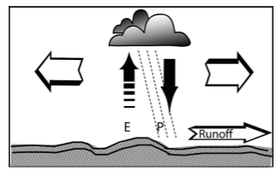
Relative roles of remote transport and local re-cycling in forming precipitation over land
For this aspect of the simulation of the Global Climate system, models are converging and we know what resolution is adequate.
Transport of water from ocean to land
Local recycling of precipitation
Resolution
High local recycling
Low transport
Lower local recycling
Higher transport
Demory et al, Clim. Dyn., 2014
Notes:
Plot:
Black dots: E/P over land (left axis): for HadGEM1 (plain dots), HadGEM3 (circles), ERA-I and Trenberth11’s estimates (triangles)
Red dots: convergence(qU)/P over land (right axis): for HadGEM1 (squares)
Note that E/P is not a measure of local moisture recycling. However the decrease in E/P with resolution shows the tendency of high-resolution models to better partition moisture available for precipitation over land.
Excess in E/P ratio at low-resolution due to deficiencies in simulating atmospheric moisture transport
Partitioning of moisture sources for precipitation over land much improved at high-resolution, compared to reanalyses (ERA-interim) and observations (Trenberth et al, 2011)
There are several dots in HG3 N216. These include the standard N216, the N216 with CAPE=1h, and two N216 with OSTIA SSTs. In this way, we can completely compare the HG3 low-resolution AMIP-II models with the high N512 OSTIA. The spread at N216 is larger than for any other ensemble, this is due to OSTIA and CAPE, but this larger spread is still lower than the differences between resolutions.
Sensitivity to resolution larger than interannual variability
15

Slide 16
Understanding causes of hydrological changes with model resolution
ocean-to-land water transport and global land precipitation has been shown to increase with AGCM resolution (Demory et al., 2014)
  What is the role of better resolved orography at higher model resolution?
  How well is the amount of land precipitation (spatial averages over large areas) constrained by observations?

Slide 17
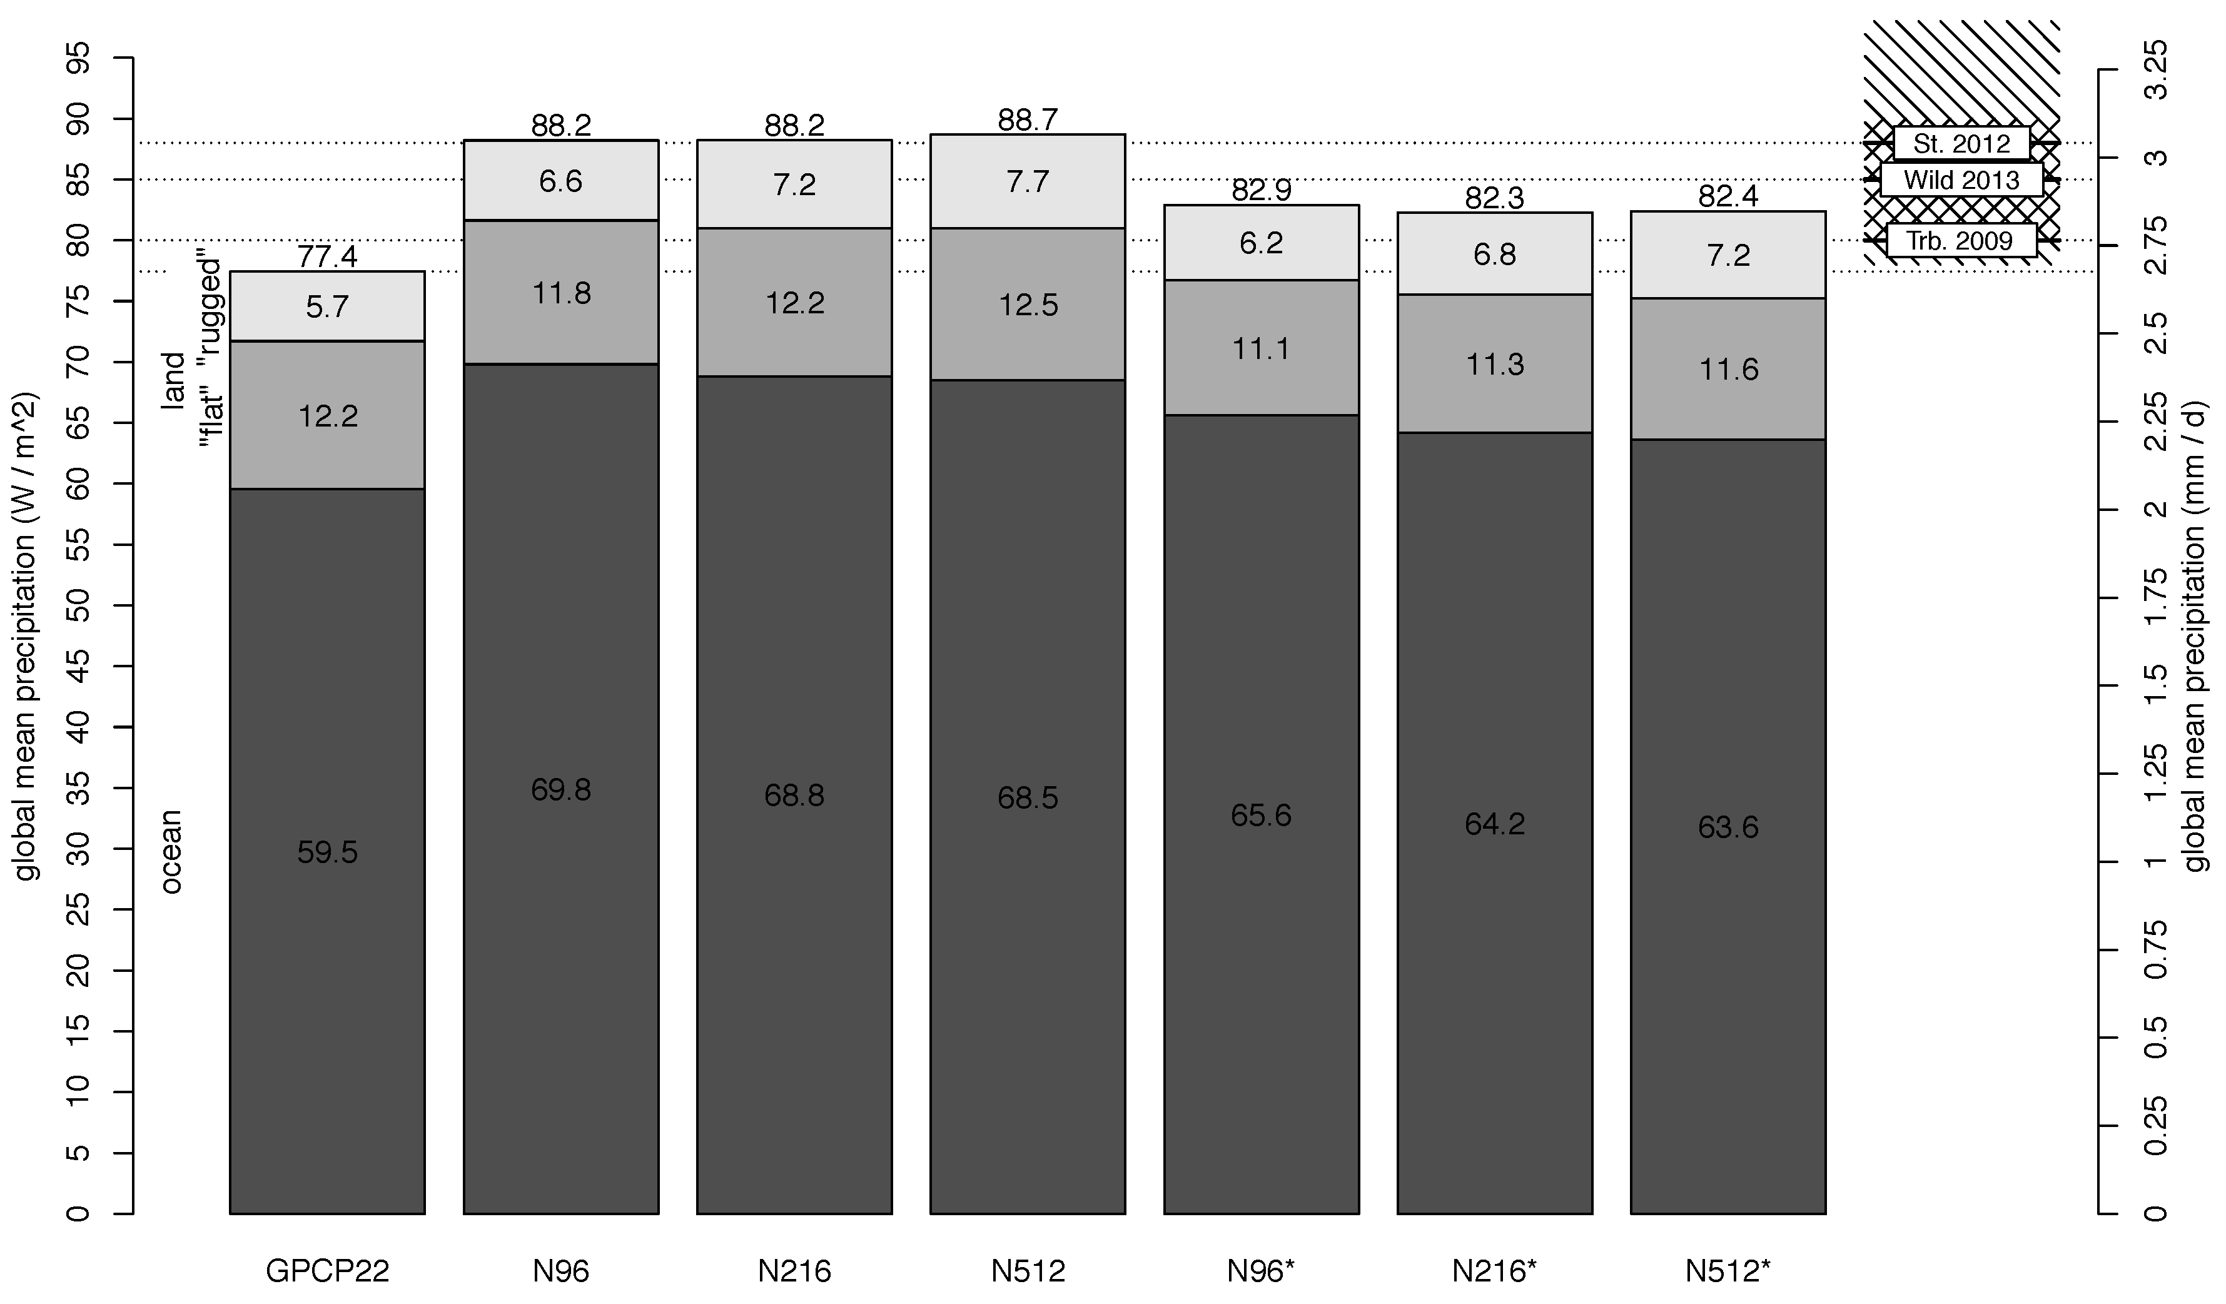
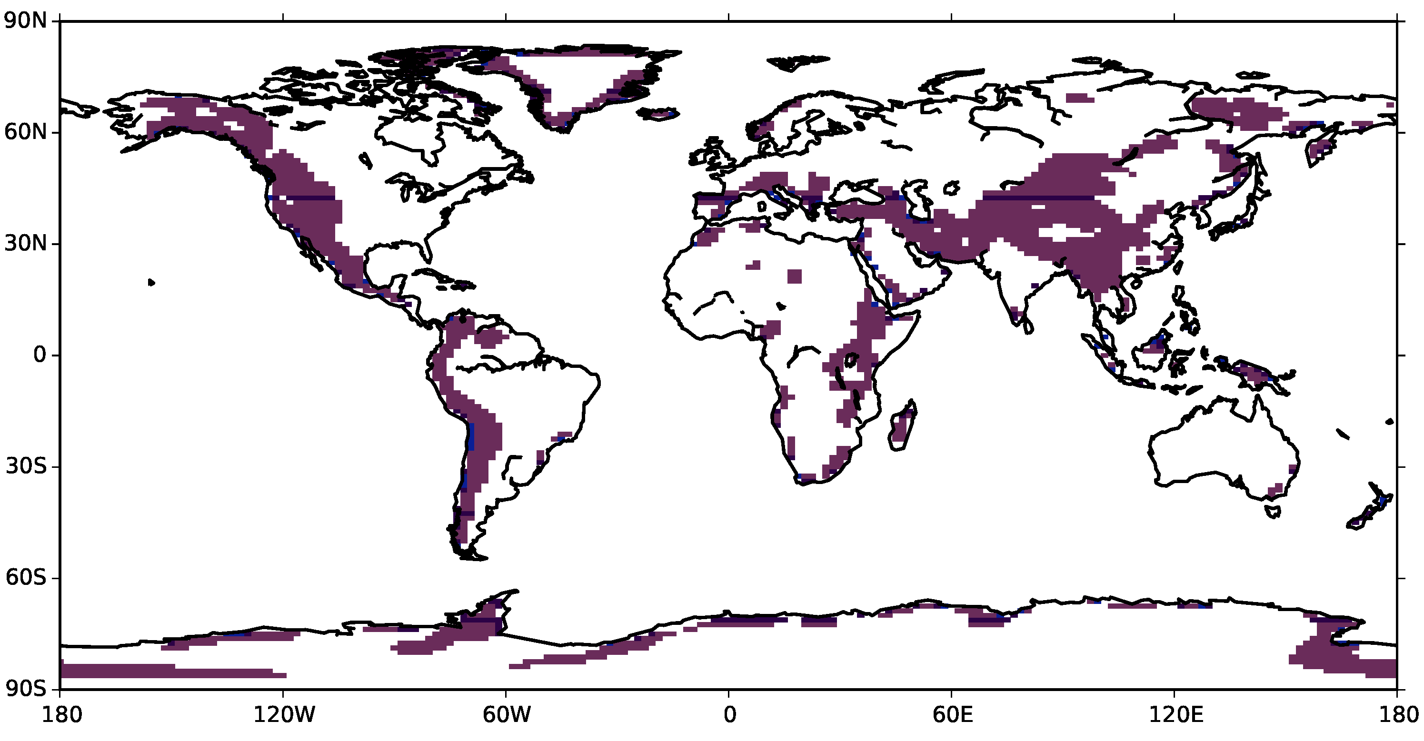
Global mean
Schiemann et al., in prep
Notes:
Fig. 1: Global mean precipitation in GPCP22 and UPSCALE model simulations at different resolutions (box 3). For (i) oceans, (ii) land with high spatial variation of topographic height (purple areas in inset map, 25% of all land), (iii) remaining “flat” land. Righ-hand three bars are obtained by simple scaling with the model global surface net shortwave radiation bias. Three independent estimates of global-mean precipitation are shown on the right: Trenberth et al. (2009), Stephens et al. (2012), Wild et al. (2013).

Slide 18
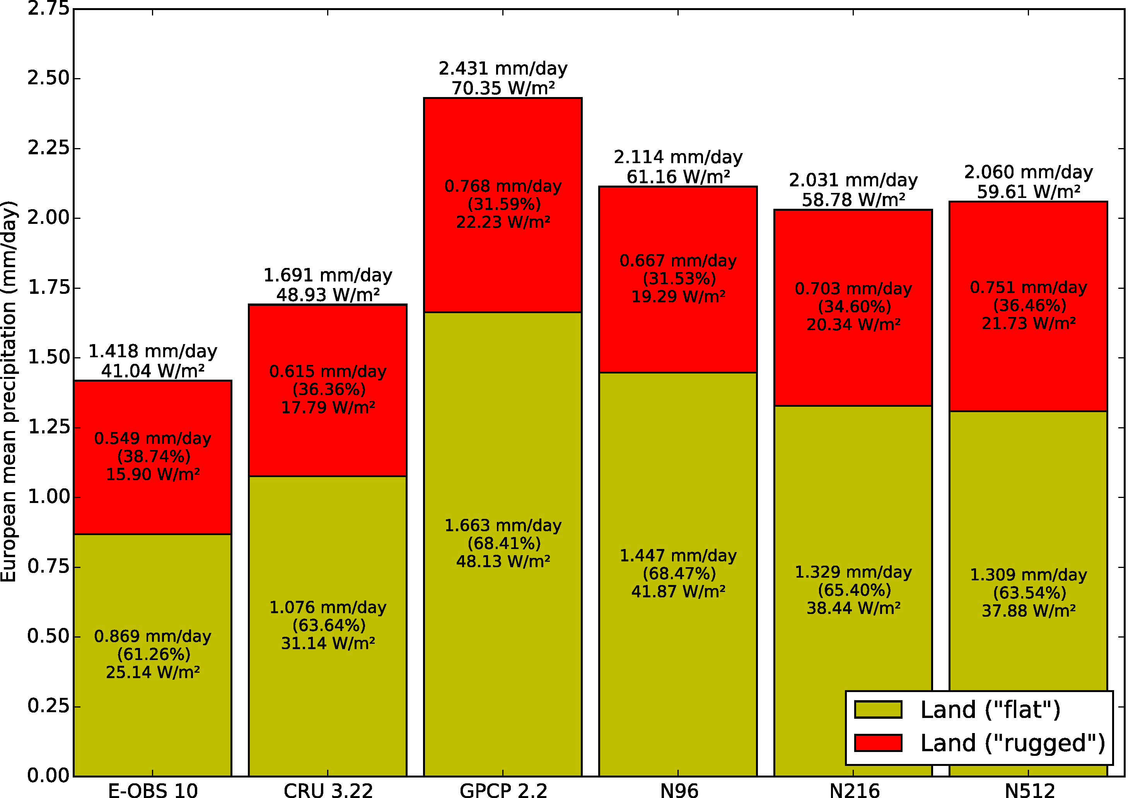
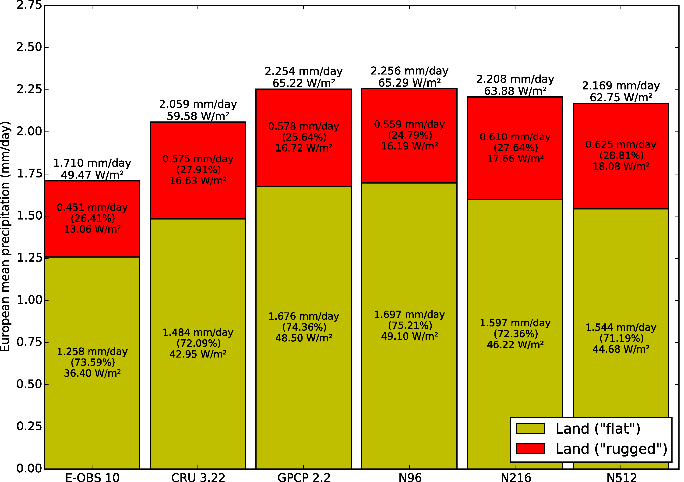
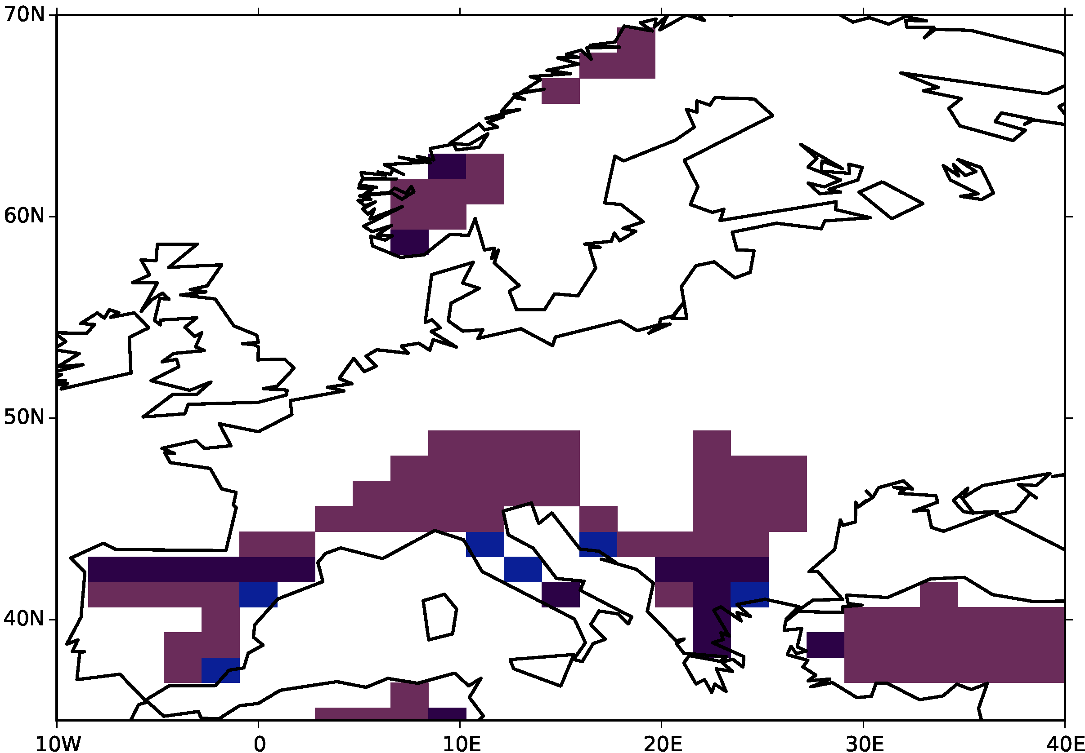
Example: Europe
DJF
JJA
Schiemann et al., in prep
Notes:
Fig. 3: As Fig. 2, but for Europe. Map shows analysis domain and “rugged” areas of complex topography.
higher proportion of modelled orographic precipitation at higher resolution both in winter and summer
large variation in area-averaged values across the three gridded observational datasets
GPCP22 has lowest proportion of orographic precipitation

Slide 19
Air-sea interactions

Slide 20
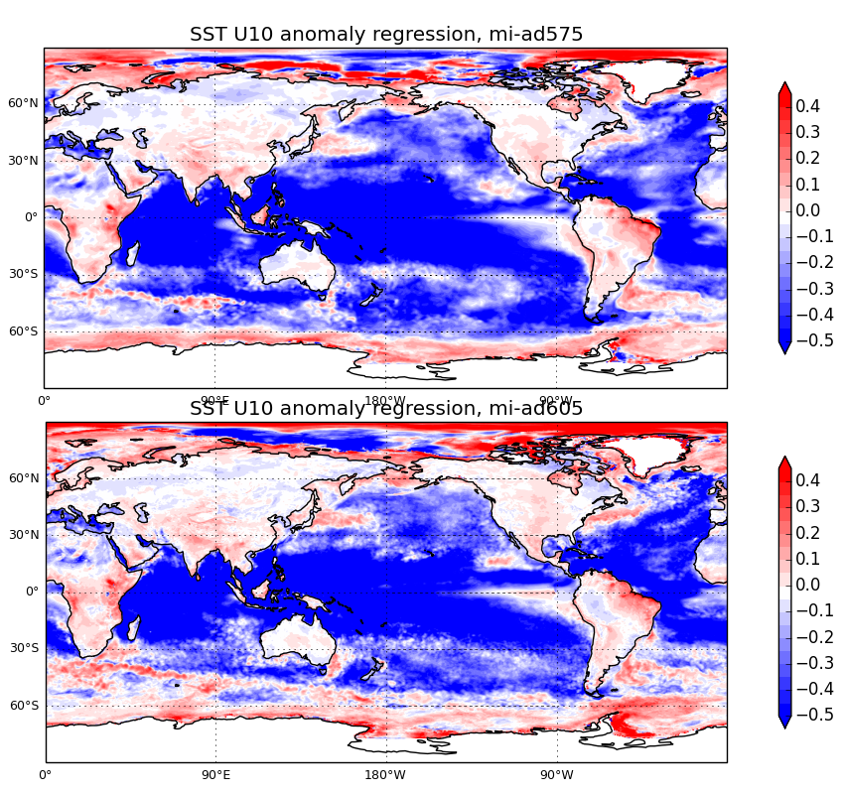
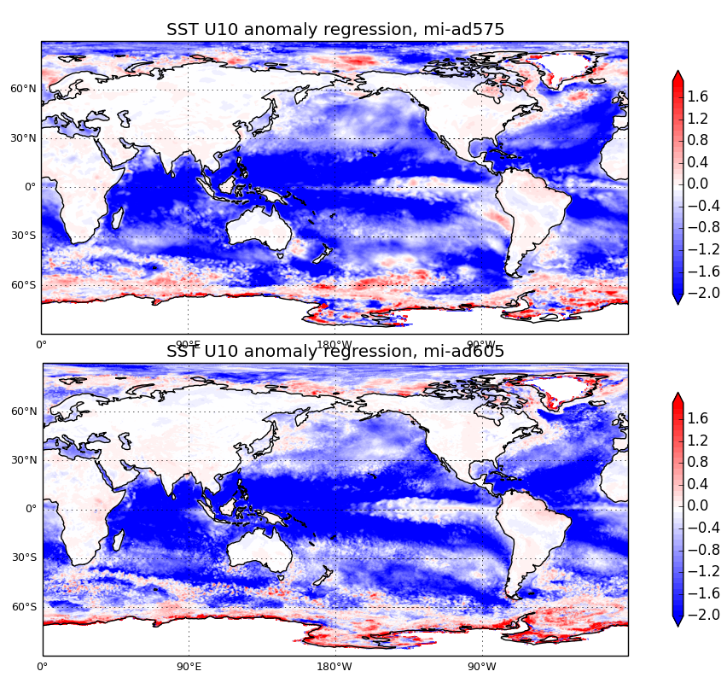
SST-wind speed relationships at monthly and daily timescales
Monthly mean SST/wind speed regression
Daily SST/wind speed regression
ORCA 1/4
ORCA 1/4
ORCA 1/12
ORCA 1/12
Courtesy Ann Shelly

Slide 21
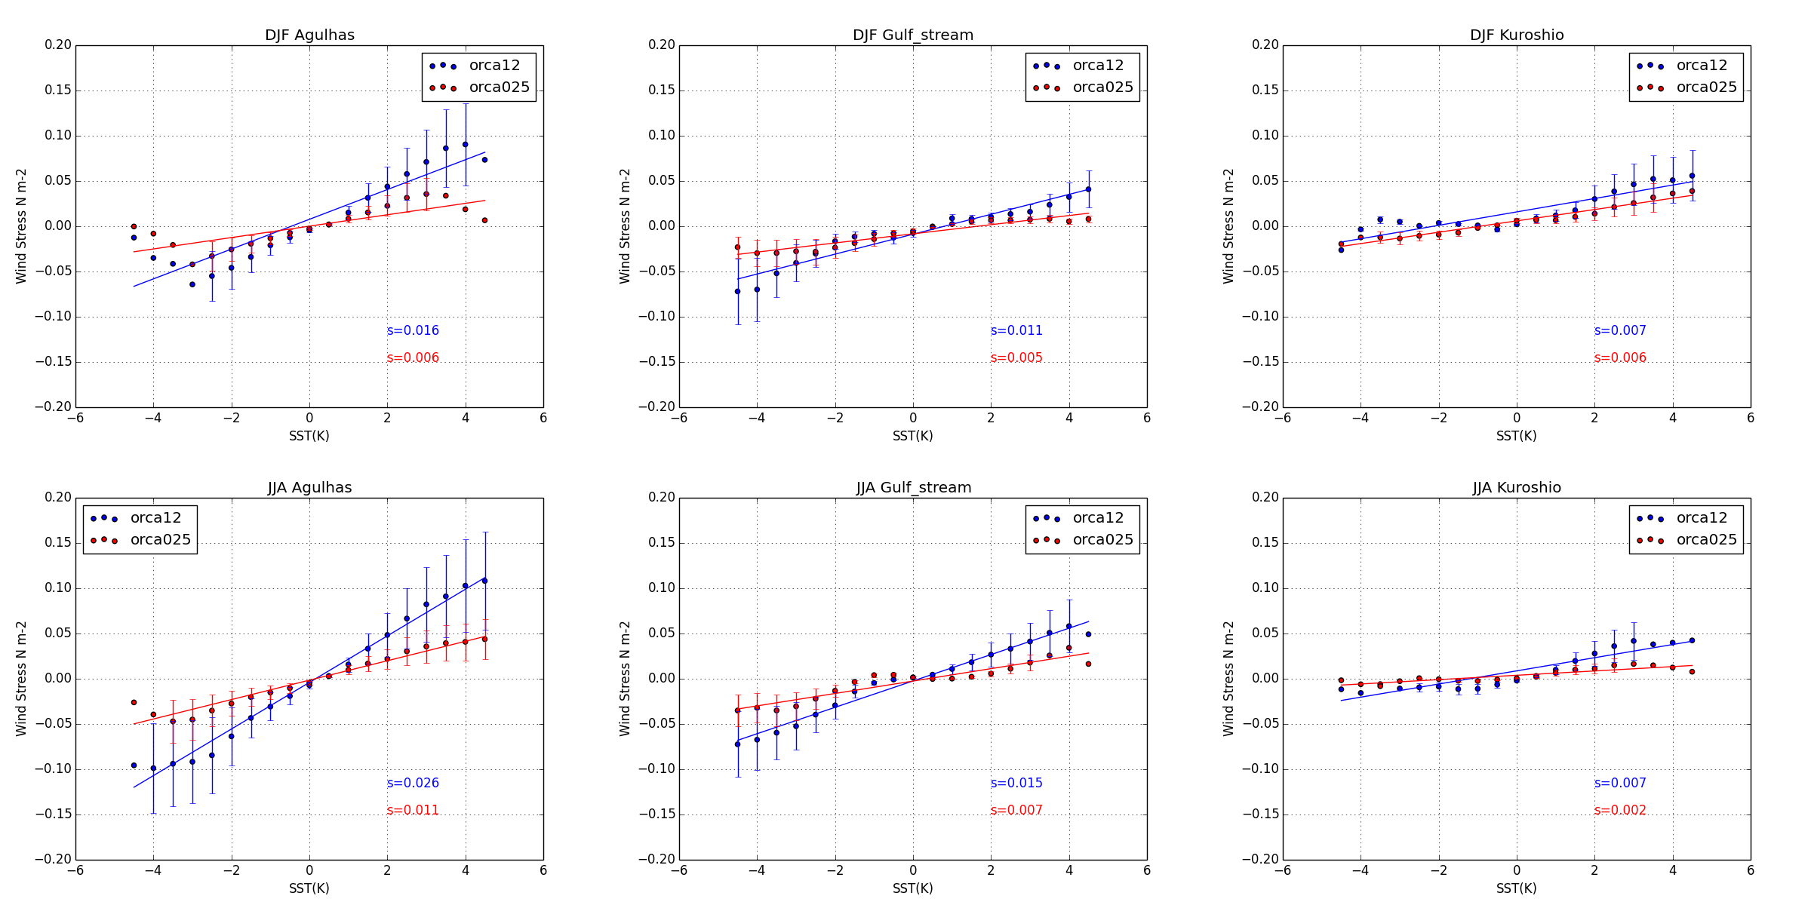
SST-wind stress coupling strength
N512-ORCA12
N216-ORCA025
OBS (Jan-Feb for AGUL and GS, 2003-2007 for KUR)
0.016
0.006
0.017
0.011
0.005
0.014
0.007
0.006
0.01
0.026
0.011
0.015
0.007
0.007
0.002
0.01
Courtesy Ann Shelly

Slide 22
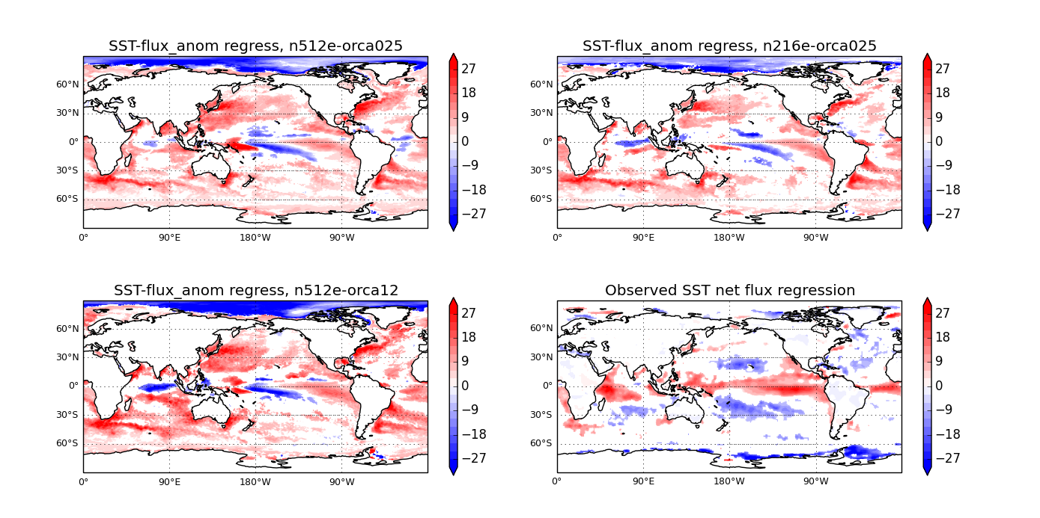
Regression between monthly SST anomaly and monthly net heat flux anomaly
Different model resolutions
Observations = Reynolds OI SST and fluxes derived from TOA and
ERAI (Liu et al, submitted)
Notes:
Trenberth and Carron 2001 using atmos column energy budgets– using TOA minus ERAI total energy divergences (with some important extra correction terms)

Slide 23
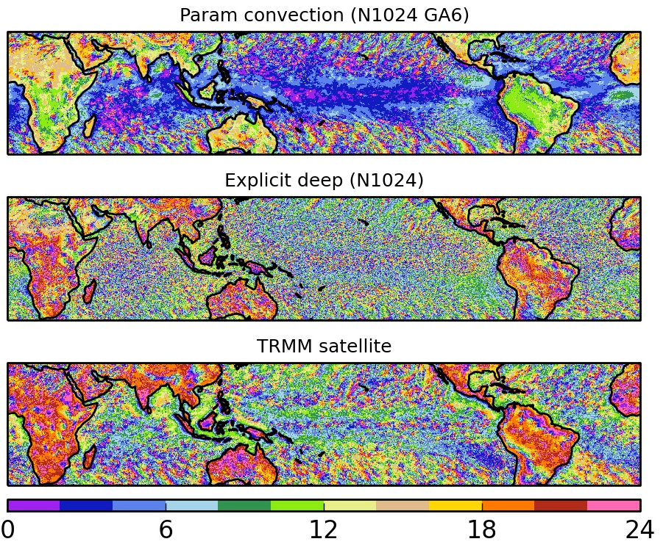
Local time of peak precipitation for 12km models
(diurnal cycle) – Jan-Dec 2006
Birch et al,
in revision

Slide 24
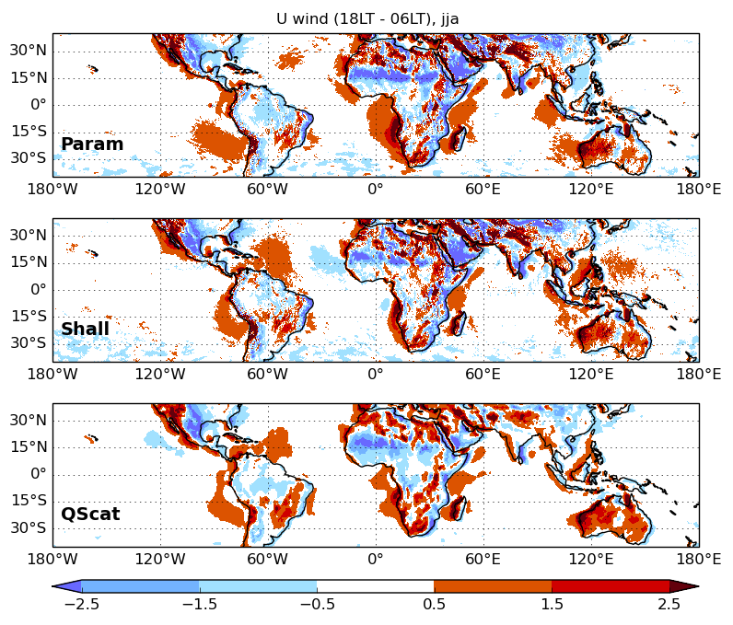
Diurnal cycle of 10m u wind, 1800LT – 0600LT, JJA
N1024 GA4 parameterised convection
N1024 GA4 with only shallow param
JPL-multi-sat-platform + reanalysis CMPP-L3
Thanks to S. Peatman

Slide 25
ECV properties
Global coverage
Long time period, homogeneous datasets
Gridded, quality controlled, familiar data formats
Quantified uncertainties
Easily searchable, downloadable
Co-location of related quantities for understanding processes
Availability of multiple observations of same ECV for comparison, understanding uncertainty

Slide 26
Precipitation and orography
3hr precipitation for diurnal cycle
Rainfall over steep orography – reduced biases
Ocean
Sub-daily SST product to assess diurnal cycle
In-situ heat fluxes over ocean
  Including temperature, humidity, wind in order to validate turbulent fluxes and parameterisations in models

Slide 27
Clouds and aerosols
Cloud properties – big differences in observational estimates
  Droplet number
  Effective size
Ice water path
Lightning
  Satellites detect light – mainly cloud to cloud
  Radio detect mainly cloud to ground
  Models simulate both – how to assess
Differentiation between cloud regimes/different cloud layers
Estimates of vertical velocity would be amazing to look at convective up and downdrafts

Slide 28
Sea-ice
Volume
  the combination of snow and sea ice
  Closely related to energy budget, and hence essential to understand and constrain model processes (and for understanding global warming)
Thickness
Albedo (particularly over sea-ice)
  constrain parameterisations
  Understand feedbacks, climate sensitivity
Short length of series - 1992-2008 for ice concentration, few years for thickness
Quality problems – sea-ice detected far from ice edge (being worked on)

Slide 29
Land surface
Soil moisture
  Dataset produced confined to surface
    Really want down to root zone, ~2m
  To use in models to understand vegetation dynamics, need to create model+data hybrid to produce a type of soil moisture that we can use to understand vegetation dynamics
  Standardising such hybrid methods is important
Indicator of vegetation activity, e.g. fPAR
  Fraction of Absorbed Photosynthetically Active Radiation
  This biophysical variable is directly related to the primary productivity of photosynthesis and some models use it to estimate the assimilation of carbon dioxide in vegetation.
  use to estimate whether or not vegetation is stressed (soil moisture stress and/or temperature stress).
Water table depth
  Enable understanding of global transports of water
Notes:
fraction of the incoming solar radiation in the Photosynthetically Active Radiation spectral region that is absorbed by a photosynthetic organism, typically describing the light absoprtion across an integrated plant canopy.

Slide 30
Initial Met Office work using CCI SST
Several 25km integrations complete using CCI SST and sea-ice as driving data (together with 130km simulations for comparison)
To compare with standard model development integrations using Reynolds OI

Slide 31
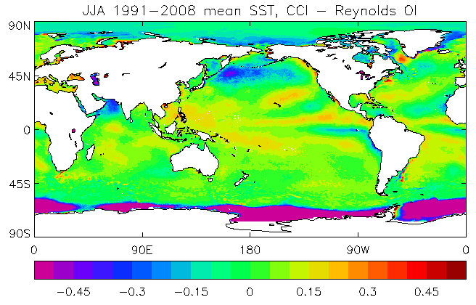
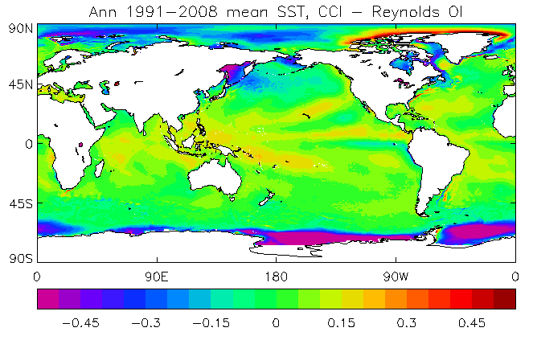
Comparing different SST datasets over long timescales

Slide 32
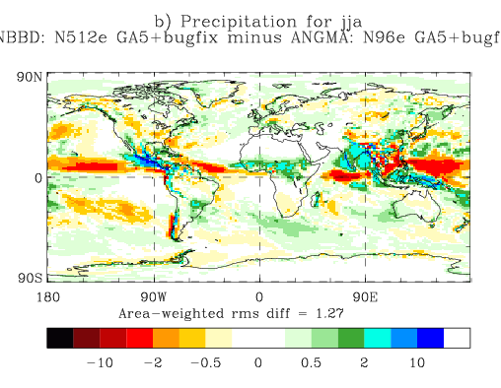
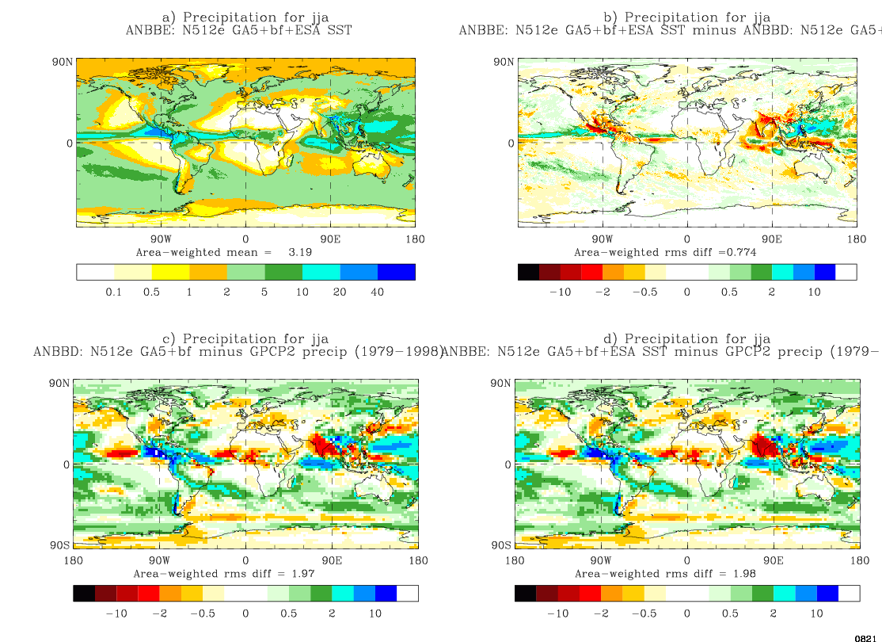
Precipitation change: Model resolution vs SST forcing
Impact of model resolution
Impact of SST forcing at same resolution
JJA precip: 25km – 130km simulation,
18yr mean
JJA precip: 25km: CCI – Reynolds OI
18yr mean
25km model bias vs GPCP2

Slide 33
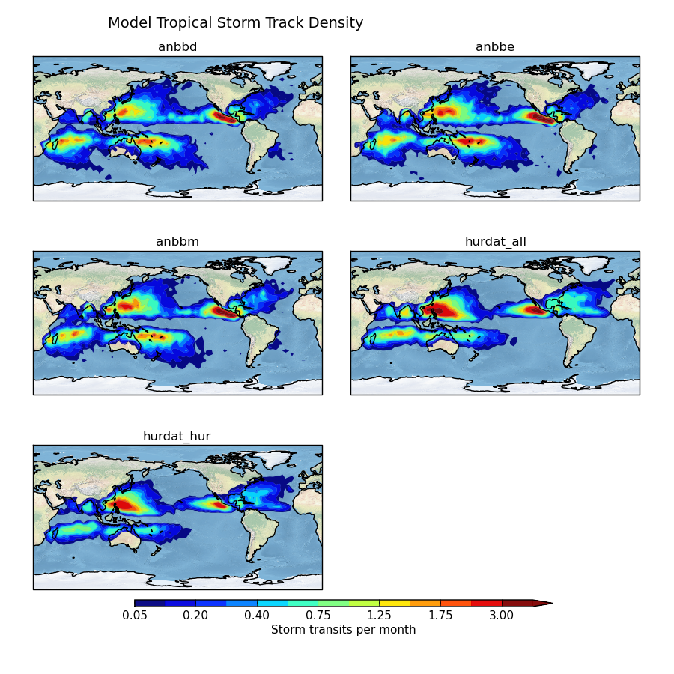
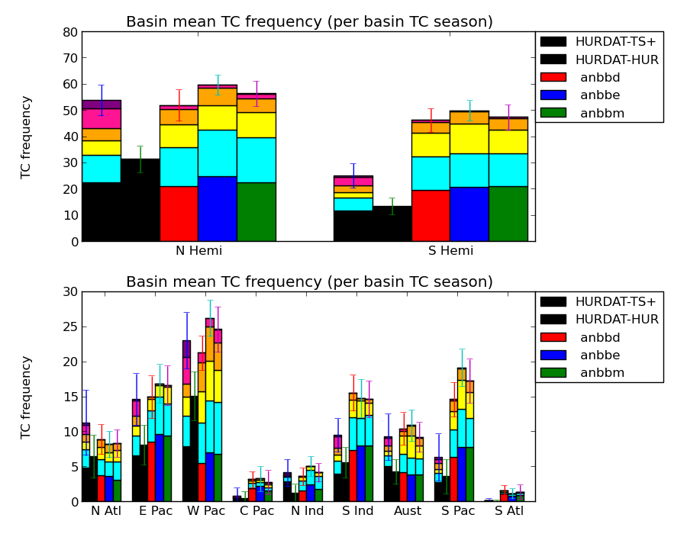
Changes in tropical cyclone climatology with different SST forcings
Daily Reynolds OI
Daily CCI
Monthly HadISST
Rey
CCI
HadISST
Obs

Slide 34
Future plans
Testing and understanding impact of using different forcing datasets on model simulations
  Differences between ECVs is much smaller than coupled model biases
  However can still have a significant effect on other quantities of interest
Understanding relative impact of
  Uncertainty in ECVs (running ensembles of models with different forcing/including uncertainty)
  Quantifying impact of these uncertainties on response of relevant climate variables and processes
Make use of CCI datasets in PRIMAVERA work packages
  Metrics
  Model development and assessment – both core and frontier simulations

Slide 35
Q&A

Slide 36


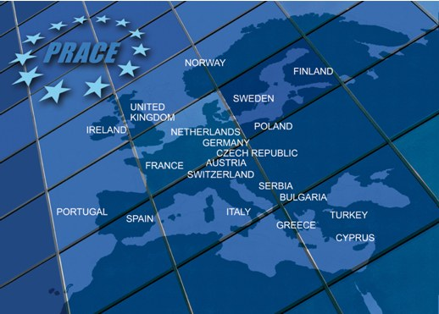
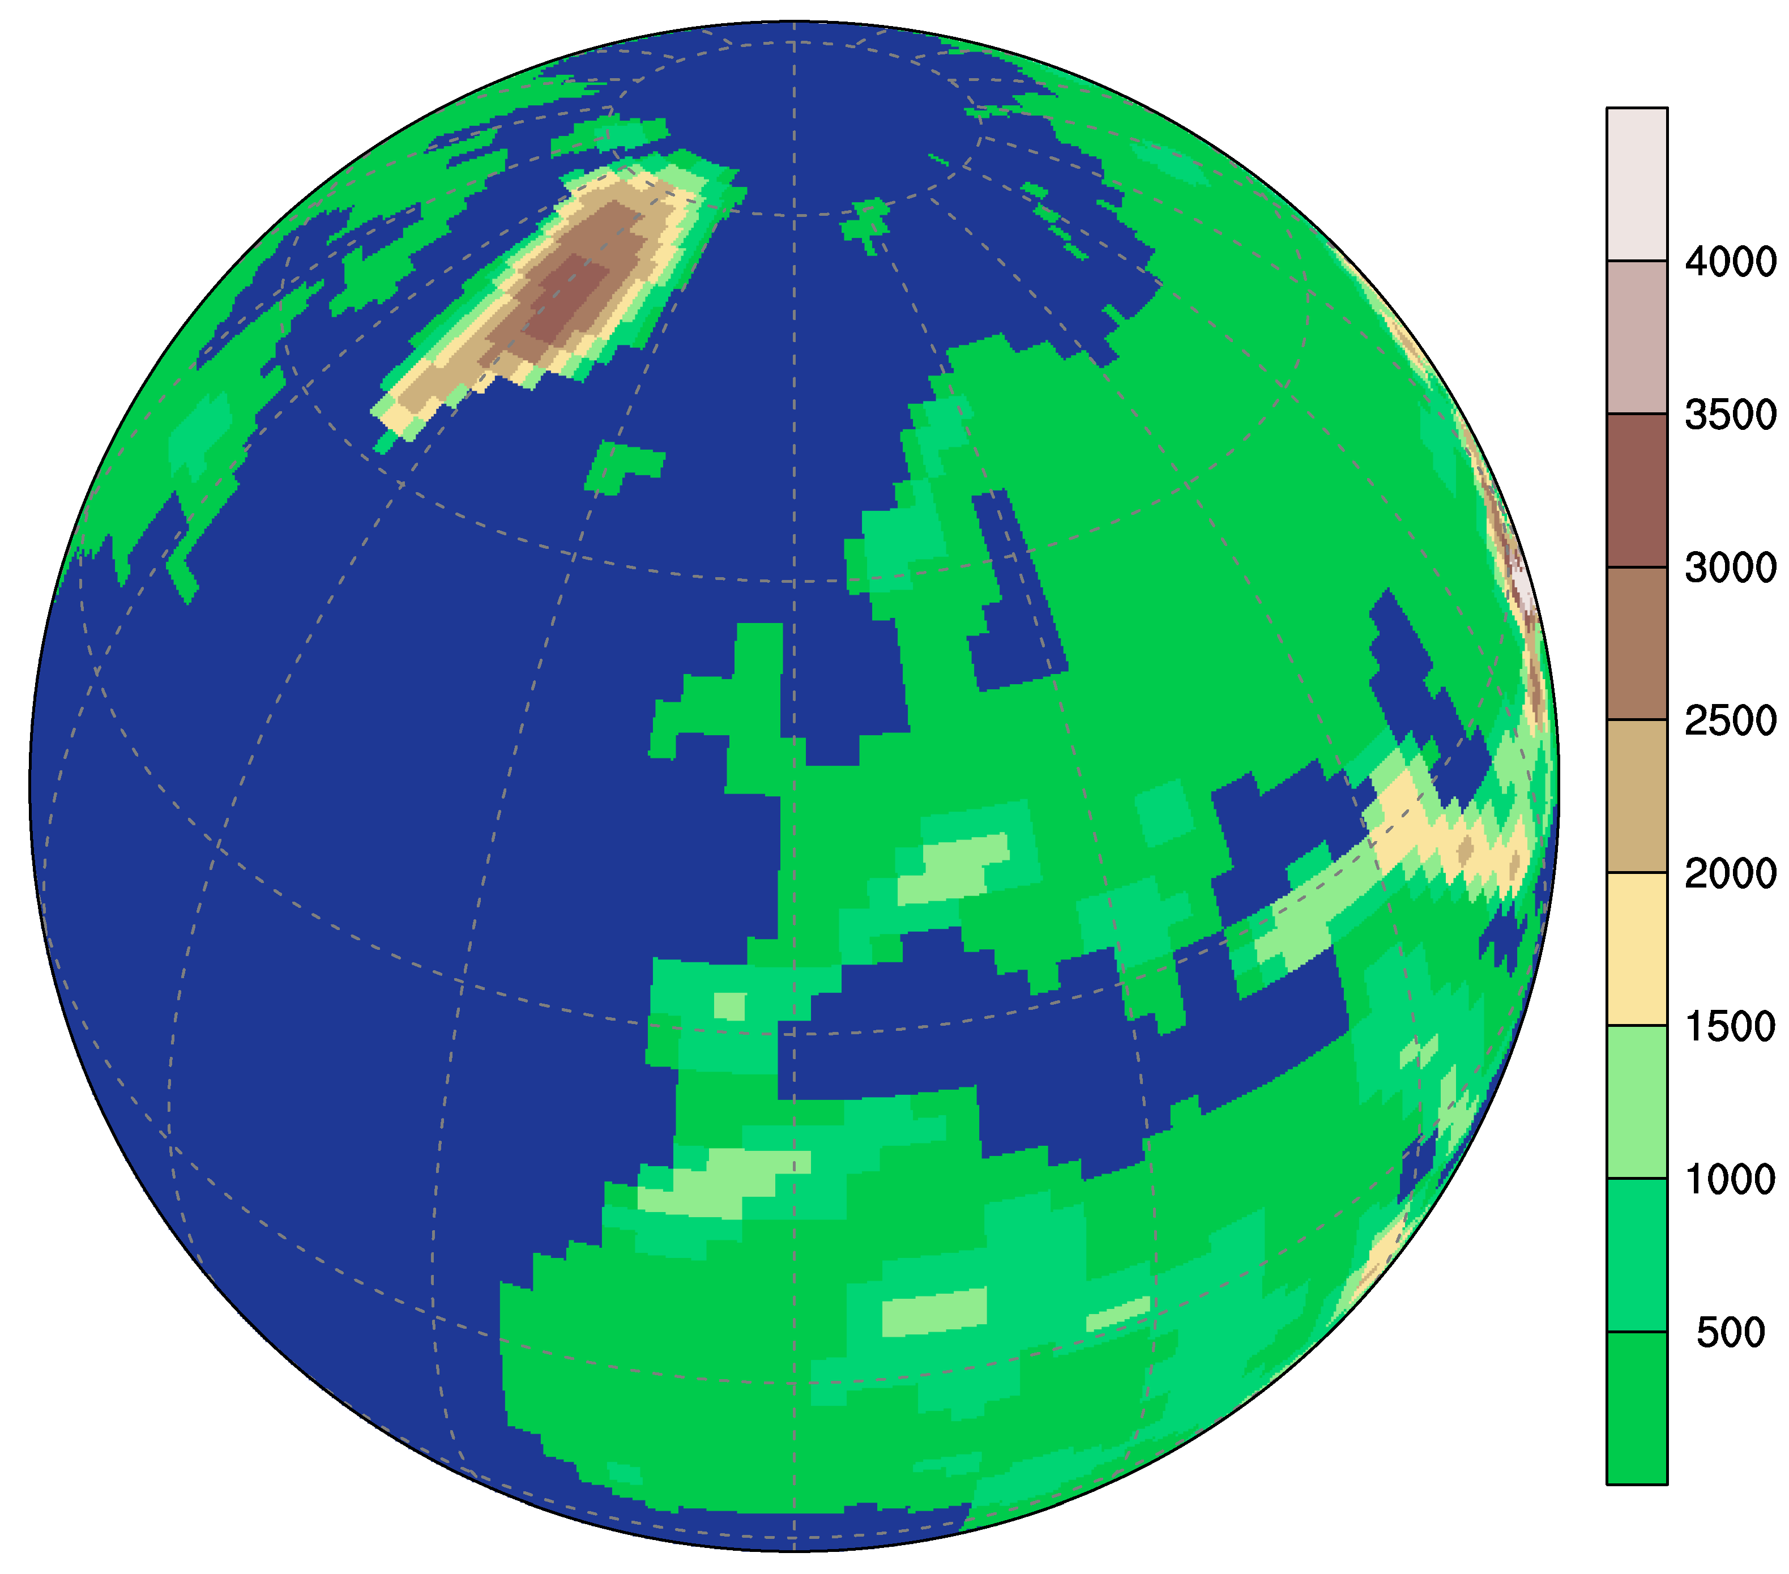
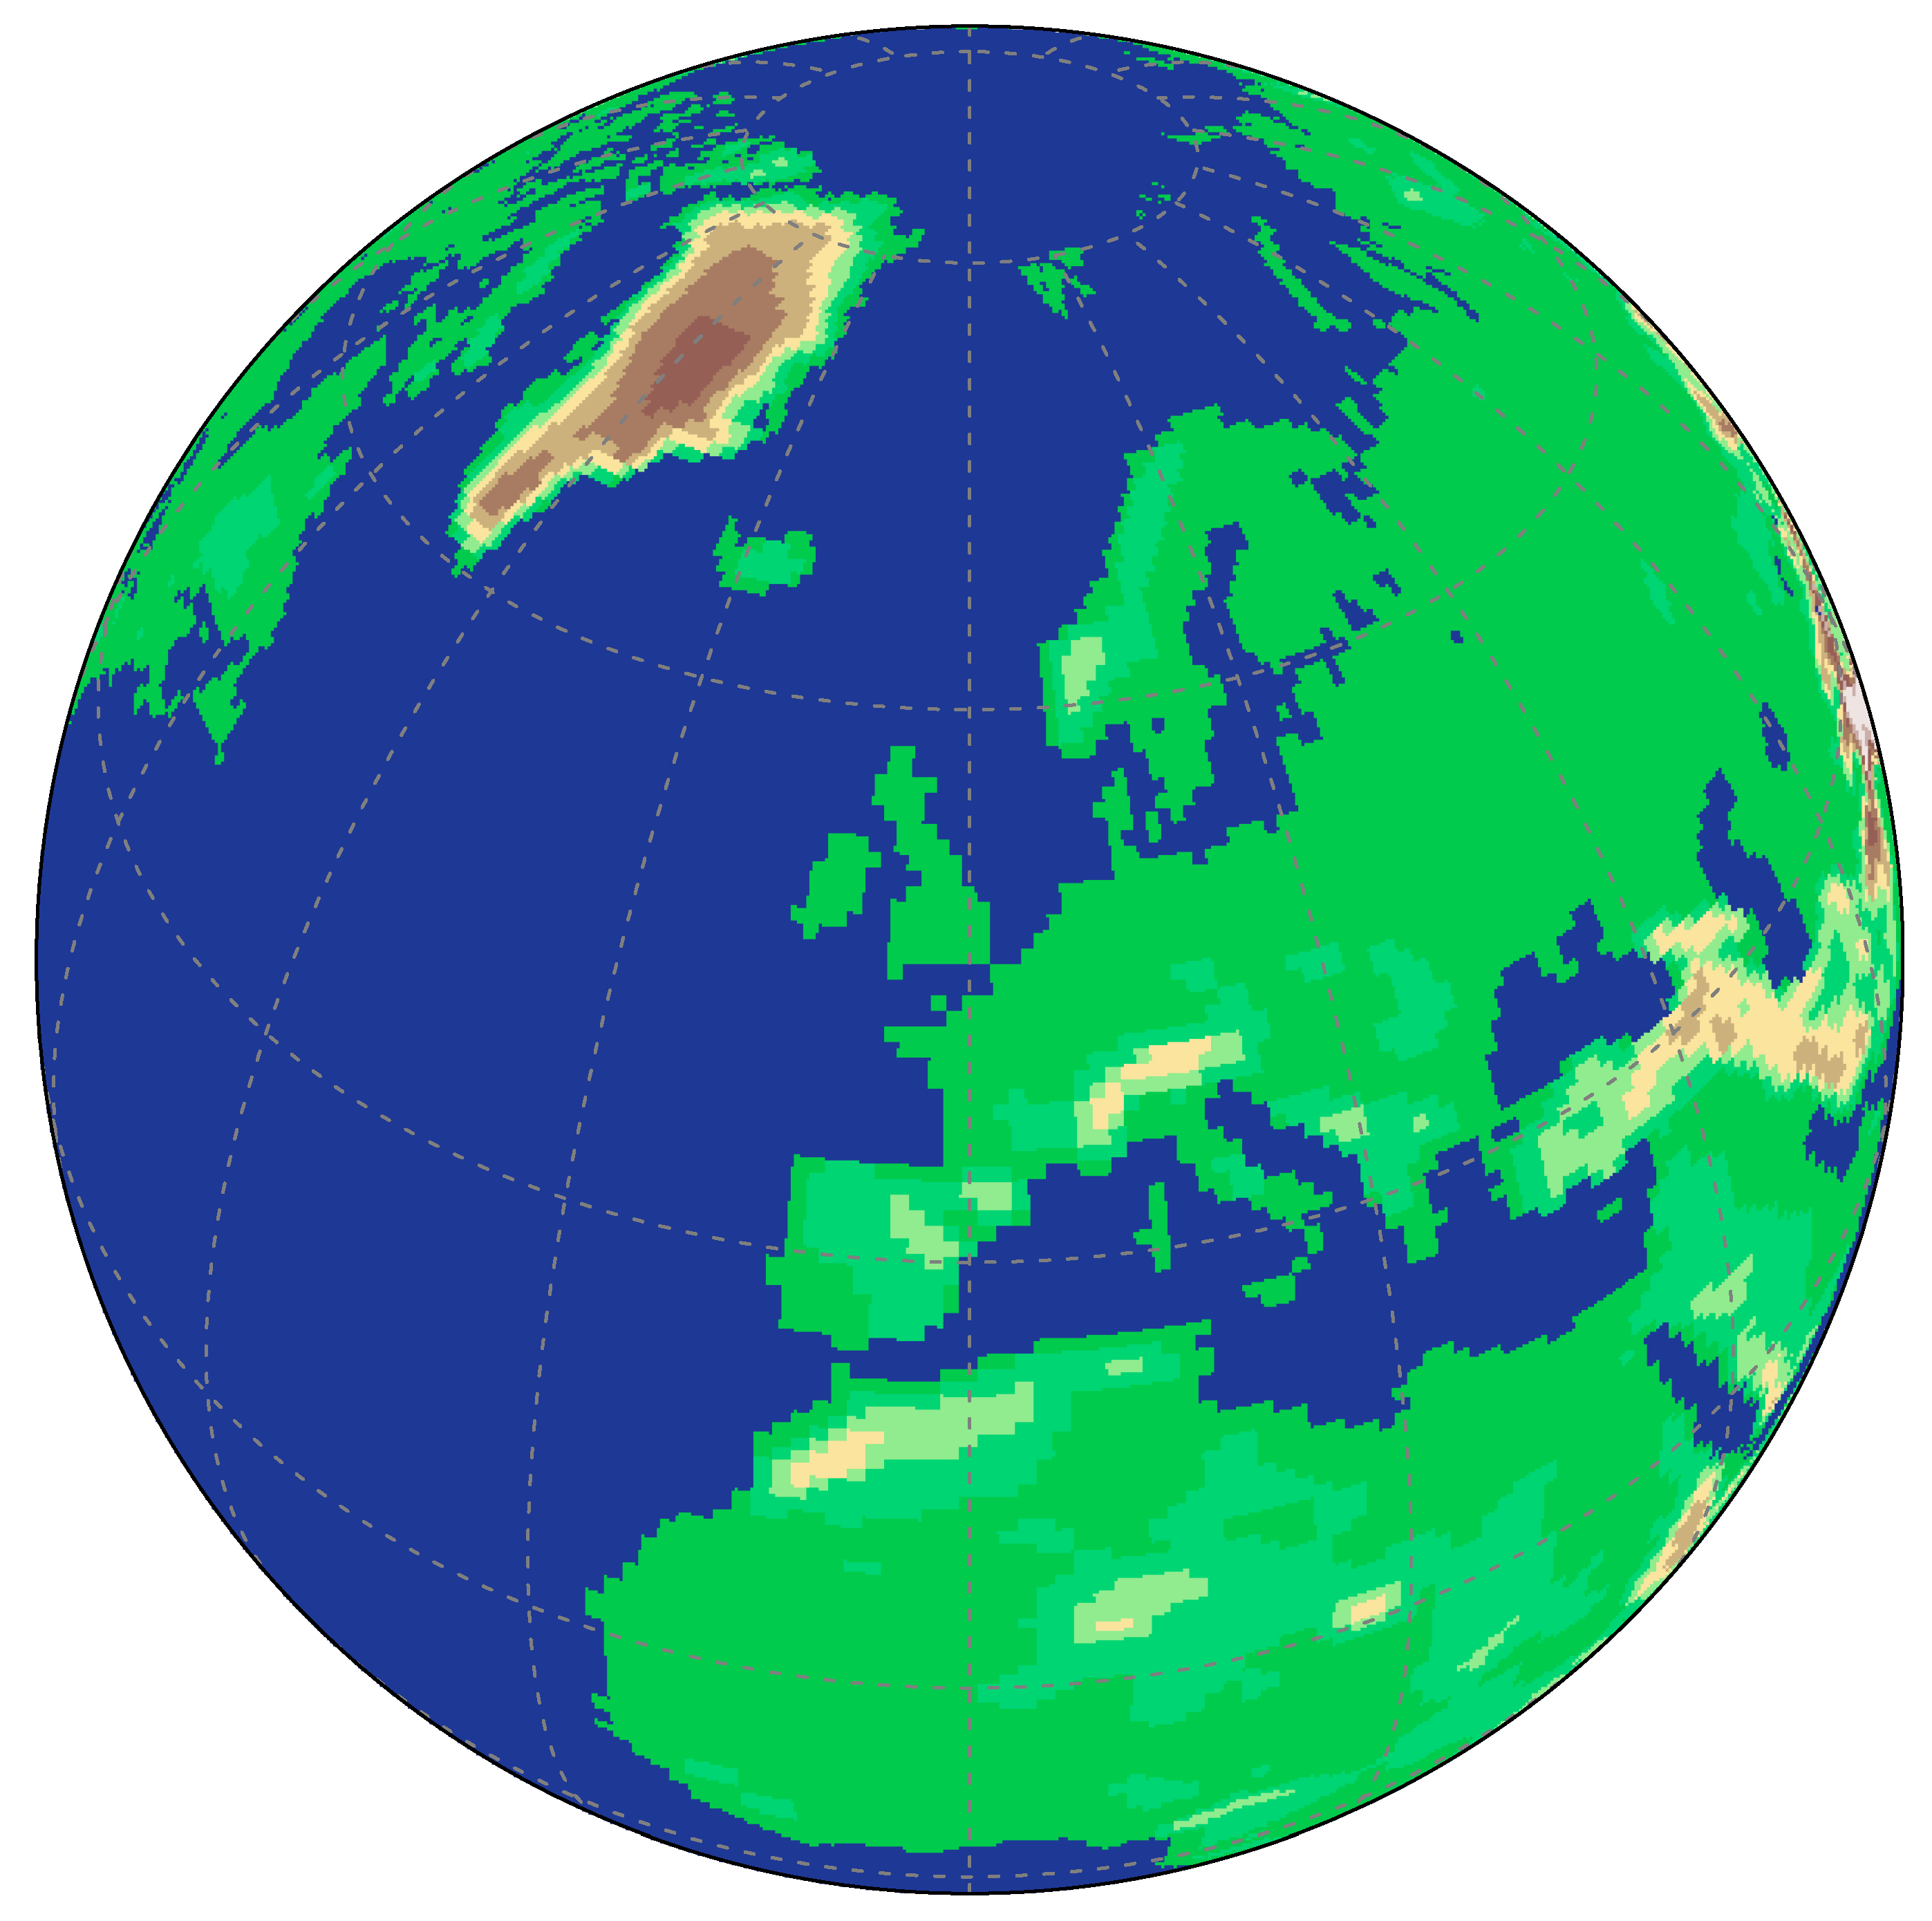

UPSCALE: UK on PRACE - weather resolving Simulations of Climate for globAL Environmental risk
PI: P.L. Vidale, NCAS-Climate, Reading
Joint Weather and Climate
Research Programme
A partnership in climate research
AIM: To increase understanding of climate processes and their resolution dependence
Forced atmosphere-land integrations, 1985-2011, 3-5 ensemble members/resolution
SST and sea-ice forcing from OSTIA 1/20° daily data
CMIP5-defined forcings including historic aerosol emissions
Timeslice future climate for 2100 with ΔSST from HadGEM2-ES using RCP8.5, 3 ensemble members/resolution
Using PRACE HPC grant of 144M core hours on HLRS Stuttgart CRAY XE6
400TB data produced
Demory et al (2013), Mizielinski et al (2014), Allan et al 2014, Roberts et al 2015, Vidale et al (in prep), Bush et al (in revision), Vellinga et al (in revision)
500
1500
orography (m)
UPSCALE: HadGEM3-A GA3.0 (85 levels, top@85km)
Essentially the same physics/dynamics parameters used throughout model hierarchy
5 members
3 members
5 members
N96 (135 km)
N216 (60 km)
N512 (25 km)
Resolution increase

Slide 37
UK – HighResMIP - PRIMAVERA
UK results
  Impact of resolution and links to multiple model biases
    e.g. Sahel rainfall and decadal variability, AEJ/AEWs, Atlantic tropical cyclones
    Eddy resolving ocean, improved ocean circulation, reduced Southern Ocean biases, improved Atlantic
Individual or small group campaigns
  E.g. Athena, UPSCALE, HiResCLIM, EC-Earth, STORM, Climate-SPHINX
Leading to HighResMIP
  Coordinated international multi-model high resolution comparison
  Robustness across multi-models
Leading to PRIMAVERA
  Model development and assessment with focus on Europe
  Frontier simulations

Slide 38
Modelling groups expressing interest in HighResMIP
(at least for Tier 1 simulations)
Country | Group | Model
China | BCC | BCC-CSM2-HR
Brazil | INPE | BESM
China | Chinese Academy of Meteorological Sciences | CAMS-CSM
China | Institute of Atmospheric Physics, Chinese Academy of Sciences | FGOALS
USA | NCAR | CESM
China | Center for Earth System Science/Tsinghua University | CESS/THU
Italy | Centro Euro-Mediterraneo sui Cambiamenti Climatici | CMCC
France | CNRM-CERFACS | CNRM
Europe | EC-Earth consortium (11 groups) | EC-Earth
USA | GFDL | GFDL
Russia | Institute of Numerical Mathematics | INM
Japan | AORI, University of Tokyo / JAMSTEC / National Institute for Environmental Studies | MIROC6-CGCM
Japan | AORI, University of Tokyo / JAMSTEC / National Institute for Environmental Studies | NICAM
Germany | Max Planck Institute for Meteorology (MPI-M) | MPI-ESM
Japan | Meteorological Research Institute | MRI-AGCM3.xS
UK | Met Office | UKESM /HadGEM3

Slide 39
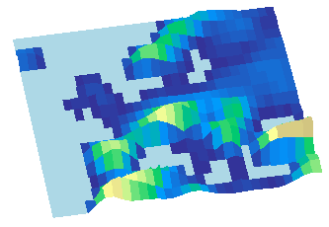

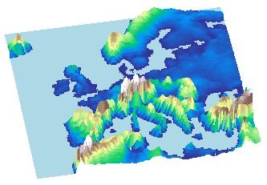
Global HighResMIP resolution
representation of orography
130km resolution orography
Illustration of the orographic representation at standard and high resolution over Europe in a global model.
Orographic processes are highly non-linear
25km resolution orography

Slide 40
High resolution climate modelling - multi-resolution and multi-model robustness
Need a traceable resolution hierarchy with no tuning between resolutions
UPSCALE – tropical cyclones, moisture transports, tropical precipitation
explicit convection – diurnal cycle, land-atmosphere interaction, precipitation intensity
ORCA12 – mean state, air-sea interaction
Towards multi-model – robust changes with resolution alone (no resolution-specific tuning)
Give examples of these from UK group, what answers and questions there are and how multi-model can help to address these CMIP5/IPCC AR5 questions

Slide 41
MetUM global atmosphere/coupled model climate configurations in use
Atmosphere/land
GloSea5
UPSCALE
N216
60km
N512
25km
N144
90km
N768
17km
N96
130km
UK-ESM1 for CMIP6?
N1024
12km
ORCA025
0.25°
ORCA1
1°
ORCA12
0.08°
Explicit convection
Ocean/sea-ice
CMIP3&CMIP5 resolution
Charisma project
Project to assess impact of global explicit convection
Essentially the same physics/dynamics parameters used throughout model hierarchy
GA = Global Atmosphere
GC = Global Coupled

Slide 42
