Slide 1


Carbon cycle assessment
Patricia Cadule
Jean-Louis Dufresne
Institut Pierre Simon Laplace, Paris.
CCI-CMUG, 27 May 2015

Slide 2
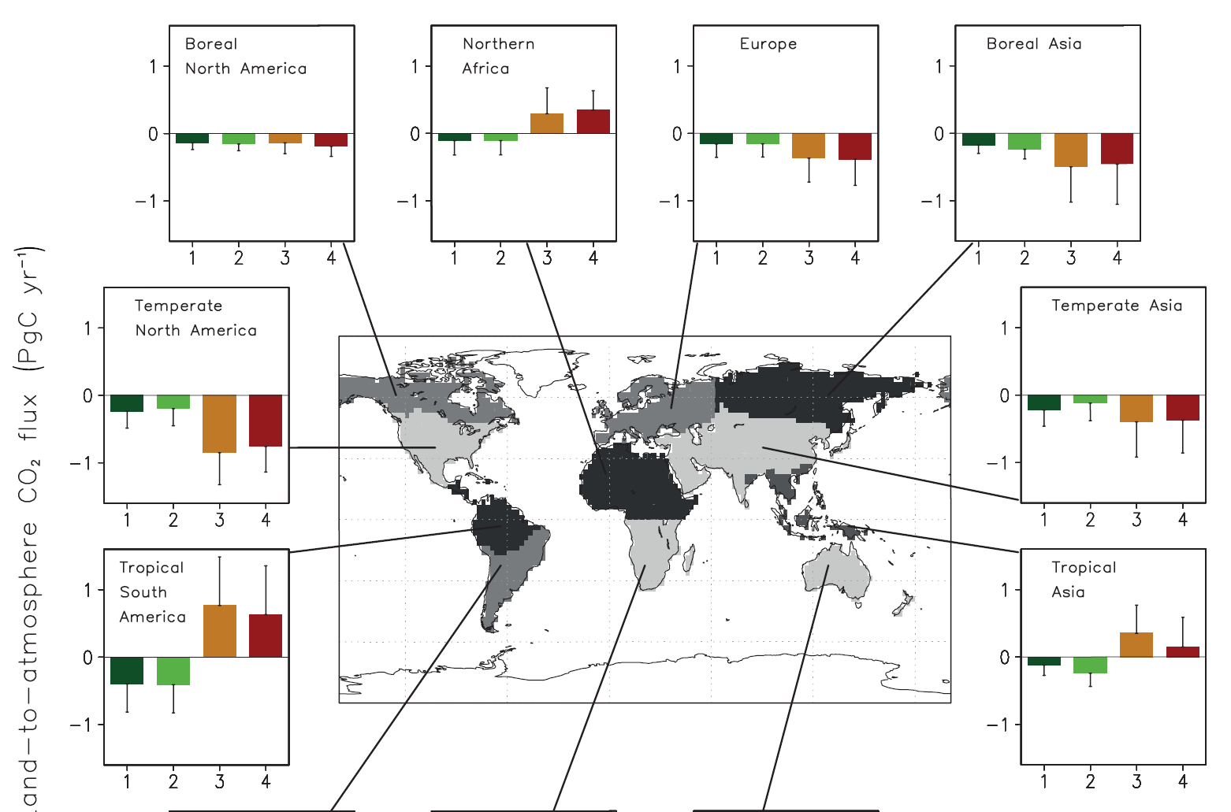
Regional CO₂ fluxes
Veget.
models
Inversions
[Peylin et al]
[IPCC AR5]
Notes:
The results from atmospheric CO2 inversions, terrestrial ecosystem models and forest inventories consistently show that there is a large net CO2 sink in the northern extratropics, albeit the very limited availa- bility of observations in the tropics (Jacobson et al., 2007; Gurney and Eckels, 2011; Pan et al., 2011). Inversion estimates of atmosphere–land CO2 fluxes show net atmosphere-to-land CO2 flux estimates ranging from neutral to a net source of 0.5 to 1.0 PgC yr–1 (Jacobson et al., 2007; Gurney and Eckels, 2011)

Slide 3
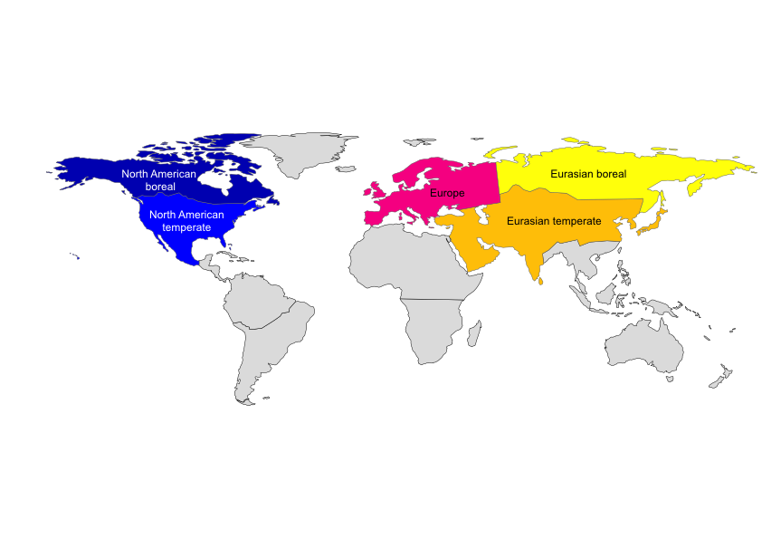
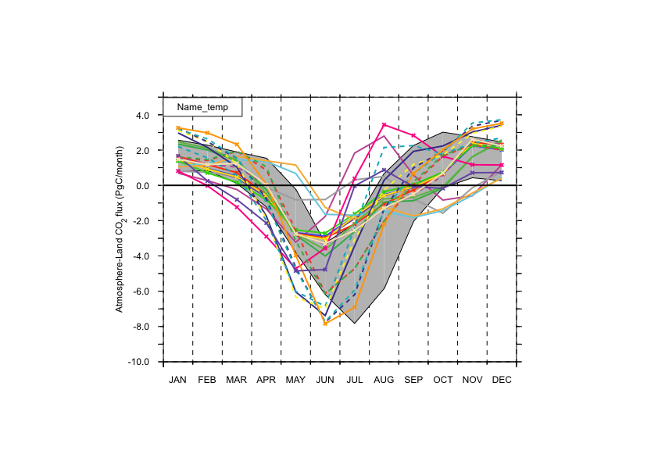
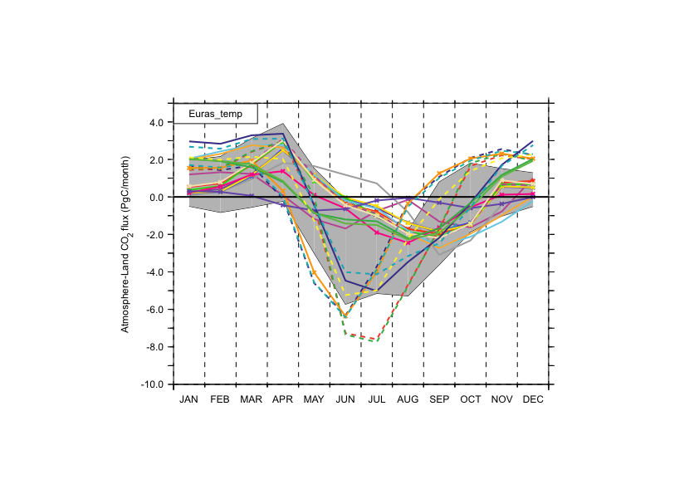
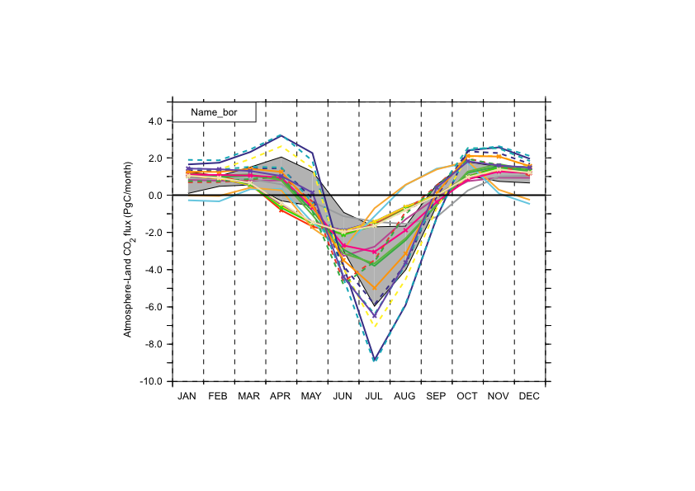
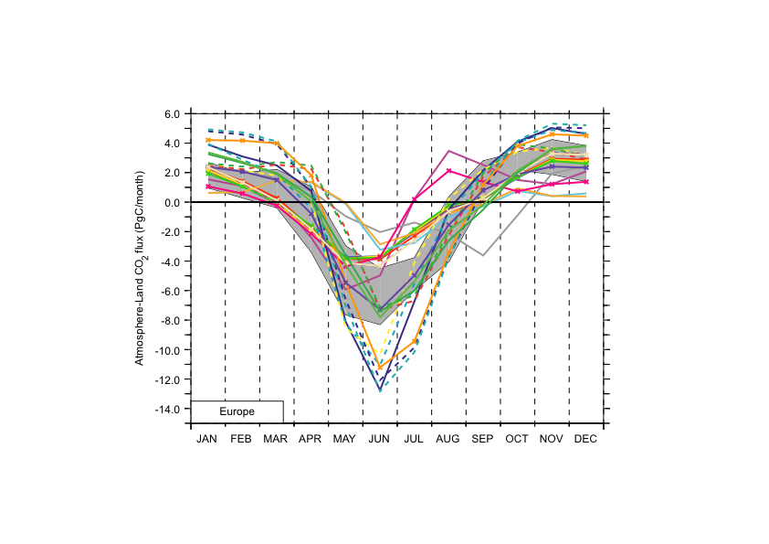
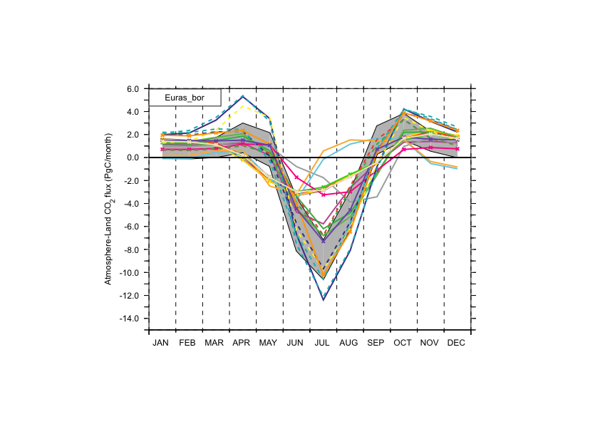
CMIP5 Models vs Inversions
Regional CO₂ fluxes
Grey shading: inversions
Color lines: CMIP5 models
(PgC/yr)
(PgC/yr)
Month
Month
(PgC/yr)
(PgC/yr)
(PgC/yr)
Month
Month
Month

Slide 4
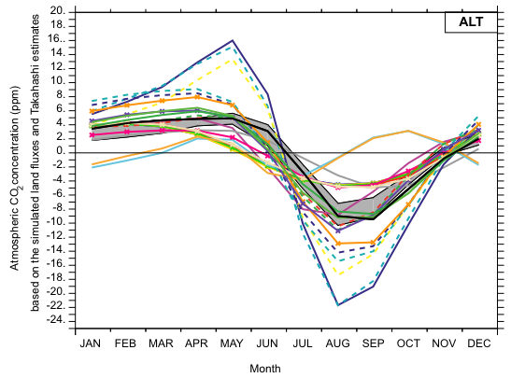
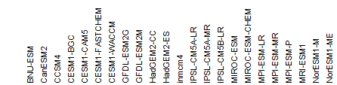
Regional CO₂ fluxes
Comparing models with
carbon flux estimates (inversions)
CO2 concentration in a few locations (transport of surface CO₂ flux)
Evaluations of the atmospheric CO₂ concentration of the 23 CMIP5 models
Alert (Canada)
Over 11 CO2 stations

Slide 5
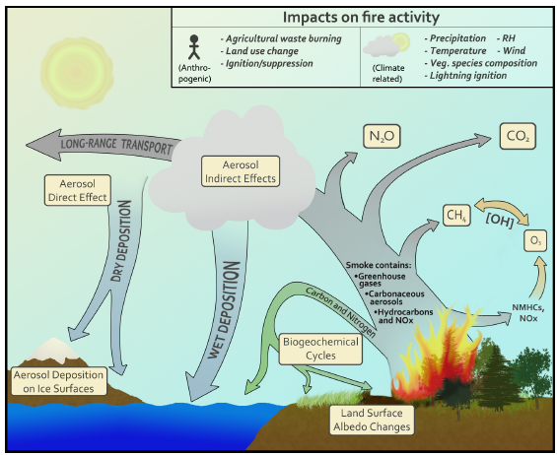
Project
- Added value of CCI variables
- Consistencies amongst variables
- Focus on fires
Fires produce
Greenhouse gases (CO₂, CH₄, N₂O, …) that impact the radiation budget
CO, non-methane hydrocarbons, and NO_{x} altering the oxidation capacity of the atmosphere
Aerosols (OC, BC) having an impact on the radiation budget
Ward et al., 2012

Slide 6
Project
- Added value of CCI variables
- Consistencies amongst variables
- Focus on fires
Fires and vegetation models
ORCHIDEE-SPITFIRE modeling framework, coupled with the LMDZ climate model
SPITFIRE (Thonicke et al., 2010)

Slide 7
Bottom-up approach of emissions estimation (aided by vegetation models)
Atmospheric model
Transport and
Inversion models
Vegetation model
Emission
(carbon and other gases)
Observation
ESA fire_cci
DGVM
BA
(Burned Area)
Fuel
(biomass,
litter etc.)
CF
(Combustion Fraction)
EF
(Emission Factor)

Slide 8
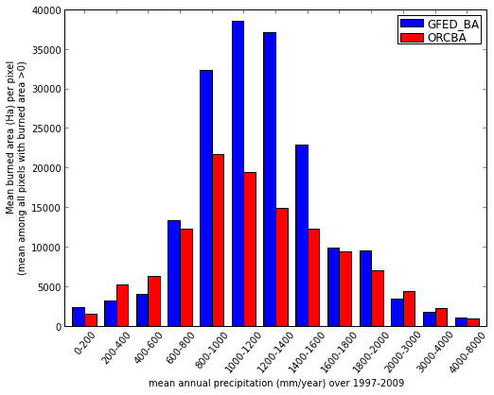
Consistency fires vs precipitation
Low precipitation:
limited by fuel (vegetation) amount
High precipitations:
limited by the degree of drought
Mean burn area
Mean annual precipitation (mm/yr) (1997-2009)

Slide 9
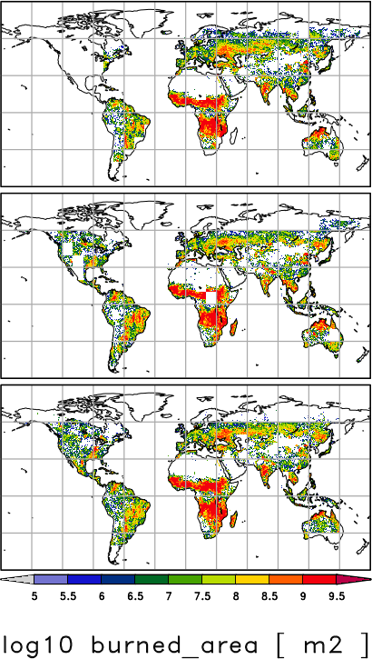
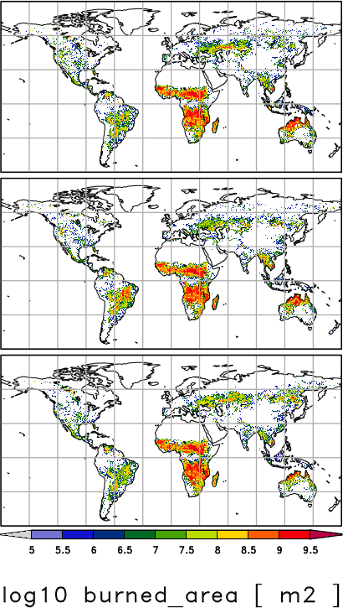
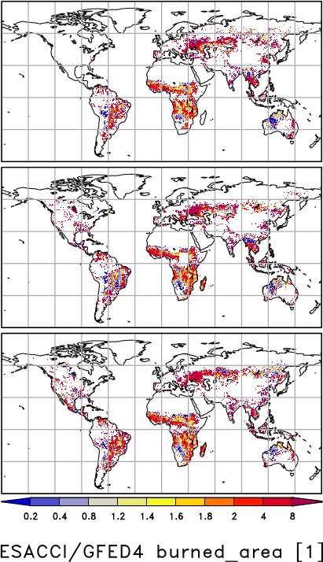
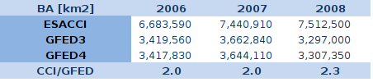
Burned area: ESA fire_cci vs. GFED4
ESACCI GFED4 ESACCI/GFED
2006
2007
2008
Annual burned area
ESACCI ≈ 2x GFED4,
despite many
tiles still missing in ESACCI

Slide 10

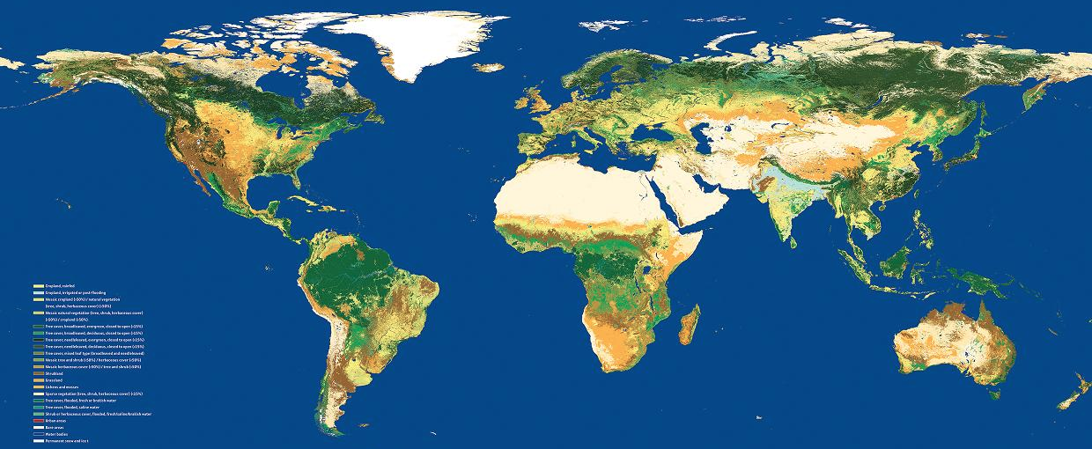
Experiments: Land cover data
LC_CCI
Current land cover map
Outdated land cover inputs
  IGBP land cover (Belward et al. 1999) and,
  Olson vegetation map with 96 classes (1983)
ESA LC_CCI PFT datasets
Land cover
Köppen-Geiger
climate zones
Land Cover -> PFT Conversion Tool (BEAM)
Phenology & Physiognomy
Plant Functional Types

Slide 11
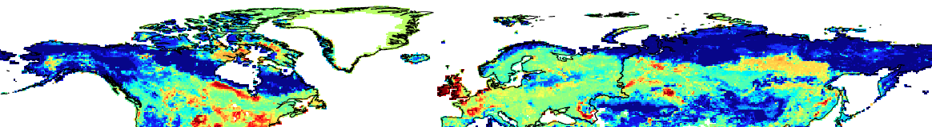
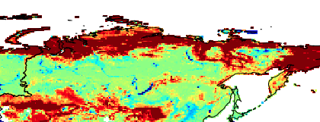
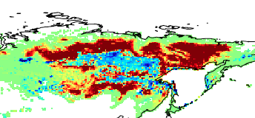
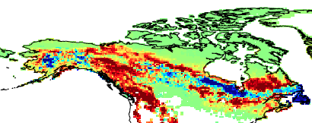
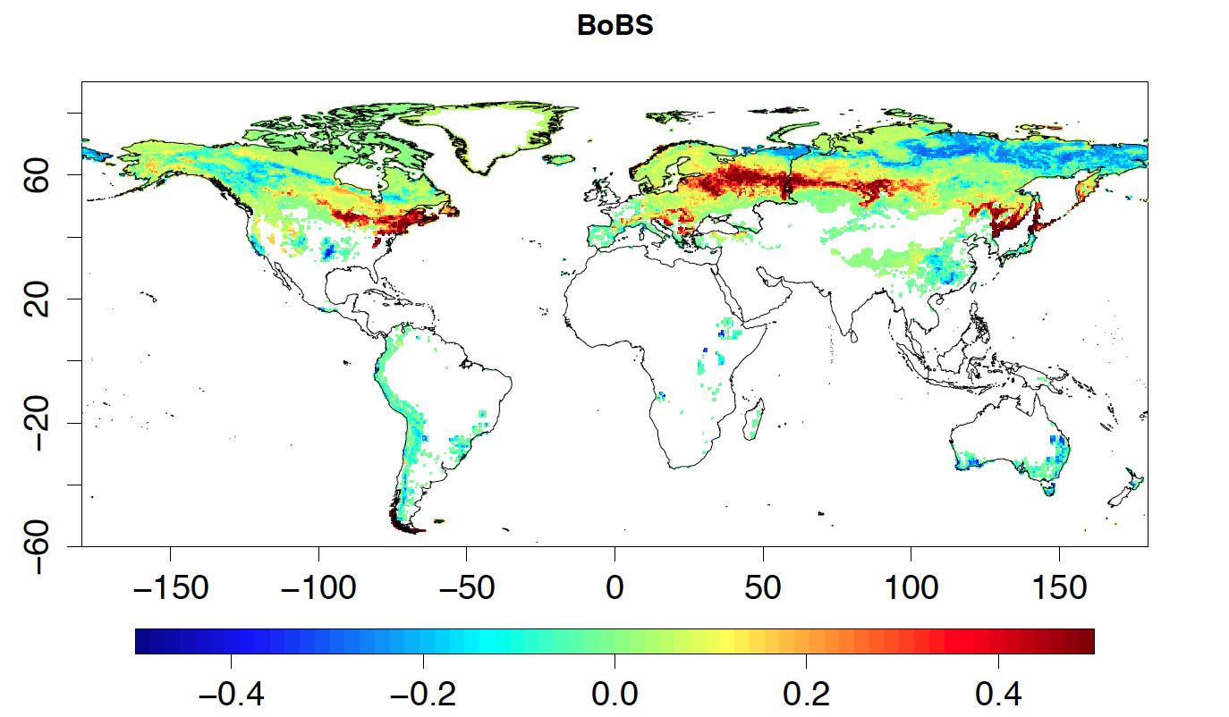
PFT differences – high latitudes
Decrease in tundra C3 grass cover
Increase in Bare Soil
Decrease in BoNS
Increase in BoNE
Increase in BoBS at expense of BoNE
(LC_CCI – Olson)
decrease
increase
Notes:
1 - Bare soil
7 – BoNE : boreal needleleaf evergreen
8 – BoBS : boreal broad-leaved summergreen
9 – BoNS : boreal needleleaf summergreen

Slide 12
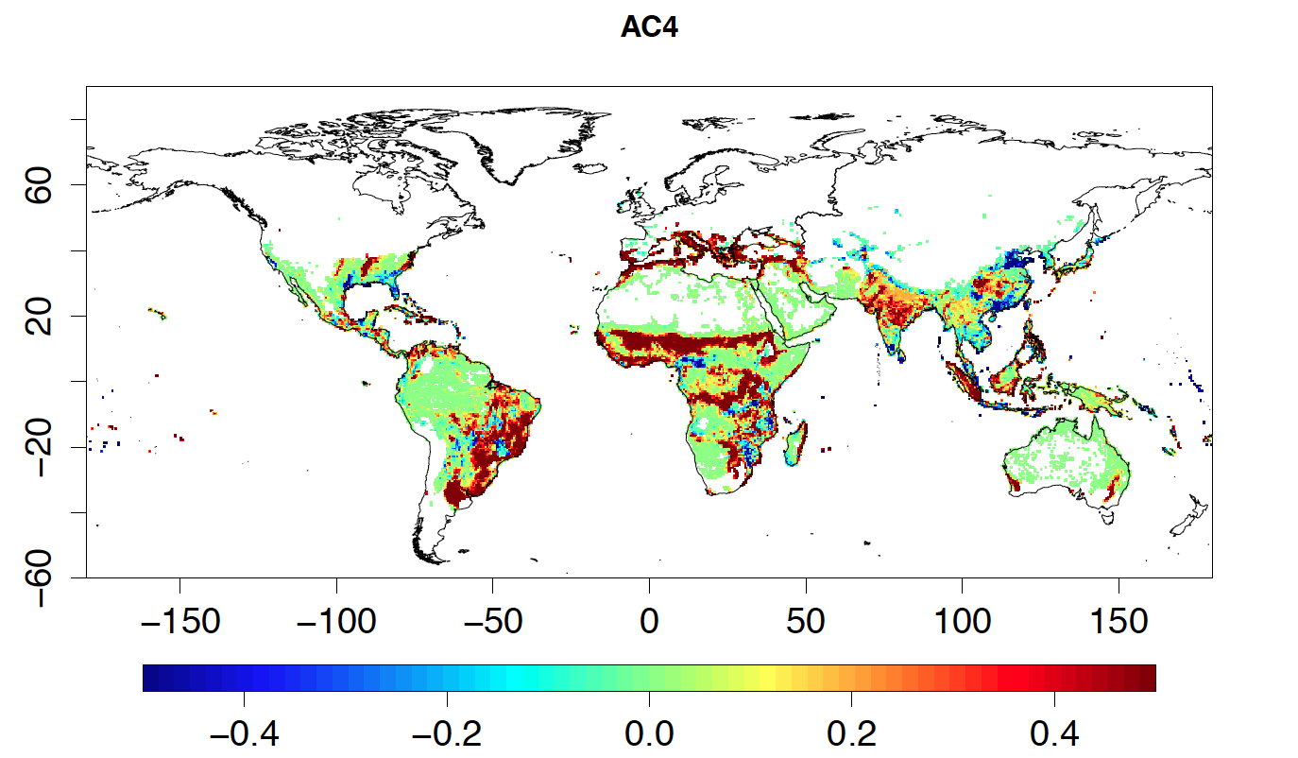
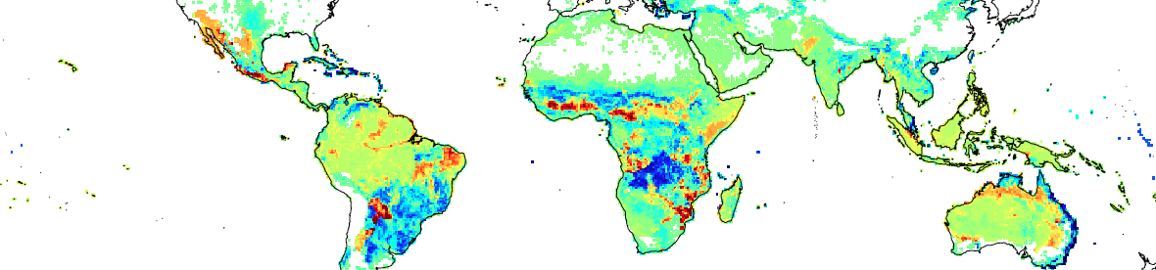
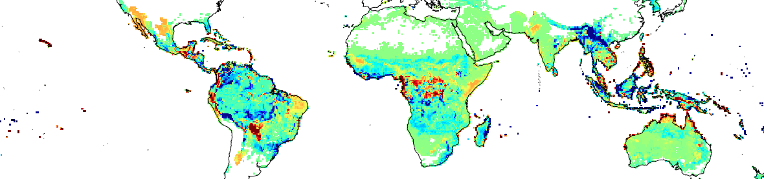
PFT differences – tropics (LC_CCI – Olson)
Increase in C4 crops
Decrease in TrRG
Decrease in TrEV
Notes:
1 - Bare soil
2 – TrBE : tropical broad-leaved evergreen
3 – TrBR : tropical broad-leaved raingreen

Slide 13
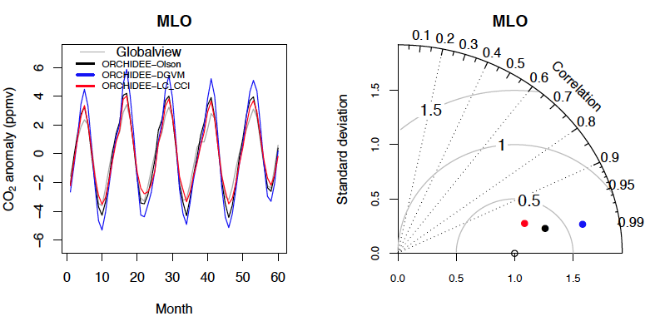
Carbon budget evaluation
Mauna Loa (Pacific)

Slide 14
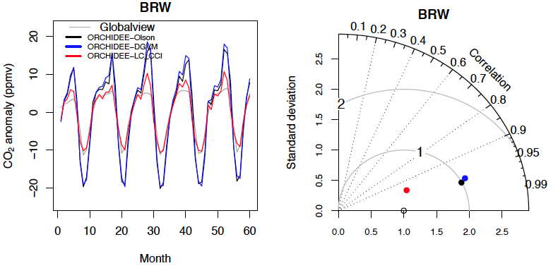
Carbon budget evaluation
Barrow (Alaska)

Slide 15
Complementary studies towards assessment of carbon cycle and fires in coupled climate model:
  Identify (in)consistencies amongst related datasets
  Determine the origins of added values of CCI
  Improve knowledge and understanding processes

Slide 16
Study 1
Dataset analysis
Using the following datasets: SST, SI, LC, GHG, FIRE, SM, ALB
Look for fires (region, spread/extent, duration)
Identify corresponding pre-fire conditions (availability of fuel, climate conditions, ignition source, …)
Identify corresponding post-fire conditions (climate conditions, emissions, albedo, land cover)
Objectives
  Propose to the extent possible improvement margins for future datasets (e.g., spatial and temporal resolutions) in case of inconsistencies between fires and pre/post conditions
  Categorize fires for use in Study 2

Slide 17

Thank you for your attention

Slide 18
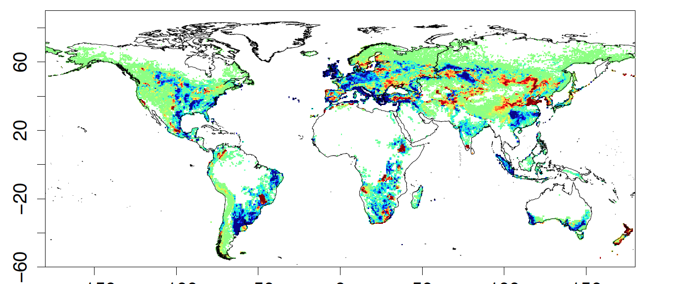
PFT differences (1) – crops (LC_CCI – Olson)
Decrease in C3 croplands replaced by C3 grasslands
Increases in C4 grasslands due to use of Koppen-Geiger climate zones
C3
1 - Bare soil
2 – TrBE : tropical broad-leaved evergreen
3 – TrBR : tropical broad-leaved raingreen
4 – TeNE : temperate needleleaf evergreen
5 – TeBE : temperate broad-leaved evergreen
6 – TeBS : temperate broad-leaved summergreen
7 – BoNE : boreal needleleaf evergreen
8 – BoBS : boreal broad-leaved summergreen
9 – BoNS : boreal needleleaf summergreen
10 – NC3 : C3 grass
11 – NC4 : C4 grass
12 – AC3 : C3 agriculture
13 – AC4 : C4 agriculture
C4
decrease
increase

