Slide 1

Copernicus Climate Change Service:
Update on plans
(2015-2016 perspective)
Jean-Noël THÉPAUT
ECMWF
Norrköping, 27 May 2015

Slide 2
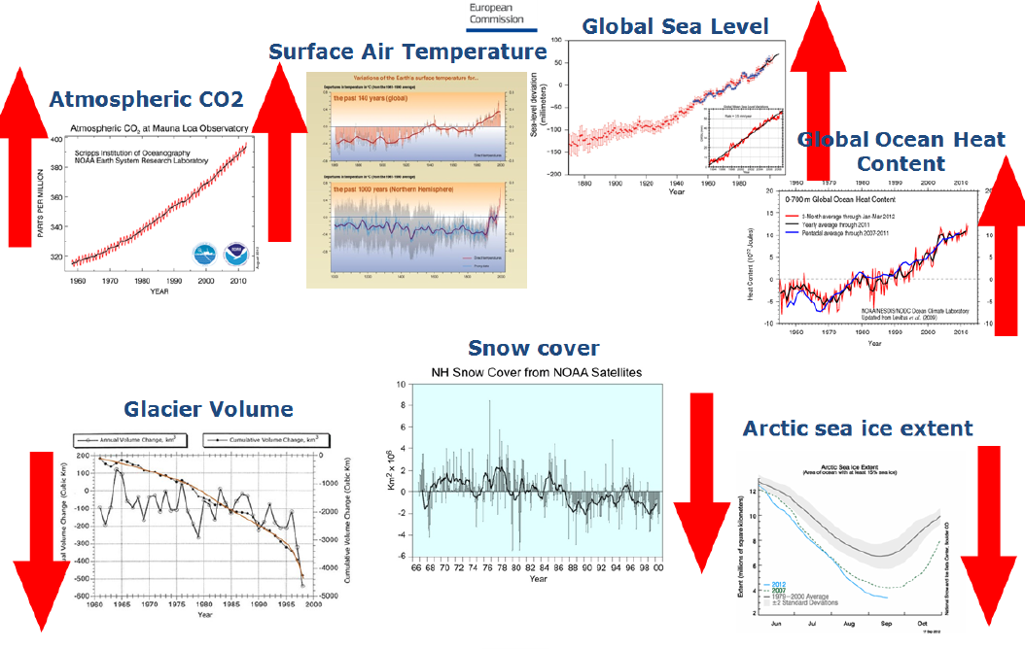
From the Copernicus regulation
(EU) 377/2014:
  "the Climate Change service shall provide information to increase the knowledge base to support adaptation and mitigation policies. It shall in particular contribute to the provision of Essential Climate Variables (ECVs), climate analyses, projections and indicators at temporal and spatial scales relevant to adaptation and mitigation strategies for various Union's sectoral and societal benefit areas."

Slide 3

Copernicus Climate Change Service (C3S)
How is the climate changing?
Will climate change continue, accelerate?
Earth observations
Reanalyses
Predictions
Projections
What are the societal impacts?
Climate indicators
Sectoral information
27/05/2015, CCI-CMUG integration meeting, Norrköping

Slide 4
Organisation
from European commission e.g.,FP7
Space calls
from other bodies e.g., MS, ESA, Eumetsat, EEA, WMO..
Climate Data Store
Evaluation & QC function
Outreach & Dissemination
Sectoral Information System
Stakeholders and Users

Slide 5
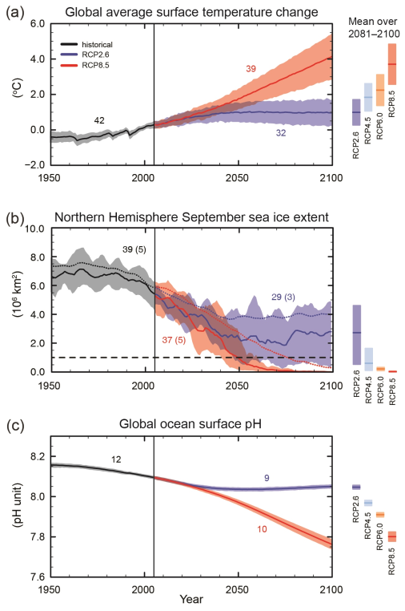
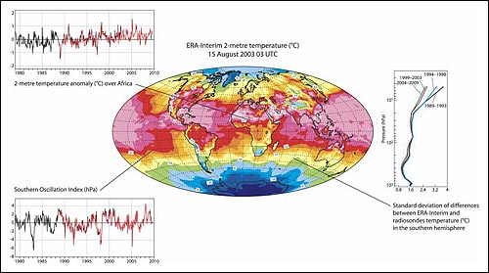
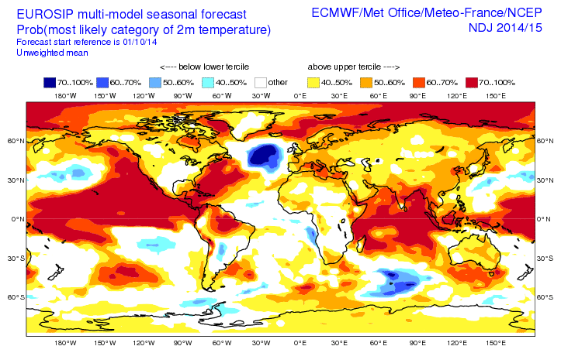
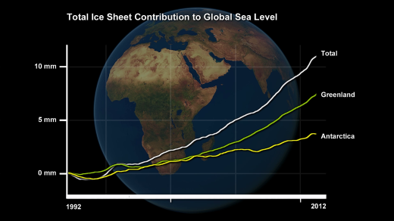
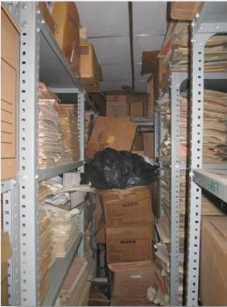
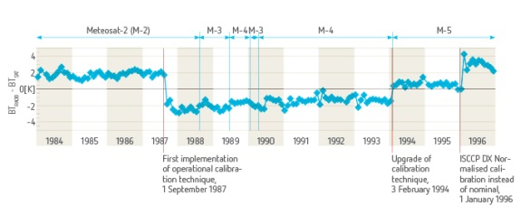
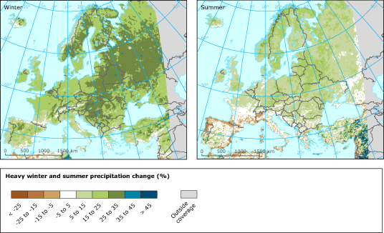
C3S Service elements: Climate Data Store
Series of ECV datasets and climate indicators
  Observed, reanalysed and simulated
  Relevant to support adaptation/mitigation policies at European level and wider
Reanalyses
Multi model seasonal forecast products
Other ECV datasets
Data reprocessing
Climate projections
Data collection and data rescue

Slide 6
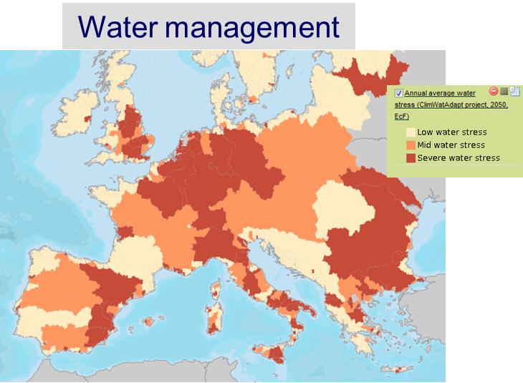
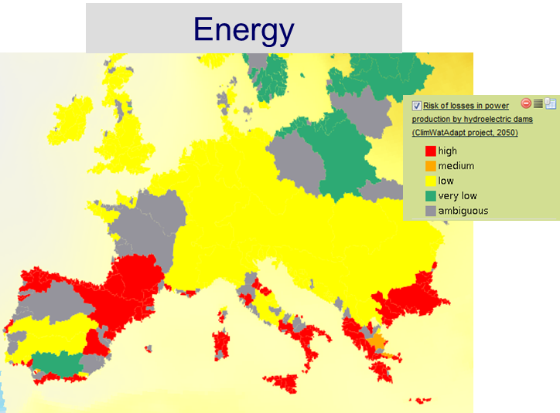
C3S Service elements: Sectoral Information System
Tailored climate indicators for primary users:
  CLIMATE-ADAPT, institutional users at European level,…
  Science users, innovation and business development
Data and tools to support sectoral applications and policy development
~ 30 ECV datasets and ~ 8-10 Sectors to be addressed by 2020

Slide 7
Copernicus Climate Change Service (C3S)
Activity Number | Activity Description
C3S_1000 | Management
C3S_2000 | C3S infrastructure
C3S_3000 | Climate Data Store content
C3S_4000 | Sectoral Information System
C3S_5000 | Evaluation and Quality Control
C3S_6000 | Outreach and Dissemination

Slide 8
Copernicus Climate Change Service: C3S
C3S_2000: C3S infrastructure
Goal: Develop the C3S infrastructure with interim solutions for pre-operational activities
  Provide a temporary infrastructure for proof-of-concept phase
  Implement a Climate Monitoring Facility and Observation Feedback Archive
  Develop further appropriate links with WIS, WMO GFCS, etc.
  Co-develop and integrate technical solutions for the C3S portal and Climate Data Store in the operational phase
  Provide computing support for reanalysis and seasonal forecast production
27/05/2015, CCI-CMUG integration meeting, Norrköping

Slide 9
Copernicus Climate Change Service: C3S
C3S_3000: Climate Data Store Content
Goal: Develop the CDS catalogue and start providing access to data
  Develop the observational component of the CDS catalogue
  Production of a global atmospheric reanalysis for climate monitoring (ERA5)
  Provide access to observations via the Observation Feedback Archive
  Provide access to climate monitoring products via the Climate Monitoring Facility
  Prepare systems for multi-model seasonal forecast product generation
  Develop an initial CDS catalogue for climate projection products
27/05/2015, CCI-CMUG integration meeting, Norrköping

Slide 10
Copernicus Climate Change Service: C3S
C3S_4000: Sectoral Information System
Goal: Develop proof-of-concept for three relevant sectors
  Develop demonstrators for three sectors: Energy, Water Resource Management, and one TBD based on quality of proposals
  Document the value chain from Earth observation and model output to tailored climate information for each sector
  Identify implications for CDS requirements (data, tools, access)
  Define a consistent view of a comprehensive SIS architecture
27/05/2015, CCI-CMUG integration meeting, Norrköping

Slide 11
Copernicus Climate Change Service: C3S
C3S_5000: Evaluation and Quality Control
Goal: Develop proof-of-concept EQC for all service elements
  Identification of communities of practice and user requirements
  Implications for CDS, SIS and O&D service elements
  Technical assessments of C3S infrastructure (design, tools, access methods)
  Scientific assessments of CDS content (climate data sets)
  Assessments of proof-of-concept SIS developments
  Consolidation of networks of expertise for EQC for all elements of the service, via specific procured activities
27/05/2015, CCI-CMUG integration meeting, Norrköping

Slide 12
Copernicus Climate Change Service: C3S
C3S_6000: Outreach and Dissemination
  Manage COP21 outcomes and its implications for C3S as a tool to support policy making, business decisions, and public information needs
  Build upon the channels developed in 2015 and ensure that content development meets evolving stakeholders’ needs
  Devise and implement an information campaign targeting policy makers at national and European levels to present C3S services
  Ensure presence at relevant international / European conferences and events, working with the EU and other Copernicus Services
  Develop a programme of stakeholder engagement (MEPs, national governments officials, international partners…)
  Start implementing the 2015 Training Strategy by competitive procurement
27/05/2015, CCI-CMUG integration meeting, Norrköping

Slide 13
C3S: Procurement plan
Call theme | Title | Call date | Start | End
C3S_2000
 | System software development | Q2-2015 | Q4-2015 | Q4-2018
 | Application software development | Q2-2015 | Q4-2015 | Q4-2018
C3S_3000
 | Observation collection and processing | Q3-2015 | Q4-2015 | Q4-2020
 | Observation gridded products (I) | Q3-2015 | Q1-2016 | Q4-2017
 | Observation gridded products (II) | Q3-2016 | Q1-2017 | Q4-2020
 | Regional Climate reanalyses | Q3-2016 | Q2-2017 | Q4-2020
 | Seasonal Forecasts | Q1-2015 | Q3-2015 | Q4-2017
 | Global Climate Projections | Q2-2015 | Q4-2015 | Q4-2018
 | Regional Climate Projections | Q3-2015 | Q2-2016 | Q4-2018
27/05/2015, CCI-CMUG integration meeting, Norrköping

Slide 14
ESA CCI, C3S and User Consultation
ECMWF is involved in CMUG
ECMWF is providing expertise to ESAC, CSAB, has had involvement in some CCI procurement reviews
ESA will provide expertise on Copernicus (CAMS and C3S) ITT evaluations
Continual exchanges between ESA and ECMWF on CCI and C3S interactions and complementarity
Need for for clarity on synergies, overlaps, etc. with other Copernicus Services
A C3S workshop on observations requirements will be organized end of June 2015.
27/05/2015, CCI-CMUG integration meeting, Norrköping

Slide 15
Copernicus Workshop on Climate Observation Requirements (29 June – 2 July 2015)
Observation-based content of the C3S Climate Data Store (CDS).
Open and full access to observations and derived data products spanning the entire instrumental record available for climate applications and services
  Climate data records from satellites
  Collections of in-situ climate observations
  Gridded ECV products derived from observations
  Input observations for model-based reanalyses
  Reference datasets for evaluation of models and climate data products
Topics to be discussed include:
  Data rescue activities for in-situ and satellite observations
  Best practices in homogenisation and data reprocessing
  Metadata, traceability and transparency of climate data products
  Best practices for uncertainty characterization of climate data products
Outcomes of the workshop will be used to guide the development of the observational component of the Climate Data Store catalogue
27/05/2015, CCI-CMUG integration meeting, Norrköping

Slide 16
C3S: Procurement plan
Call theme | Title | Call date | Start | End
C3S_4000
 | Proof-of-concept (PoC) with three sectors | Q1-2015 | Q3-2015 | Q4-2018
 | Extension to other sectors | Q2-2016 | Q4-2016 | Q4-2020
 | Toolbox and business developments | TBD
C3S_5000
 | Proof-of-concept: CDS infra. and content, UR | Q2-2015 | Q4-2015 | Q4-2017
 | Proof-of-concept: SIS development for pilot sectors, UR | Q2-2015 | Q4-2015 | Q4-2017
C3S_6000
 | Web content provision & management | TBD
 | Public Outreach |  | ongoing
 | Events |  | ongoing
 | Training | Q3-2015 | Q1-2016 | Q4-2020
27/05/2015, CCI-CMUG integration meeting, Norrköping

Slide 17
Copernicus Climate Change Service(C3S)
Indicative list
Consistent Climate Data Store - ~ 30 ECVs & indicators -
Observed, re-analyzed and model projected products
ATMOSPHERE
OCEAN
LAND
Surface Air Temperature
Surface Precipitation
Water Vapor
Surface Radiation Budget
Earth Radiation Budget
Carbon Dioxide & Methane
Ozone & Aerosols
Cloud properties
Wind Speed & Direction
Upper Air Temperature
Other Long-Lived GHGs
Ocean Color
Sea Ice
Sea Level
Sea Surface Temperature
Global Ocean Heat Content
CO2 partial pressure
Ocean Acidity
Sea Surface Salinity
Current Salinity
Snow Cover
Glaciers & Ice Caps
Albedo
FAPAR
Fire
Ice Sheets
Lakes
Permafrost
Land Cover
Leaf Area Index
Soil Moisture
Sectoral Information System – ~ 10 sectors
Agriculture and forestry
Energy
Infrastructure
Health
Coastal areas
Water management
Tourism
Insurance
Marine and fisheries
Disaster risk reduction
Biodiversity
Transportation
Notes:
17

Slide 18
Copernicus Climate Change Service (C3S)
Provisional timing
Stage 0 - Proof of Concept
Stage I - Pre-Operational
Stage II - Operational ~20 ECVs, ~5-6 Sectors
Stage III - Operational ~30 ECVs, ~8-10 Sectors
PoC
Pre-operational Phase
2013
2014
2015
2016
2017
2018
2019
2020
2021
Stage 0
Stage I
Stage II
Stage III
Operational Phase
27/05/2015, CCI-CMUG integration meeting, Norrköping

Slide 19
Conclusions
C3S will be an operational service
Most of the activities will be competitively procured
A large user consultation process is ongoing throughout
  Note the C3S workshop on observations in June 2015
Ongoing discussions with ESA, EUMETSAT, and with other Copernicus Services
Have a look at:
http://www.copernicus-climate.eu/
27/05/2015, CCI-CMUG integration meeting, Norrköping

Slide 20
Thank You
27/05/2015, CCI-CMUG integration meeting, Norrköping

