Slide 1
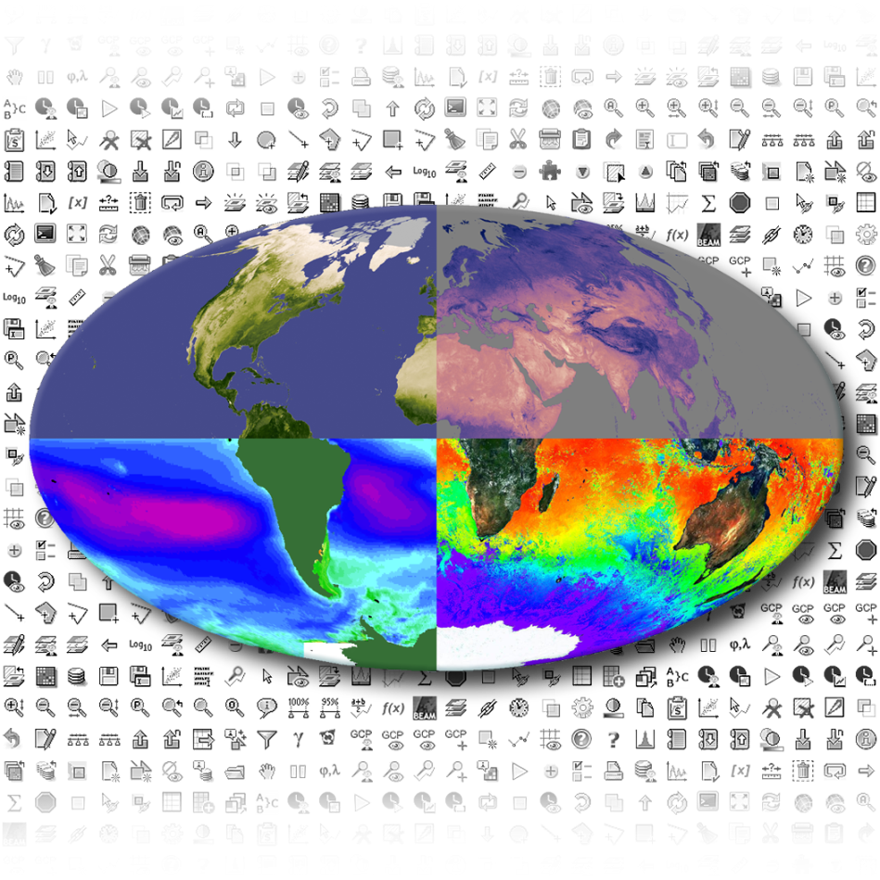
CCI Toolbox
CCI Integration Meeting

Slide 2
Why a CCI Toolbox?
Users have
No means to access ECV data across different ESA and non ESA ECV data types
Limited means for applying processing algorithms consistently across different ECV types
Limited means to visualise and analyse the original ECVs and such as derived with own algorithm in a consistent way and taking uncertainties into account
→ A user-friendly, reliable and sustained CCI Toolbox shall mitigate these issues and meet the needs of the Climate community
within, and beyond the ESA CCI programme;
the focus shall be on cross-ECV applications.

Slide 3
Objectives
Equip climate users with the means to operate on CCI ECV data.
It is noted that for some ECVs tools have been developed and are extensively used by user communities to operate on individual ECV types. However, no tool currently exists that can easily be used to analyse all the CCI ECV data products.
Specific objectives:
Ingest different ECV products into a common data model
Compute algorithms homogeneously across a common data model
Support ECV analysis and visualisation
Engange with the user community
Take into account
Giovanni, CEOS COVE, GrADS, UV-CDAT, Panoply
OpenLayers, ncBrowse, Ferret, Dchart, ADAGUC, Godiva
Apache Open Climate Workbench, Rasdaman, NASA EOSDIS Worldview, CDOs
ESA Earth Observation toolboxes such as Sentinel Toolboxes, BEAM, BEAT, BEST and BRAT

Slide 4
Meeting the Objectives - User Interactions
Objective: ensure relevance of development to climate users
Include Champion Users in the team, representing different user communities
Tasks:
Provide requirements
Test and operate the CCI Toolbox
Provide essential feedback during the software development
Address Wider User Communities
Provide training & documentation to Climate Communities
YouTube videos, tutorials, eBook , …
Outreach activities
CCI Toolbox User Group; feedback mechanisms

Slide 5
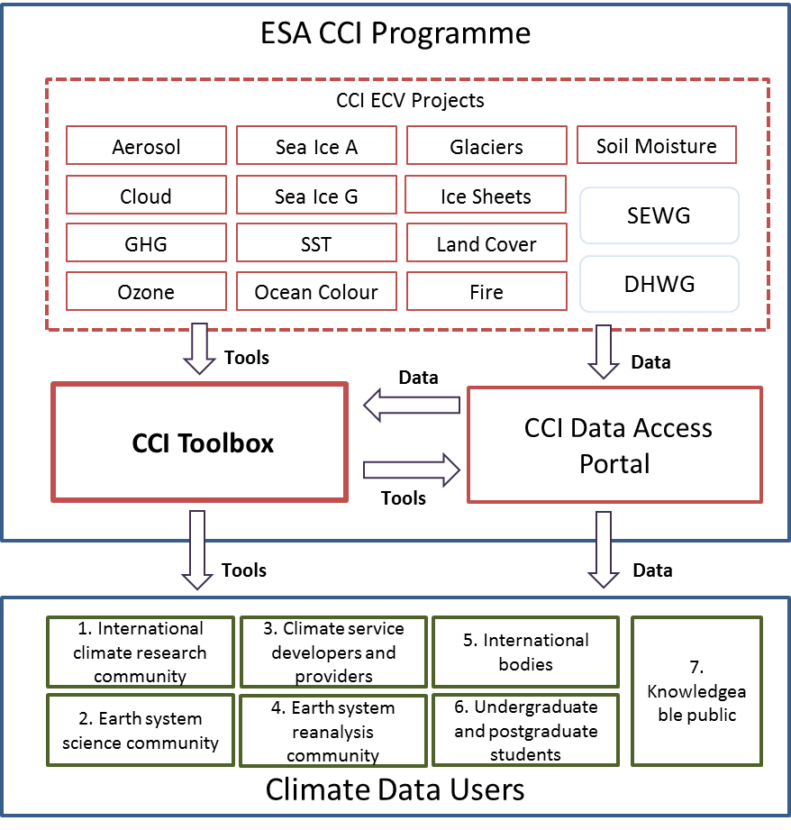
Context

Slide 6
Approach
Experienced team: EO data & tools, climate user, project management, well integrated into ESA CCI activities already
Close interaction with ESA CCI teams as well as wider climate data user community
Building on the Sentinel Toolbox (SNAP) software and experience
a modular, loosely coupled application framework
core: common data model
using SNAP as reference but not necessarily as code basis
Providing support to ECV data users and programmers
API & extension points
open for variety of programming languages (Python, R, C, Java)
training & outreach
Agile development process, open source
iterative development cycle
beta testing by champion users

Slide 7
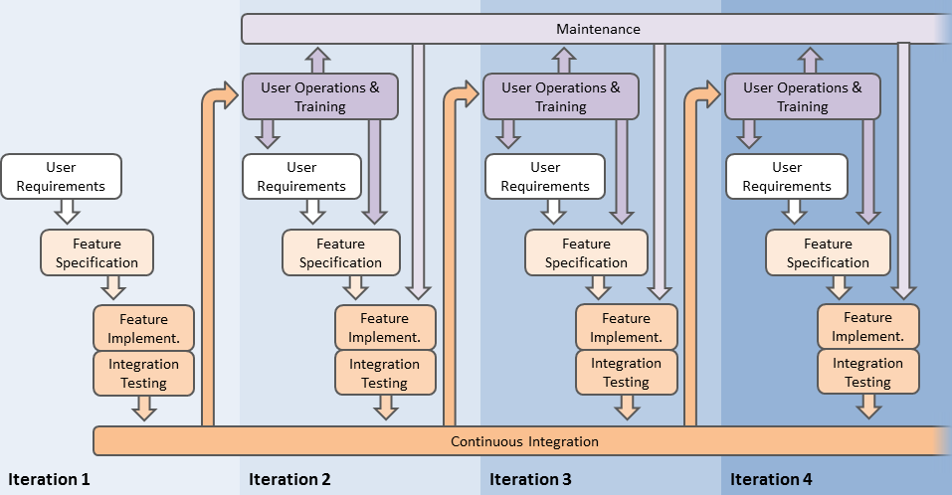
Iterative Development
Current activity

Slide 8
How to collect User requirements?
Analysis of CCI URD‘s
Collect „Use Cases“ from Champion User
Interaction with key user communities
You can contribute!
-> cci.esa.int/content/ccitoolbox-take-our-survey
Current activity

Slide 9
Application Areas
User Level | General Requirements | User Community | Specific Requirements and Applications
High-level expert user | Full time series Different CCI and other climate data Error information Meta data High performance computing Configurability and adaptability | 1 - International climate research community contributing to IPCC scientific assessments | Climate model verification and improvement Climate monitoring, trend detection Development of mitigation strategies
 |  | 2 - Earth system science community | General considerations regarding the global climate system and its feedback mechanisms Synopsis of climate information
 |  | 4 - Earth system reanalysis community | Regional to global scale modelling, re-analyses Error characterisation
Expert user | Ambitious tools Good defaults rather than too many options | 3 - Climate service developers and providers | CCI data complementary to surface observations Development and improvement of downstream services
 |  | 5 - International Bodies | Bundled, integrated information Quick, user friendly access to CCI data
Non-expert user | Selected topics Easy, understandable tools Easy data access Clear guidance on choice of tools, smart defaults Demonstrations, help, tutorials | 6 - Undergraduate and postgraduate students | Differing skills and interests, growing expertise Specific as well as general information Data & tools to study certain mechanisms Alternative options
 |  | 7 - Knowledgeable public | User friendly interface, understandable language Tools that can be used without pre-knowledge (smart defaults, good help)

Slide 10
Use Cases
Table 2: Categorisation of Use Cases.
UC number |  | 1 | 2 | 3 | 4 | 5 | 6 | 7 | 8 | 9 | 10 | 11 | 12 | 13 | 14 | 15 | 16 | 17 | 18 | 19 | 20 | 21
User Level | Non-expert |  | X |  |  | X | X |  |  |  |  | X |  |  |  |  |  |  | X | X
 | Expert |  |  |  | X |  |  | X | X |  |  |  | X | X | X | X | X | X
 | High-level expert | X |  | X |  |  |  |  |  | X | X |  |  |  |  |  |  |  |  |  | X | X
Area of Interest | Global | X |  | X | X | X | X |  | X | X | X |  |  |  |  | X |  | X
 | Regional | X |  |  | X |  | X | X |  |  |  | X | X | X | X | X | X |  | X | X | X | X
 | Point |  | X
Data | Single CCI |  |  |  | X |  |  |  | X |  |  |  |  |  |  |  | X |  |  | X | X | X
 | Multiple CCI | X | X | X |  |  | X | X |  | X | X | X | X | X | X | X |  | X | X
 | RGI and WGMS data |  |  |  |  | X |  | X | X
 | Additional data (model, obs., …) |  |  |  | X |  |  |  |  |  |  | X | X
 | Multiple additional data | X | X | X |  |  | X | X | X |  |  |  |  | X | X | X |  |  | X |  | X
 | Non-geographic data/information |  |  |  |  |  |  |  |  |  | X |  | X |  |  |  |  | X | X
 | Vector data |  |  | X |  |  |  |  |  |  |  |  |  |  |  |  | X
 | Topographical data |  |  | X |  |  |  |  | X |  |  |  |  |  | X | X
Complexity | Low |  | X |  | X | X |  | X | X | X | X | X |  |  |  |  | X |  |  | X |  | X
 | High | X |  | X |  |  | A |  |  |  |  |  | A | A | A | A |  | A | A |  | X
Focus | Data comparison and combination | X |  | X | x | X | X |  | X | X | X |  | X | X | X | X |  | X | X |  | X | X
 | Visualisation |  | X |  | x |  |  | X |  |  |  | X |  |  |  |  | X |  |  | X
Need for plug-in/API? |  | X |  | X |  |  | X |  |  |  | X |  | X | X | X | X | X | X | X |  | X
A = possibly solved by API or plug-in

Slide 11
Use Cases – UC 19: GHG Emissions over Europe
User Characteristics: User Level 3 non-expert user (User Community 7 knowledgeable public)
Problem Definition: Evolution of GHG emissions over Europe during the last years.
Required features:
Access to and ingestion of ESA CCI GHG data
Selection of required products/variables
Temporal and spatial subsetting
Generation of maps/animations depicting the evolution of GHG emissions
Exemplary Workflow: The user …
selects CCI ECV data products from a checklist.
selects a geospatial area of interest from a list of main regions.
selects start and end years of a time range.
selects a “Visualisation” processor.
selects options.
The Toolbox creates (animated) maps including legends etc.
clicks a button to save the maps.

Slide 12
Use Cases – UC 20: NE Atlantic SST Projections
User Characteristics: User Level 1 High-level expert user (User Community 1 international climate research community)
Problem Definition:
Validation of CMIP5 models concerning SST in the north eastern Atlantic Ocean.
Trend analysis regarding the future evolution using the ensemble mean and uncertainties as well as probability density functions of the best model runs.
Analysis of Variance for the examination of differences between the model results.

Slide 13
Use Cases – UC 20: NE Atlantic SST Projections
Required features:
Access to and ingestion of ESA CCI SST data
Access to and ingestion of CMIP5 model data
Filtering regarding variable
Geometric adjustments
Spatial and temporal subsetting
Quality assessment of model data by satellite-observed SST data using plug-in/API (user-determined validation method).
Application of best models for trend analysis (removal of seasonal cycles)
Calculation of SST anomaly/increase values for several time steps compared with reference data (ensemble mean and spread/uncertainties), construct probability density functions, examination of differing results by ANOVA
Visualisation
Data export

Slide 14
Use Cases – UC 20: NE Atlantic SST Projections
Exemplary Workflow: The user …
selects CCI ECV data products from a checklist.
selects/inputs model data products.
selects a “Geometric Adjustment” processor.
selects options.
clicks a button to execute.
selects a geospatial area of interest.
selects start and end years of a time range.
selects/inputs a plug-in/API script comprising a user-determined validation model.
enters and modifies values.
runs the plug-in/script.
selects a created dataset comprising quality measures and opens it as a table.
discards model datasets undercutting particular values.
selects a “Statistics” processor.
selects “Ensemble Statistics” from a list opening.
selects options to remove seasonal cycles and perform a trend analysis (individual values, ensemble mean and uncertainties).

Slide 15
Use Cases – UC 20: NE Atlantic SST Projections
clicks a button to execute.
selects a “Statistics” processor.
selects options to calculate SST anomalies compared to climatology of reference data for different time steps.
clicks a button to execute.
selects a “Statistical Interference” processor.
selects options to compute probability density functions for SST anomalies of different time steps.
clicks a button to execute.
selects a “Statistical Interference” processor.
selects options to perform an Analysis of Variance between the differing model results.
clicks a button to execute.
selects a “Visualisation” processor.
selects options.
The Toolbox creates several maps and graphs depicting the results.
clicks a button to save the output.

Slide 16
Software - State of the Art and Impact Analysis
State of the Art Study
What current climate tooling exists?
How can these tools already serve the user and system needs?
What gaps exist in the current tooling wrt URD?
How are these tools designed?
Programming language, technologies, data models, interfaces, standards
Impact Analysis
What, if we consider (or do not consider)
this platform being the basis of the CCI Toolbox?
this popular tool being a component of the CCI Toolbox?
this programming language, technology, standard
→ Should lead to decision how the CCI Toolbox will be finally realised

Slide 17
Analysis on Climate Tooling
A lot of tools out there, how to choose?
How many too look at? How deep?
51 GitHub repositories tagged ‘global climate’
Selection Approach
Tools which were already indicated by the SoW
Tools that we have been pointed to by EO scientists and potential CCI Toolbox users
Tools that seem important from our own experience
Categorisation schema
19 tools analysed and categorised
>10 new libraries used

Slide 18
Analysed Tools
Name | Domain | Value | Interface | Impl. Lang. | API Lang. | Status | License | User
ADAGUC | I,O,V | S,C | W,S | C,E |  | 7 | MIT,GPL-3.0 | 1,2,3,4
AOCW | I,V,P | L,S | W,S,P | P | P | 9 | Apache-2.0 | 1,2,3,4
Cesium | I,V | L,S,C | P | E | E | 10 | Apache-2.0 | 3
CDO | I,O,P | L | C,P | C,P | P,R | 6 | GPL-2.0 | 1,2,3,4,6
CODA | I,O | L,C | P | C | C,J,P | 10 | GPL-2 | 3
COVE | I,O,P,V | L,S | W,S | E |  | 10 | ? | 1,2,3,4
DChart | I,V | S | W | E |  | 1 | ? | 1,2
EOSDIS Worldview | I,O,V | L,S,C | W | E |  | 10 | NASA-1.3 | 1,2,3,4,6,7
Ferret | I,V,P | L,S | D,P | J,P | J,P | 5 | OS Ferret license | 1,2,4,6
GDAL | I,O,P | L,C | P | C,P | C,J,P | 10 | MIT | 3
Giovanni 4 | I,O,P,V | L,S | W | ? |  | 10 | ? | 1,2,3,4,6
GrADS | I,O,P,V | L,S | C,D,P | C,F | C,F | 5 | GPL-2.0 | 1,2,6
KNMI Climate Explorer | O,P,V | S | W | ? |  | ? | ? | 1,2,3,4,6,7
ncBrowse | I,V | S | D | J |  | 7 | ? | 1,2,4,6
OpenLayers | I,V | L,S,C | P | E | E | 10 | BSD-2-Clause | 3
Panoply | I,V | S | D | J |  | 7 | ? | 1,2,4,6
Rasdaman | I,O | L,C | C,P | C |  | 10 | GPL, LGPL | 1,2,3,4
SNAP | I,O,P,V | L,S,C | C,D,P | J | J,P | 10 | GPL-3 | 1,2,3
UC-CDAT | I,O,P,V | L,S | P | P | P | 5 | CCLRC | 1,3,4

Slide 19
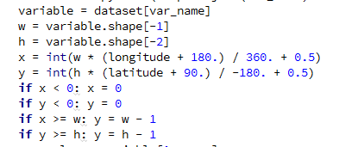
Two Major Uses
Code Dependency
Build on it: platform, framework
Make it a core part: static component
Make it an optional part: plugin component
Adaptation
Copy and adapt design and concepts
E.g. user interface, data model, API design, programming models
Tool/Library #1
CCI Toolbox
Tool/Library #2

Slide 20
General Findings
A number of tools use a client-server high level architecture with a web front end and a web service back end
ADAGUC, COVE, DChart, EOSDIS Worldview, Ferret, Giovanni, KNMI Climate Explorer
Only a few have a classical desktop GUI
GrADS, UV-CDAT, SNAP
Some libraries are developed for Unix or require a Unix (POSIX) environment
Open Climate Workbench, Climate Data Operators, UV-CDAT
The majority of scientific/climate tools expose a Python API, some of them are even implemented in Python
Climate Data Operators, Open Climate Workbench, GDAL
Java only rarely used for scientific applications
SNAP

Slide 21
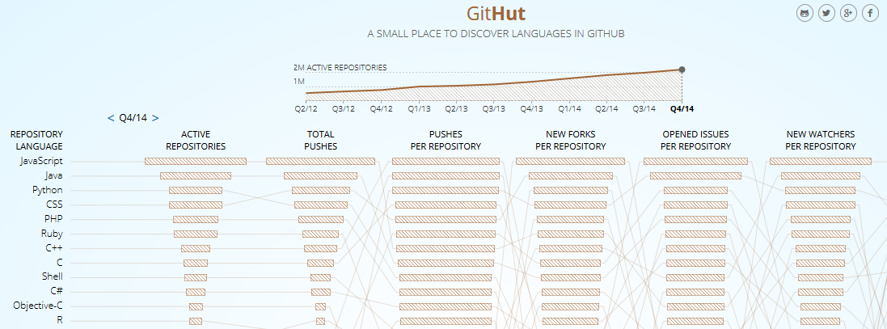
Languages on GitHub

Slide 22
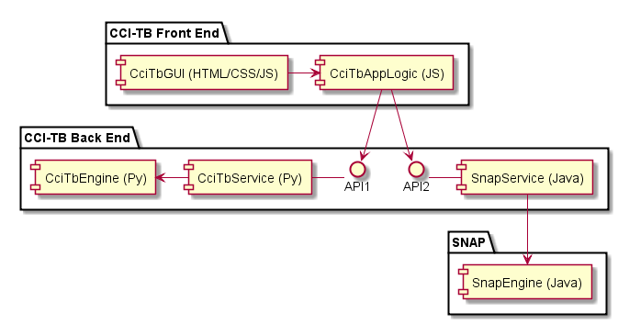
Basic Prototype Architecture
CCI Toolbox Front End
HTML5 / CSS / JavaScript
in browser or desktop window
HTTP
CCI Toolbox Back End
(local) web service
CCI Toolbox Engine
Python and/or SNAP

Slide 23
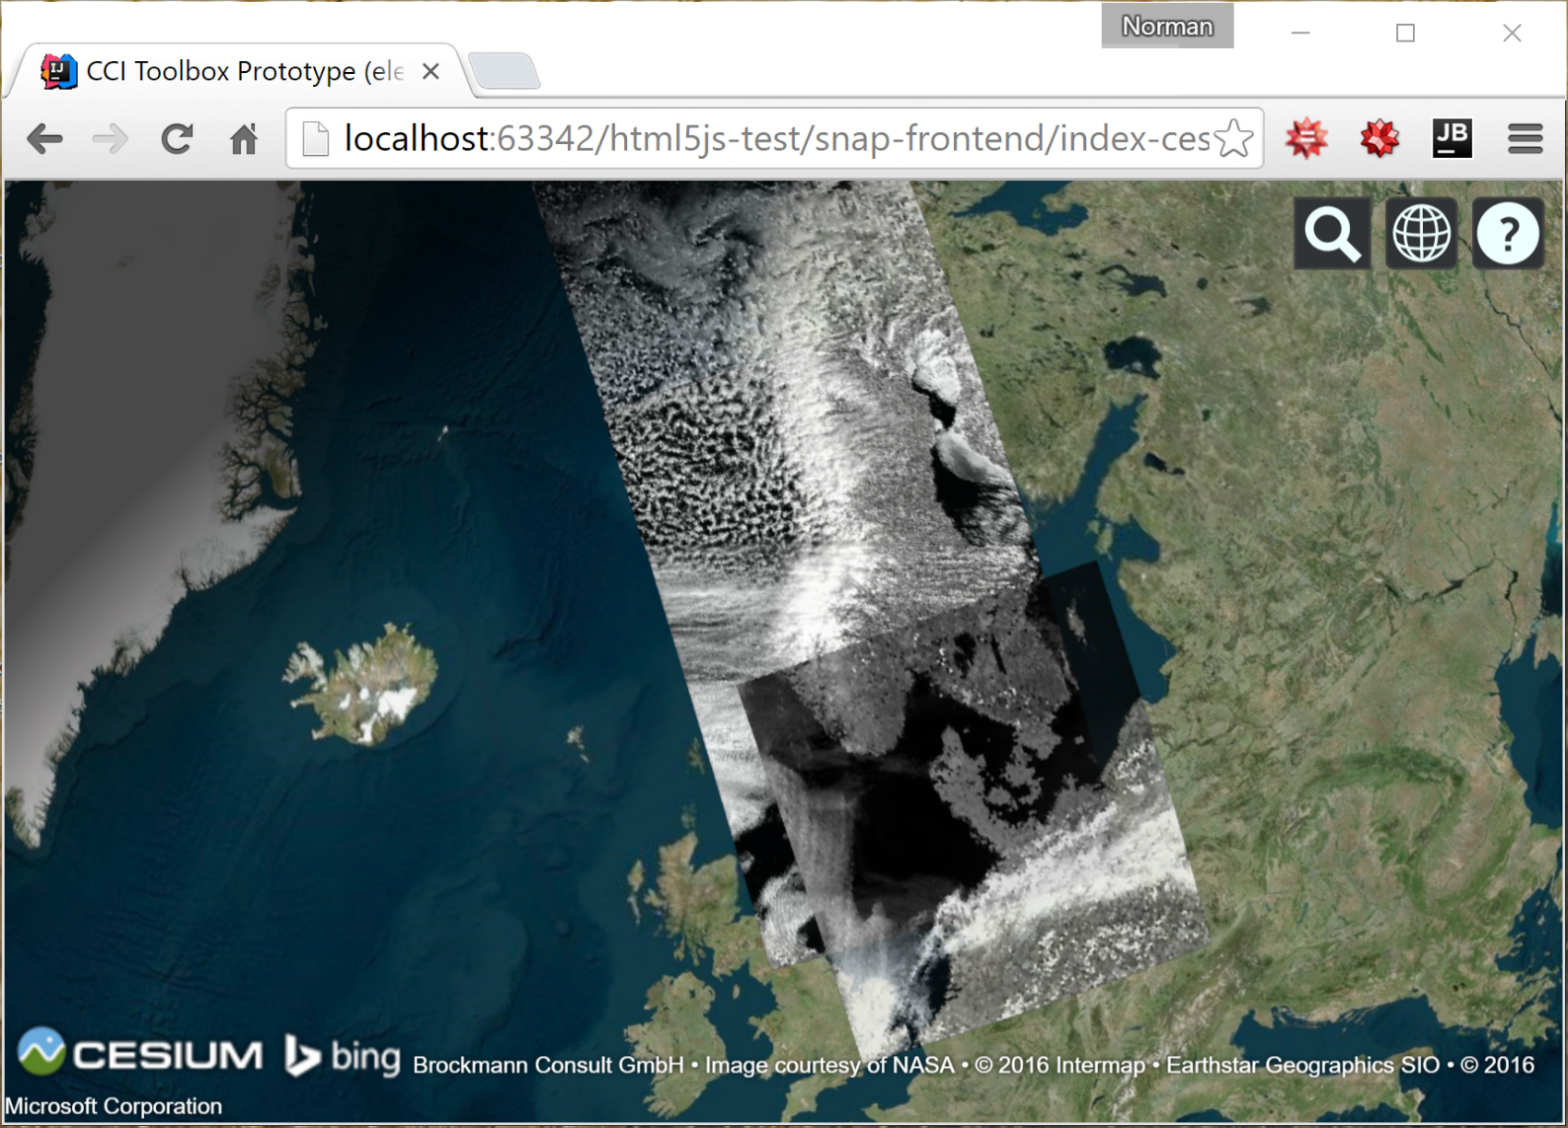
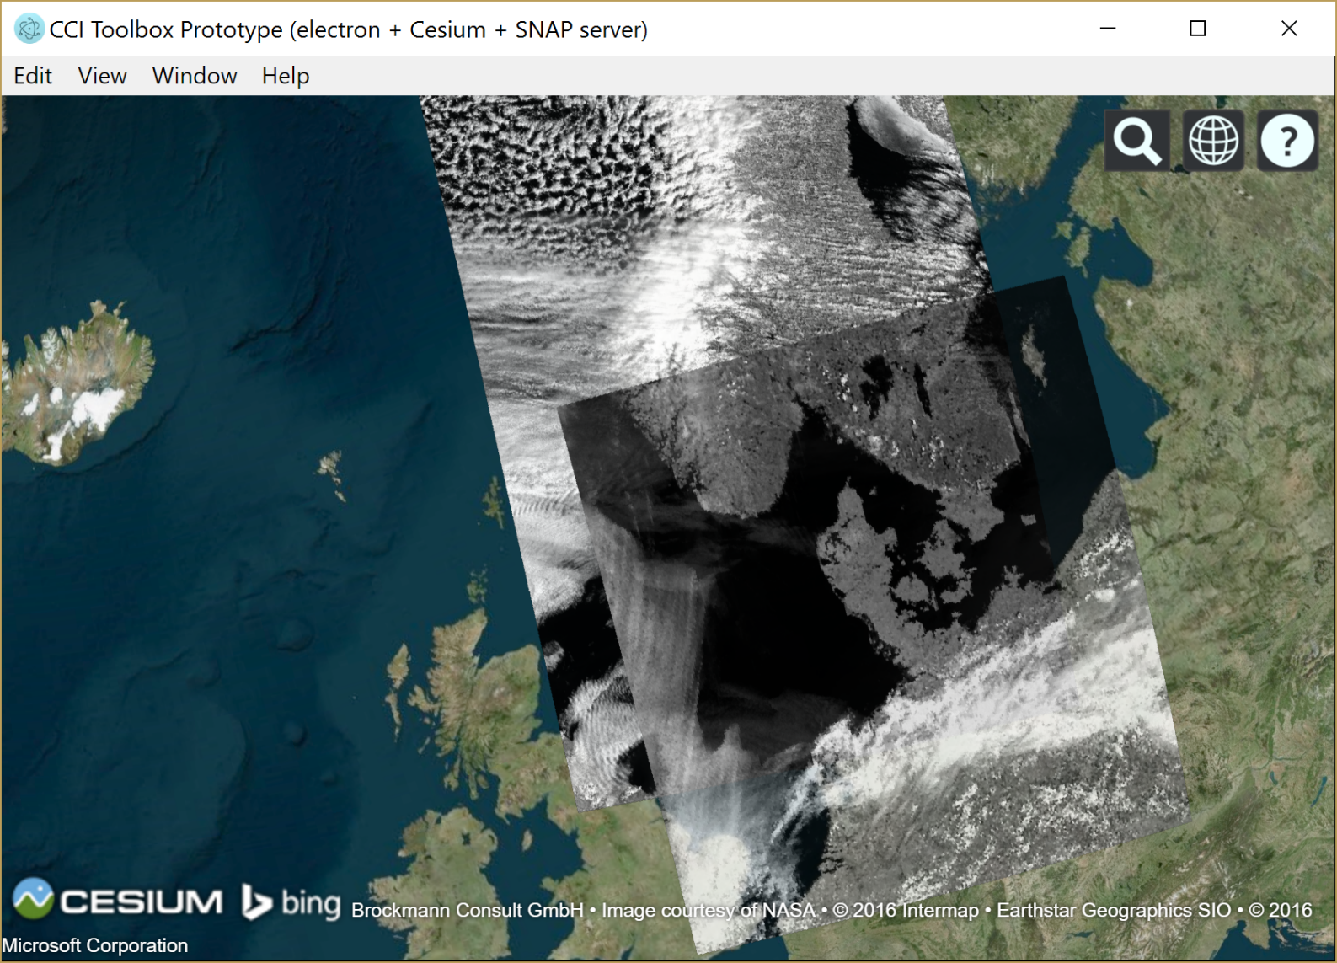
Prototype 1 – Demo

Slide 24
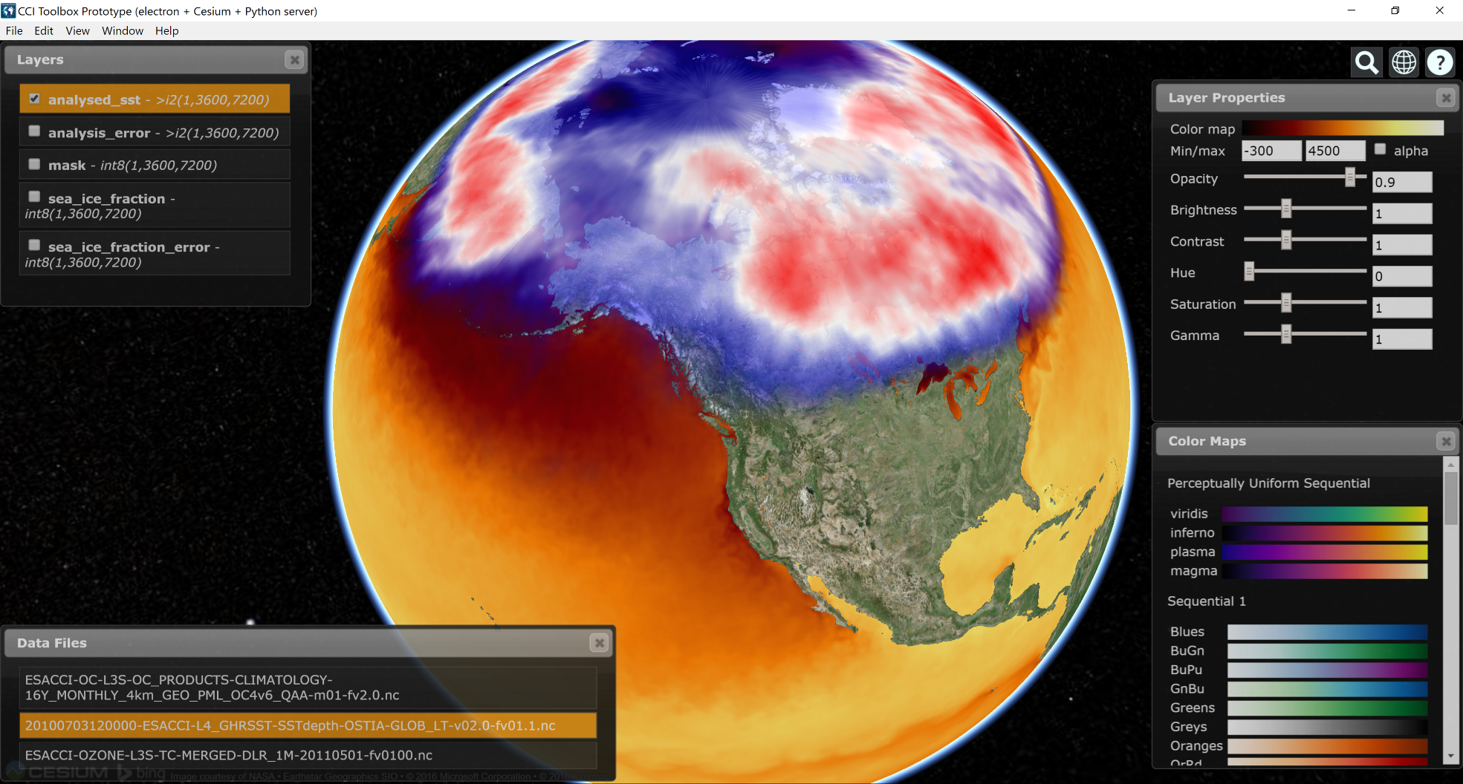
Prototype 2 - Demo

Slide 25
Summary
CCI Toolbox shall equip climate users with the means to operate on CCI ECV data
within, and beyond the ESA CCI programme;
the focus shall be on cross-ECV applications
It will be strongly user driven
Iterative approach, fast release cycles
Including revision of user requirements and feature selection
Initial set of user requirements and use cases have been defined
Technology study to select a suitable software approach has been conducted
Please take advantage of the CCI Data Session on Tuesday afternoon to give us your feedback on CCI Toolbox, Portal and beyond!

