Slide 1
Roadmap for the Intergovernmental Panel on Climate Change (IPCC) Sixth assessment cycle: The Working Group 1 contributions
Wilfran Moufouma-Okia, IPCC Working Group 1 Technical Support Unit (TSU), Head of sciences
CCI CMUG Integration 7 meeting, IPSL, Paris,13 February 2017

Slide 2
IPCC role and key principles:
Not doing own research - but triggers research
The role of the IPCC is to assess on a comprehensive, objective, open and transparent basis the scientific, technical and socio- economic information relevant to:
understanding the scientific basis of risk of human-
induced climate change
its potential impacts
and options for adaptation and mitigation.
WGI basis: peer-reviewed literature (transparency, rigour, robustness, comprehensiveness)
IPCC reports should be neutral with respect to policy

Slide 3
IPCC Structure
UN body
Intergovernmental Panel
(195 member States)
IPCC Plenary
IPCC Secretariat
(in Geneva, Switzerland)
IPCC Bureau
IPCC Executive Committee
Working Group I
The Physical Science Basis
Working Group II
Climate Change Impacts, Adaptation and Vulnerability
Working Group III
Mitigation of Climate Change
Task Force on National Greenhouse Gas Inventories
(TFI)
TSU
(France)
TSU
(Germany)
TSU
(UK)
TSU
(Japan)
Authors, Contributors, Reviewers
International scientific, techical and socio-econominc expertise
Notes:
Policy/Science Interface
Working Group I (WGI): observed and projected changes in climate
Working Group II (WGII): vulnerability, impacts, and adaptation related to climate change
Working Group III (WGIII): options for mitigation of climate change
Task Force on National Greenhouse Gas Inventories (TFI): internationally-agreed methodology and software for the calculation and reporting of national GHG emissions and removals

Slide 4
2001
Climate change science
“There is new and stronger evidence that most of the warming observed over the last 50 years is attributable to human activities”
2007
"Warming of the climate system is unequivocal…"
2013
“Human influence on the climate system is clear.”
1990
Gave a broad overview of climate change science, discussion of uncertainties and evidence of warming
1995
“The balance of evidence suggests a discernible human influence on global climate”
Improvements:

Slide 5
How the IPCC produces its reports?
Ongoing activties here

Slide 6
Key SPM Messages
19 Headlines
on less than 2 Pages
Summary for Policymakers ca. 14,000 Words
14 Chapters, Atlas of Regional Projections, 1535 pages
54,677 Review Comments
by 1089 Experts
2010: 259 Authors Selected
from 39 Countries
2009: WGI Outline Approved
2

Slide 7
Limiting climate change will require substantial and sustained reductions of greenhouse gas emissions
Human influence on the climate system is clear
Warming in the climate system
is unequivocal

Slide 8
Gaps and key uncertainties
Major uncertainties are associated with observed changes in atmospheric variables other than surface temperature, due to limits in observing capabilities, data incompleteness, and/or large inter-annual to decadal variability
Aerosol-cloud interactions are the largest source of uncertainty associated with anthropogenic forcing, despite the availability of global satellite monitoring
Detection and attribution methodologies remain constrained by observational uncertainties for variables other than temperature, uncertainties in aerosol forcing, modelling uncertainties and limits in process understanding

Slide 9
Some sensitive issues
Links with global temperature targets: It is more likely than not that air temperature for the period 2016-2035 will be more than 1°C above the mean of 1850-1900, and very unlikely that it will be more than 1.5°C above the 1850-1900 mean (medium confidence)
Hydrological cycle: Low confidence in an observed global-scale trend in drought or dryness (lack of rainfall) since the 1950s, due to lack of direct observations, methodological uncertainties and choice and geographical inconsistencies in the trends
Rate of global warming: The observed recent warming hiatus, defined as the reduction of GMST trend during 1998-2012 as compared to the trend during 1951-2012

Slide 10
Emerging science since AR5
Climate extremes, including detection and attribution:
With new analyses of observations, developments of methodologies for understanding processes and drivers of extreme events (e.g. in relationship to SST and atmospheric circulation patterns), and growing use of high resolution modelling
Aerosol and cloud processes:
New understanding of atmospheric chemistry and aerosol processes is expected to strengthen the knowledge associated with air quality response to changing emissions as well as changing climate conditions.
Climate model developments and evaluation:
Knowledge emerging from the new MIPs will contribute to many aspects of model evaluation, process understanding, detection and attribution, and projections, including cloud processes, predictability.

Slide 11
Considerations for the AR6 cycle
Changing perspectives since AR5 (Emerging science,Paris Agreement, Global stocktake)
Strengthening the regionalization (with focus on extremes) and allow detailed assessment of regional and sectorally-relevant climate information
Focus on process-based understanding (// WCRP grand scientific challenges)
Factor in stake-holder and end-user needs in scoping, and thinking upfront of the distillation of the report
More authors from developing countries and economies in transition

Slide 12
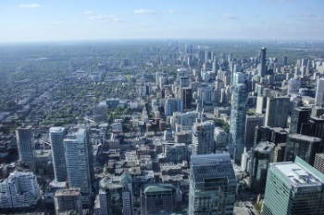
AR6 cycle products
AR6 Main Report
Expected to be released in three working group contributions in 2020/2021 and a Synthesis Report in 2022
AR6
Methodology Report update
TFI
Methodology Report on National Greenhouse Gas Inventories by 2019
Cities
Attention on cities in AR6 including an International Conference to be held in 2018 and a Special Report on Cities in AR7

Slide 13
AR6 cycle products (cont.)
AR6 cycle Special Reports on
Impacts of global warming of 1.5 ºC above pre-industrial levels and related global greenhouse gas emission pathways by 2018
Climate change and oceans and the cryosphere
Climate change, desertification, land degradation, sustainable land management, food security, and greenhouse gas fluxes in terrestrial ecosystems

Slide 14
SR1.5 - Preparation
To be developed under the joint scientific leadership of Working Groups I, II and III
Supported by the WGI Technical Support Unit (TSU)
Working Group I
The Physical Science Basis
V. Masson-Delmotte
P. Zhai
Working Group II
Climate Change Impacts, Adaptation and Vulnerability
D. Roberts
H.-O. Portner
Working Group III
Mitigation of Climate Change
J. Skea
P. Shukla
Working Group I Technical Support Unit

Slide 15
Outline of special report
Global warming of 1.5 ºC
Chapter 1: Framing and context
Chapter 2: Mitigation pathways compatible with 1.5°C in the context of sustainable development
Chapter 3: Impacts of 1.5°C global warming on natural and human systems
Chapter 4: Strengthening and implementing the global
response to the threat of climate change
Chapter 5: Sustainable development, poverty eradication and reducing inequalities

Slide 16
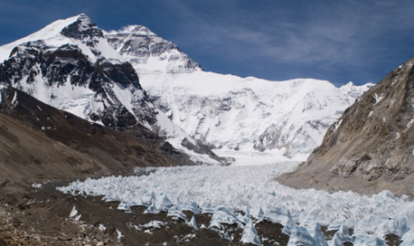
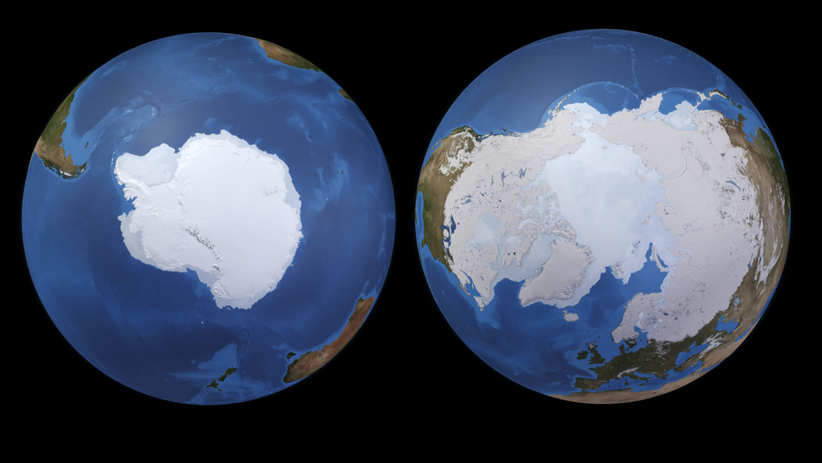
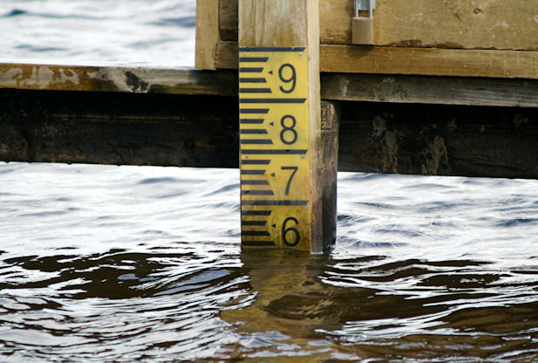
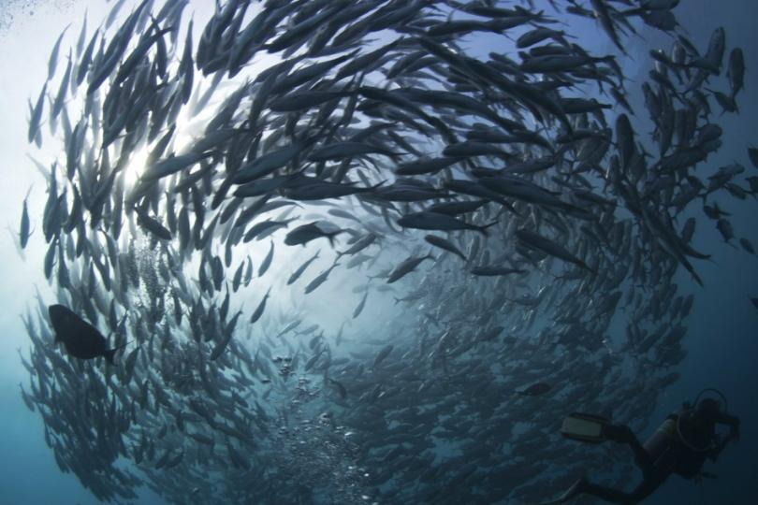
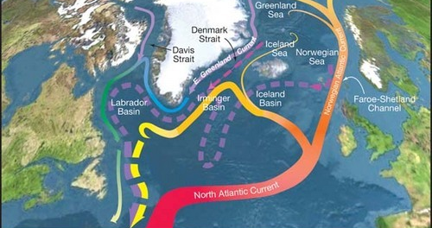
SR3: Proposed structure
Summary for Policymakers (~10 p.)
1. Framing and context (~15 p.)
~255 pages total
2. High Mountain Areas (~20 p.)
3. Polar Regions (~50 p.)
Cross-Chapter Box (~5 p.)
Low Lying Islands & Coasts
4. Sea Level Rise and Implications for Coasts and Communities (~50 p.)
5. Changing Ocean, Marine Ecosystems, and Dependent Communities (~65 p.)
6. Extremes, Abrupt Changes and Managing Risks (~20 p.)
Case Studies, FAQs and Boxes (~20 p.)
Notes:
http://www.redorbit.com/media/uploads/2013/02/sealevel.jpg
http://i1-news.softpedia-static.com/images/news2/Tibetan-Glaciers-Are-Shrinking-at-Surprisingly-High-Elevations-384032-2.jpg

Slide 17
Timeline for coming IPCC reports
Sept 2018
Fall 2019
April 2021
October 2021
April 2022
Global warming of 1.5°C
Oceans and cryosphere
Climate Change Impacts, Adaptation and Vulnerability
The Synthesis Report
The Physical Science Basis
Facilitative dialogue UNFCCC
Land Use
Mitigation of
Climate Change
Global Stocktake 2023 UNFCCC
Fall 2019
July 2021

Slide 18
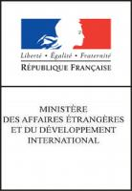
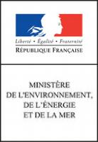
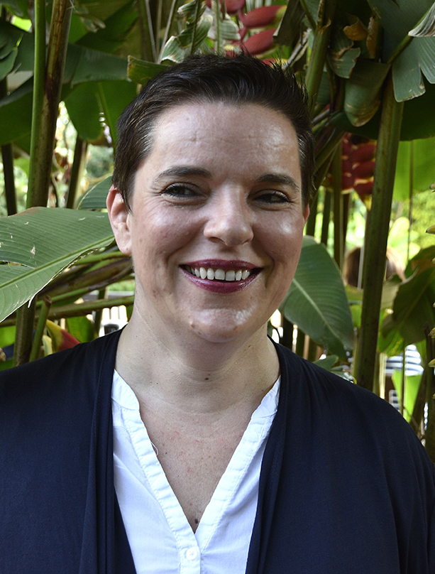
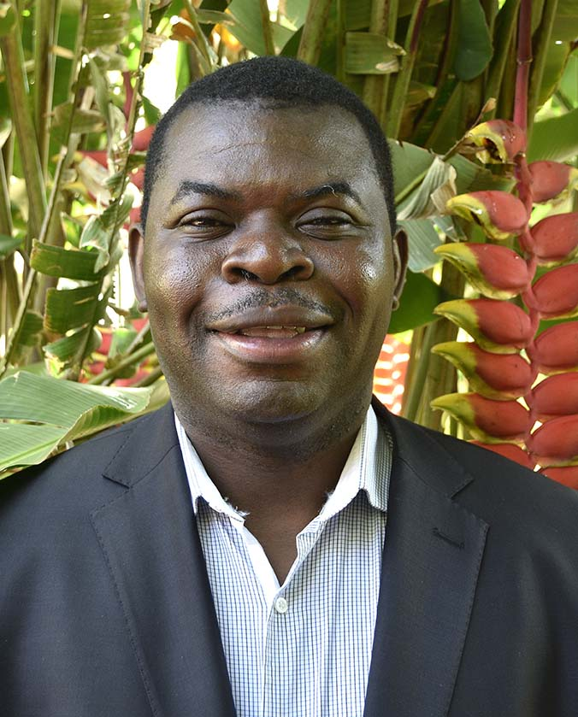
WGI Technical Support Unit (TSU)
The WGI TSU is funded by the French Government and is based at Université Paris Saclay in France.
Head / TSU
Anna Pirani
Head Operations
Clotilde Péan
Project Manager
1+ Assistant
Head Science
Wilfran Moufouma-Okia
3+ Science Officers
Communication
Outreach
IT system
Webmaster
Notes:
The IPCC TSUs:
Support the Co-chairs and Bureaux of their respective WG or TF, or the IPCC Chair in the case of the Synthesis Report, in the preparation and production of all relevant IPCC products defined in Appendix A to the Principles Governing IPCC Work and in accordance with these Principles;
Contribute to the implementation of the IPCC Protocol for addressing errors, the IPCC Communication Strategy and the Conflict of Interest Policy, in accordance with their responsibilities contained in these documents;
Participate, through their TSU heads, in the IPCC Executive Committee as Advisory Members;
Undertake any other task as required by the Co-Chairs or WG/TF Bureaux, or the IPCC Chair in the case of the Synthesis Report, to assist them in fulfilling their IPCC roles.
French Government sponsors: Ministry for Foreign Affairs, Ministry of Education and Research and Ministry of Environment via ADEME (Environment and Energy Management Agency).

Slide 20
SR1.5 - Key Dates
31 October - 11 December 2016 Call for author nominations
29 January 2017 Selection of authors
6-12 March 2017 1st Lead Author Meeting (Brazil)
5-11 June 2017 2nd Lead Author Meeting (UK)
31 July - 24 September 2017 First Order Draft Expert Review
23-29 October 2017 3rd Lead Author Meeting
5 January - 25 February 2018 Second Order Draft Expert and Government Review
9-15 April 2018 4th Lead Author Meeting
4 June - 29 July 2018 Final Government Review of SPM
24-30 September 2018 IPCC 48: acceptance/adoption/approval

